Slide 1
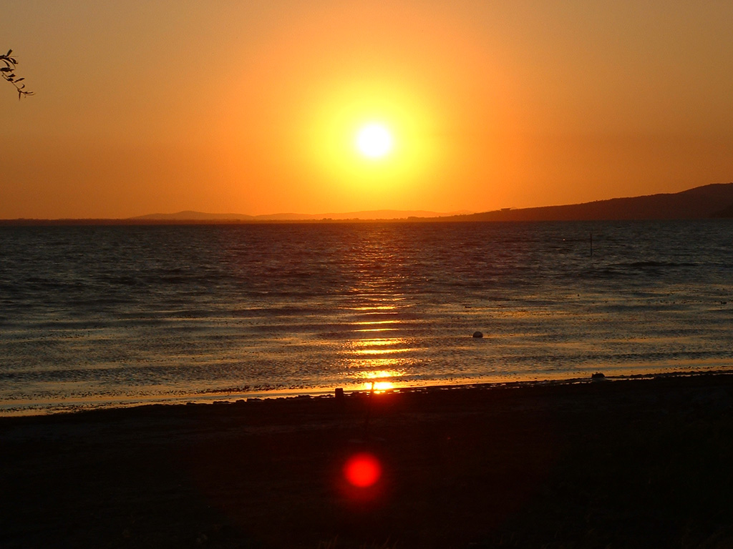
In my life…
I have seen the birds migrating for foreing countries.
I have heard the sound of the silence in my room.
I have touched the wet sand by the sea.
I have smelled the salt air ruined by pollution.
I have tasted our culture sinking among books.
I have done good but dangerous things with my friends and I don’t regret it.

