Slide 1
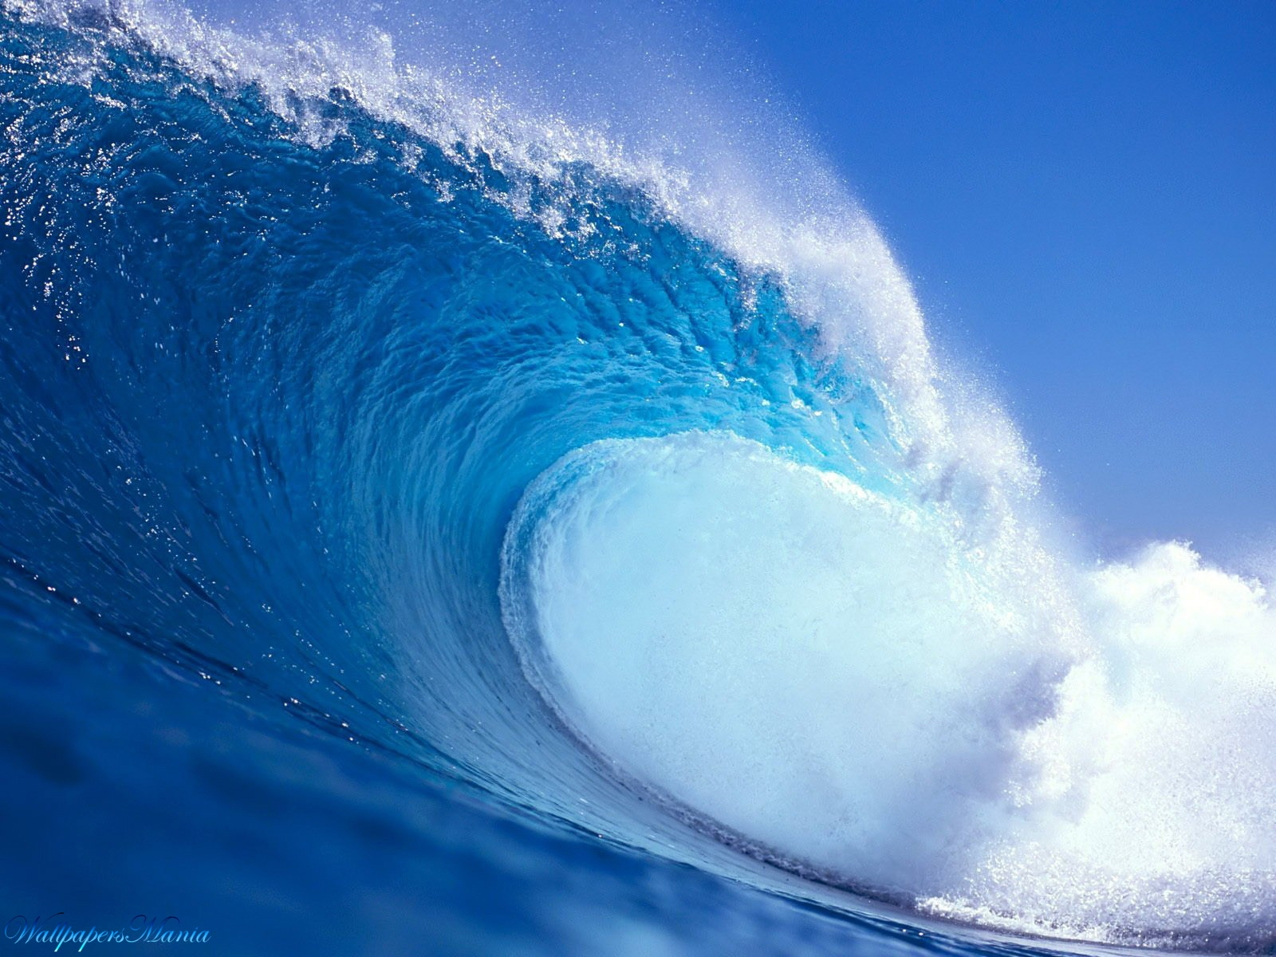
In my life…
I’ve seen this eternal movement,
I’ve heard the beat of this gentle and wilderness,
I’ve touched the water’s freshness,
I’ve smelled the scent of the sea ,
I’ve tasted the flavor of salt ,
I’ve done the sea the joy of living!

