Slide 1
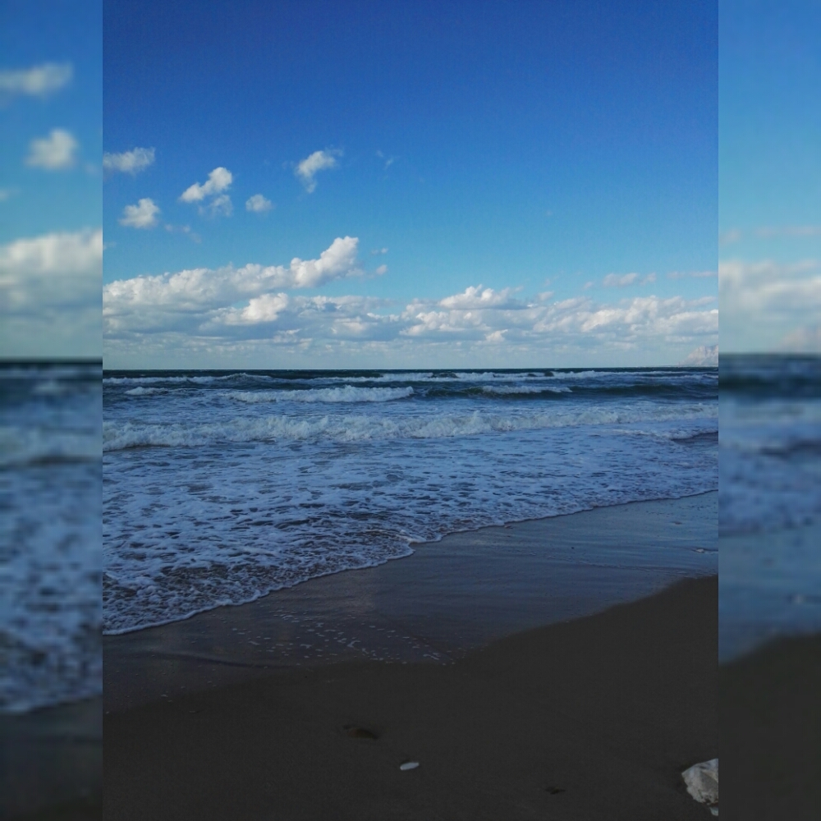
IN MY LIFE…
«I have seen in the deep of nature and
I have understood better all thinghs»
«I have heard the waves of sea shater
In the rocks»
«I have tached with hand the dried tree
Lifeless.»
«I have smelled the sea after the storm
of rain»
«I have tasted typicals fruits of my
country .»
«I have done as the tree that it has
Changed the leaves but it has preserved
The roots.»

