Slide 2
ITALY

Slide 3
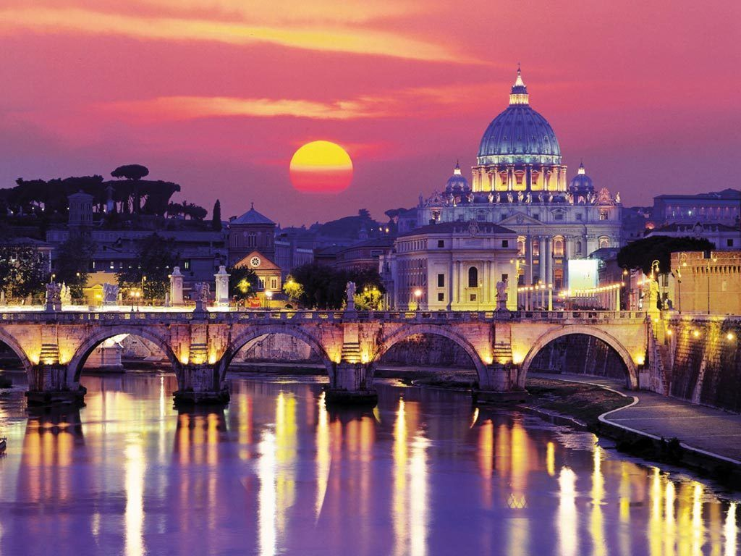
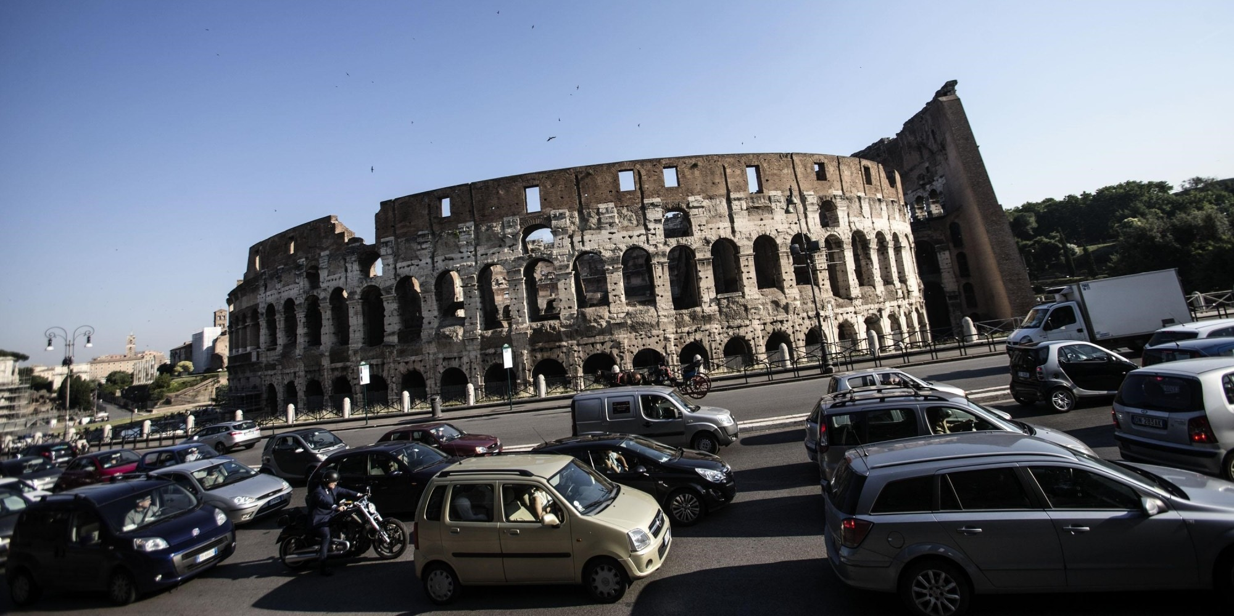
We could have spoken about
Rome
…BUT…
Notes:
But there is too much traffic jam
3

Slide 4
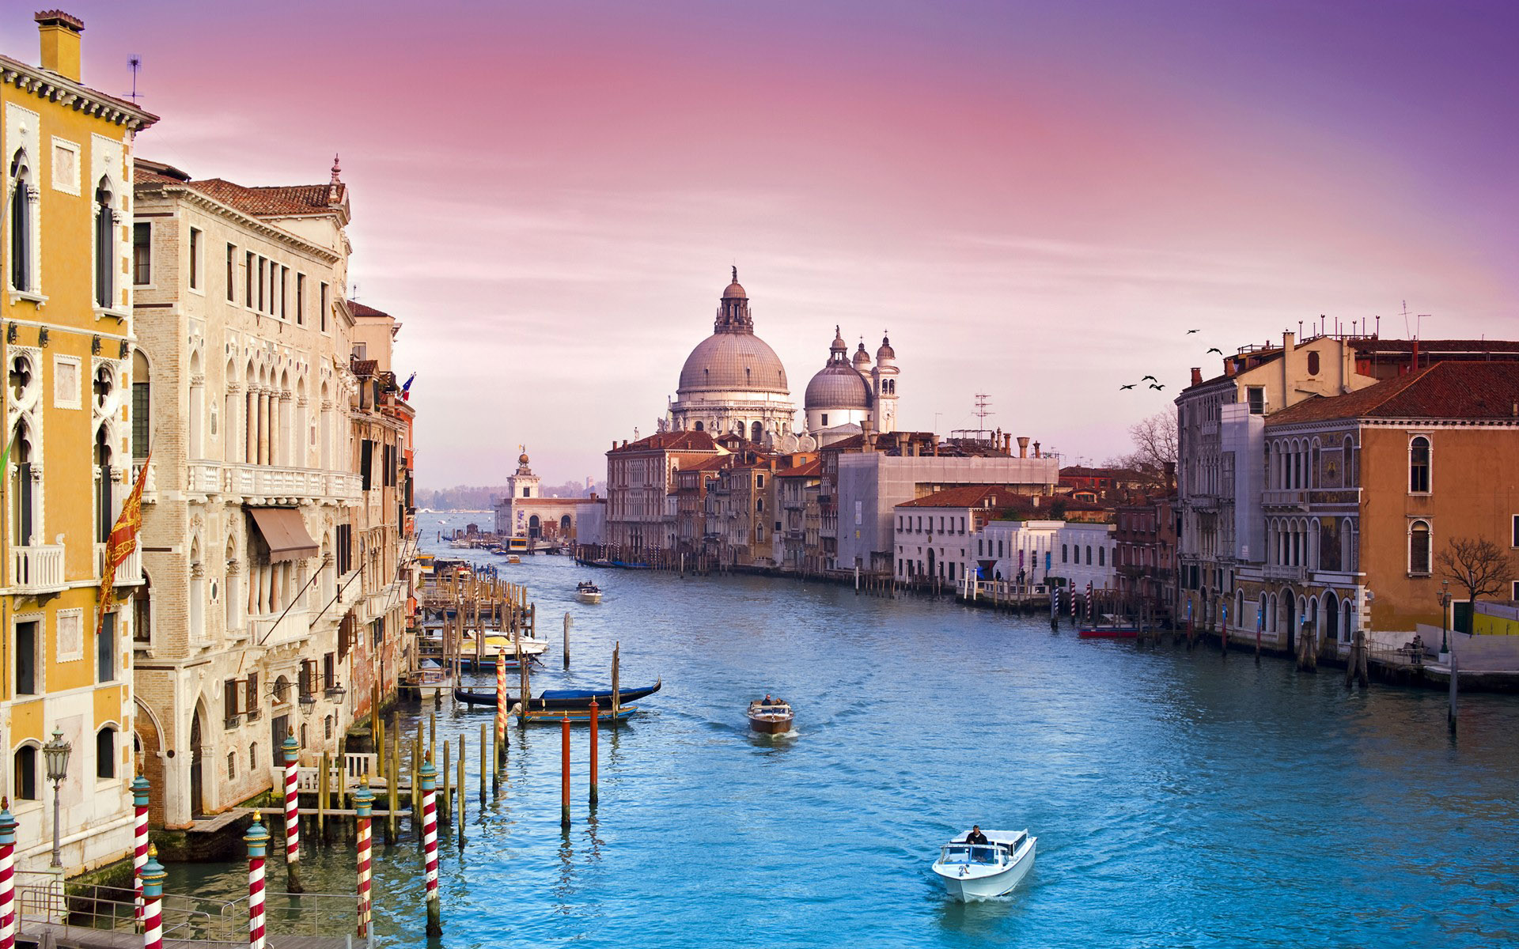
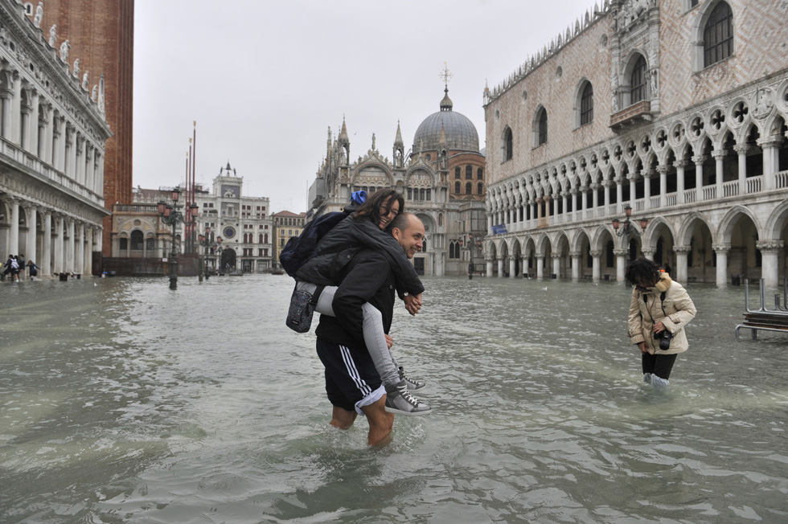
We could have spoken about
Venice
…BUT…
Notes:
But it is too wet
4

Slide 5
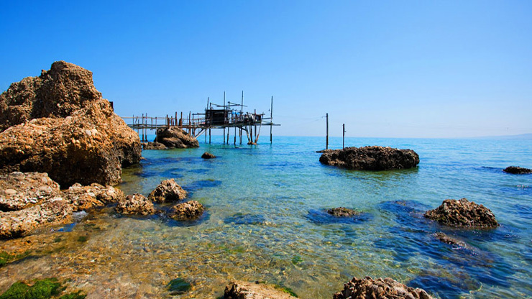
So, we will speak about…
Abruzzo !
Notes:
5

Slide 6
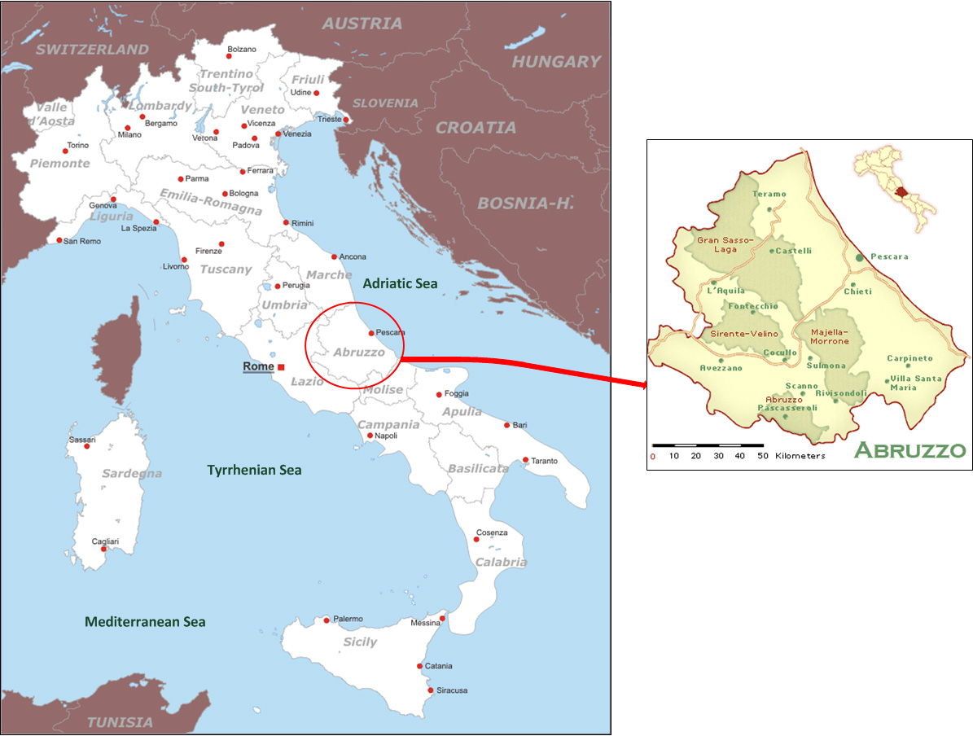
Where is Abruzzo ?
WE
ARE HERE

Slide 7
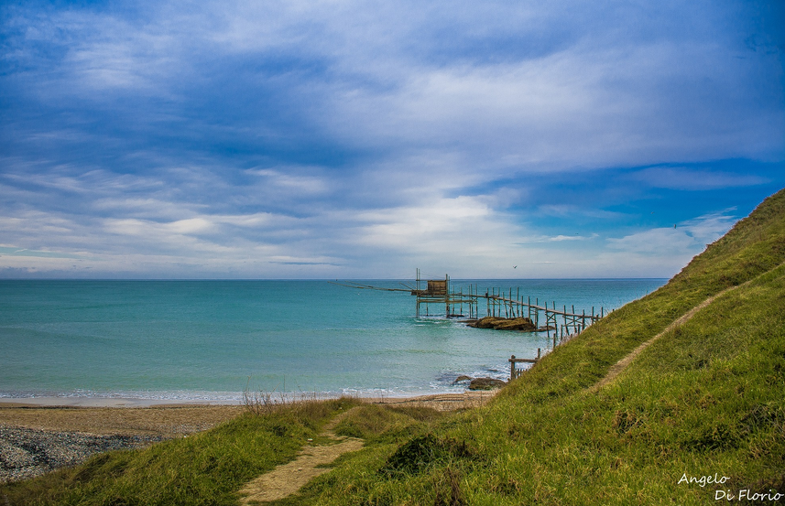
Beautiful sea

Slide 8
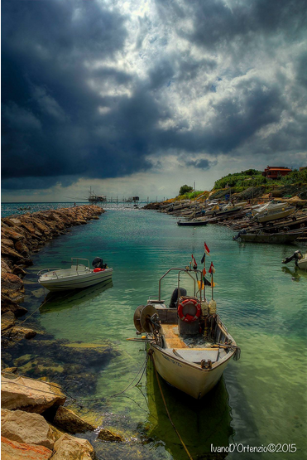
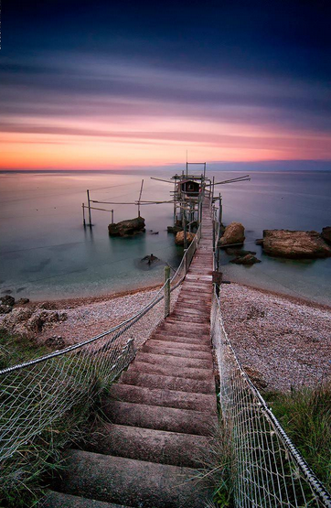
Beautiful sea
Notes:
sx: Vallevò; dx: punta Torre, Rocca San Giovanni
8

Slide 9
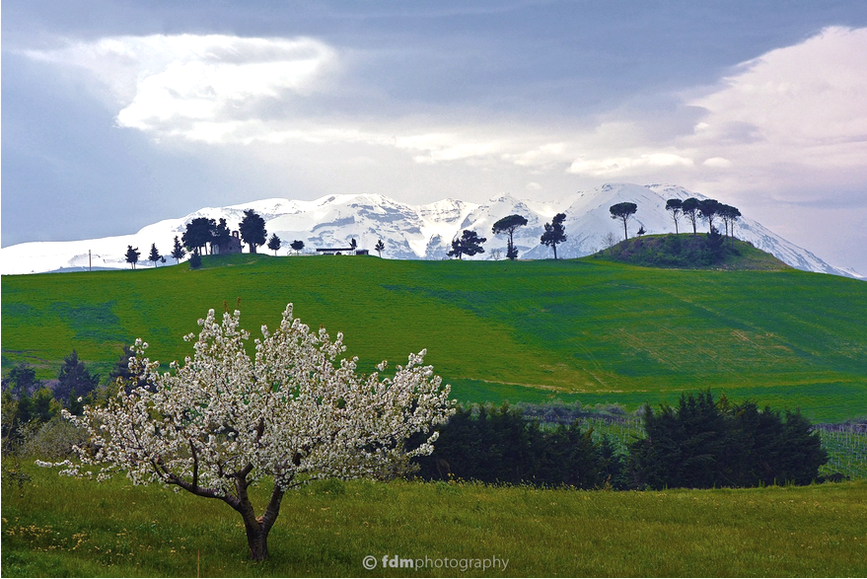
Green hills
Notes:
Hills near Loreto Aprutino; in the background the Maiella mountain
9

Slide 10
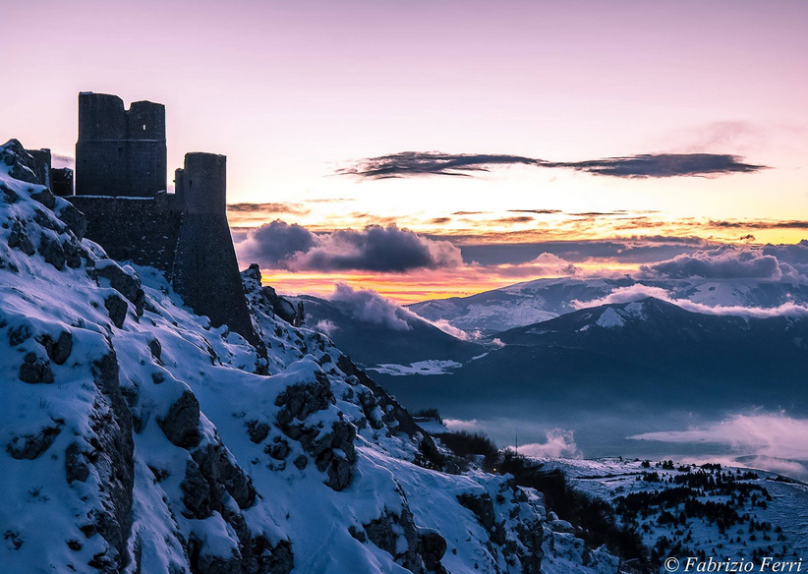
Video
Mountains & castles
Notes:
Castle of Rocca Calascio
10

Slide 11
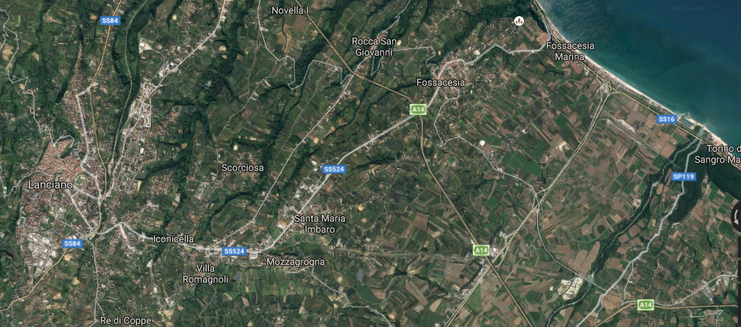
Our Comprehensive Institute
is made up of three towns
SEA
Fossacesia, Mozzagrogna, S.Maria Imbaro

Slide 12
Fossacesia Primary school
S. Maria Imbaro Primary school
Fossacesia Secondary school
Mozzagrogna Secondary school
Mozzagrogna Primary school
Notes:
Our institute: Five different schools
12

Slide 13
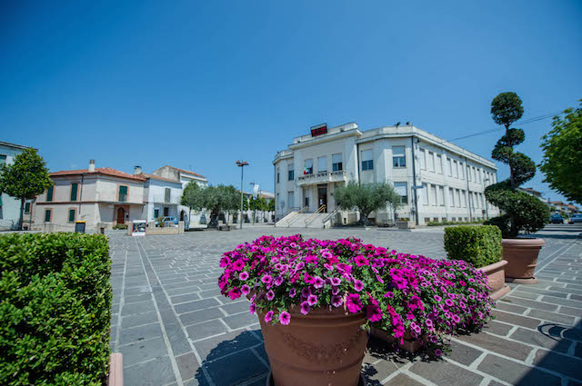
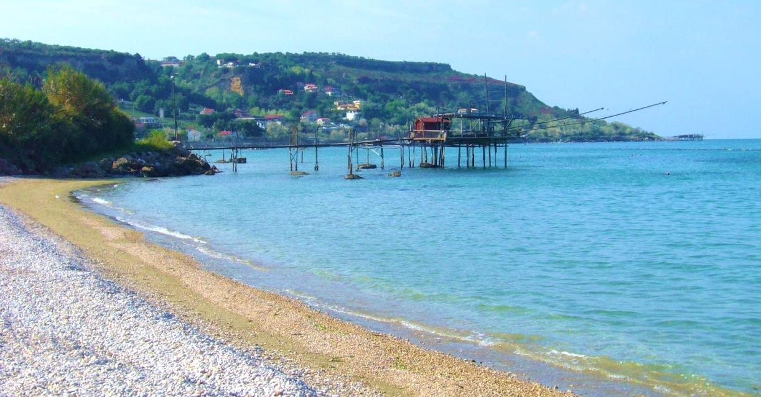
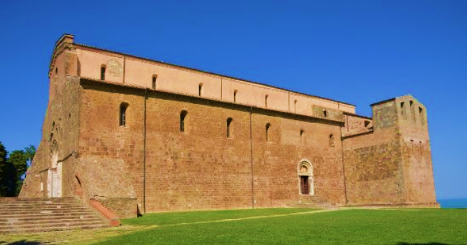
Fossacesia
Main square
The beach
Abbey of Saint John in Venus
The Abbey is a monastery complex located on a hill facing the Adriatic Sea.
It is a superb example of medieval architecture, built in 11th and 12th century
Video

Slide 14
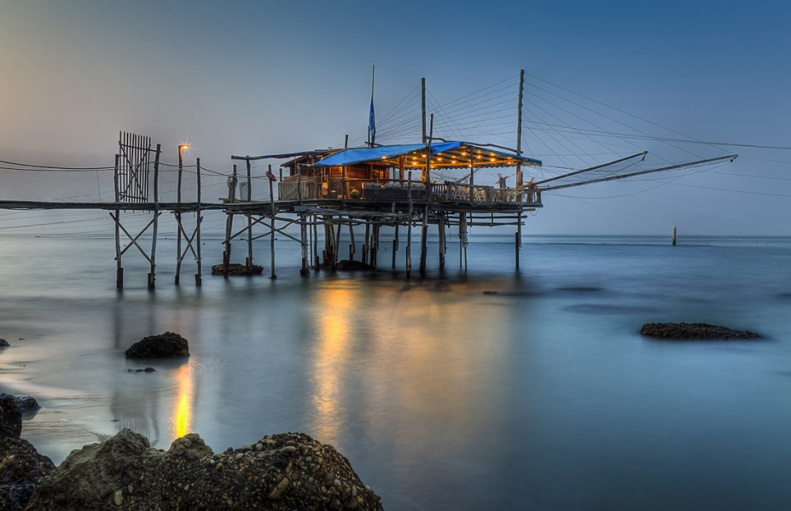
Trabocco near the sea

Slide 15
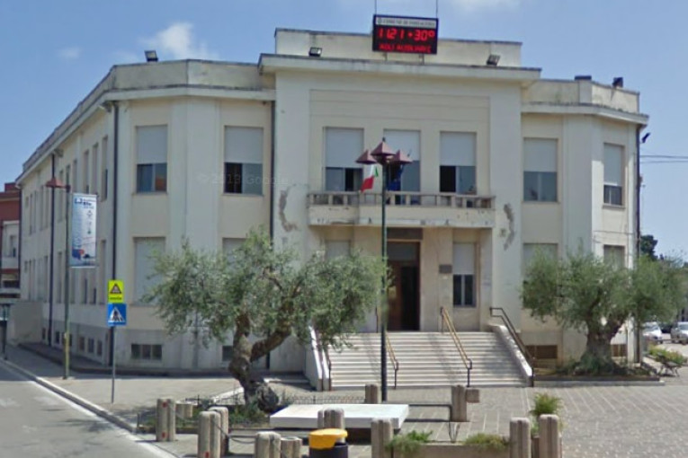
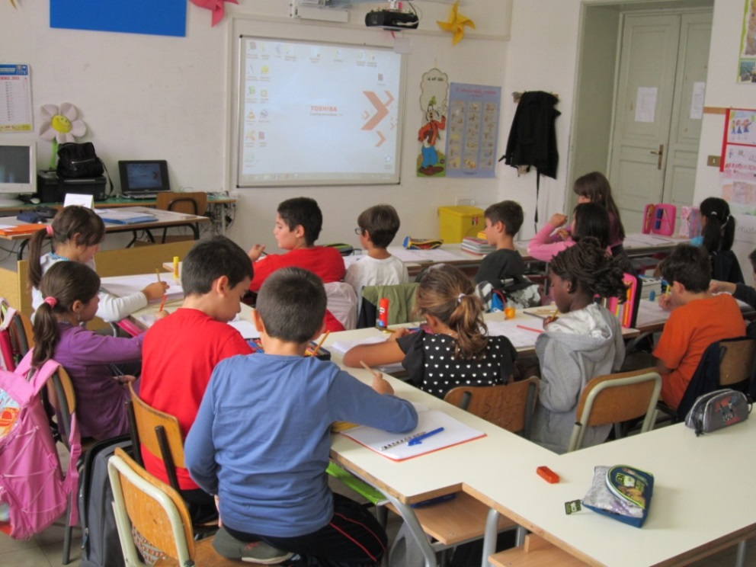
Fossacesia Primary school
Pupil’s age: from 6 to 10
15 classes, 250 students
Interactive multimedia boards, gym, canteen

Slide 16
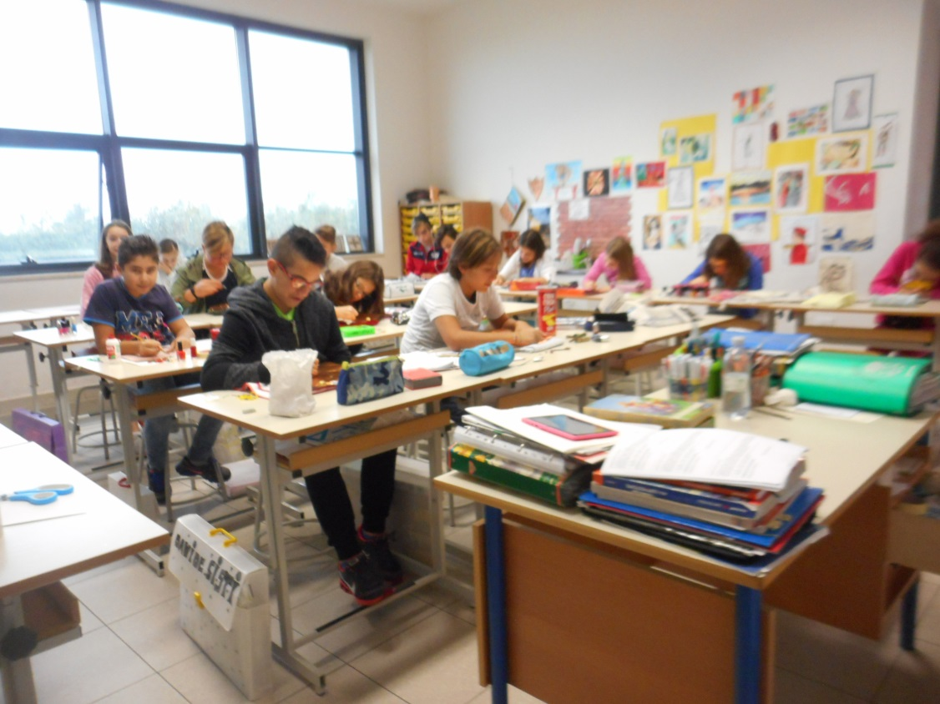
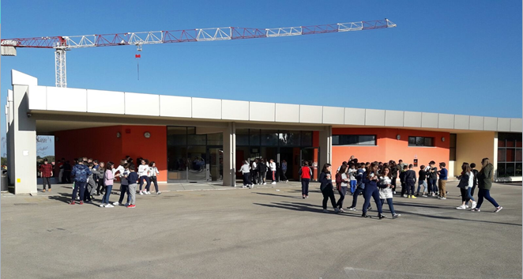
Fossacesia Secondary school
Pupil’s age: from 11 to 13
9 classes, 180 students
Interactive multimedia boards, pc
Laboratories: music lab, art lab, IT lab

Slide 17
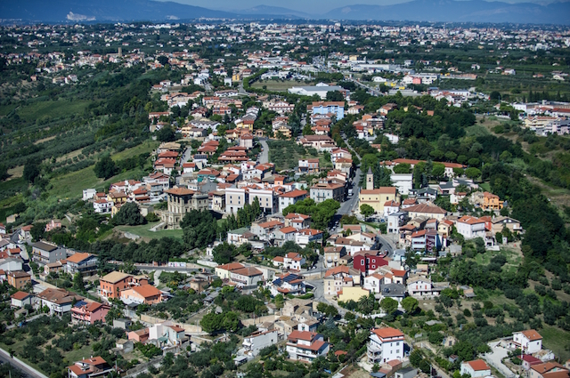
Mozzagrogna

Slide 18
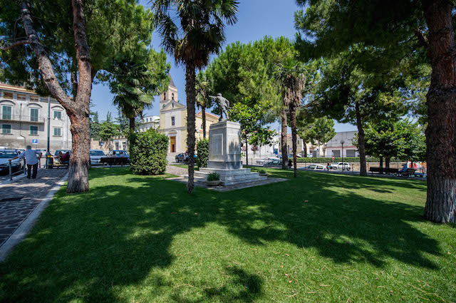
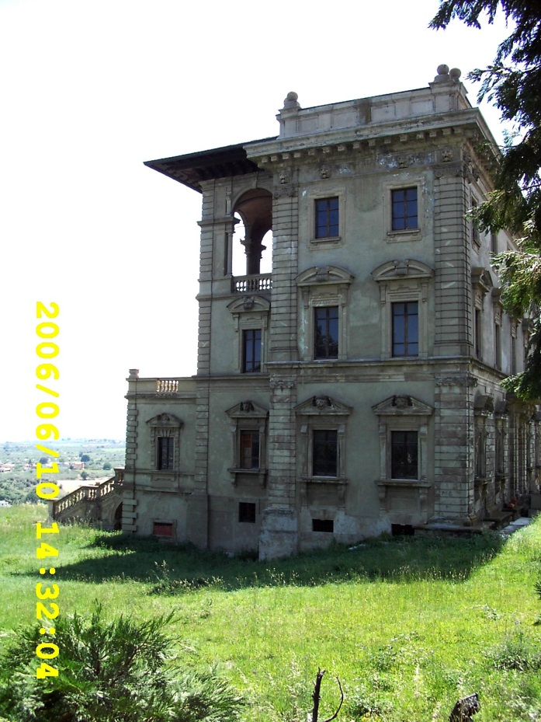
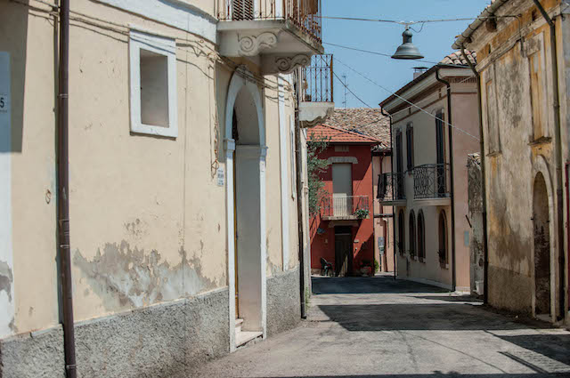
Mozzagrogna
Main square
Old town
Notes:
Main square, Marcantonio palace, old town
18

Slide 19
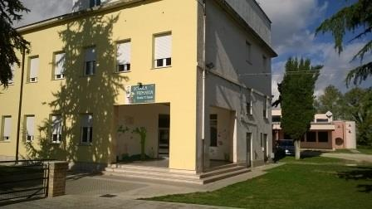
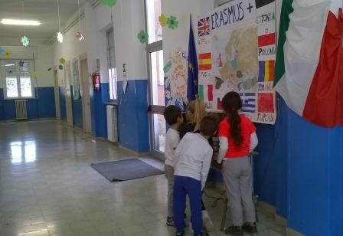
Mozzagrogna Primary school
Pupil’s age: from 6 to 10
5 classes, 90 students
Interactive multimedia boards, IT lab

Slide 20
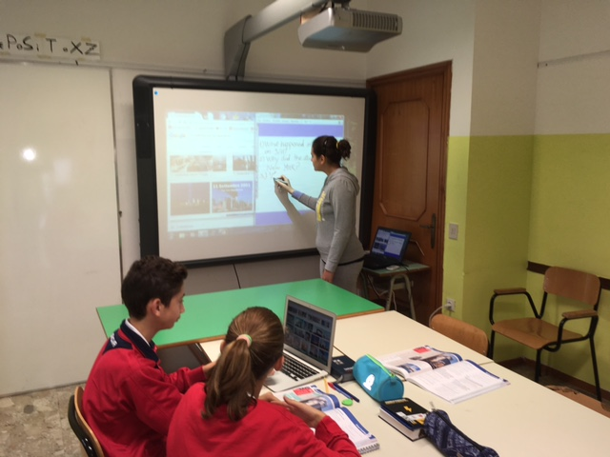
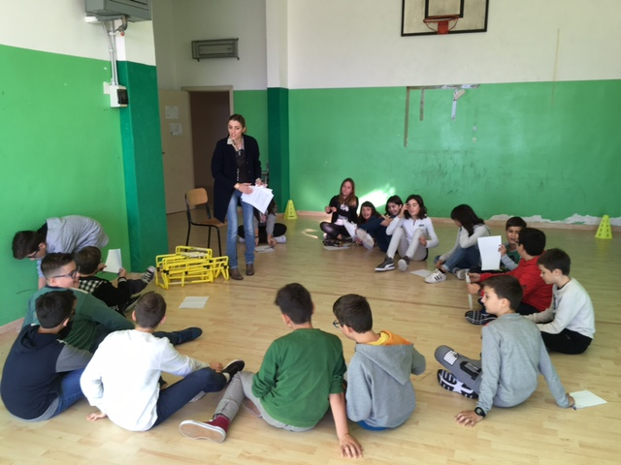
Mozzagrogna Secondary school
Pupil’s age: from 11 to 14
3 classes, 53 students
Interactive multimedia boards, gym, IT lab

Slide 21
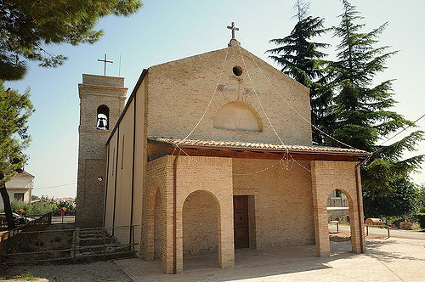
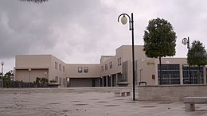
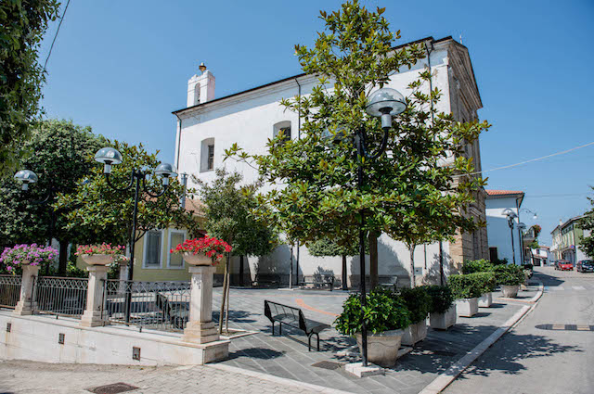
Santa Maria Imbaro
Holy mother’s God Sanctuary
Town Hall
Church of Holy mother

Slide 22
S. Maria Imbaro Primary school
Pupil’s age: from 6 to 10
3 classes, 53 students
Interactive multimedia boards, gym, IT lab

Slide 23
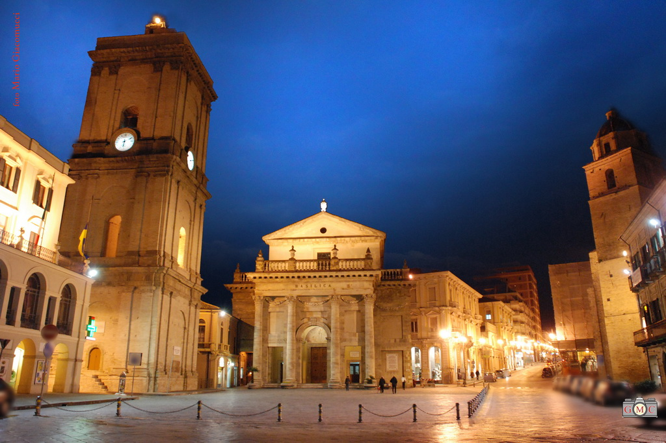
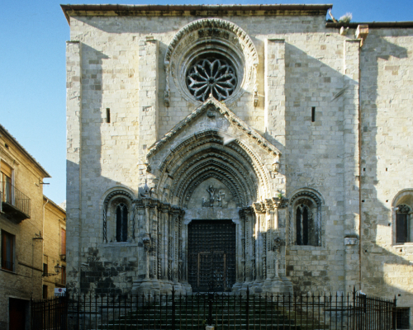
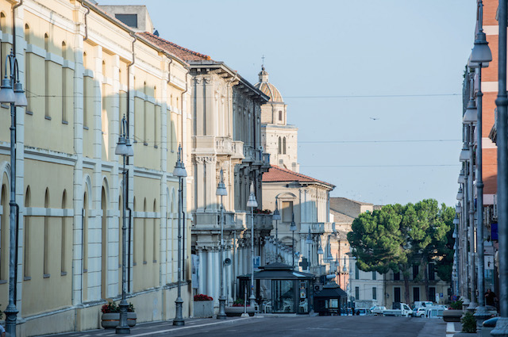
Surroundings :
Lanciano
Piazza Plebiscito, Main square
Church of Santa Maria maggiore
Notes:
Lanciano is a medieval town, vey rich in historical monuments
23

Slide 24
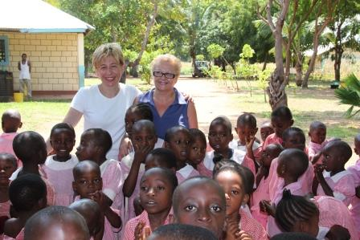
Some of our projects
Partnership with Volunteer association «For Life»,
for helping children in Kenya

Slide 25
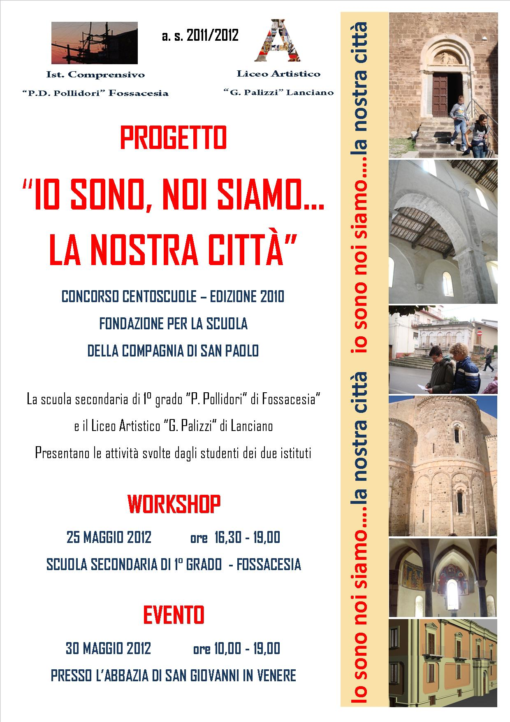
100 schools
In partnership with Art Lyceum in Lanciano. The project focuses on a multiplicity of paths of intercultural education for pupils of different ages, backgrounds, cultural identity. Students are guided to re-knowing the territory, include individual stories and project them into the world with a more conscious identity, including through the web.
Winner of the first prize
on a national contest

Slide 26
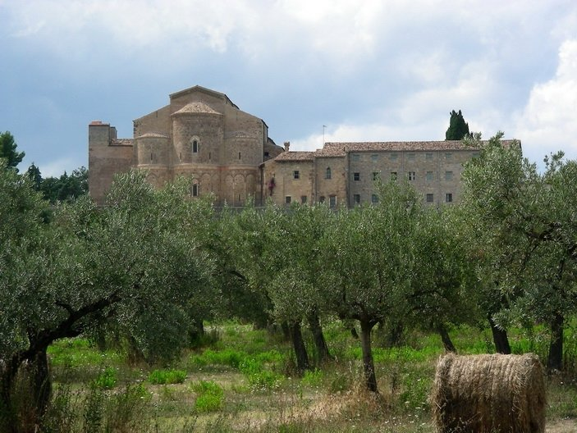
Beauty will save the world
Primary school students
adopt a monument:
Abbey of Saint John in Venus

Slide 27
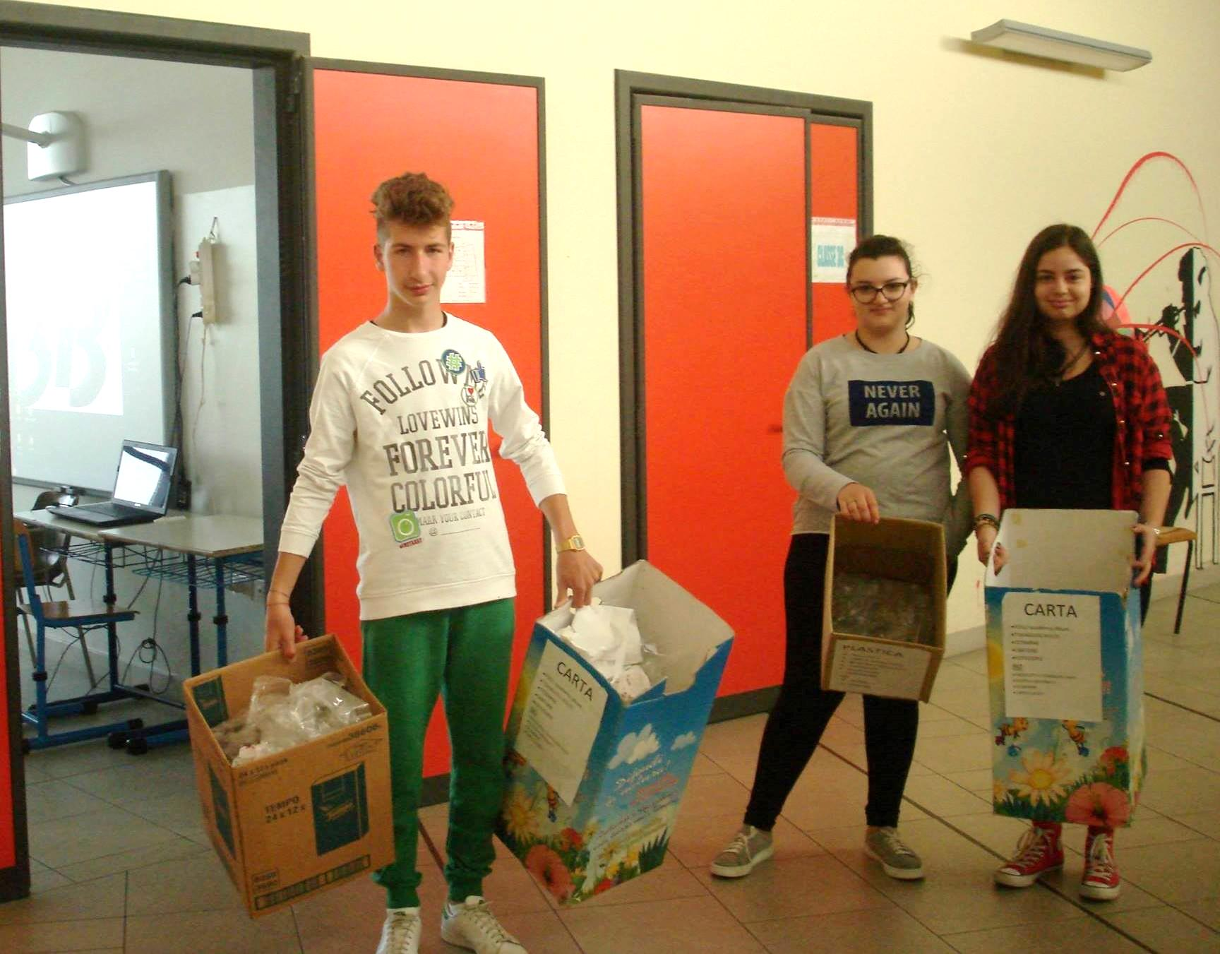
Let’s diversify
«Let’s diversify» (Differenziamoci): recycling in Secondary school

Slide 28
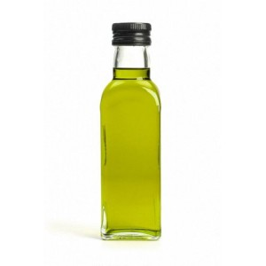
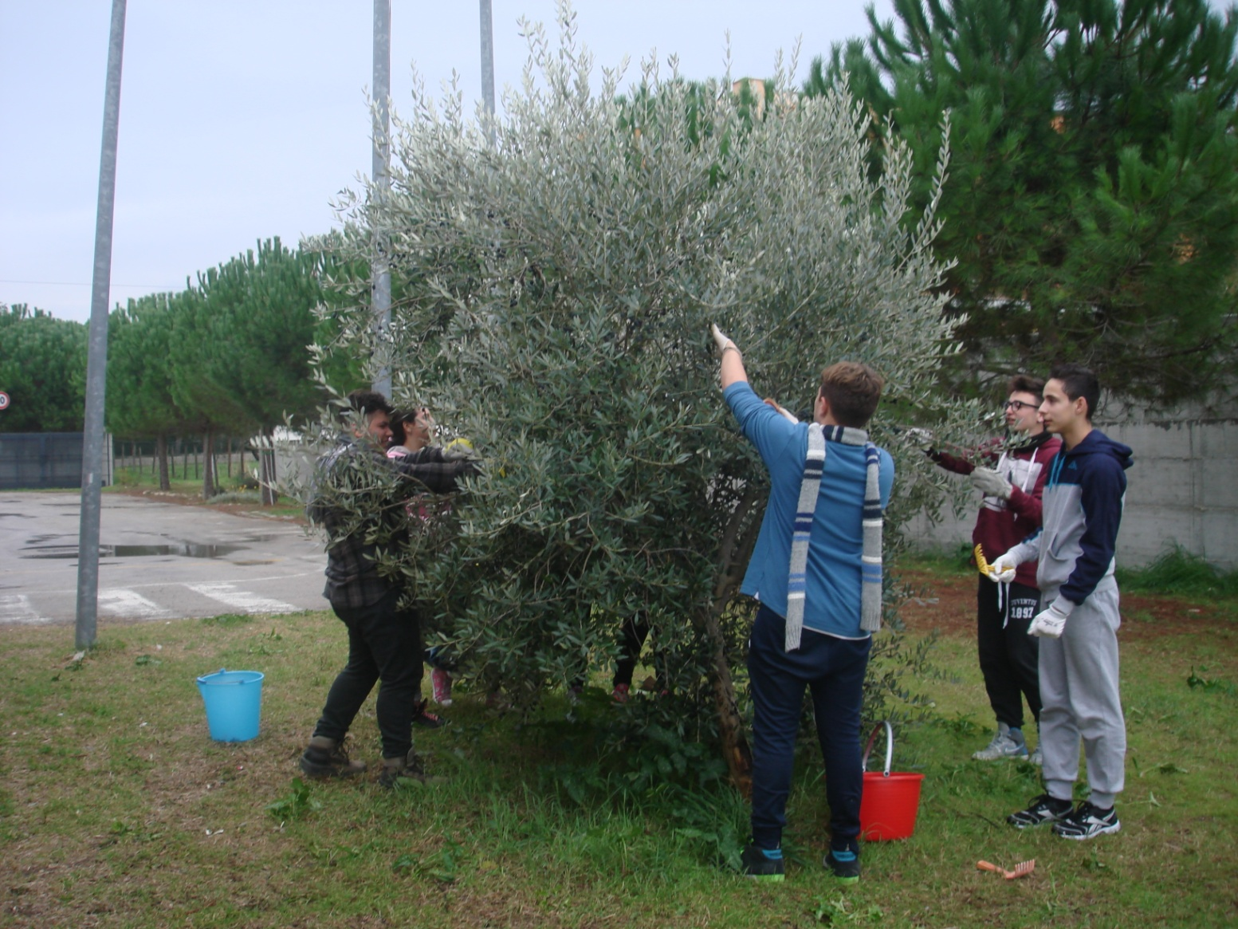
Oil and bread
Olive harvest in the school to make oil.
Bread production at school to prepare «bread and oil»

Slide 29
SEE YOU IN ITALY!

