Slide 1
Kirkbymoorside Community Primary School
Through learning, teaching and caring we achieve together.
www.kirkbymoorside-primary.co.uk

Slide 2
History of Kirkbymoorside School
Kirkbymoorside is noted as "Chirchebi" in Domesday Book (1086). It has served as a trading hub at least since 1254, when it became a market town. There are two ancient coaching inns, the Black Swan with its carved porch, and the cruck-framed George and Dragon, which originated in the 13th century.
The School was originally sited at the current doctor’s surgery, but moved in 1981 Due to the increase in pupil numbers.

Slide 3
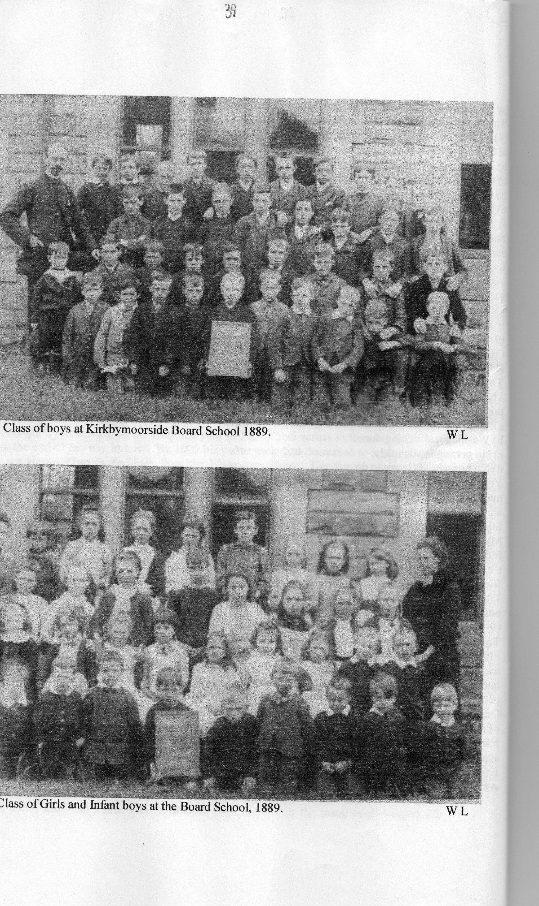
Kirkbymoorside yesterday and today...

Slide 4
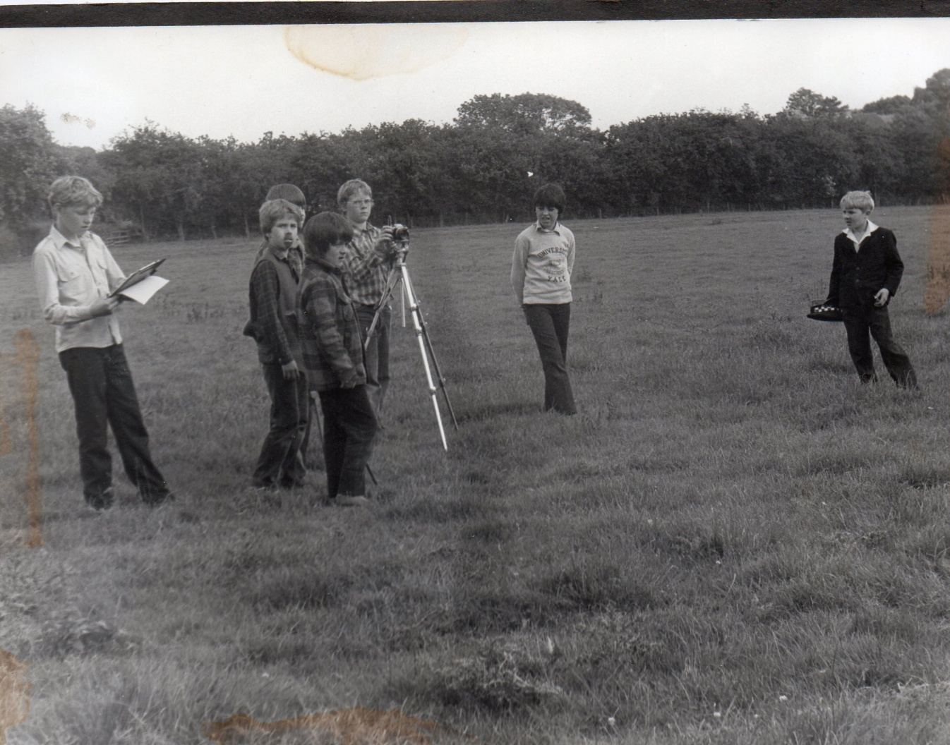
Children helping to plan the new school:

Slide 5
Classes and Staffing
The School has three key stages: Foundation, Key Stage 1 and Key Stage 2.
Foundation includes Nursery and Reception classes.
Key Stage 1 includes Year 1 and 2.
Key Stage 2 includes Year 3, 4, 5 and 6.

Slide 6
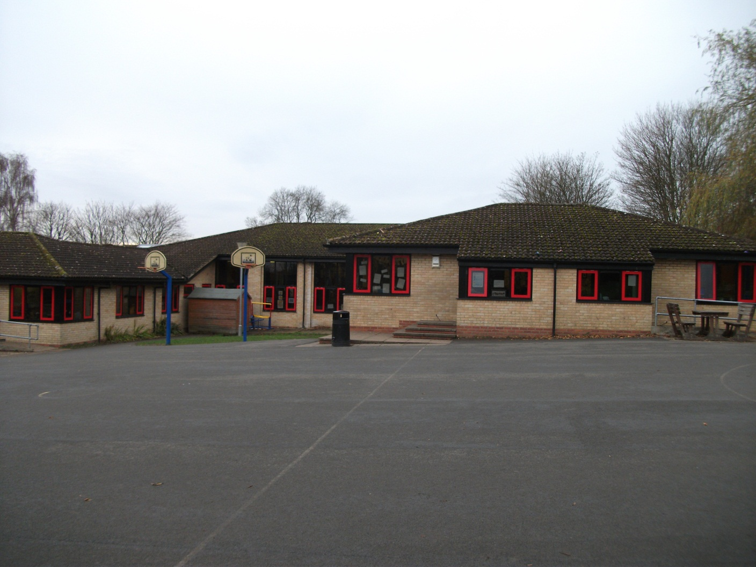

Slide 7
Classes and Staffing:
Foundation Unit
Mrs. Gledhill: Foundation, Geography
Mrs. Maxwell: Foundation, Geography
Mrs. Baldwin: Foundation, PSHE, RE
Mrs Featherstone: ATA
Mrs. Bell: ATA
Mrs. Lishman: ATA

Slide 8
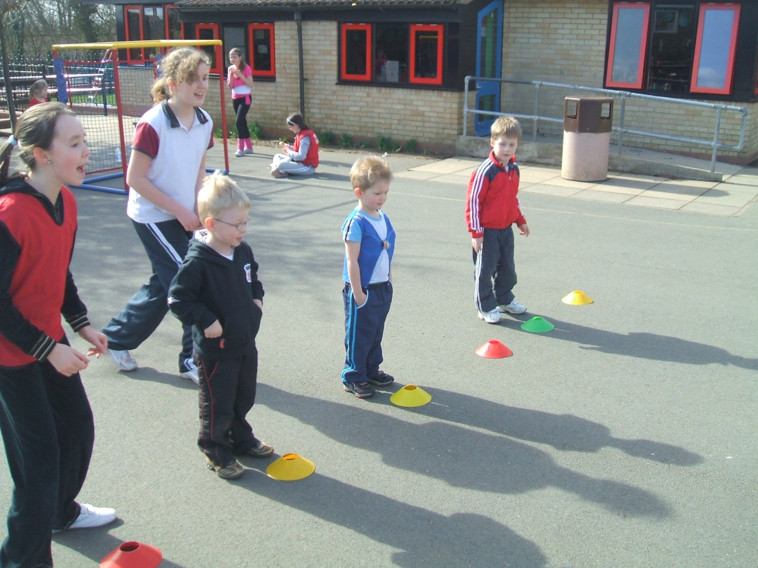

Slide 9
Classes and Staffing:
Key Stage 1
Miss Kerridge: Y1, English, International, MFL
Mrs. Turnbull: Y2 (+1), F/KS1 Co-ordinator, ICT, SENCO
Mrs. Woodward: HLTA
Mrs Featherstone: ATA
Mrs. Coppack: ATA

Slide 10
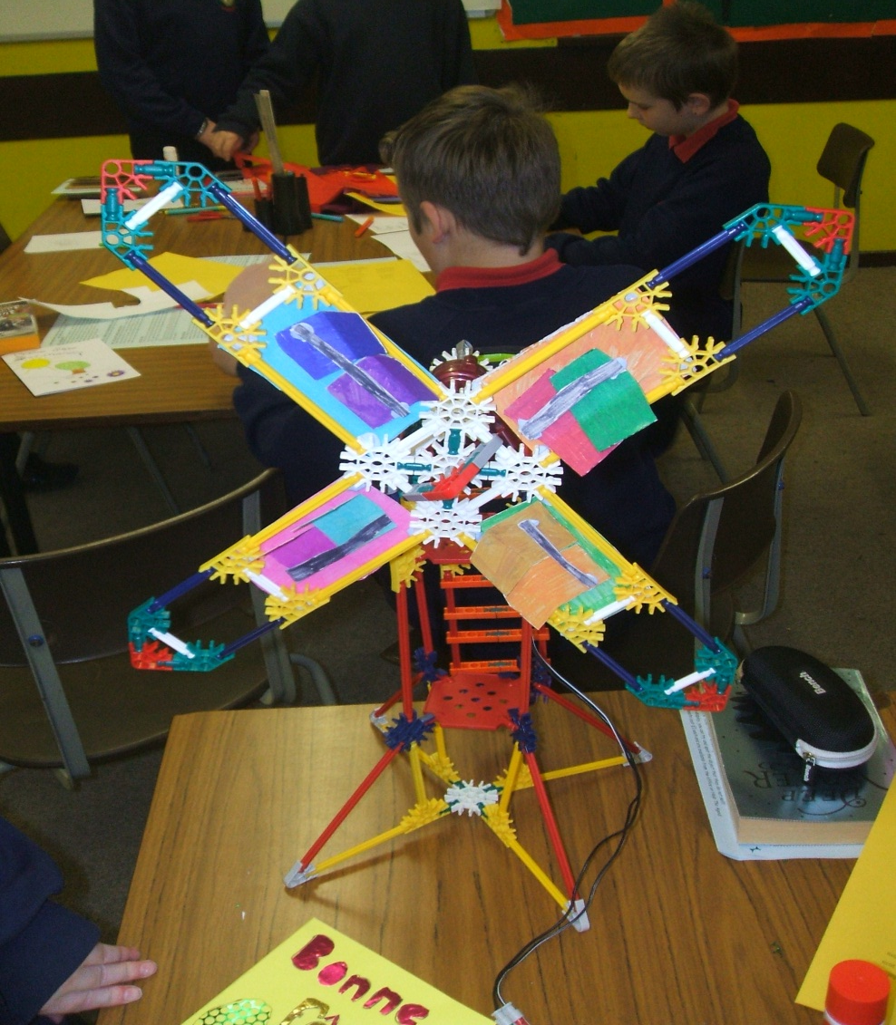

Slide 11
Classes and Staffing:
Key Stage 2
Miss Gray: Y3, Art
Mrs Hardman: Y4, History
Miss Minister: Y5, NQT
Mrs Aspery: Y6, Key Stage 2 Co-ordinator, PE, School Council
Mr Sleightholme: Y6 Maths, Deputy Head, Maths
Mrs. Atkinson: HLTA
Mrs. Cooke: ATA
Mrs Barbour: ATA

Slide 12
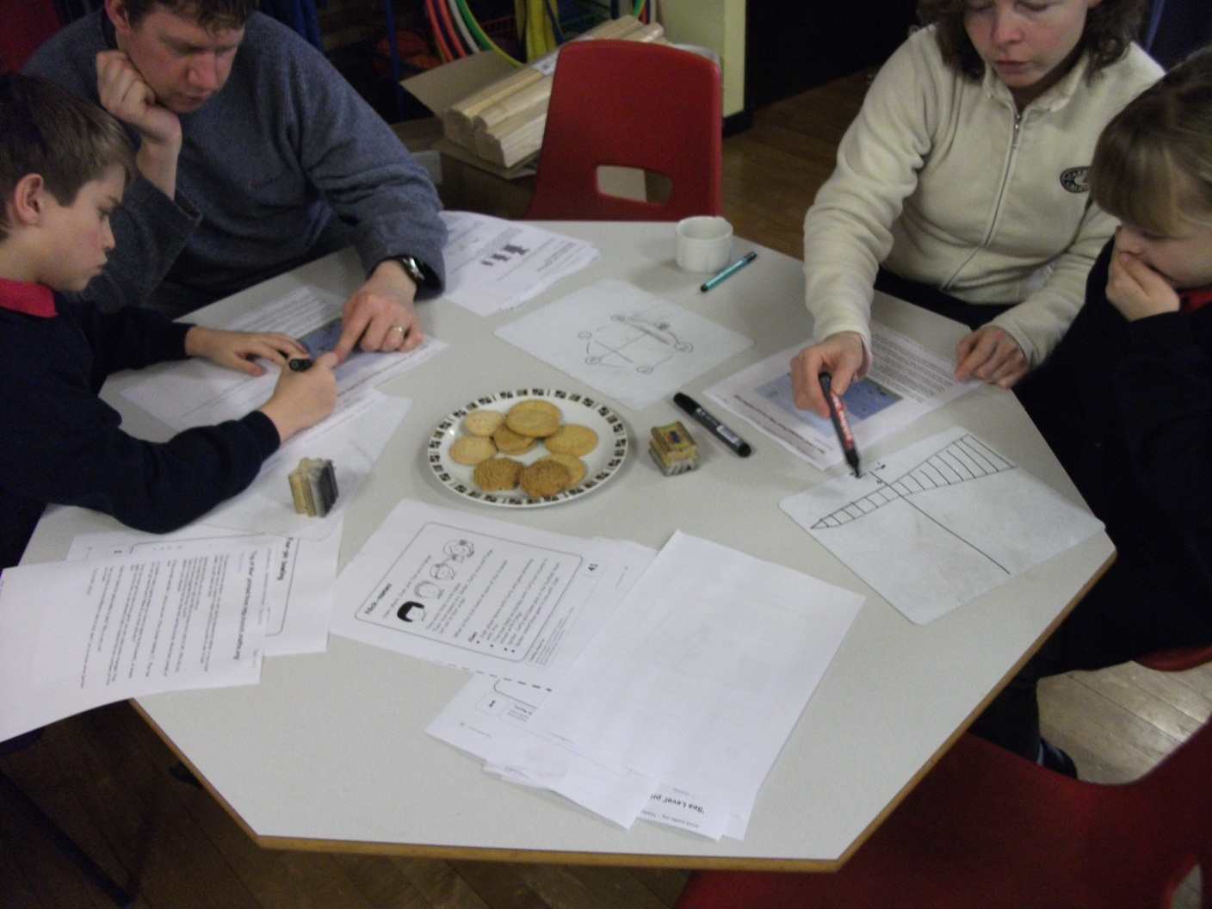

Slide 13
Enhanced Mainstream School
Mrs. Hunter: Teacher in Charge
Mrs. Cruise: Lead Teacher
Mrs. Coon: TA
Mrs Wilmore: TA
Mrs McGuire: Clerical Administration

Slide 14
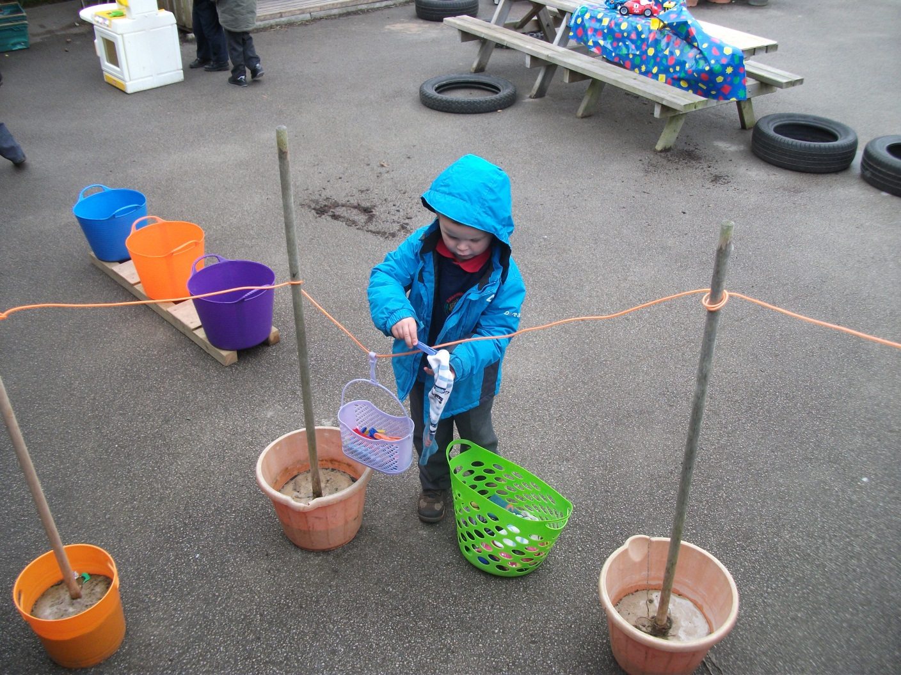

Slide 15
Classes and Staffing:
Senior Management Team
Mrs. Hardacre: Headteacher
Mr. Sleightholme : Deputy Head
Mrs. Aspery: Key Stage 2 Co-ordinator
Mrs. Turnbull: Foundation/Key Stage 1 Co-ordinator
Mrs. Hunter: Teacher in Charge of EMS

Slide 16
Curriculum and Learning
Foundation Curriculum:
From birth to 5 years old
3 Prime Areas: Communication and language; Physical development; and Personal, social and emotional development.
4 Specific Areas: Literacy; Mathematics; Understanding the world; and Expressive arts and design.
Learning through exploration and play.

Slide 17
Curriculum and Learning
History Lesson with a Difference
National Curriculum: Statutory Subjects
Key Stage 1: Ages 5-7 (Years 1-2)
Key Stage 2: Ages 7-11 (Years 3-6)
Key Stage 3: Ages 11-14 (Years 7-9)
Key Stage 4: Ages 14-16 (Years 10-11)
Our philosophy is learning through doing.
Extra Curricular Activities: Various clubs, school band, school choir, visiting music teachers, Residential Visits.

Slide 18
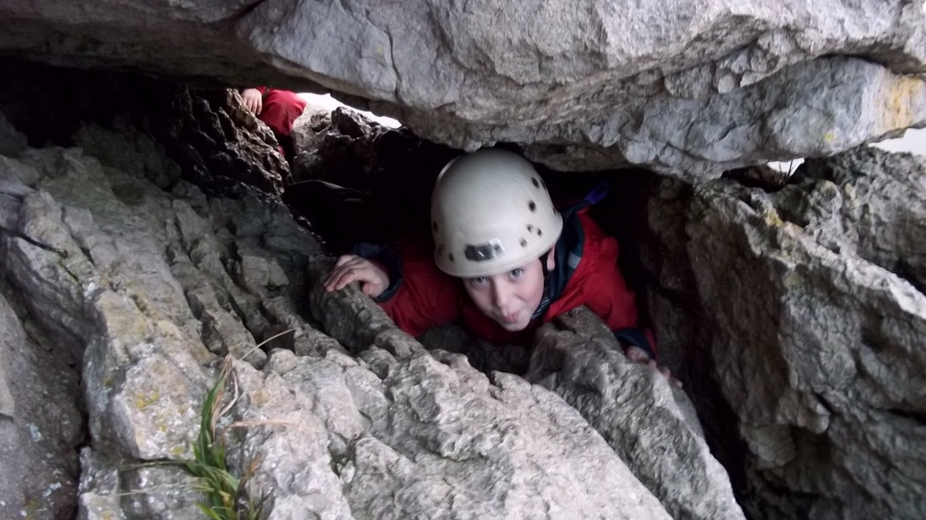
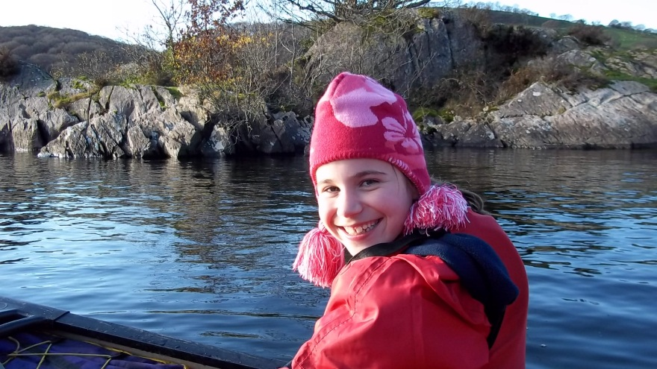

Slide 19
Curriculum and Learning
Staff development:
Process of Lesson Study
Setting Goals
Planning the Lesson
Teaching, Observing and Debriefing
Revising and Reteaching
Reflecting and Sharing Results

Slide 20
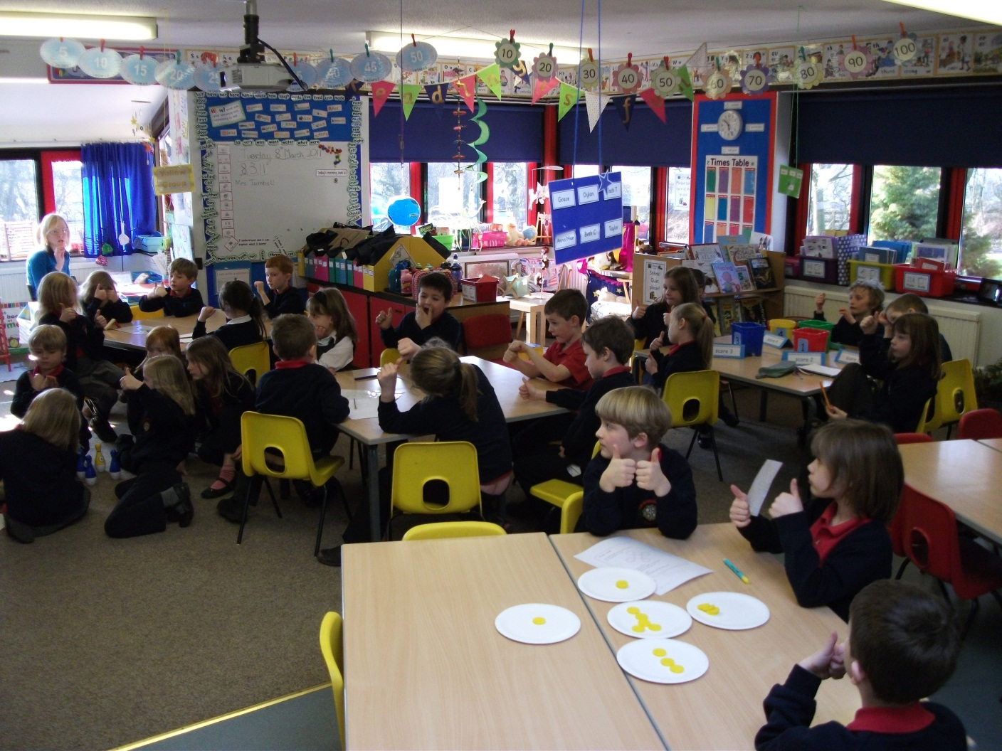

Slide 21
Ryedale Federation
Ryedale Secondary
Helmsley Primary
Sinnington Primary
Kirkbymoorside Primary
Governing Body
ELT
Secondary and Primary Directors
Headteachers

Slide 22
The Future
Federation embedded and expanded
Northstar Alliance
As the town of Kirkbymoorside grows, so will the school.

