Slide 1
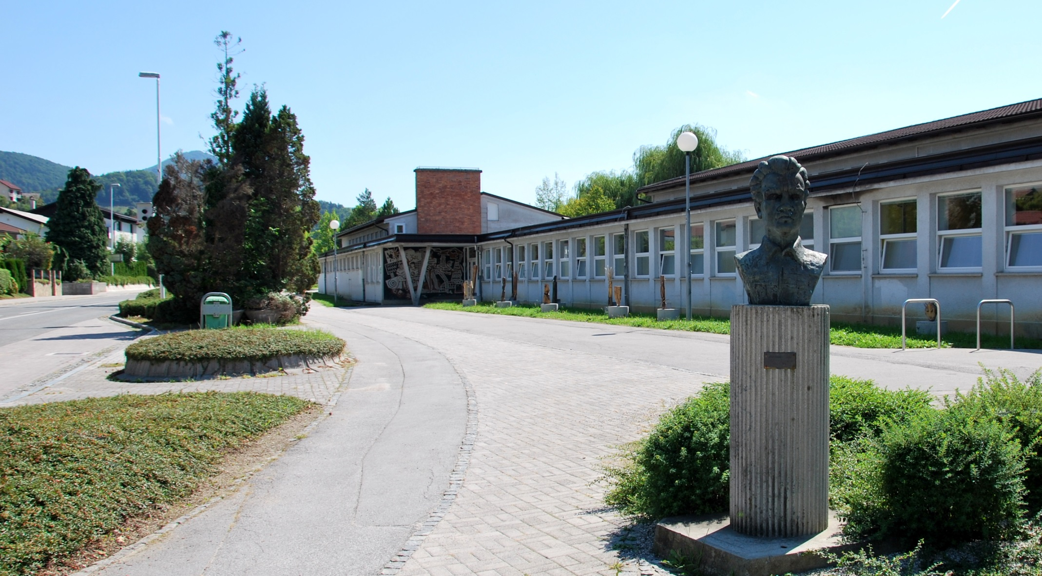
PRIMARY SCHOOL MIHE PINTARJA TOLEDA

Slide 2
Our school is called Mihe Pintarja Toleda Primary School. Miha Pintar was a soldier and our school got the name from him. The school was built in 1961. The people of our town Velenje built it for free. It is now 55 years old.

Slide 3
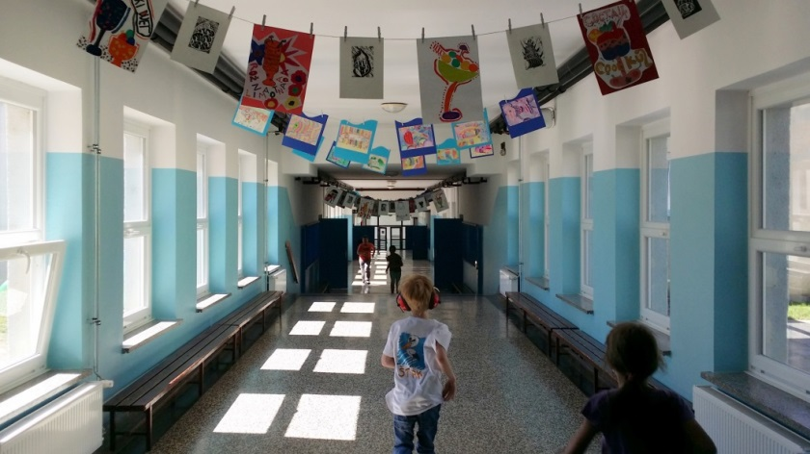
Our school is one of six primary schools in Velenje. It has 410 pupils in twenty classes. There are 38 teachers who work at the school and 13 additional workers that take care of other activitives at school.

Slide 4
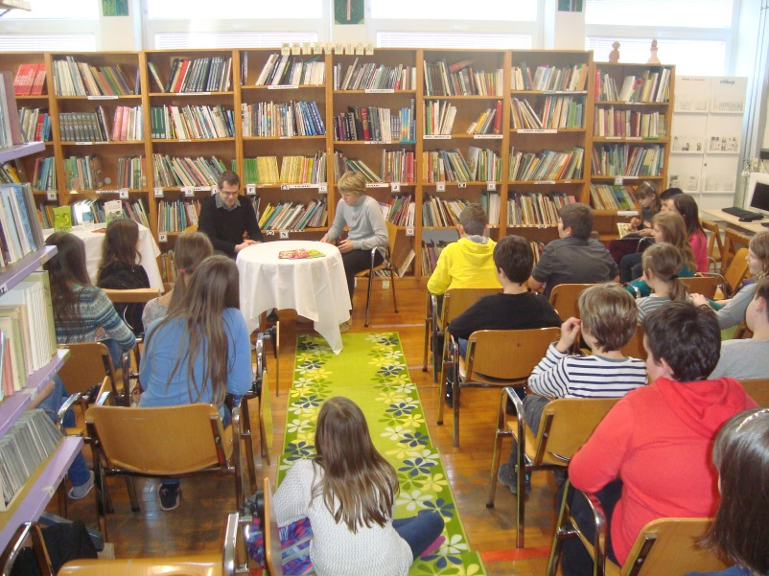
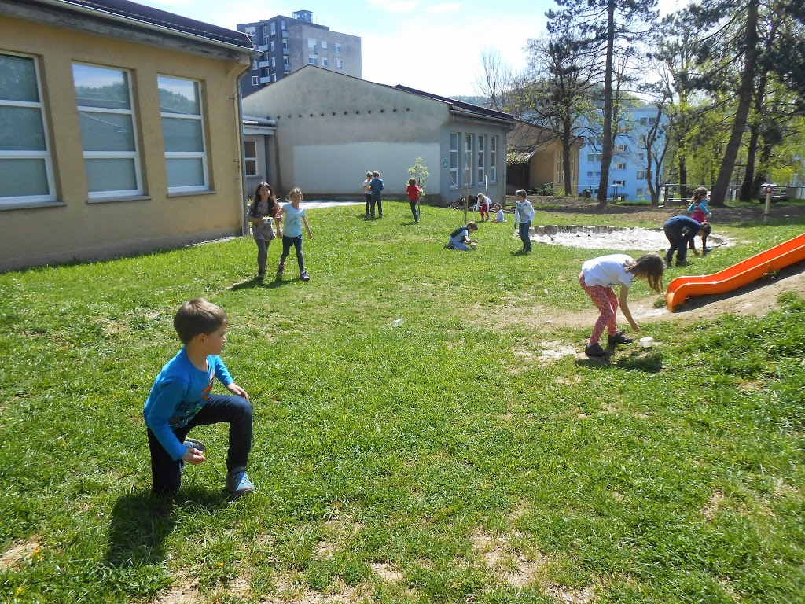
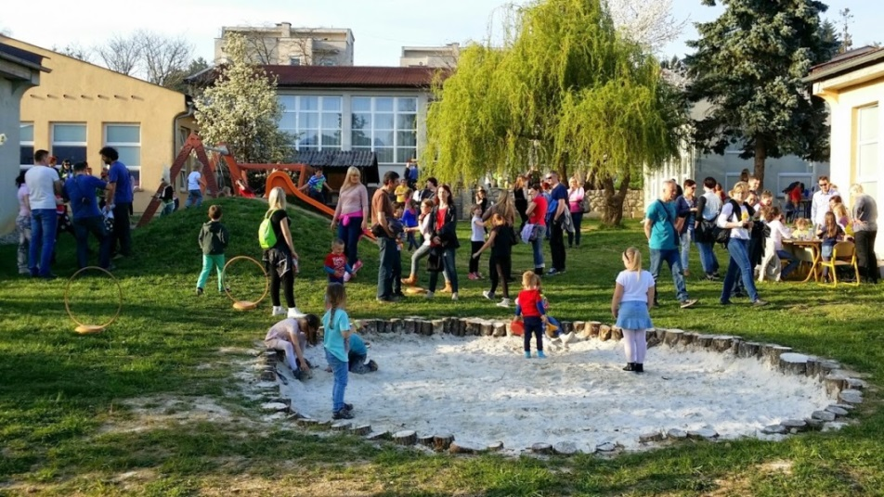
The school has an unusual shape. Each classroom has its own little room. There are 20 classrooms, two kitchens, gym, library, a hall etc.

Slide 5
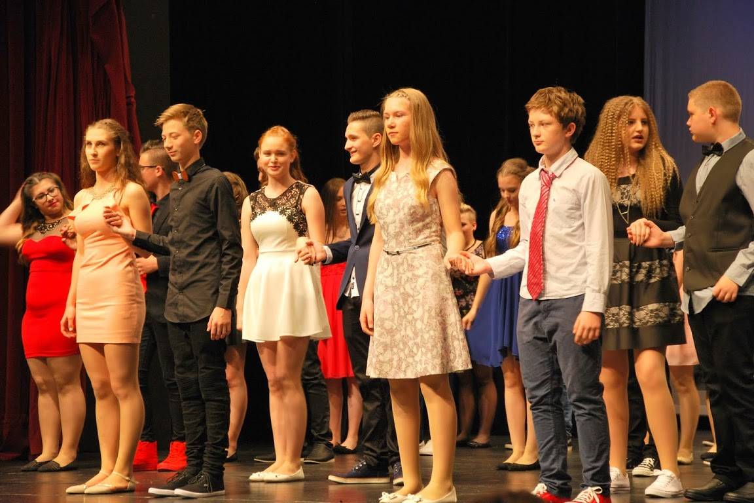
Children in Slovenia start primary school at the age of 6 and finish it at the age of 15.

Slide 6
In Slovenia, our nine-year elementary school is divided into 3 three-year cycles.
First cycle: classes 1-3 | Age 6-8
Second cycle: classes 4-6 | Age 9-11
Third cycle: classes 7-9 | Age 12-14

Slide 7
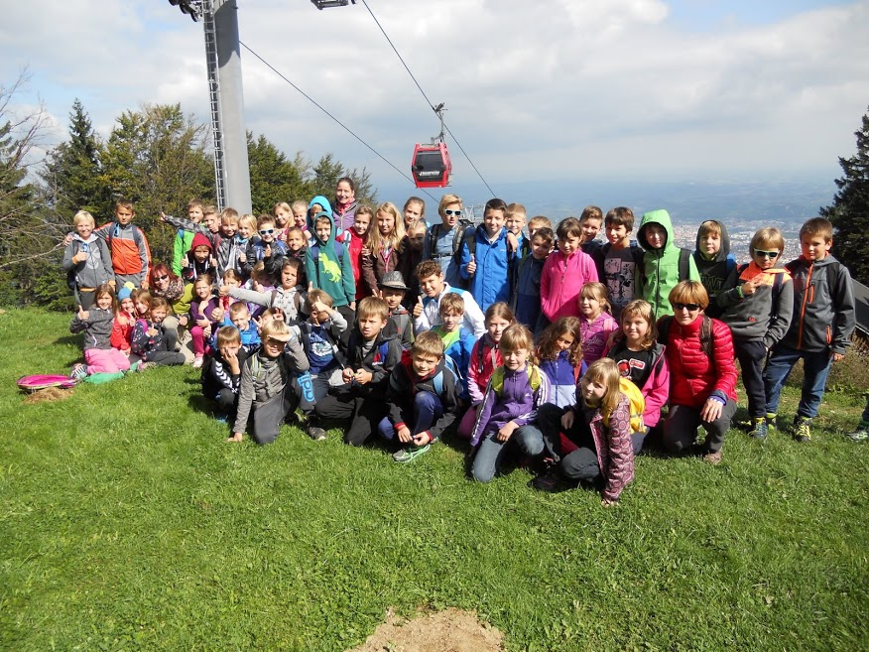
Besides the regular school curriculum, pupils from 3rd, 4th, 5th, 6th and 8th class spend a week either at the country, the see or in the mountains studying nature and also developing their physical abilities.

Slide 8
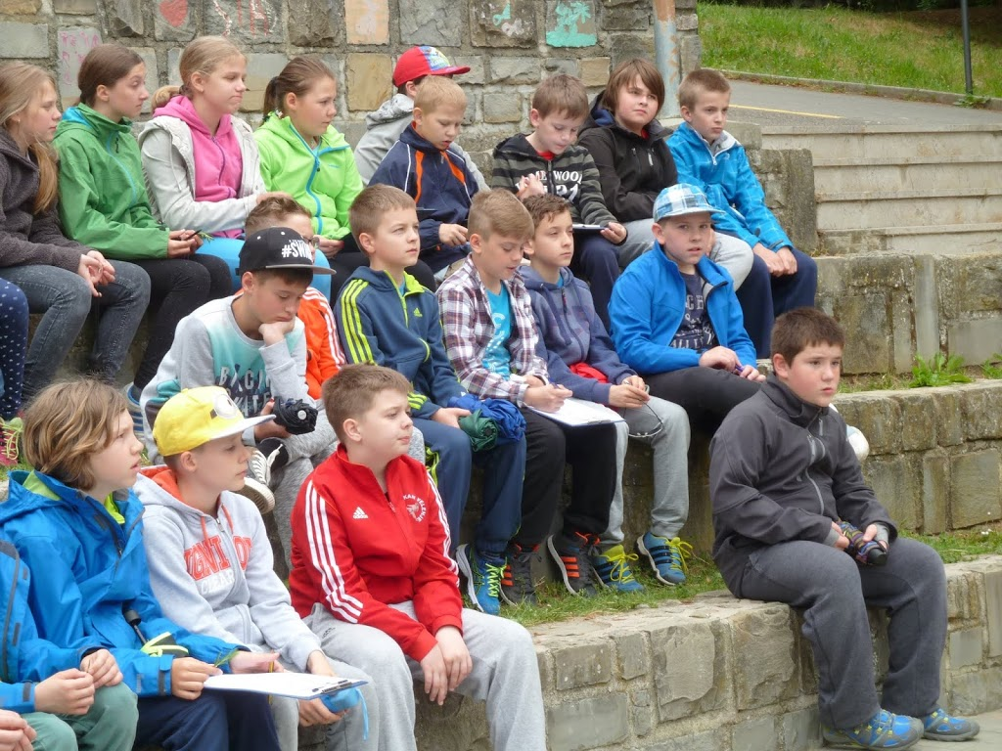
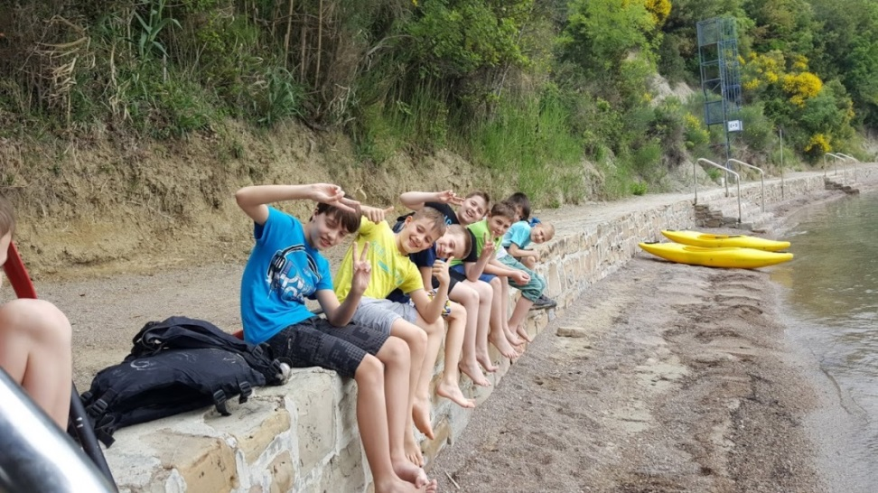
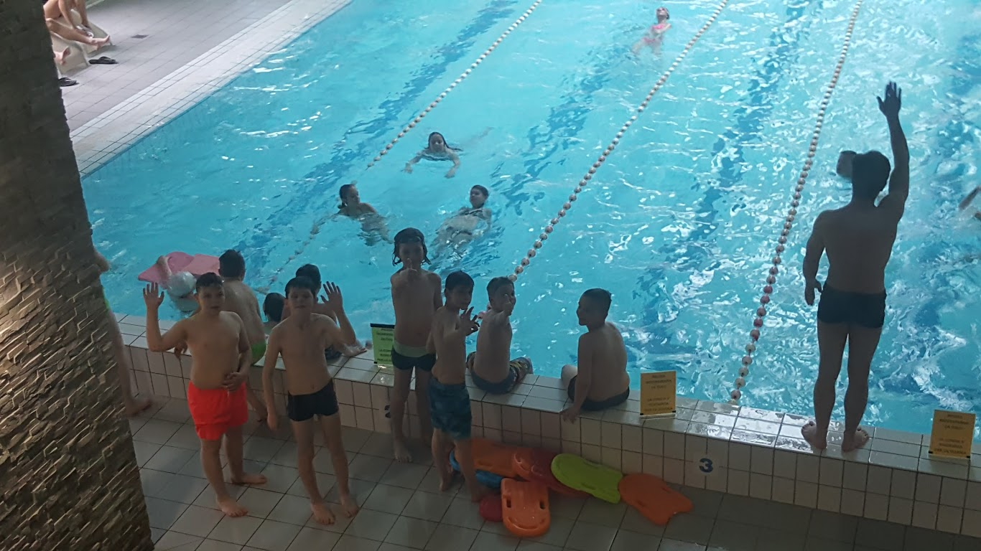
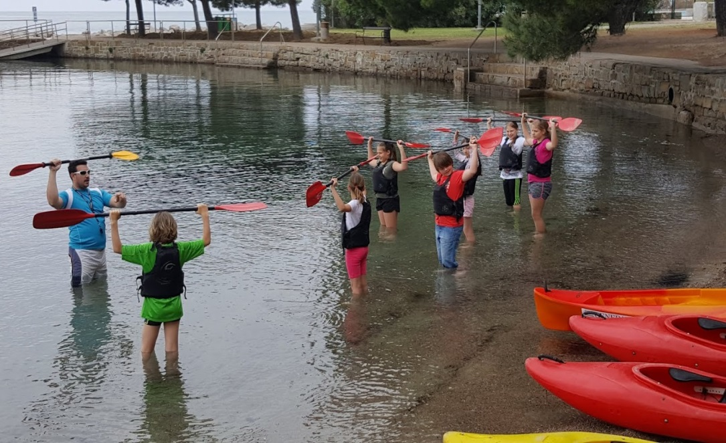

Slide 9
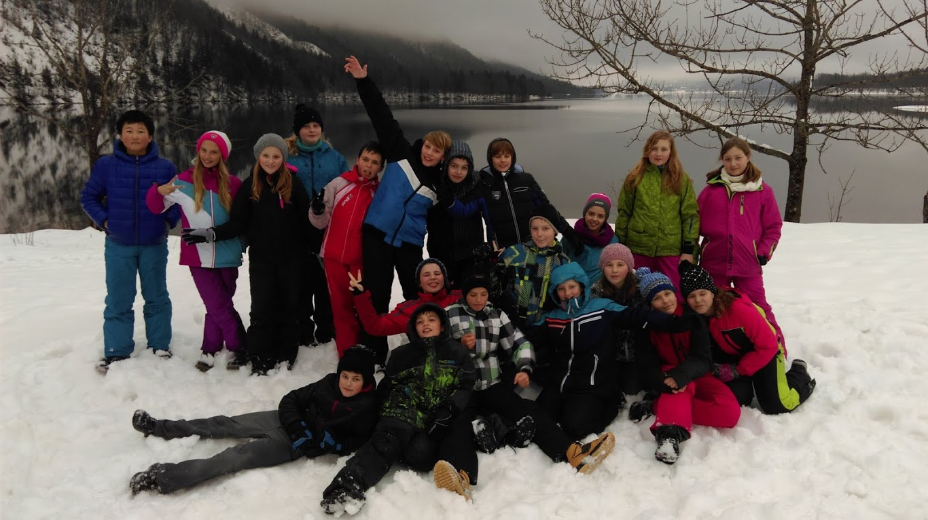

Slide 10
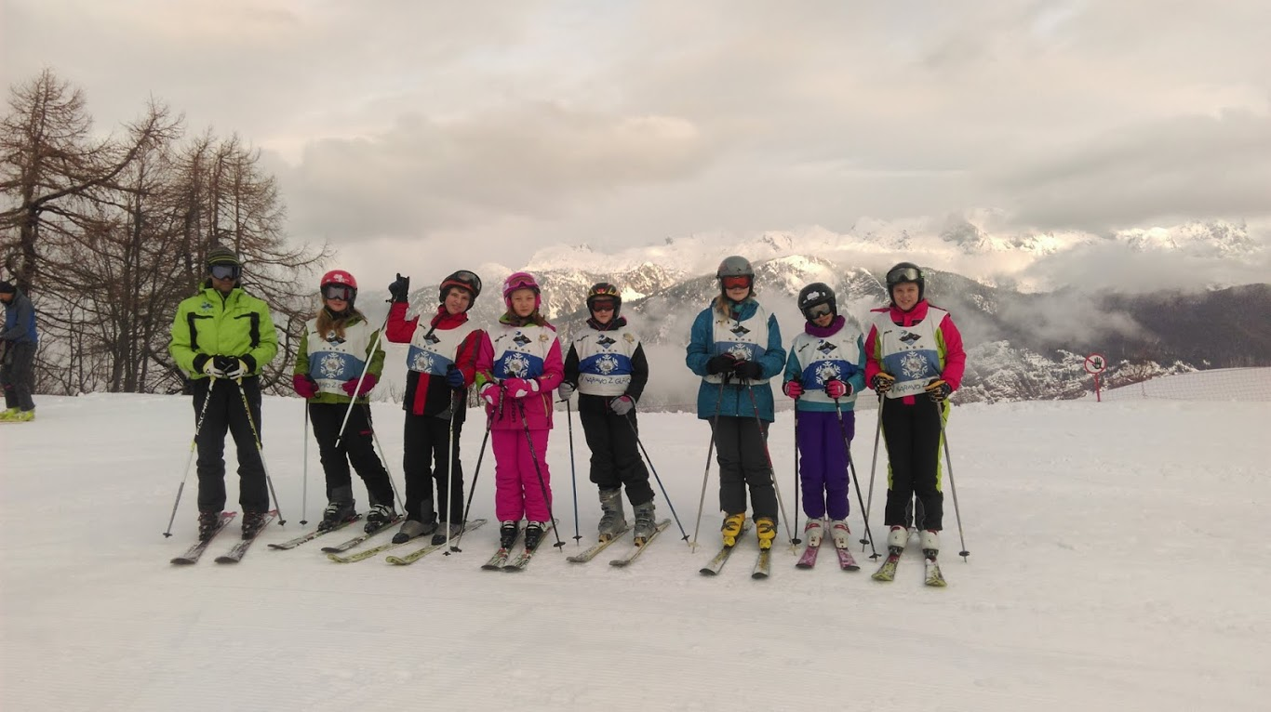

Slide 11
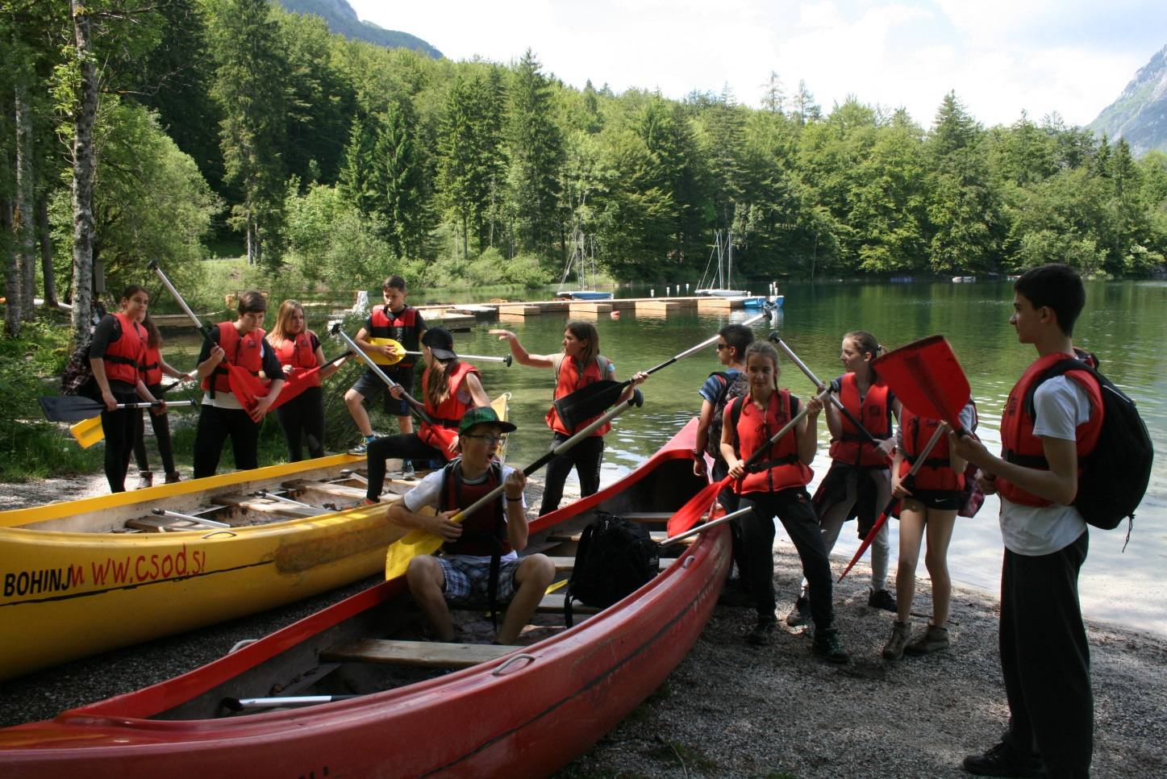

Slide 12
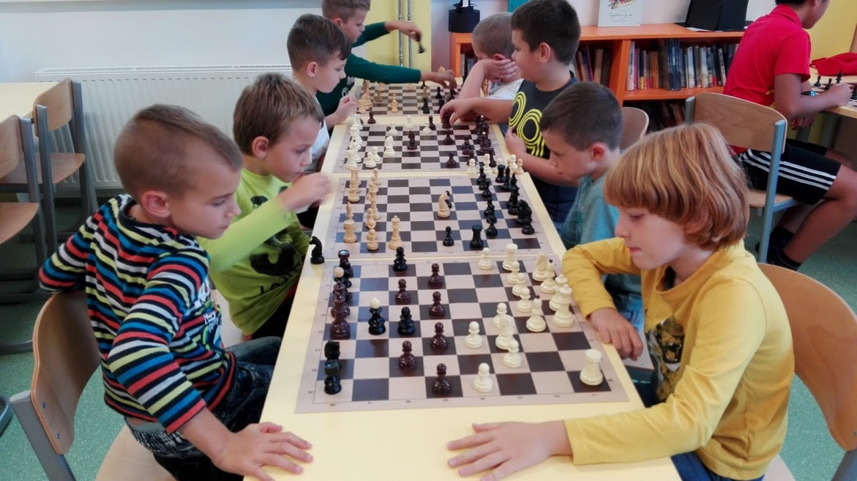
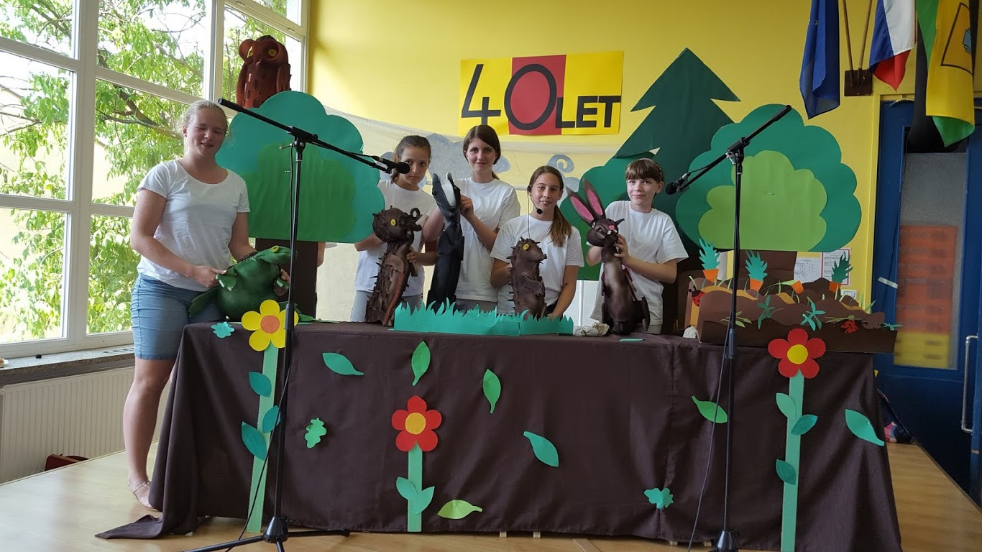
Aside from the usual curriculum, we also offer our pupils numerous choices of after school activities, like drama club, gardening, fairy tale club, Rubik's Cube solving, dance lessons, choir.

Slide 13
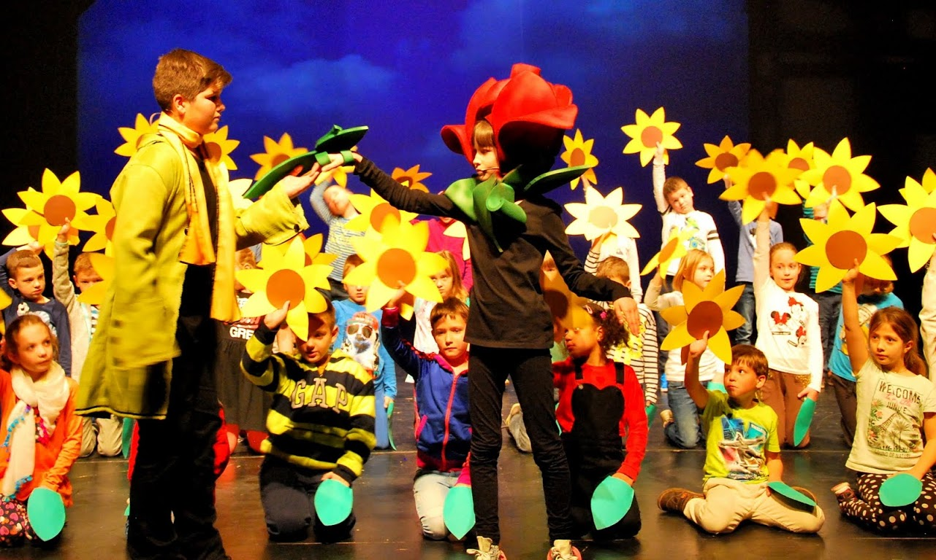
Important areas of our school curriculum are theatrical and musical productions, fairy-tales and musicals.

Slide 14
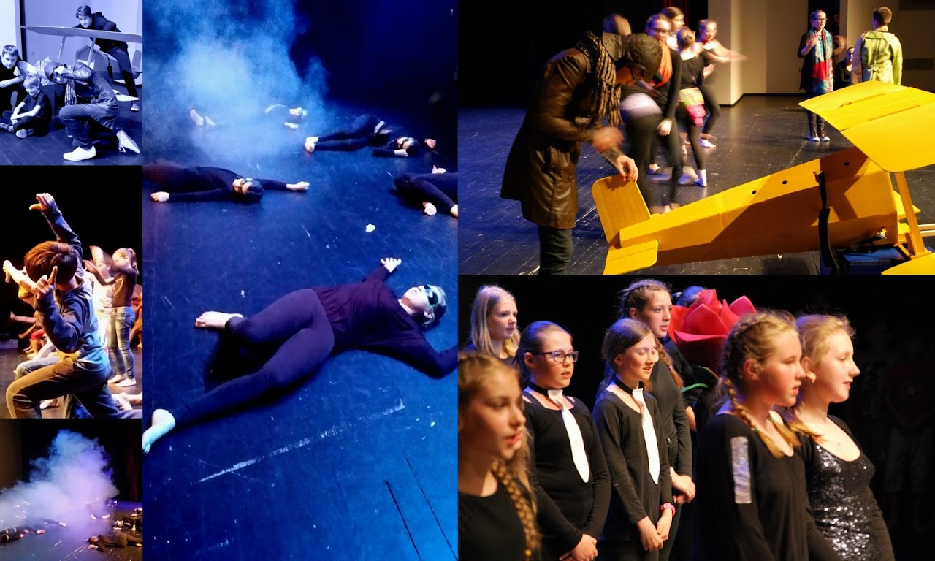

Slide 15
Our teachers and students are also very actively involved in different projects. Since 2012 our school has been the official coordinator of Earth Hour in Slovenia.

Slide 16
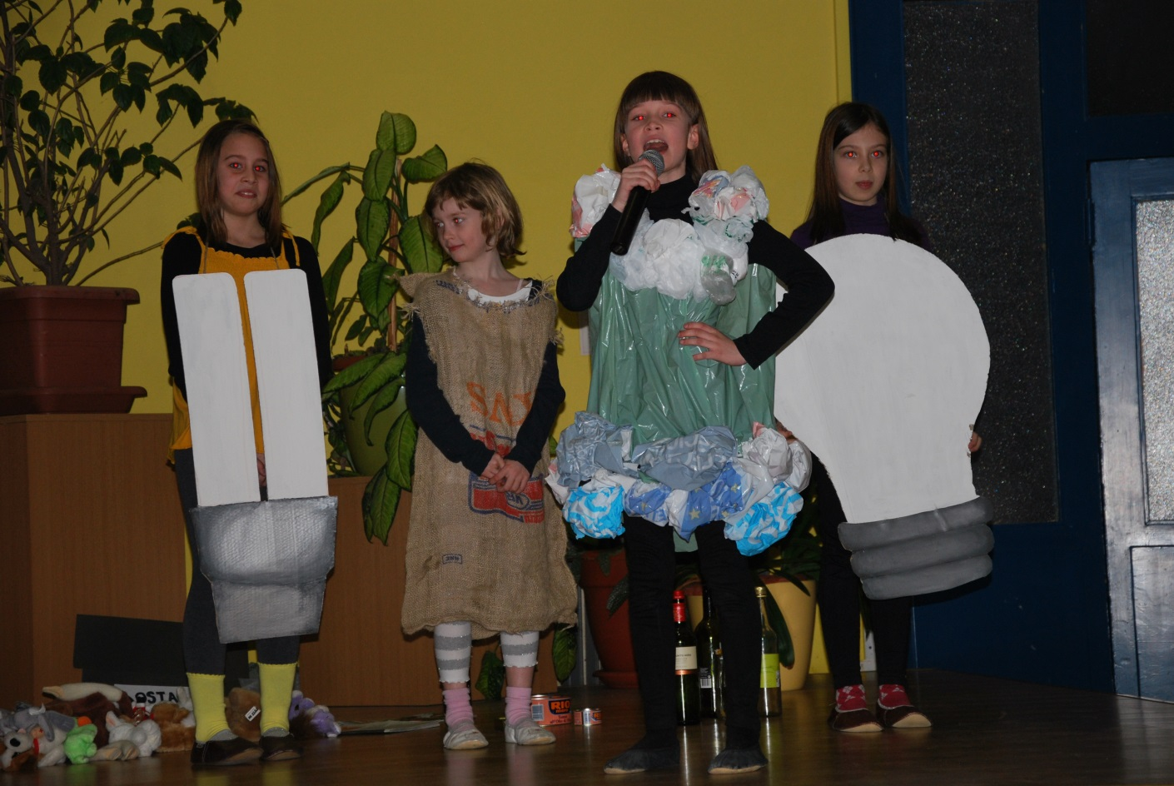
Each year more and more municipalities, mayors, businesses, organizations, and individuals support us in the Earth Hour. Under the terms of the project, we have organized cultural events, painting exhibitions, eco-workshops and lectures.

Slide 17
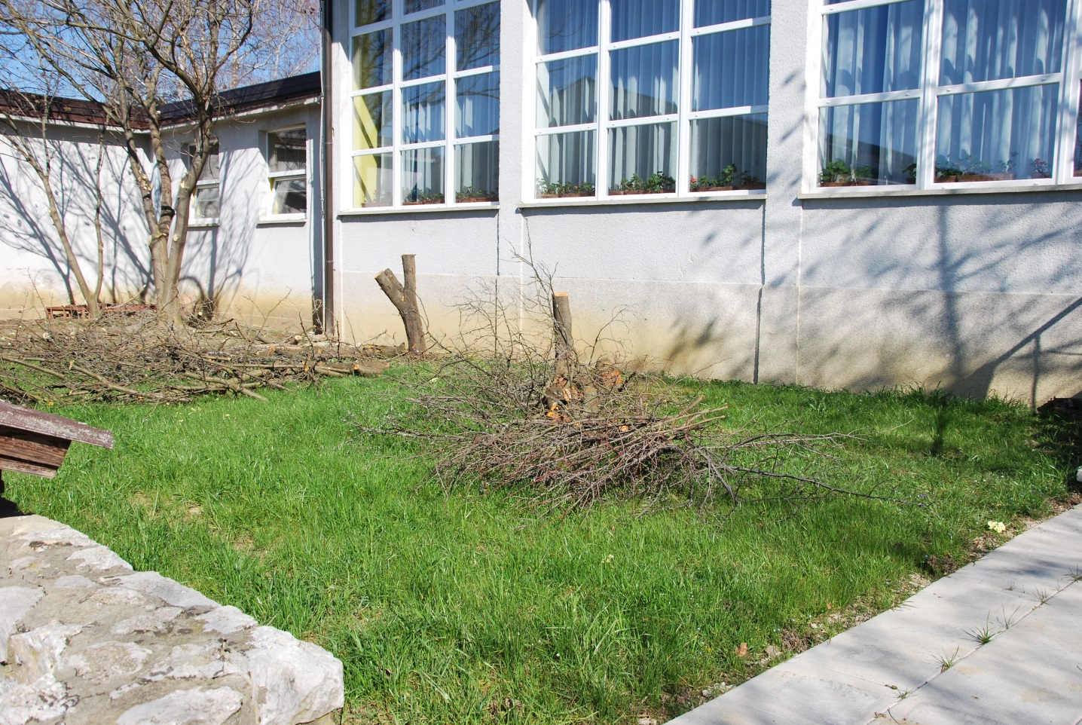
Our main goal in Earth Hour was to bring nature closer to our pupils. We decided to prepare a classrom in nature (outside) and an eco garden. ..

Slide 18
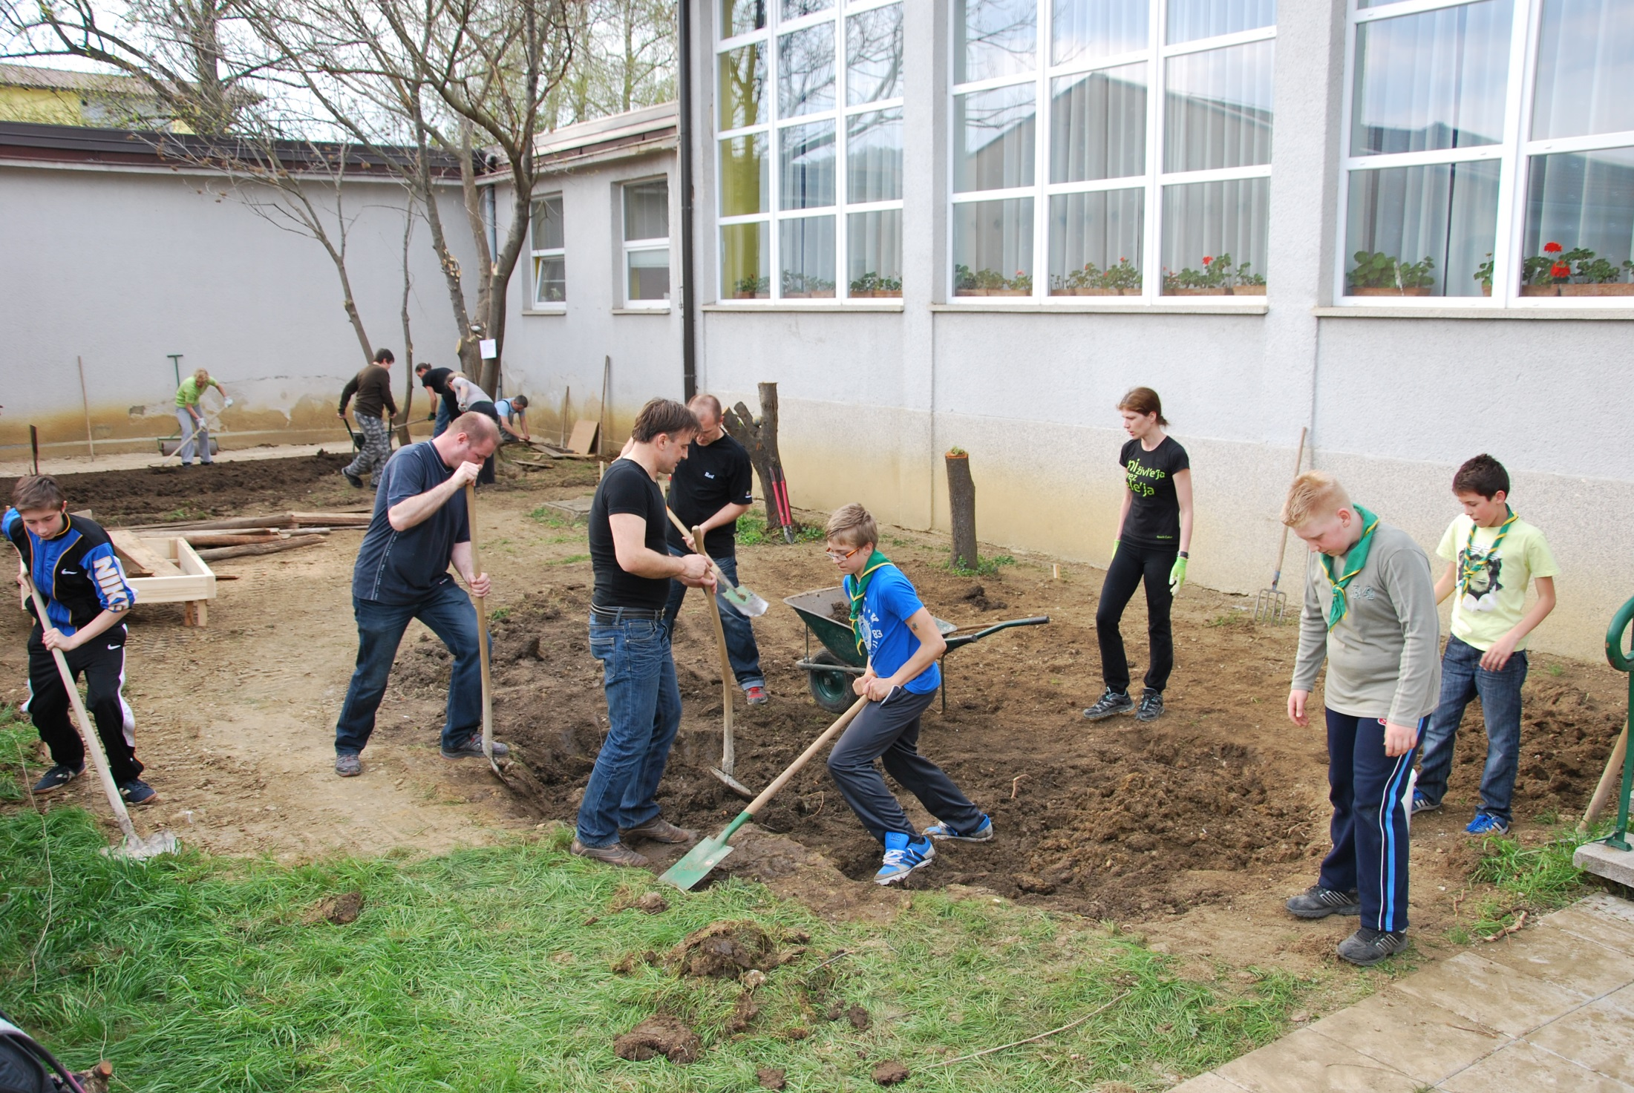

Slide 19
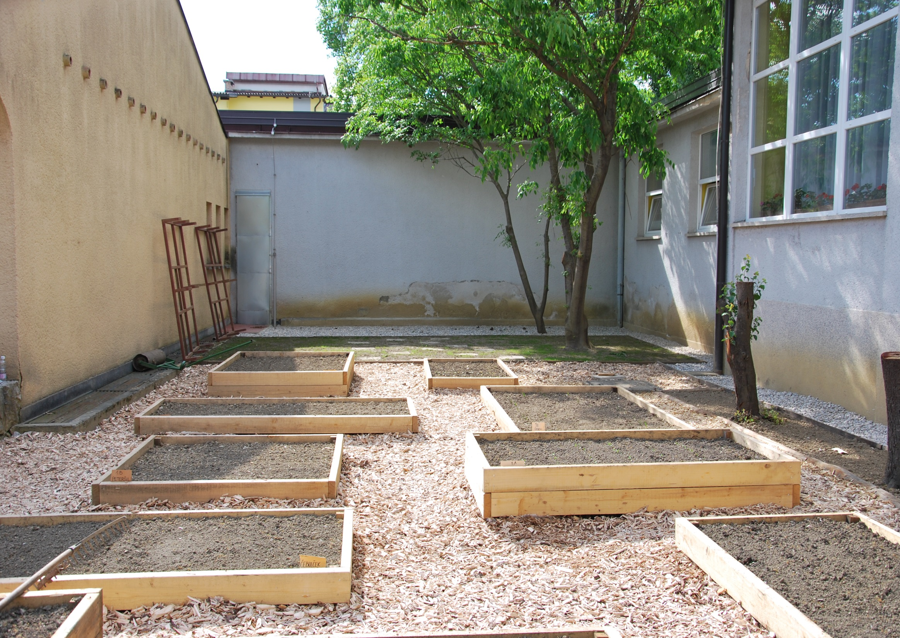

Slide 20
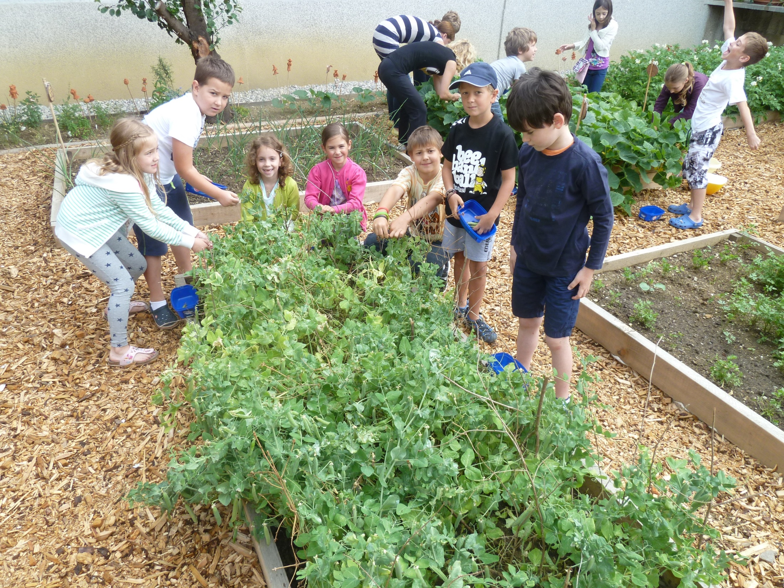

Slide 21
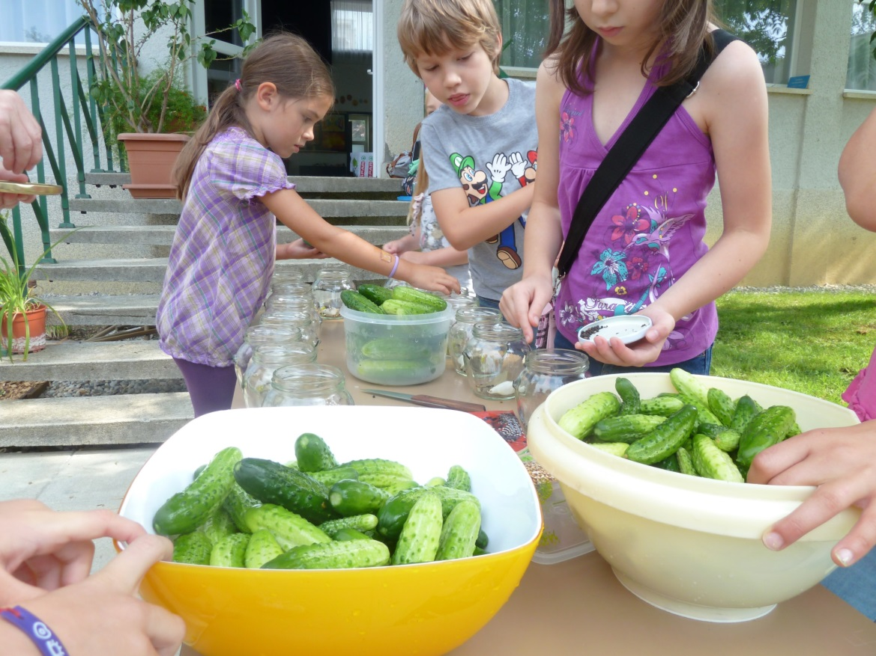
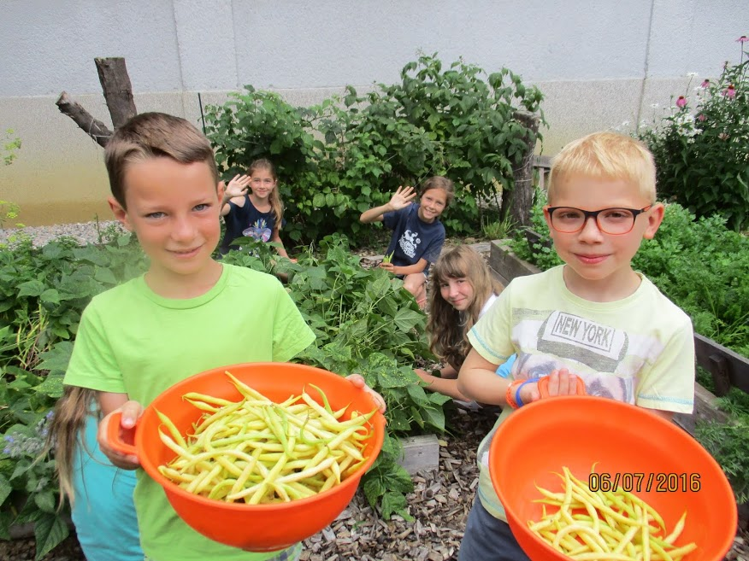
Children come to work in the gardens even during their holidays.

Slide 22
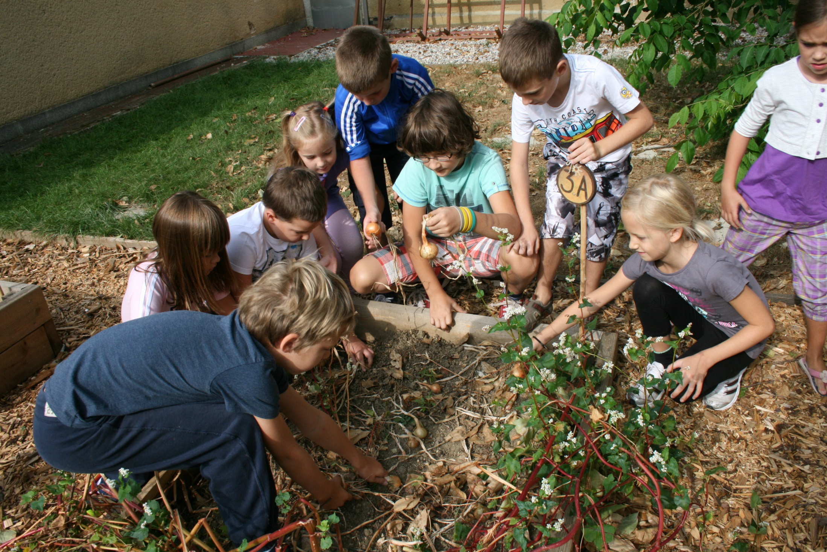

Slide 23
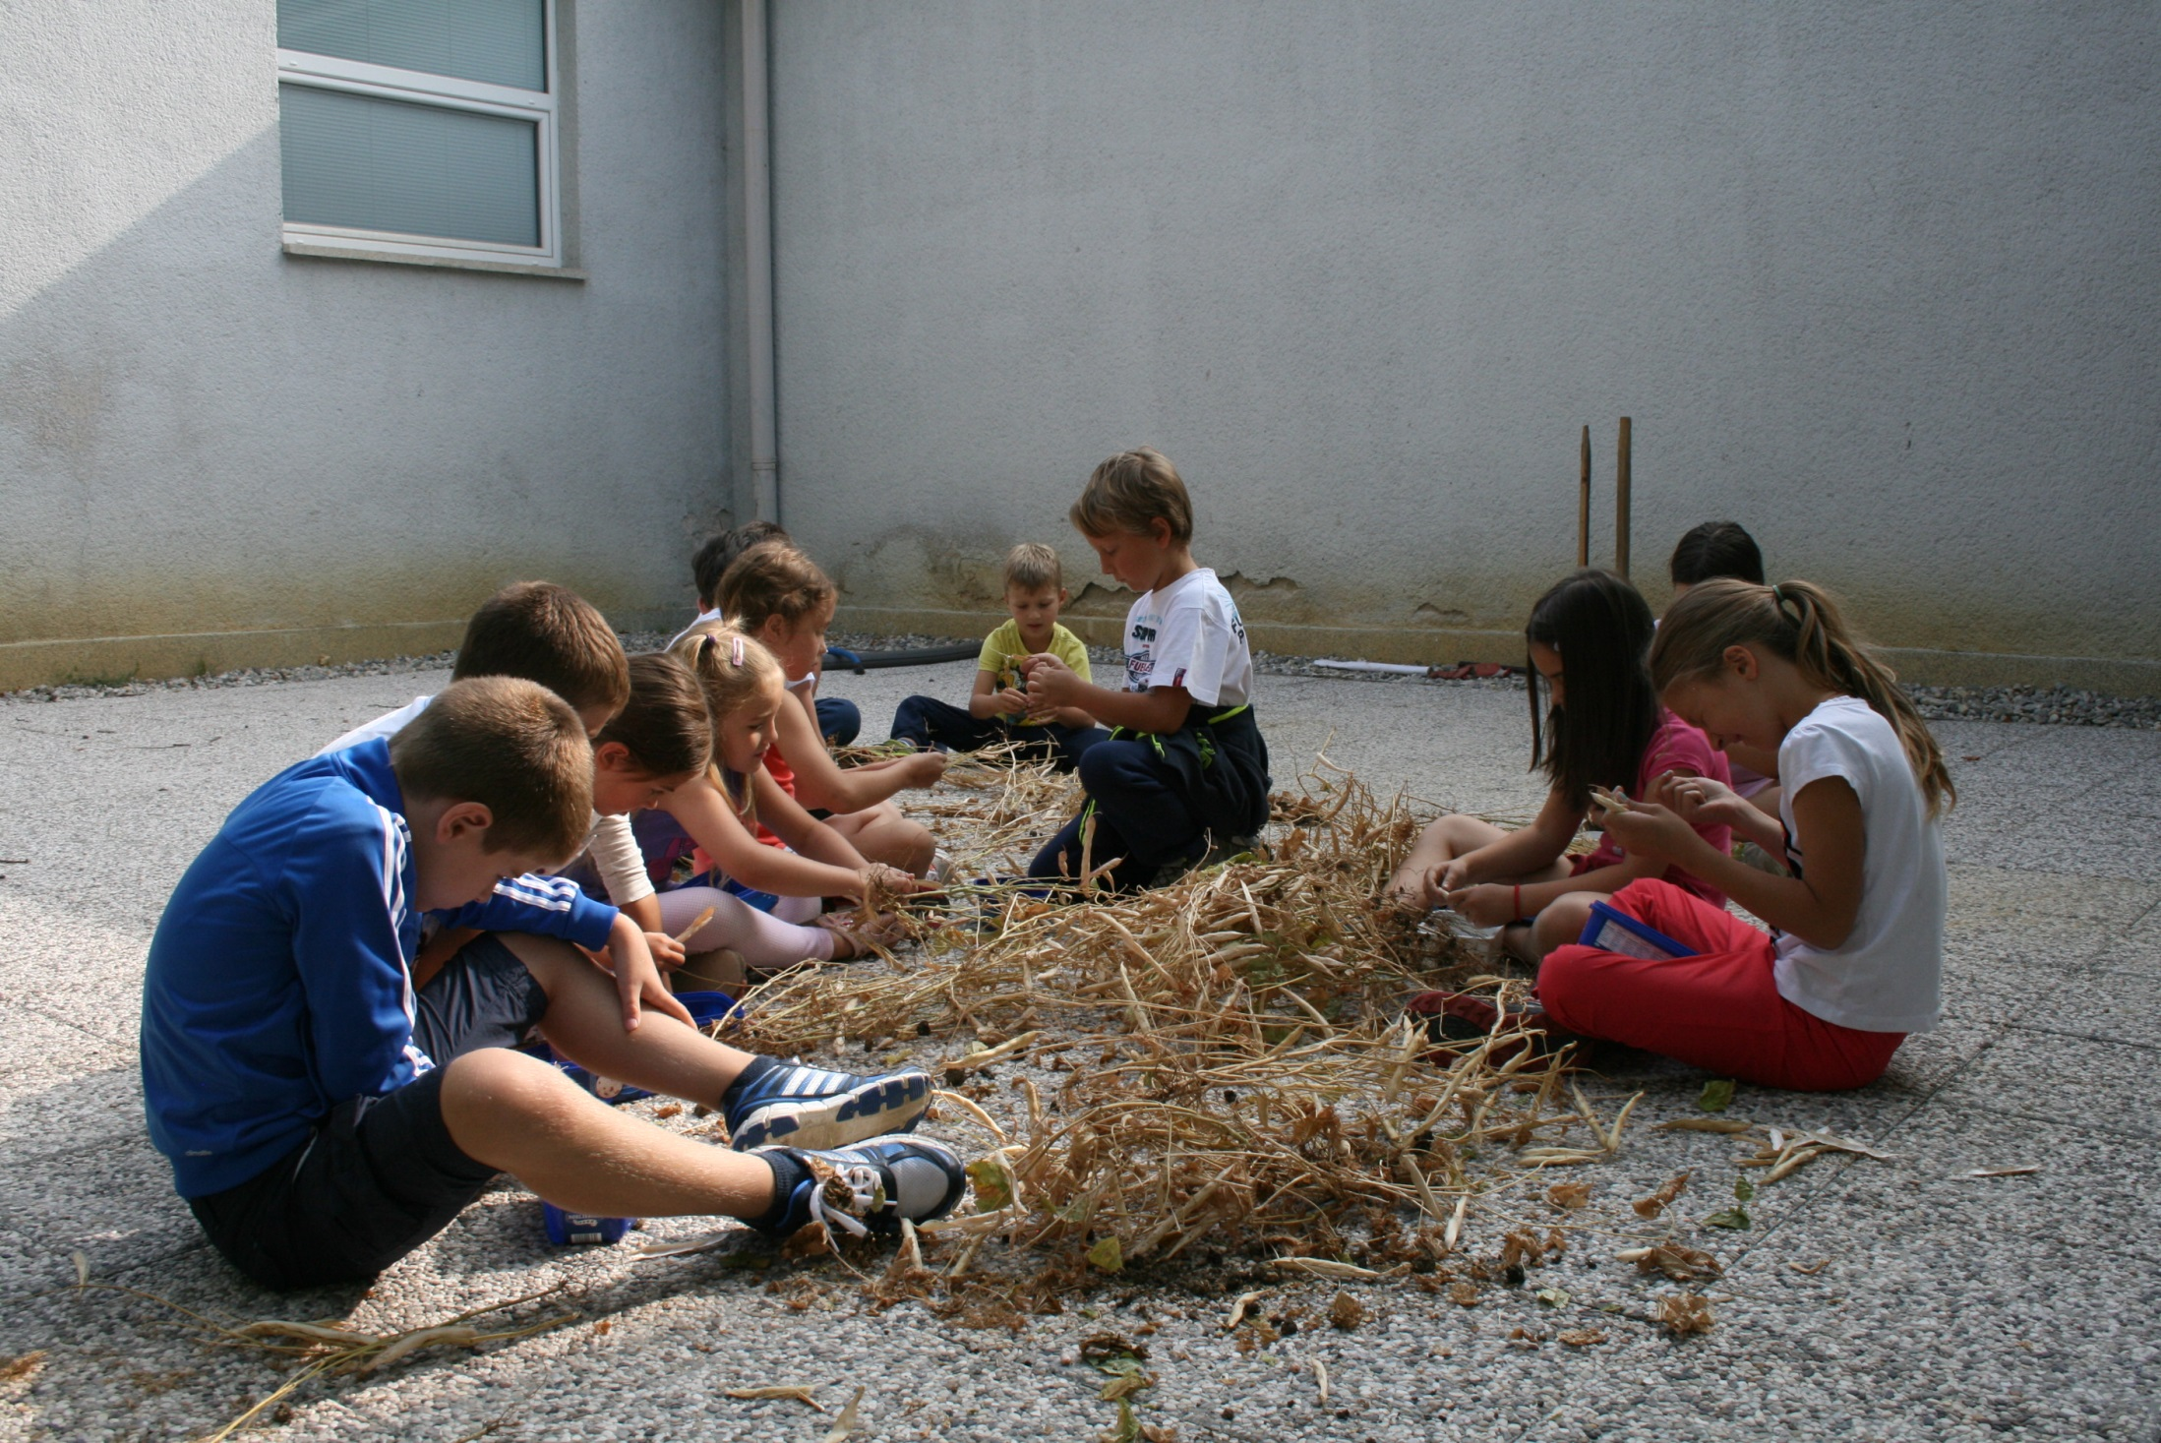

Slide 24
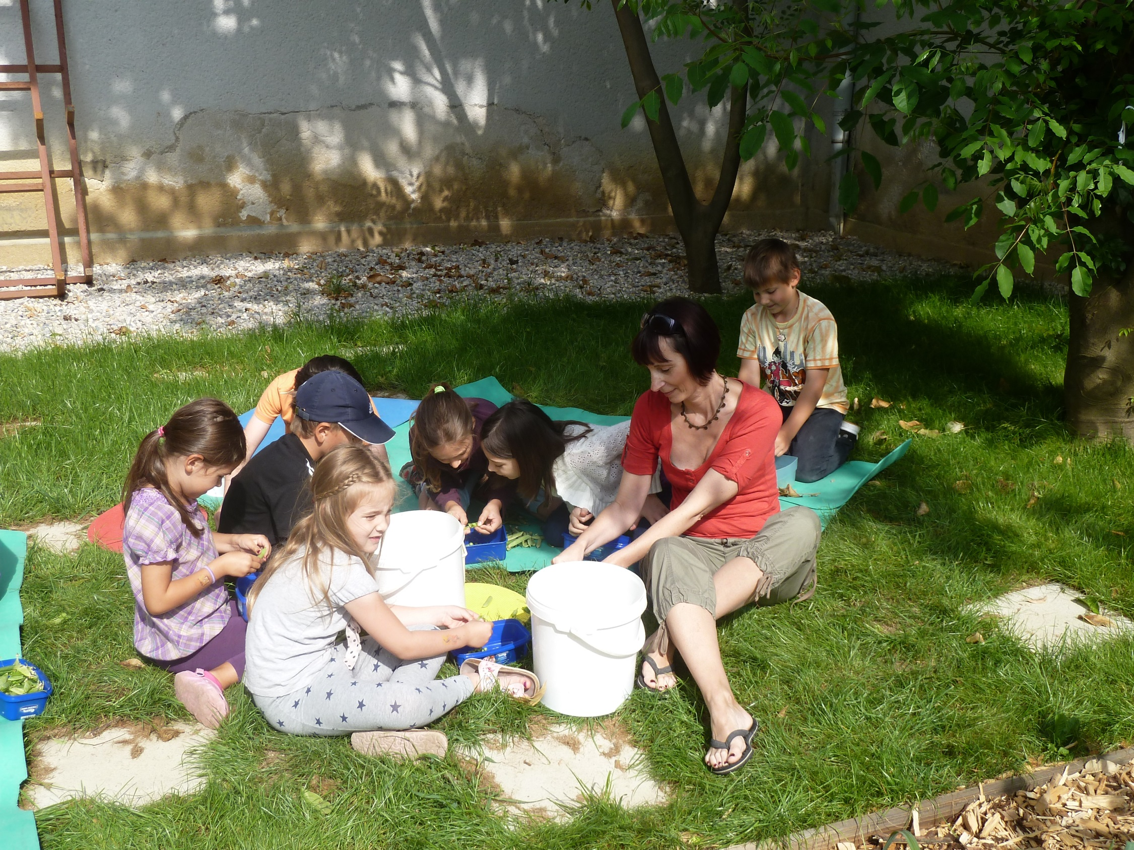

Slide 25
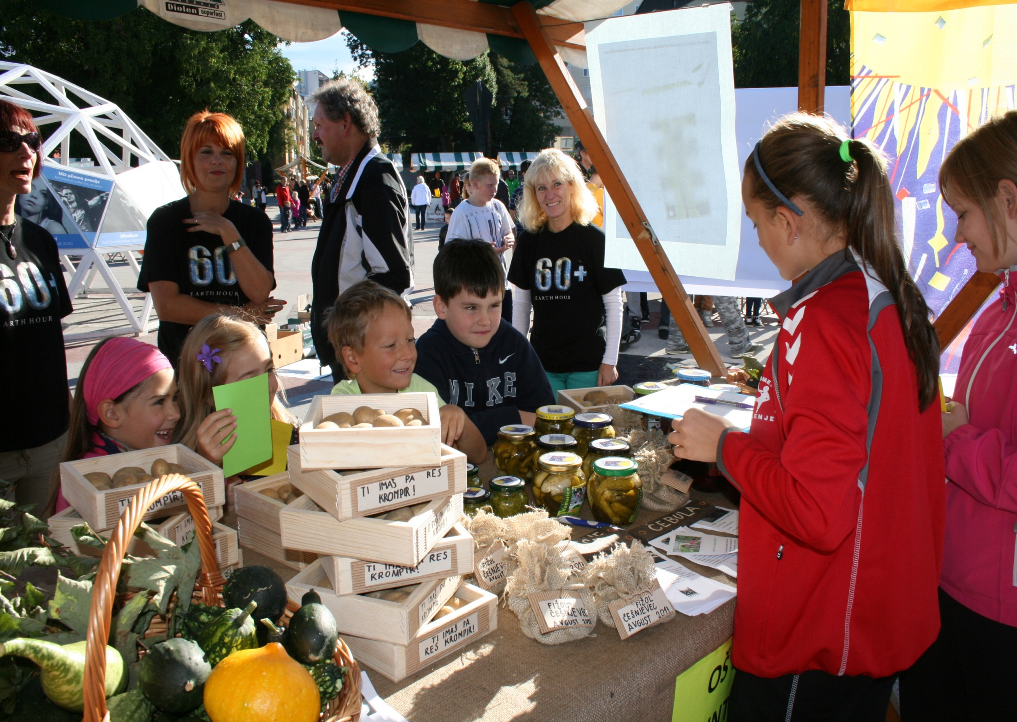

Slide 26
Anothe important project that we have participated in is the national project about tourism. Our students have been developing original and interesting thematic tour packages, combinations of guided and animated tours, which would help to complete the tourist offer in our town.

Slide 27
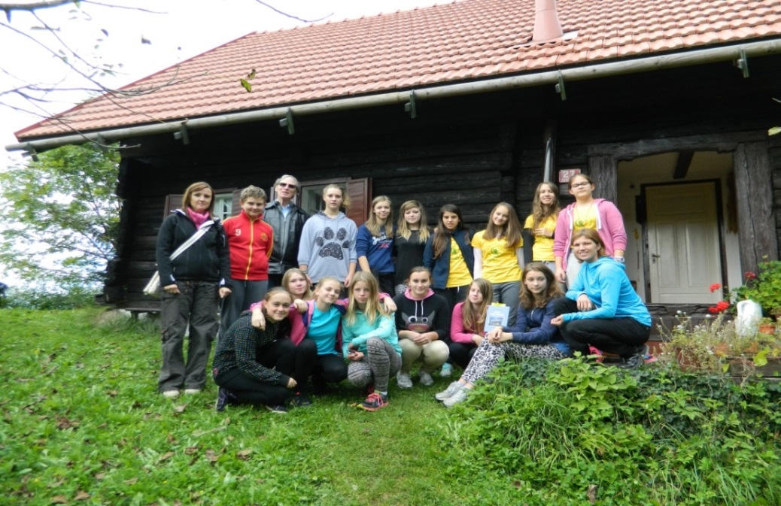
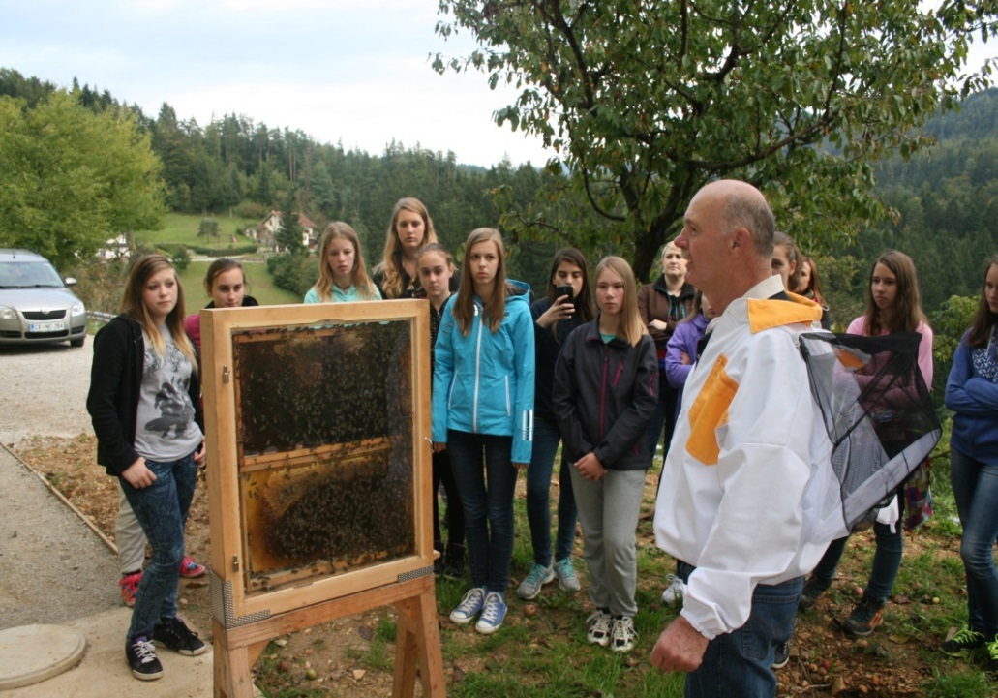
Our main topic 2013 – a party in nature.

Slide 28
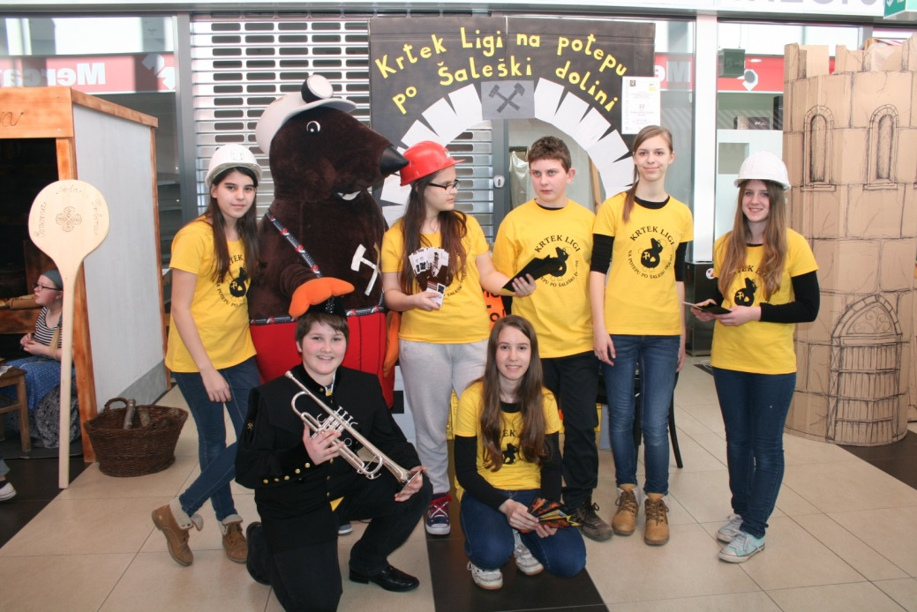
Our main topic 2014 – storytelling in our town.

Slide 29
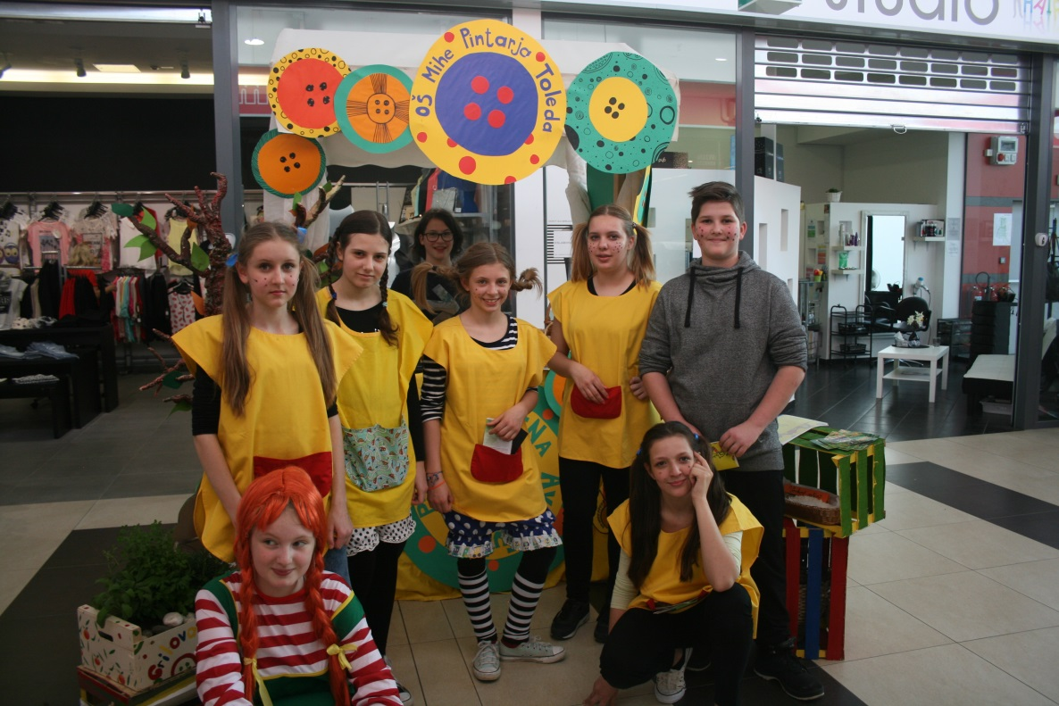
Our main topic 2015 – green tourism in our town.

Slide 30
E-twining
Our teachers and students also take a very active part in eTwinning projects.
“I'm Eco” project focused on healthy aspects of living concerning food issues, life styles, environmental protection, etc.
With eTwinning project “Let's discover school lives of students in Europe with their timetables”, the students tried to look into the lives of their fellow students from different countries by sending them their school’s timetable. By doing so, they got familiar with the countries, cities and schools of their partners and prepared a brief presentation of our country, city and school and some information about the holidays they have.

Slide 31
We educate our students to understand and appreciate the differences between cultures, which is why we think taking part in this partnership will be extremely beneficial for both our students and staff. We would like to give our students a chance to get to know different European nationalities, their culture, their language and national heritage. That is why we are extremely happy and proud to be a part of an important project such is this one.

