Slide 1
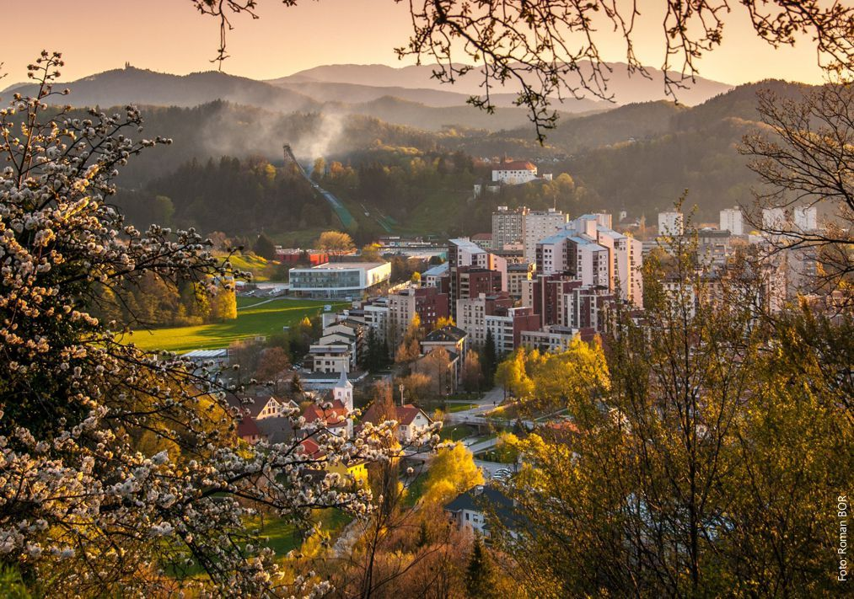
VELENJE

Slide 2
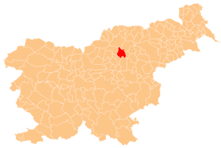
Velenje is located in the northeast of Slovenia, some 85 km from the capital Ljubljana.

Slide 3
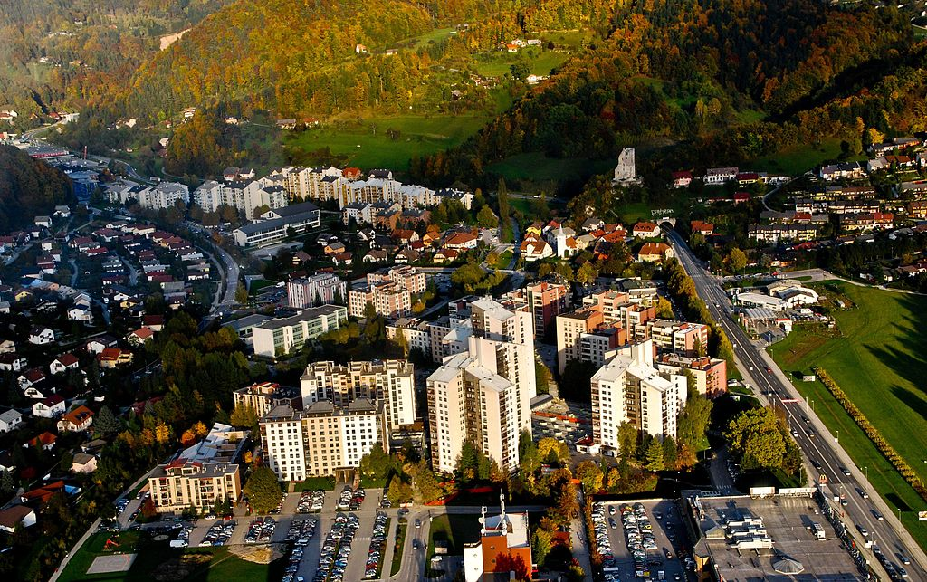

Slide 4
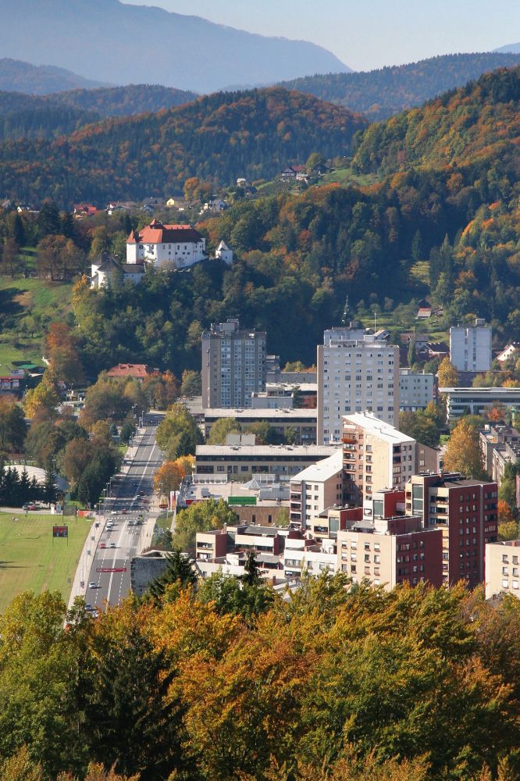
It is Slovenia's fifth largest city, and the seat of the Municipality of Velenje.
It lies in a valley called the Šaleška dolina.

Slide 5
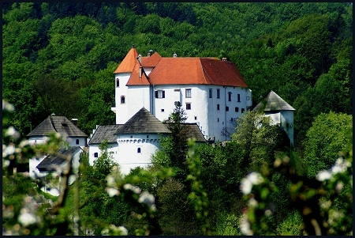
Wen you enter Velenje, the Velenje castle proudly stands above the city.

Slide 6
Velenje is situated among the rolling green hills of the Šalek Valley, with the Kamnik-Savinja Alps and Pohorje Mountains to the west, and east respectively, Velenje is embraced by nature on all sides.

Slide 7
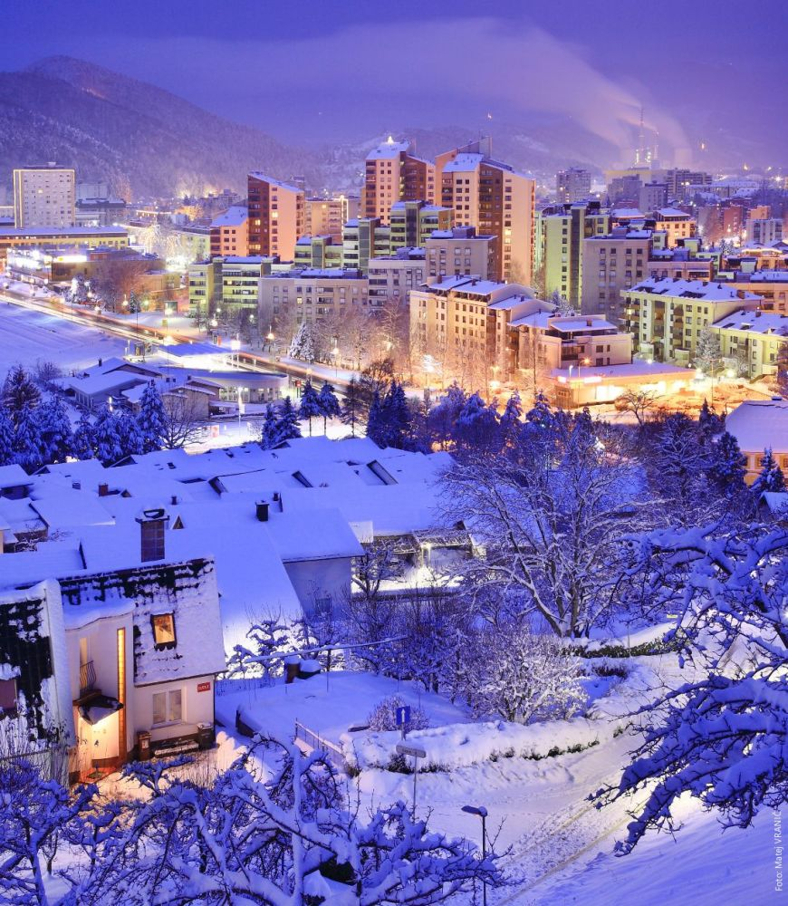
Velenje is the youngest Slovenian city.

Slide 8
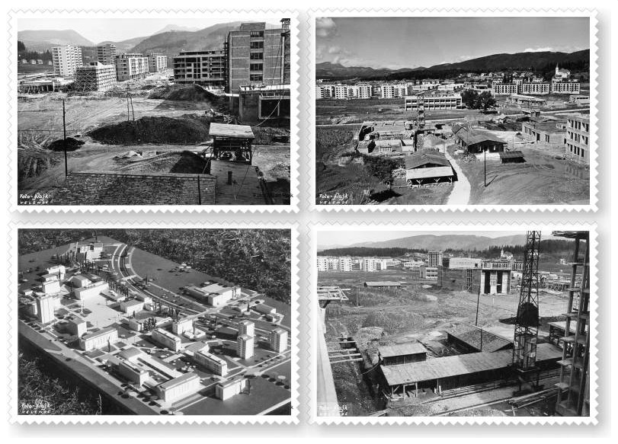
It is a town like no other in Slovenia. It was built in only a few years during 1950-1960 as a concept for healthy living in the new socialistic society.

Slide 9
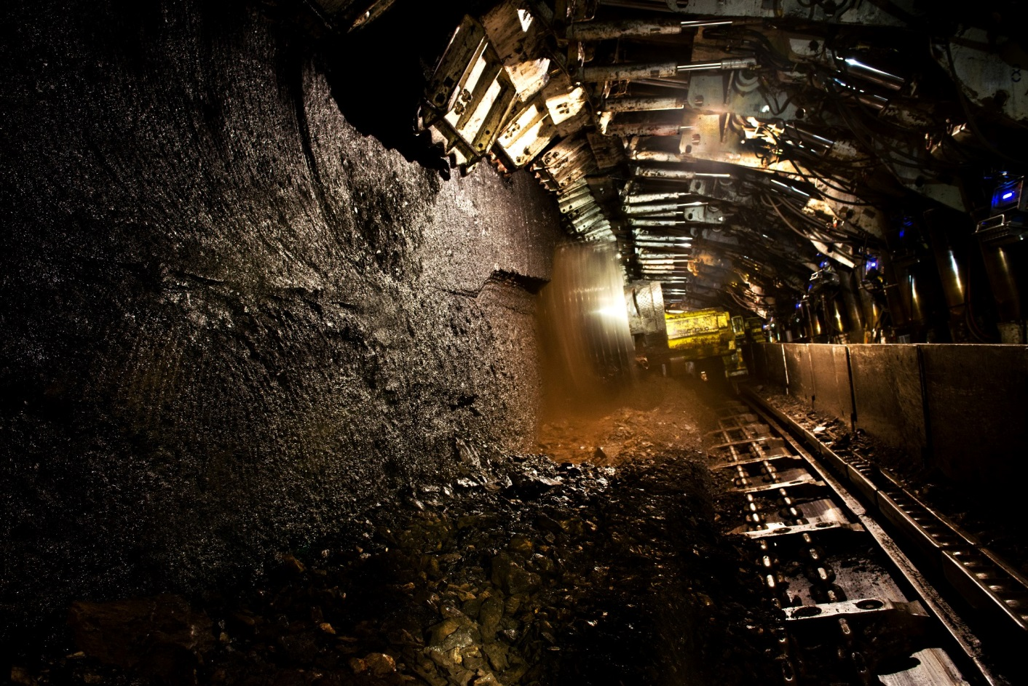
The town was built after an increased demand for coal in the Velenje Coal Mine.

Slide 10
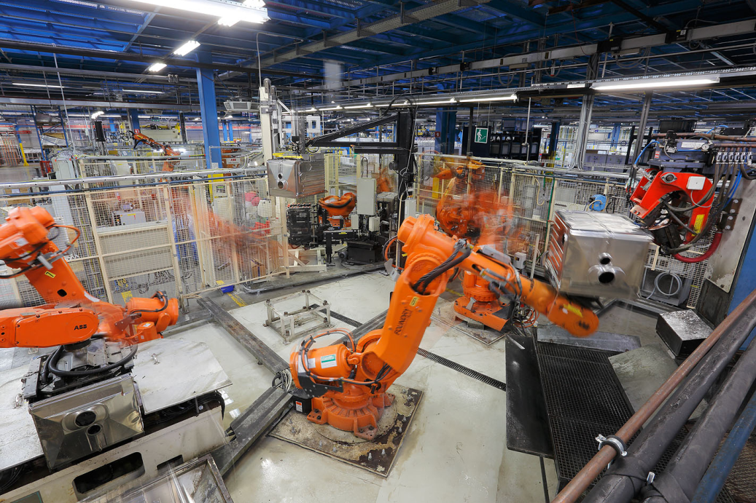
The town is one of the important economic centers in Slovenia. Economic development is based on the energy, metal-processing, and construction industries.
Notes:
Important factory in the town is Gorenje, which employs more then 10.000 people.

Slide 11
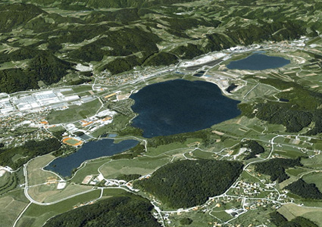
The excavation of lignite coal resulted in the formation of the lakes in town. The three lakes situated to the northwest of the city centre are one of the signature features of Velenje.

Slide 12
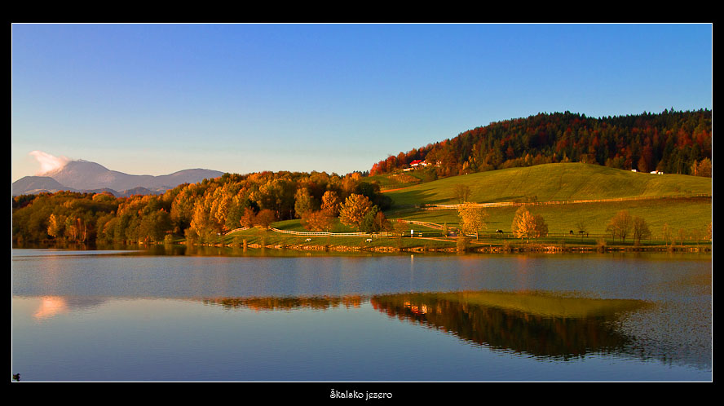
The smallest of the three lakes, Lake Škale, is just beyond the city stadium, and the residents love to walk or run around it.

Slide 13
The largest is Velenje lake, which is also appropriate for various sports activities.

Slide 14
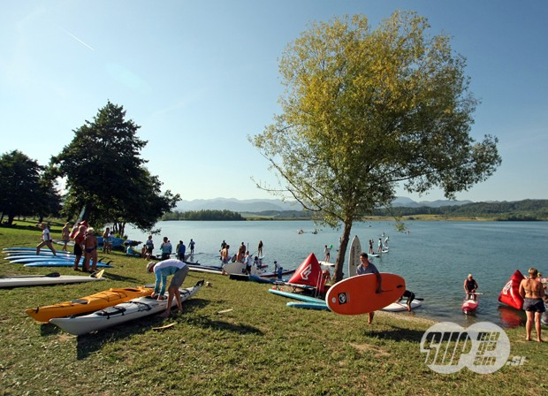
There we have the Velenje beach. This place offers a large number of possibilities for spending your leisure time in the relaxed atmosphere close to the water.

Slide 15
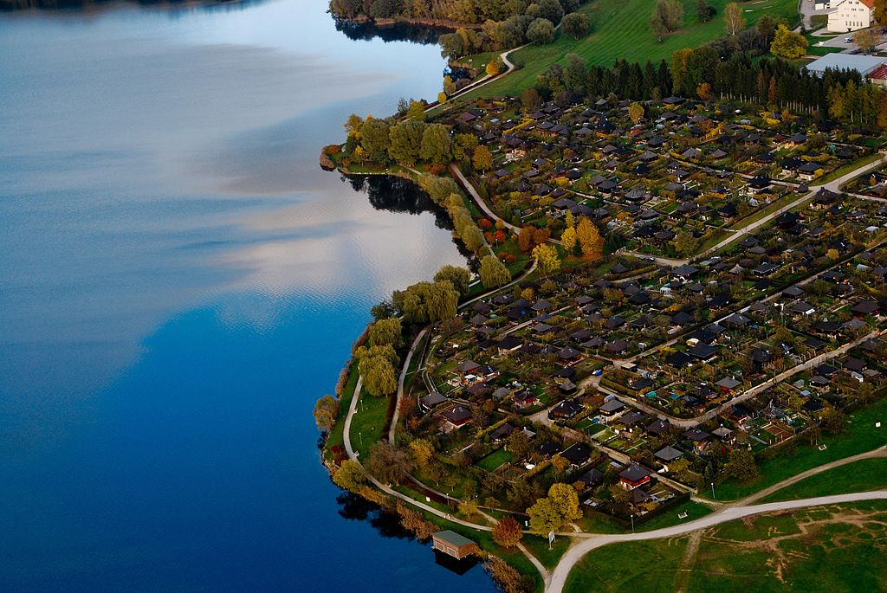

Slide 16
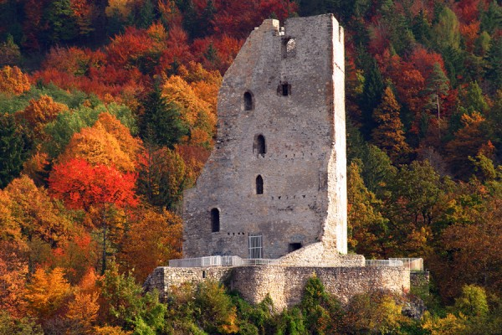
Heritage of the Municipality of Velenje
VELENJE CASTLE
ŠALEK CASTLE

Slide 17
TITO SQUARE
TITO STATUE

Slide 18
House of Culture Velenje

Slide 19
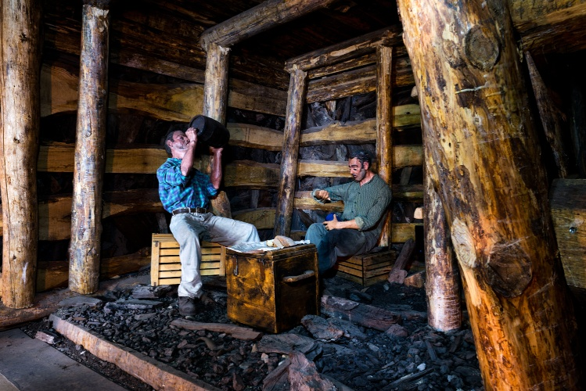
The Coal Mining Museum of Slovenia

Slide 20
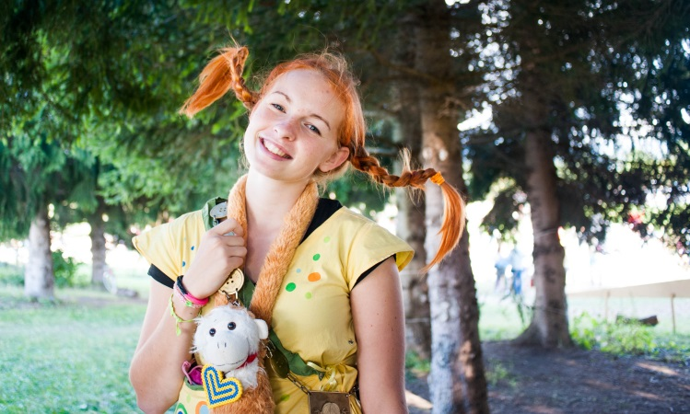
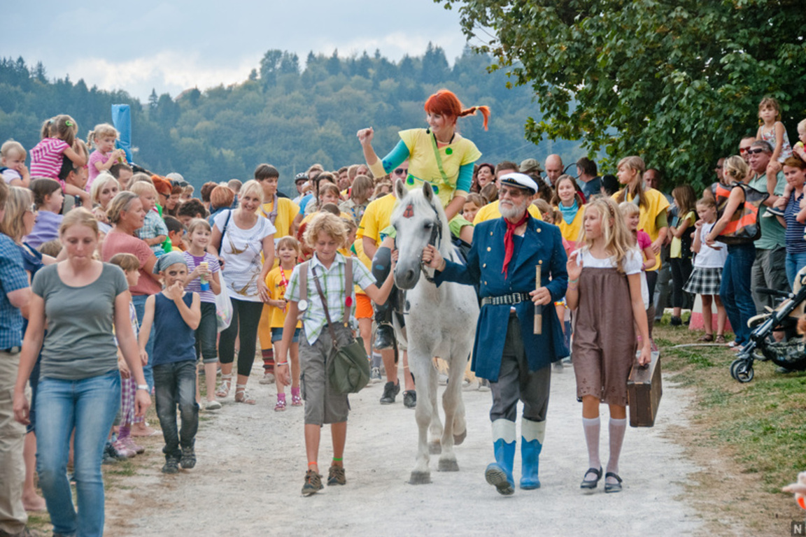
Pippi‘s festival

Slide 21
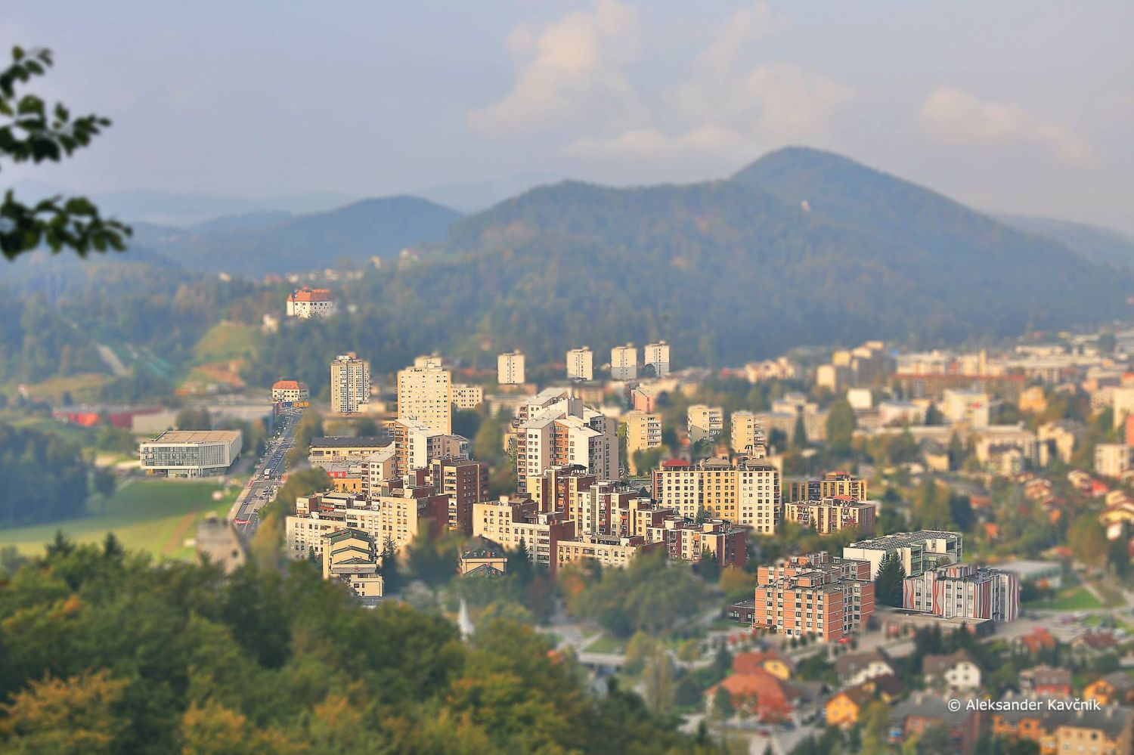
VIDEO VELENJE

Slide 22
SOURCE:
http://www.velenje.si/en/velenje
https://www.youtube.com/watch?v=RPKcBaVYFOg
http://www.velenje-tourism.si/en/
FOTO: Matej Vranič, Uroš Kotnik, Bor Roman, Bogdan Rajko

