Slide 1
eTwinning project FES & 2019 FES Erasmus+KA229 End-of-Project Assessment
Respondents - the students who took part in the mobility activities
Number of respondents - 28

Slide 2
Description
e-Twinning project “FES: Food, Environment & Sport. Let’s Be Healthier” was started in 2017
In August 2018 the project application was approved and e-Twinning project became also Erasmus+ KA229 realised by INS Manuel de Montsuar in Lleida, Spain and Talsu 2.vidusskola
Thanks to Erasmus+ KA229 grant in 2019 we were able to carry out 2 student exchanges – Mobility 1 (18 students from Talsi went to Lleida in March) and Mobility 2 (21 students from Lleida went to Talsi in May)
The final evaluations form was filled by 28 students (18 from Talsu 2.vidusskola & 10 from INS Manuel de Montsuar)

Slide 3
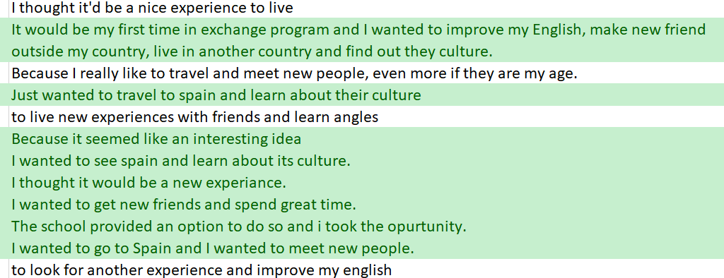
Results
The 1st questions the students were asked was:
Why did you decide to join in the Erasmus+ project?
Both Latvian and Spanish students anwered that they decided to join the Erasmus+ project, because they thought it would be an awesome experience and great opportunity to get to know the culture of the other country, meet new people, make new friends and improve their English skills.

Slide 4
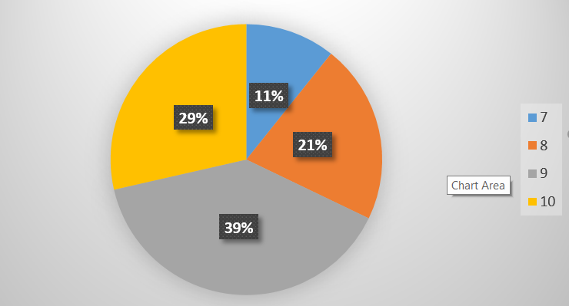
Results
The average points the students have given to rate their experience regarding the exchange in general is 8.8
From 1 (lower) to 10 (higher) - most students chose 9 and only 3 students gave 7

Slide 5
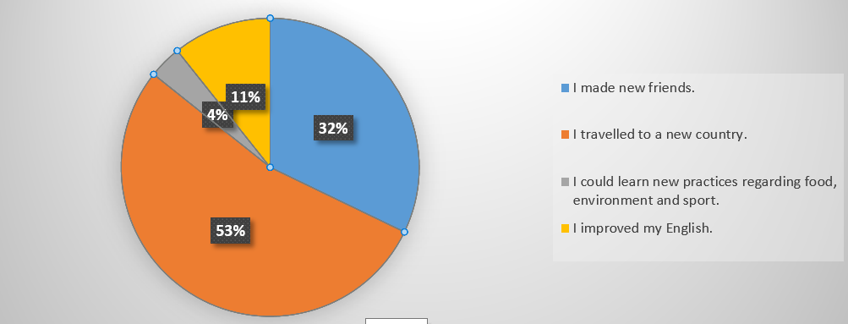
What is it that you value the most of the experience?
Most students chose the answer «to travel to a new country and make new friends».
Only 1 student from Latvia answered that she could learn about food, environment and sport (the theme if the project)

Slide 6
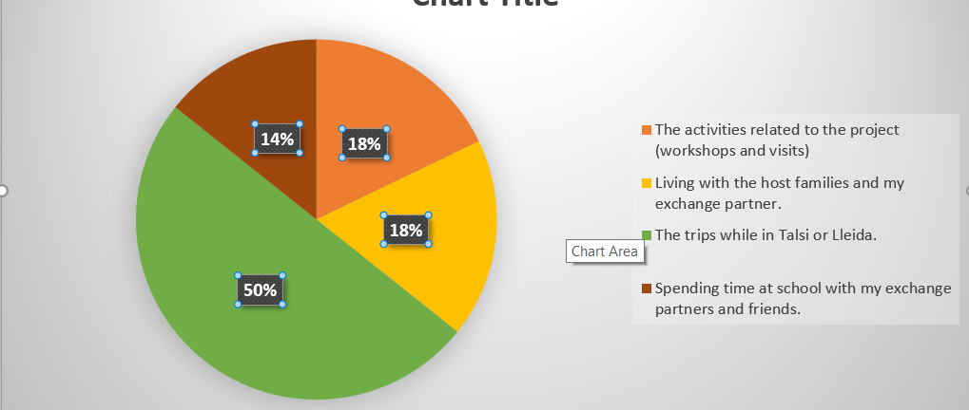
What, in your opinion, was the best of the exchange?
Half of the students think that the trips were the best part of the mobility.
Quite many students think that it was time spent with the host family and time at school with the exchang partners and friends.
The activities related to the project are at the last place☹

Slide 7
What was the less interesting activities of the exchange?
Majority answered that everything was fine.
Nearly one third of the respondents did not enjoy going to lessons during the mobility.
1 person did not like living with the host family.
1 person did not like the activities realted to the project.

Slide 8
What would the students like to add to make the whole project more motivating and appealing?
To have activities with families; more time to spend with the host family
More trips around the area.
I wanted to learn more Catalan and Spanish language.
Maybe more fun atractions
Stay more time (longer time abroad). Making exchange longer to get to know more people and experience more.
More activities; more group bonding activities
Maybe some prizes for the best workshop team so everyone is 100% in and doing everything thing to make the best work.

Slide 9
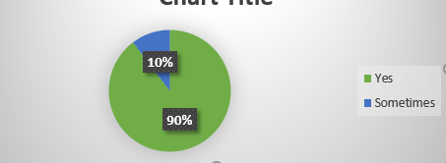
Host families
During the exchange the students lived in the families. For Latvian students it was something new and they were rather scared.
Did you have a positive experience with the host family?
At the end it turned out to be a positive experience for most Spanish and Latvian students.

Slide 10
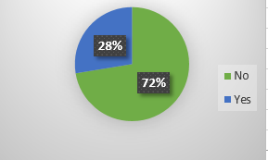
Friends
Making new friends in another country was valued as the the best part of the international project by one third of the respondents.
Are you still in touch with your exchange partner?
Two years after the exchange, nearly one third of the students are still in touch with the host family.

Slide 11
Memories
What was the best moment of the whole exchange?
Meeting the host family and getting to know them; the weekend with the host family.
Tasting and eating the different foods the hosts family made.
Flying and seeing the country
Seeing Sagrada Fami­lia in Barcelona.
The trip to Tarragona
Visiting Riga with all my classmates and exchange students
Getting to spend free time with new friends and experiencing their daily life
Just living with exchange family and going out with others all in one big group.

Slide 12
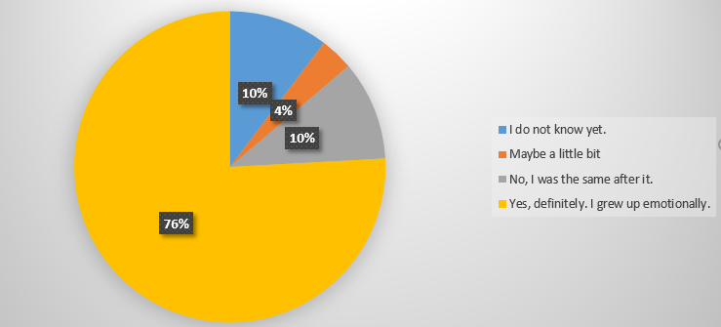
Finally
Would you join a similar exchange experience again?
Most students chose «Yes», 4 students – «Maybe» but only 1 student said «No».
Do you think that participating in the exchange changed you?
- Majority answered that this experience has changed them as they grew up emotionally.

Slide 13
Thinking about the future
After the mobililities we were happy to learn that the students would definitely recommend the younger students to join our project .
Would you recommend the younger students in your school to join the project?
From 1 (lower) to 10 (higher) – the average result was 9.3

