Slide 1
Respect nature
ETNA PARK
Circolo didattico S.G. Bosco Biancavilla CT

Slide 2
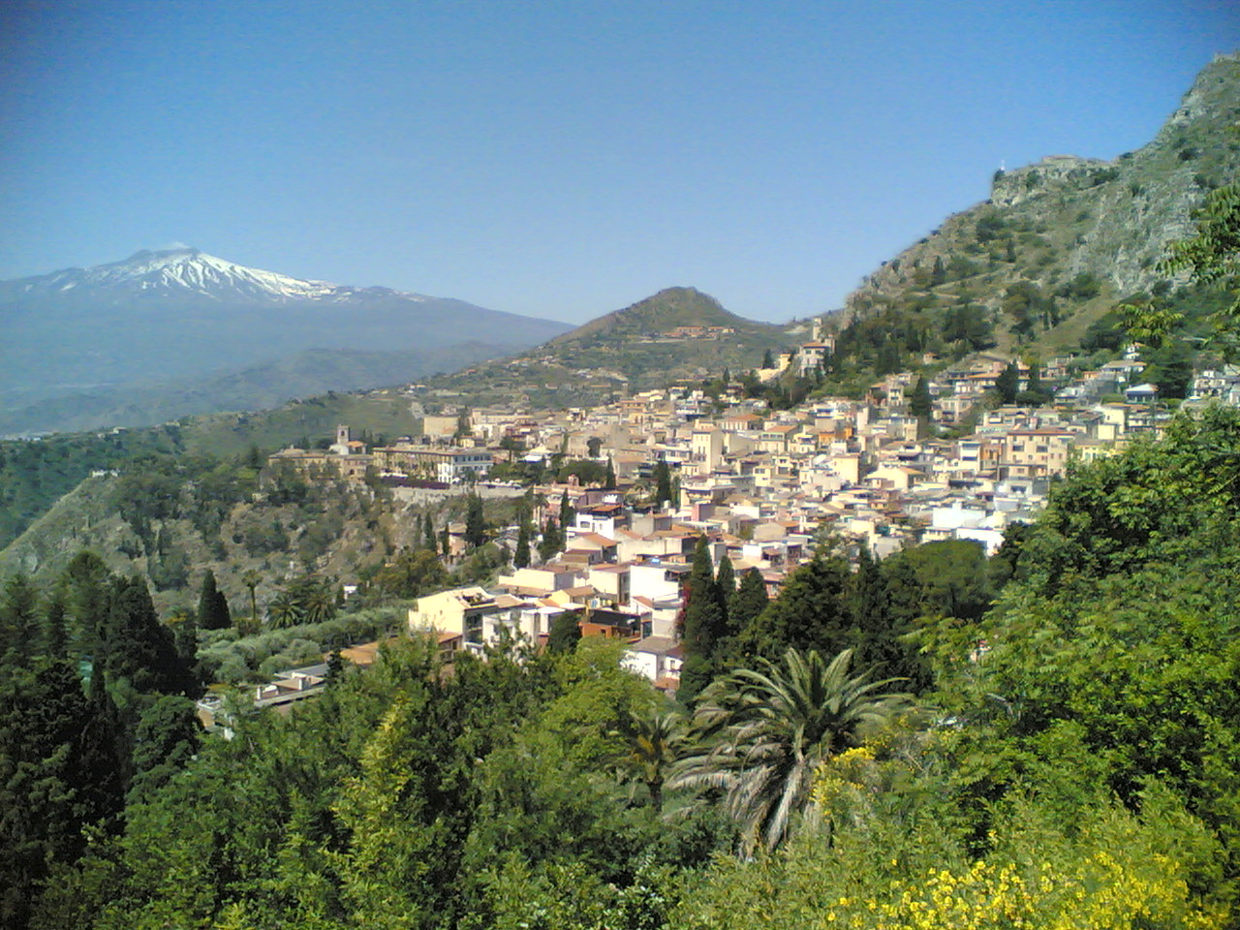
ETNA
TAORMINA
A BEAUTIFUL VIEW FRON TAORMINA

Slide 3
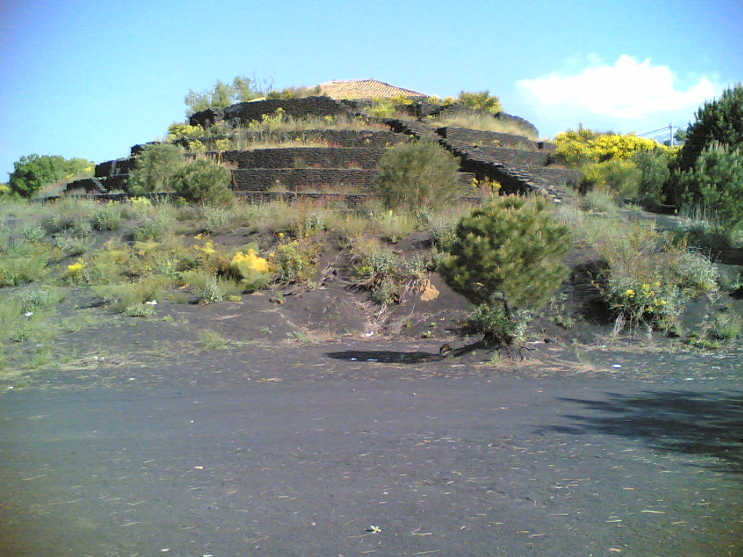
It’ is a beautiful day
We have a school trip

Slide 4
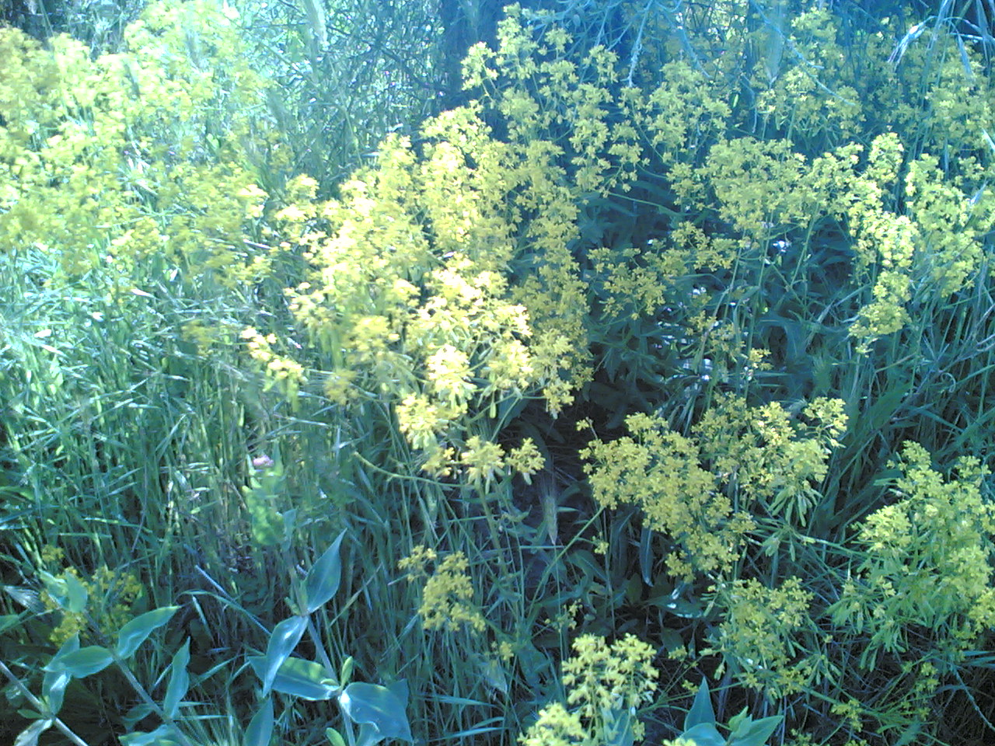
SOUND, SMELL COLOUR AROUND THE BIG ETNA PARK

Slide 5
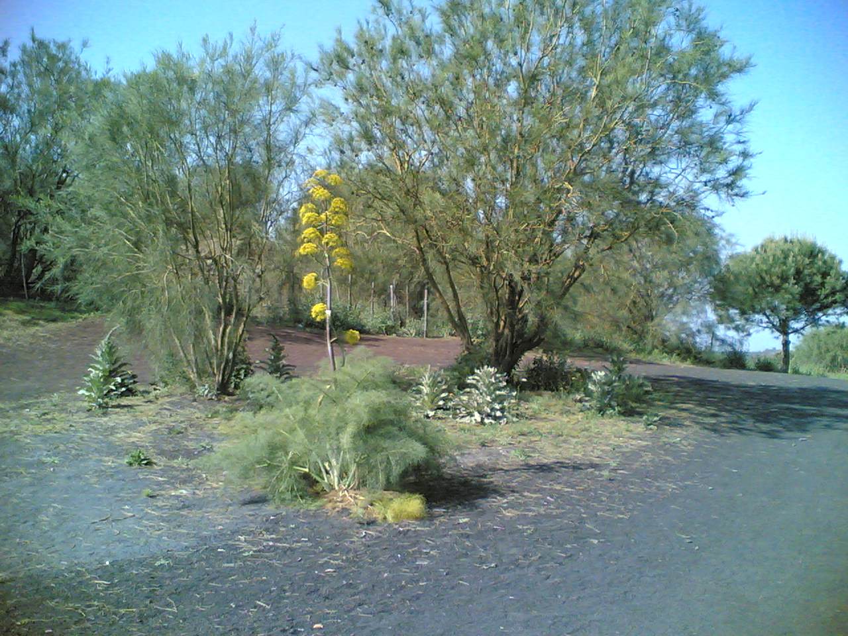
ginestra
Finocchio selvatico
This is a tipical plant:

Slide 6
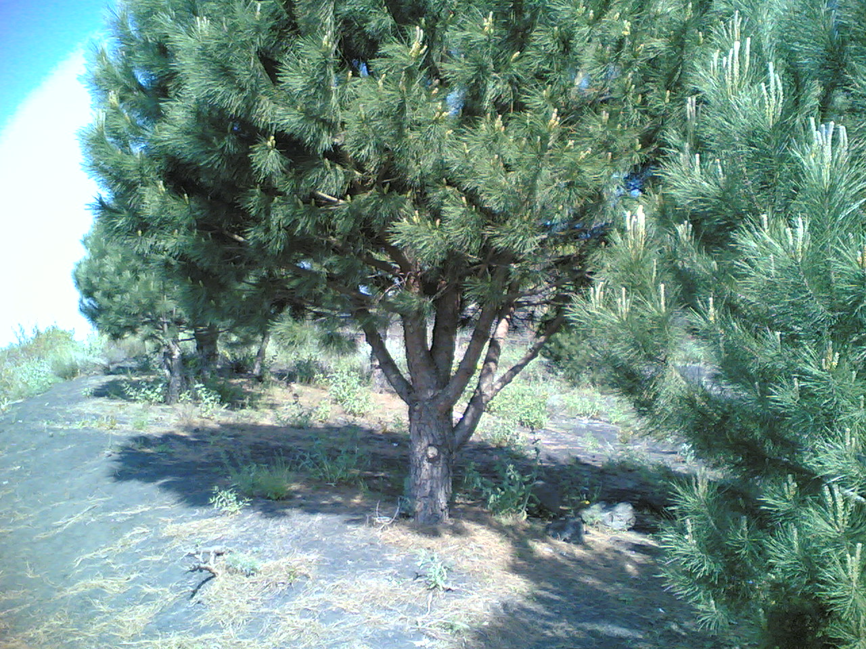
pino

Slide 7
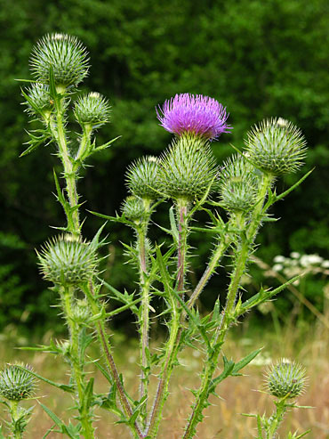
CARDO

Slide 8
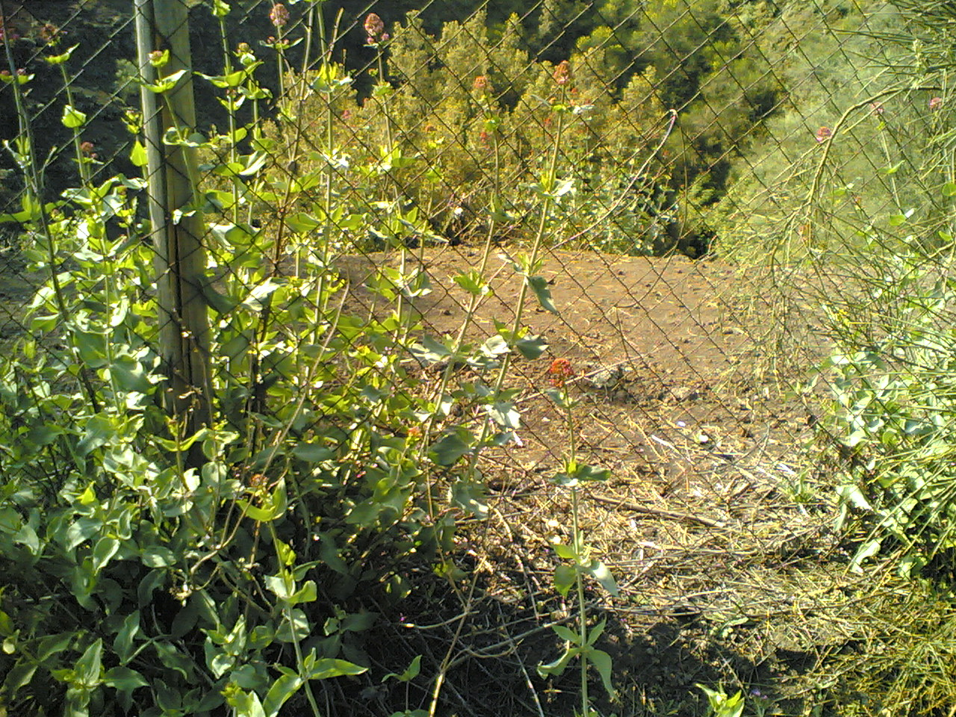
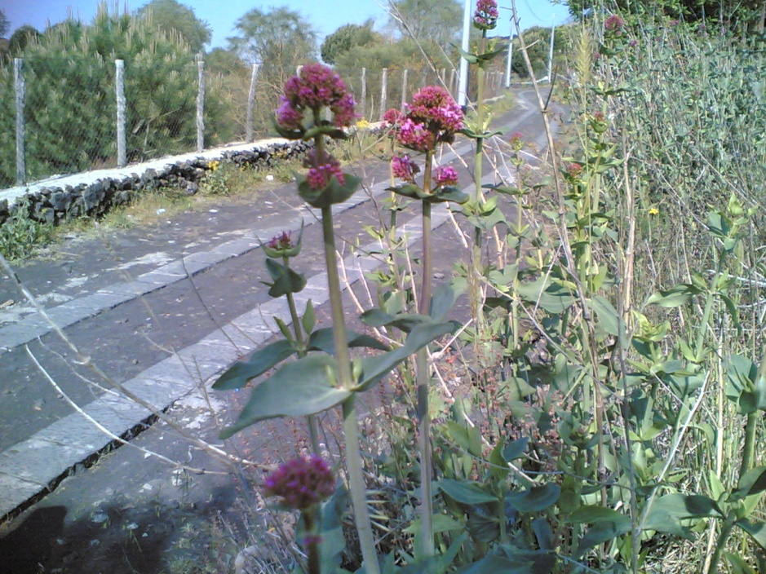

Slide 9
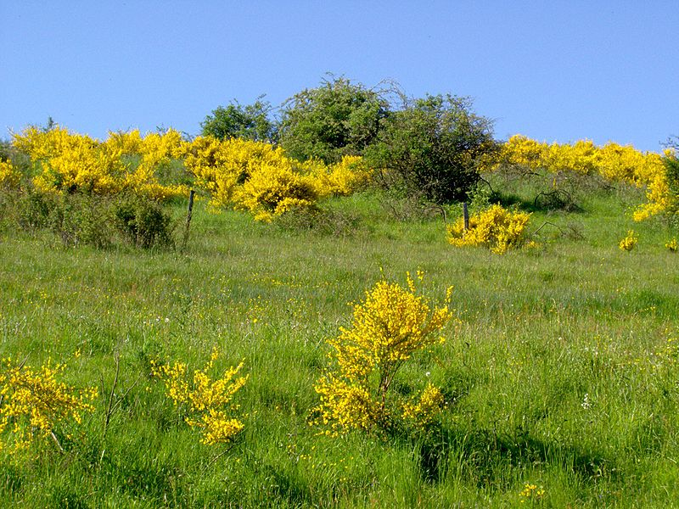
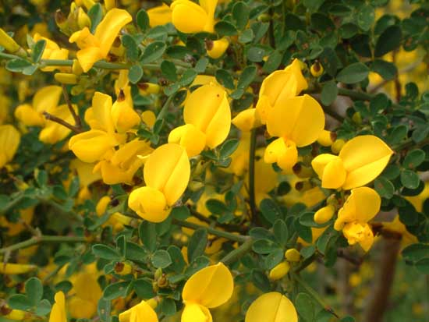
GINESTRA

Slide 10
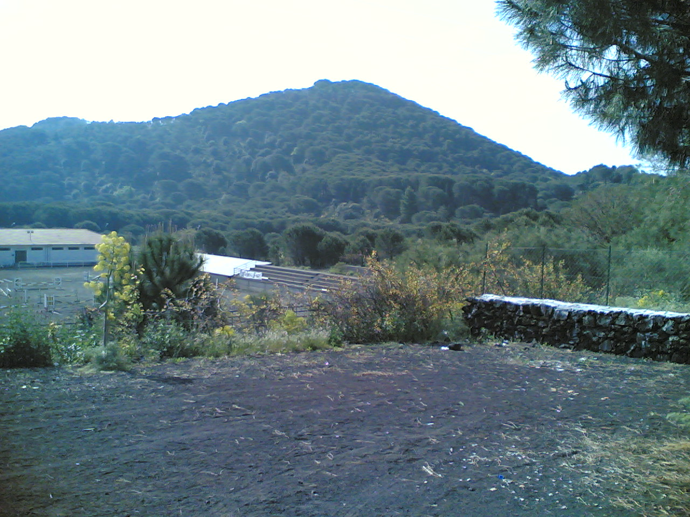
Monte rosso Red mountain

Slide 11
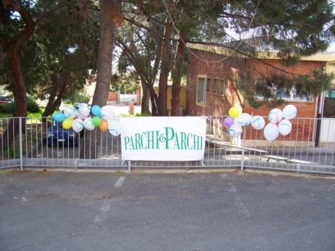
Plants in my school

Slide 12
END
SCUOLA ELEMENTARE” SAN GIOVANNI BOSCO BIANCAVILLA CT” ANNO 2008/2009

