Slide 1
Our School in Prague

Slide 2
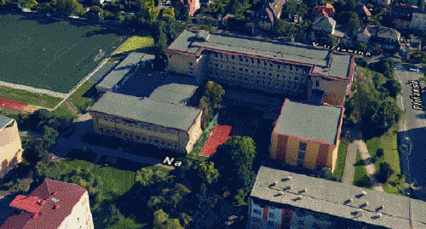
Our school building
3 floors
35+ classrooms
400+ pupils
45+ teachers

Slide 3
Entrance

Slide 4
Canteen

Slide 5
Library

Slide 6
Gym

Slide 7
Fitness

Slide 8
Chemistry and Physics LAB

Slide 9
English convesation classroom

Slide 10
English IT LAB

Slide 11
Electronic LAB

Slide 12
LAB of electronic measurement

Slide 13
Soldering LAB

Slide 14
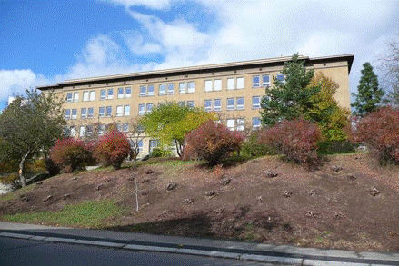
That was our school building

Slide 15
Our school buiding in summer 2017

Slide 16
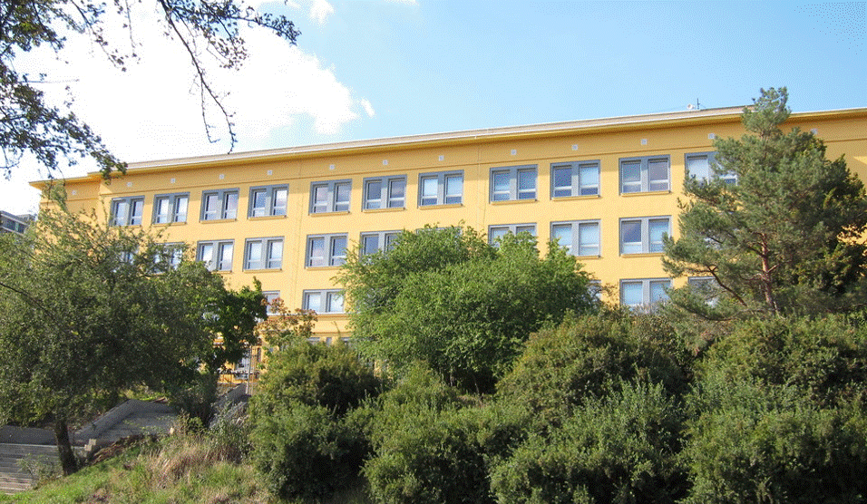
Our current school building

Slide 17
The End

Slide 19
By Vojtěch Hupcej E3A
Pictures used from:
mapy.cz ---> https://mapy.cz/zakladni?x=15.6252330&y=49.8022514&z=8
google streetview ---> https://www.google.cz/maps/@50.0799343,14.5036658,18.49z?hl=cs

