Slide 1
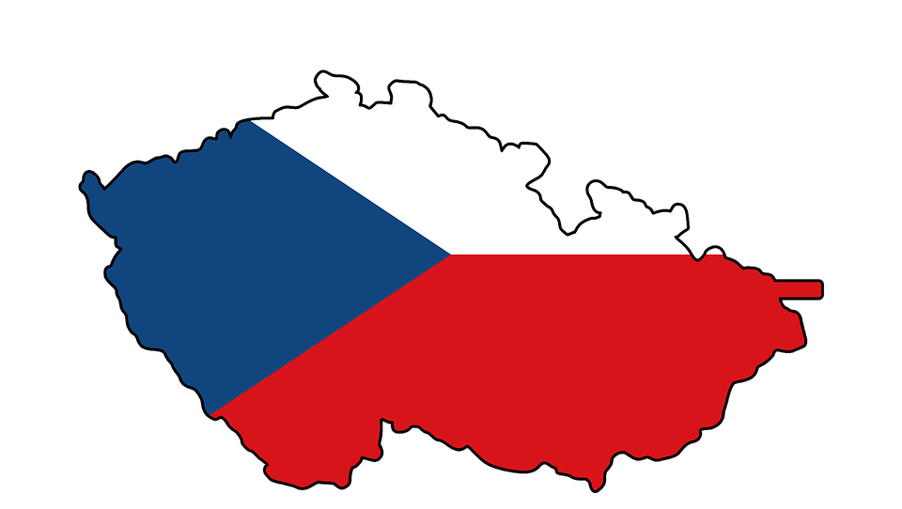
|Czech Republic

Slide 2
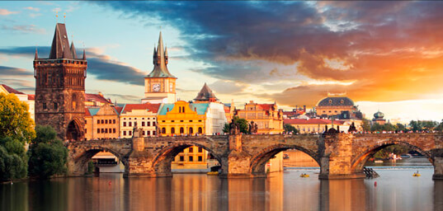
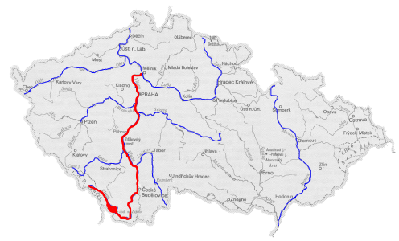
The capital city is Prague.
Prague is in the middle of the Czech Republic.
The Czech Republic have about 10.000.000 resident.
The longest river is the Vltava.
The Vltava is long 466 Km.

Slide 3
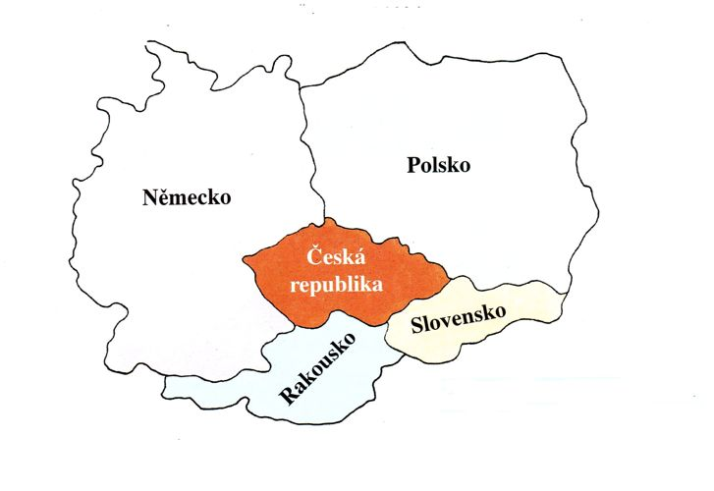
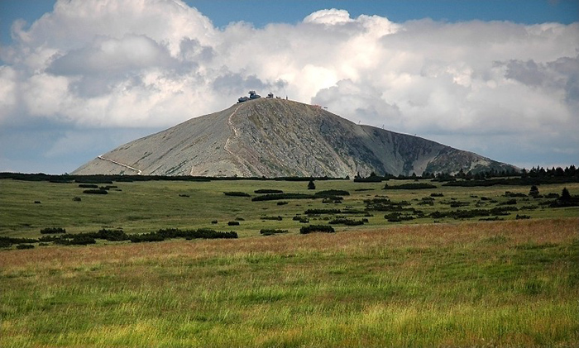
Neighbour of the Czech Republic are Germany, Poland, Slovakia and Austria.
Our borders are mainly made up of mountains.
Our biggest mountain is Sněžka.

Slide 4
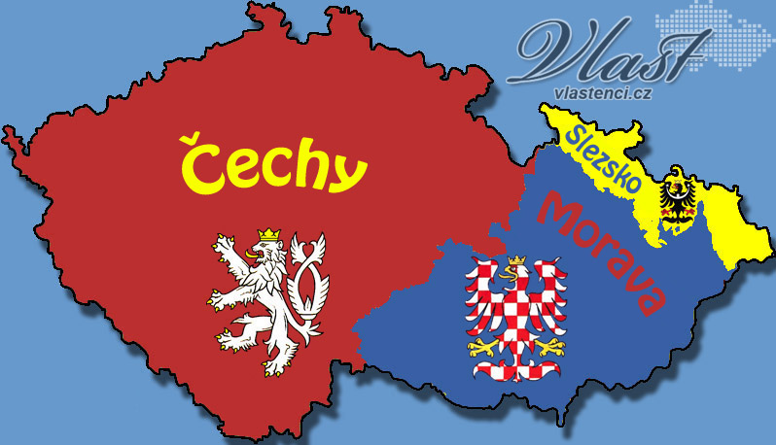
The Czech Republic is from three parts Czechia, Moravia and Silesia.

