Slide 1
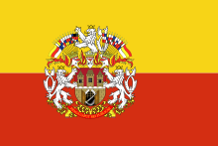
Prague
Petr Jelínek

Slide 2
Prague is a capital city of Czech Republic and 14th largest city in Europien Union. Situated in the north-west of the country on the Vltava river, the city is home to about 1.3 million people.
Prague has been a political, cultural and economic centre of central Europe complete with a rich history.

Slide 3
Prague is home to a number of famous cultural attractions, many of which survived the violence and destruction of 20th-century Europe. Main attractions include the Prague Castle, the Charles Bridge, Old Town Square with the Prague astronomical clock, the Jewish Quarter, Petřín hill and Vyšehrad.

Slide 4
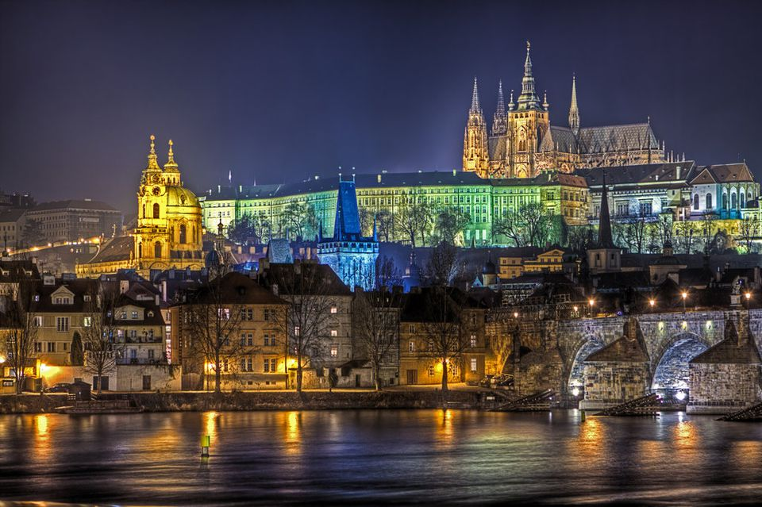
Prague Castle
is a castle complex, dating from the 9th century. It is the official office of the President of the Czech Republic. The castle was a seat of power for kings of Bohemia, Holy Roman emperors, and presidents of Czechoslovakia. The Bohemian Crown Jewels are kept within a hidden room inside it.

Slide 5
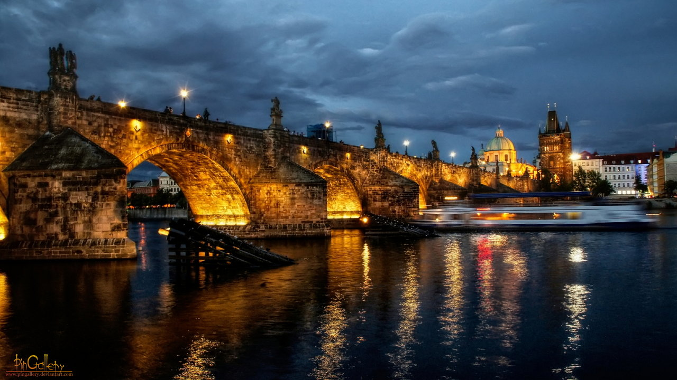
Charlest bridge
Charles Bridge is a historic bridge that crosses the Vltava river. Its contruction started in 1357 under the auspices of King Charles IV, and finished in the beginning of the 15th century.

Slide 6
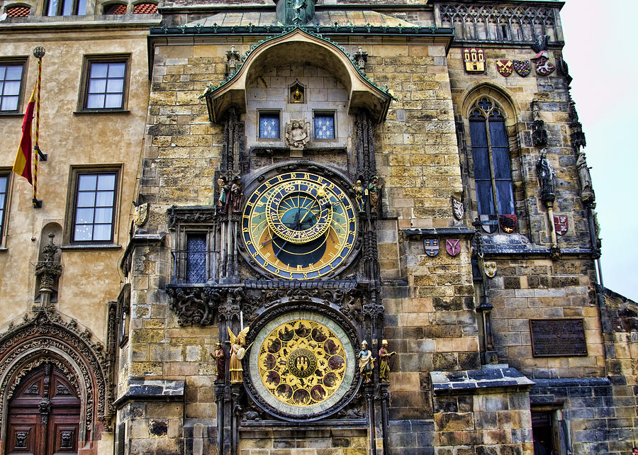
Prague astronomical clock or Prague orloj
Is a medieval astronomical clock
The Orloj is mounted on the southern wall of Old Town Hall in the Old Town Square. The clock mechanism itself has three main components: the astronomical dial, representing the position of the Sun and Moon in the sky

Slide 7
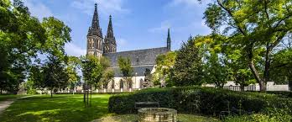
Vyšehrad
Vyšehrad is a historic fort.
It was built, probably in the 10th century, on a hill over the Vltava River. Situated within the castle is the Basilica of St Peter and St Paul, as well as the Vyšehrad Cemetery, containing the remains of many famous people from Czech history, among them Antonín Dvořák, Bedřich Smetana, Karel Čapek, and Alphonse Mucha.

Slide 8
And that´s all important about Prag
Thanks for your patience, time and attention.

