Slide 1
Living in our cities
… and towns

Slide 2
Flats

Slide 3
Detached houses

Slide 4
Semi-detached houses

Slide 5
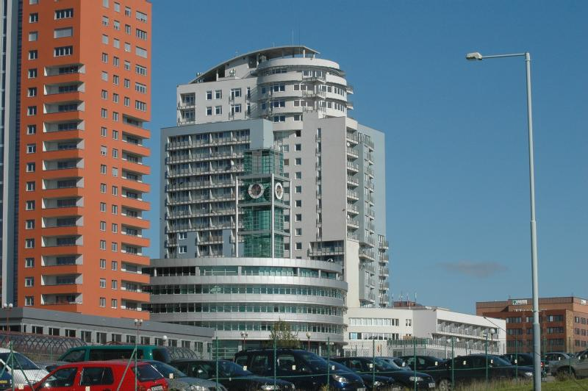
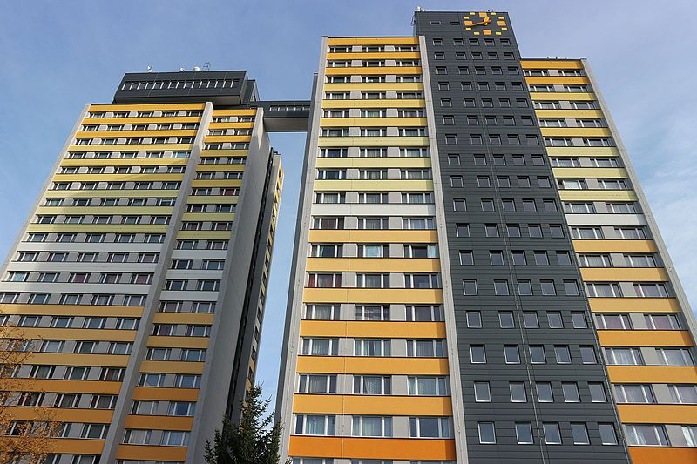
High-rise buildings

Slide 6
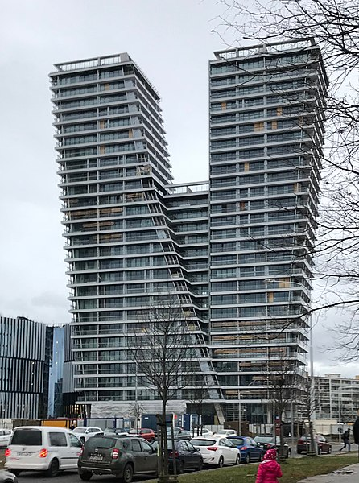
Skyscrapers

