Slide 1
Prague
Petr Nechvátal

Slide 2
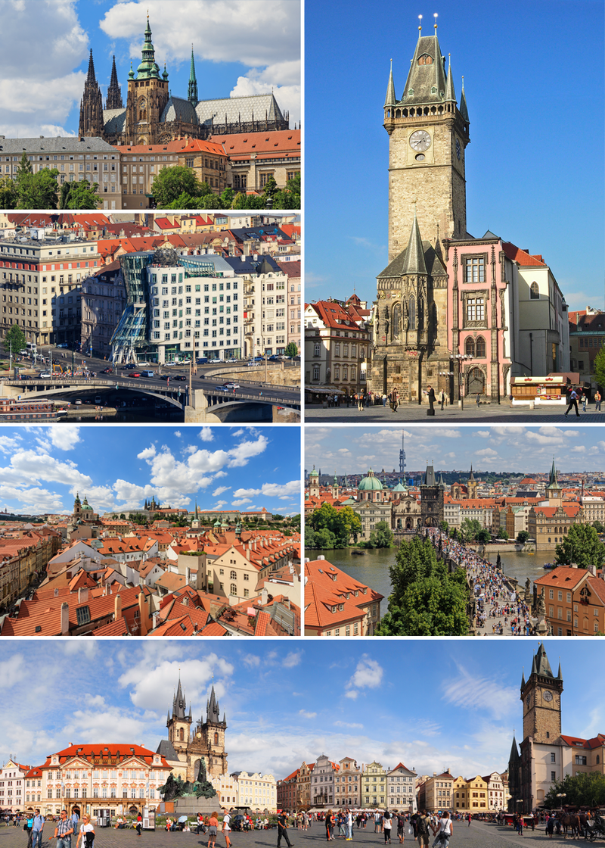
Basic information:
Population: 1 280 508 inhabitants
Area: 496 km²
It‘s the capital city of the Czech Republic and it‘s in the middle of it

Slide 3
Sights In Prague:
National Gallery
Manages the largest collection of art
Prague Castle
Castle complex from the 9th century
National Museum
Focused on historical and scientific collections
Charles Bridge
Historic bridge that crosses the Vltava river from the 15th century
National Theatre
Performances: opera, ballet, drama

Slide 4
