Slide 1
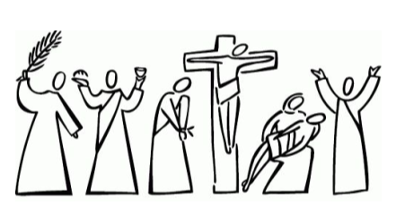
EASTER TRADITIONS IN ITALY
For some foreigners it may be hard to understand how important Easter is for Italian people.
In Italy it is the second most important religious holiday after Christmas.
From a strictly religious point of view it is even more important: in fact Easter, being the celebration of the resurrection of Christ, is the celebration of the mystery that is the basis of the Christian faith.

Slide 2
APRIL 2017
LUNEDI MONDAY | MARTEDI' TUESDAY | MERCOLEDI WEDNESDAY | GIOVEDI THURSDAY | VENERDI FRIDAY | SABATO SATURDAY | DOMENICA SUNDAY
 |  |  |  |  | 1 | 2
3 | 4 | 5 | 6 | 7 | 8 | 9
10 | 11 | 12 | 13 | 14 | 15 | 16
17 | 18 | 19 | 20 | 21 | 22 | 23
24 | 25 | 26 | 27 | 28 | 29 | 30
Holy Week marks several important events for the Christian faith: the Last Supper, the Washing of the Disciples’ Feet, Jesus in the Garden of Gethsemane, the kiss of Judas, the Calvary, the death of Christ, Deposition, Burial and Resurrection.

Slide 3
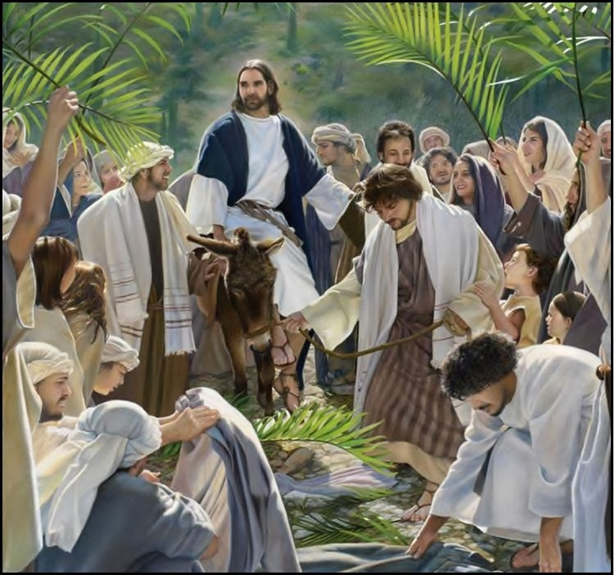
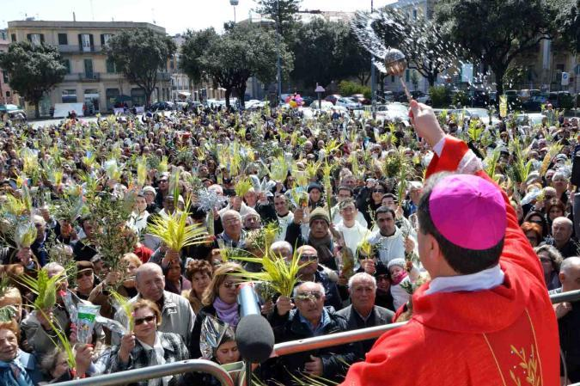
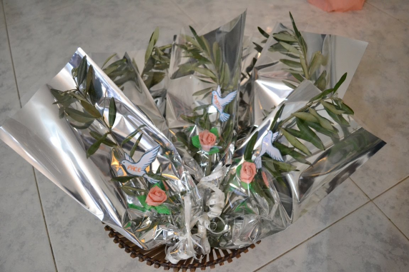
9th April
Palm Sunday recalls the entry of Jesus into Jerusalem.
When Jesus entered into Jerusalem, people
greeted him by waving palm branches and covering his path with palm branches.
On Palm Sunday, the churches are bedecked with baskets of palms or olive branches and once they have been blessed by the priest they are given out to the congregations.
As a symbol of their faith and devotion, many Christians keep the palm or olive branches which are distributed during Palm Sunday service and hang them in their houses through the year.

Slide 4
13th April
Holy Thursday is the day on which Christ celebrated the Last Supper with His disciples, four days after His triumphal entry into Jerusalem.
Only few hours after the Last Supper, Judas would betray Christ in the Garden of Gethsemane, setting the stage for Christ's Crucifixion.
Holy Thursday is marked in the churches with a ritual washing of the feet, with the priest
symbolizing the role of Jesus, and twelve church members symbolizing the role of the apostles.
At the end of the liturgies the altar is stripped bare, and all bells in the church are silent until the Gloria at the Easter Vigil on

Slide 5
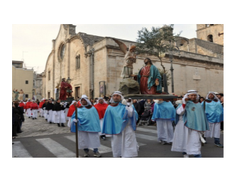
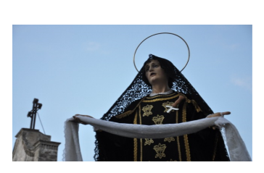
14th April
Good Friday, the Friday before Easter , commemorates the Passion and Death of our Lord Jesus Christ on the Cross.
Solemn religious processions are held in many towns on the Friday before Easter.
The Good Friday processions begin
in the evening as the different religious confraternities of the town carry out on their shoulders the Misteri, enormous statues portraying the stages of the Passion of the Christ.
They are then followed by lifelike statues of Madonna, dressed solely in black and a face full of distress, grieving for the loss of her Son.

Slide 6
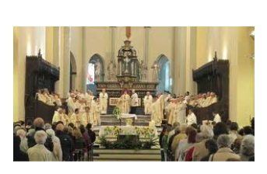
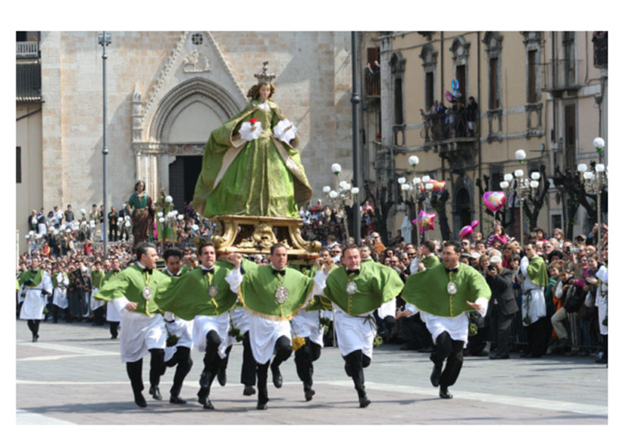
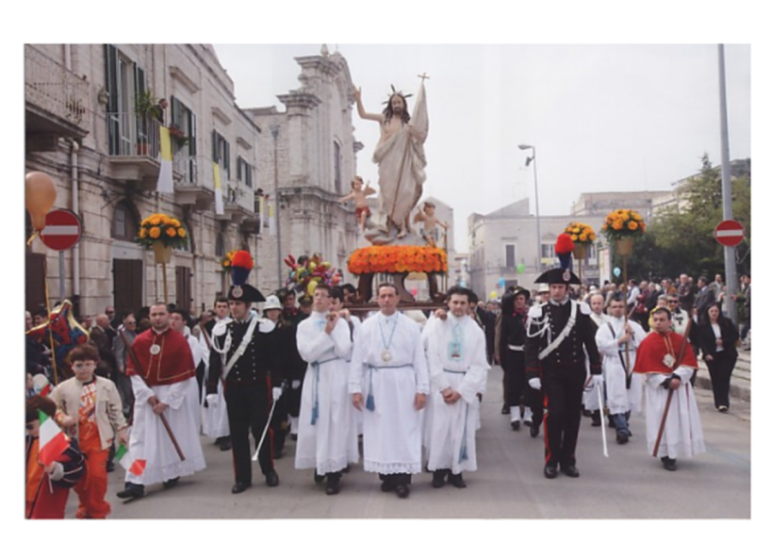
16th April
On Easter morning, the sepulchre was opened with rejoicing. The Blessed Sacrament was taken in procession around the church and
placed on the high altar with great ceremony.
Religious parades and celebrations are held in many towns and cities nationwide. A statue of Jesus or his mother Mary is carried in street processions that involve large crowds of people.

Slide 7
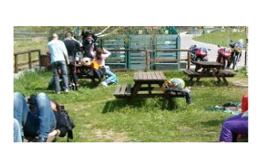
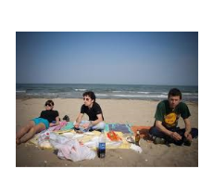
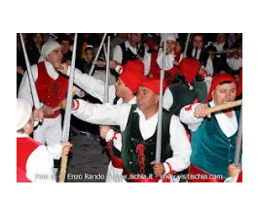
17th April
Easter Monday, also known as Little Easter (Pasquetta) is also an official Italian holiday that is often spent enjoying the fresh Spring weather with family and friends in picnics. Easter Monday is a time to gather with friends and have fun.
In Barano d'Ischia, a traditional dance called the Festa della Ndrezzata takes place on the same day.

Slide 8
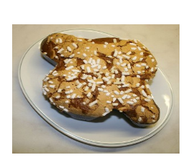
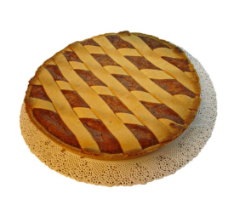
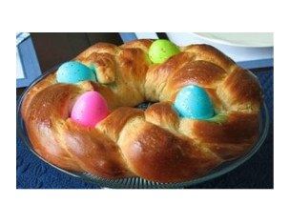
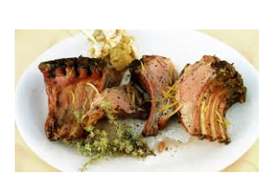
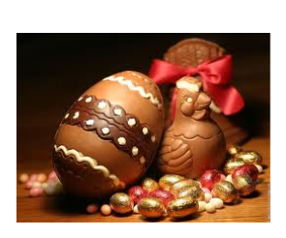
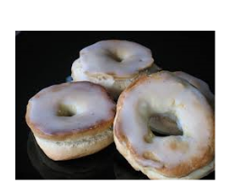
The importance of Easter in Italian culture is reflected in the country’s food traditions. During Easter lunch in Italy, lamb and eggs are always served. They appear either as part of the meal itself, or as sweets in the shape of these symbols of life and rebirth (in the case of eggs) and of sacrifice of the son of God for humanity (in the case of the lamb.)

