Slide 1
Crete is the largest island of Greece and the fifth-largest island in the Mediterranean Sea, rich in history, tradition and culture.
.

Slide 2
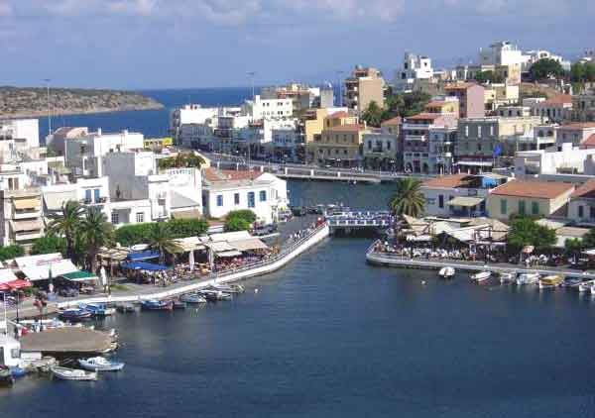
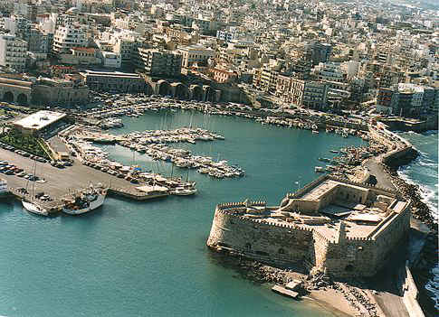
Crete is divided in four prefectures with their capitals Chania, Rethymnon , Heraklion and Ag. Nikolaos. Our school is located 15 min away from Heraklion, the capital of Crete.
Agios Nikolaos
Heraklion
Rethymnon
Chania
Notes:
Rethymnon

Slide 3
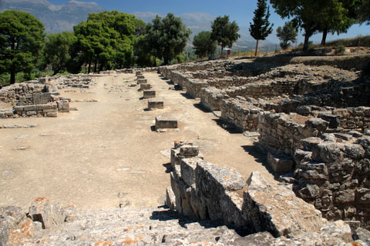
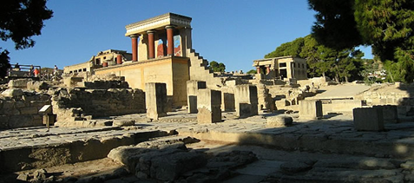
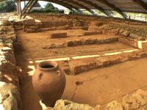
Due to its geographical position between Africa, Europe, and Asia Minor and due to its mild climate, Crete became a center of culture as early as Neolithic times. The Minoan Civilization began here, reaching its peak around 1950 BC with the erection of the imposing palaces in Knossos, Festos, and Malia.

Slide 4
Sightseeing in Heraklion Morozini fountain, Logia and the Koules castle at the harbour.

Slide 5
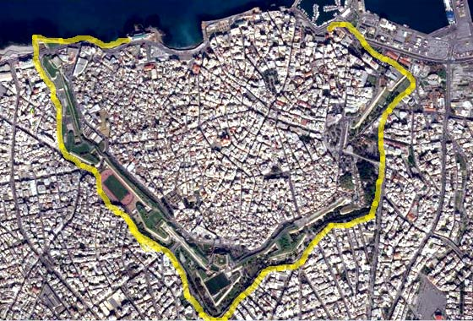
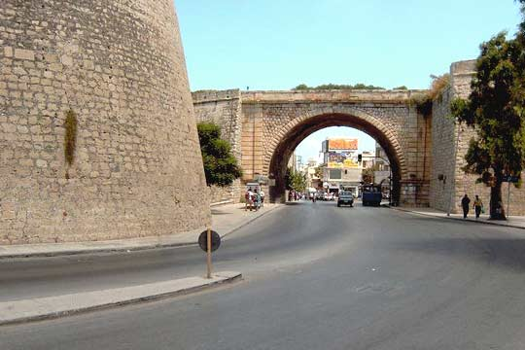
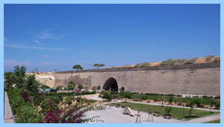
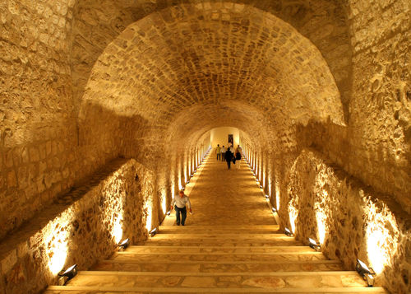
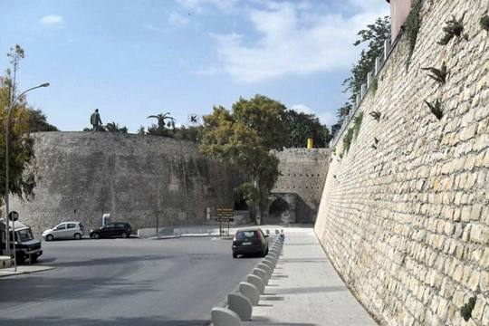
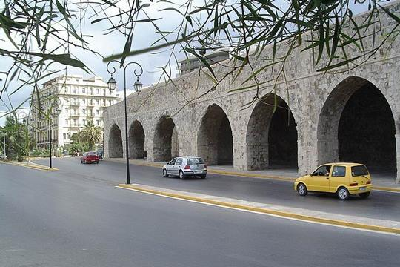
The old city of Heraklion is surrounded by Venetian walls, built in the 15th century. They are a magnificent example of medieval fortification art.

Slide 6
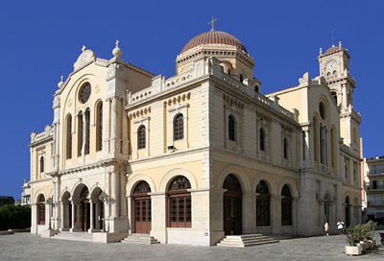
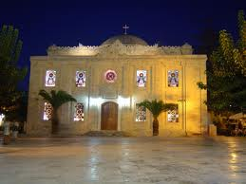
The two Cathedrals of Heraklion. Saint Minas and Saint Titus

Slide 7
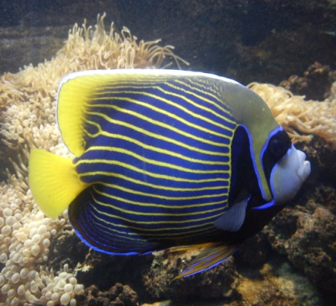
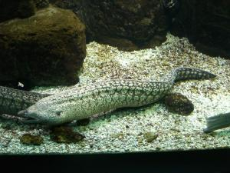
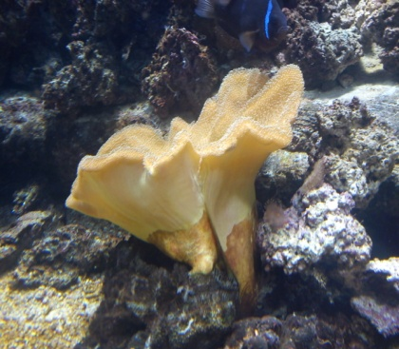
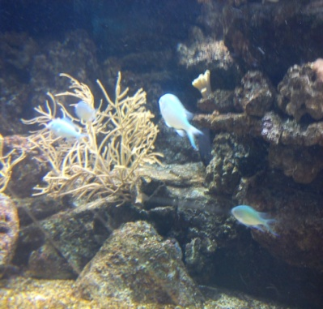
Cretaquarium or Thalassocosmos is a public aquarium located 15 km east of the city of Heraklion and about 20 Minutes away from our school.

Slide 8
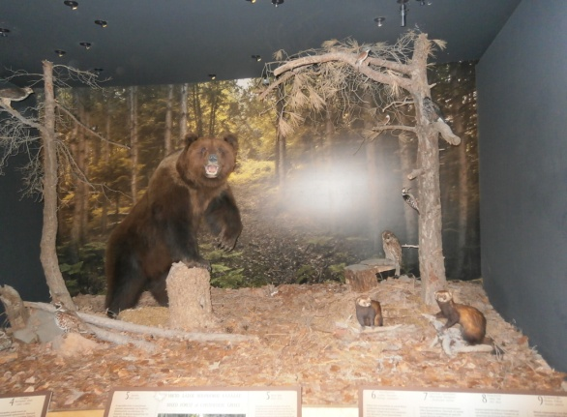
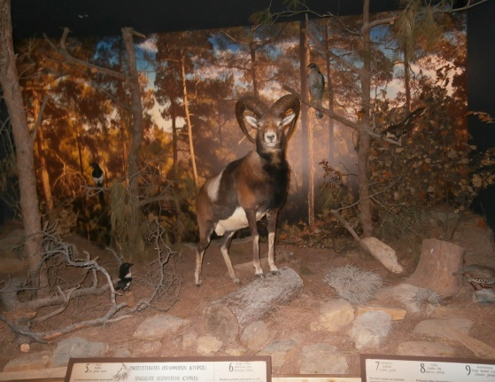
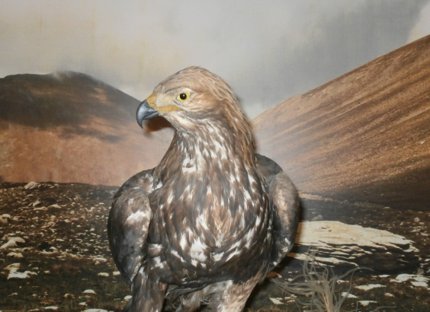
Museum of natural history
This is a museum about the flora and fauna of Crete and is located in Heraklion city, only 25 minutes from our school. We often visit this museum for educational purposes. There is also an earthquake simulator and it is very popular. You can feel an earthquake on that.

Slide 9
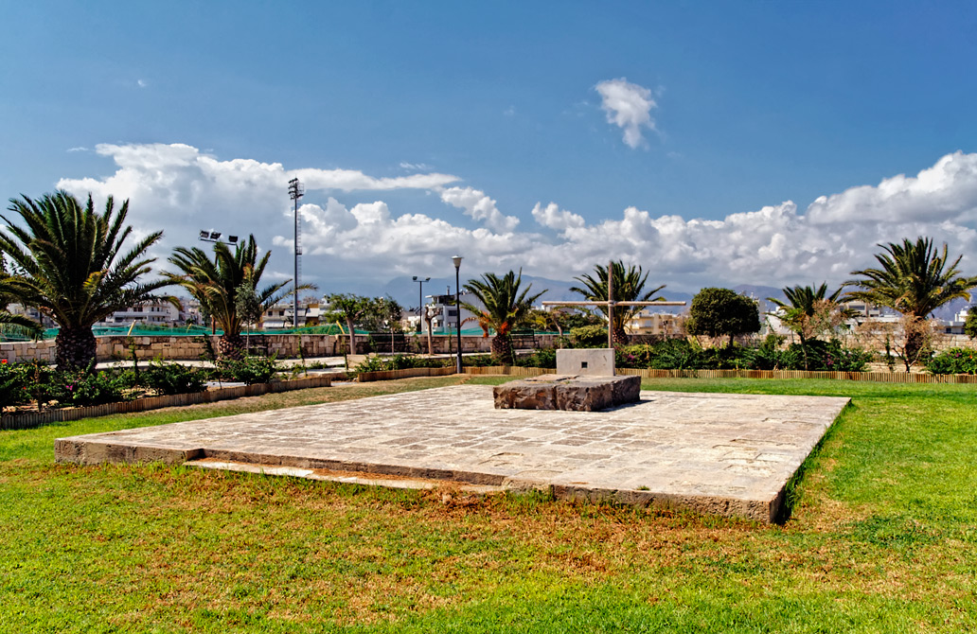
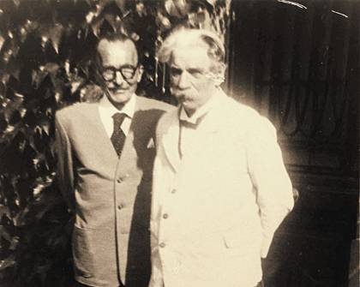
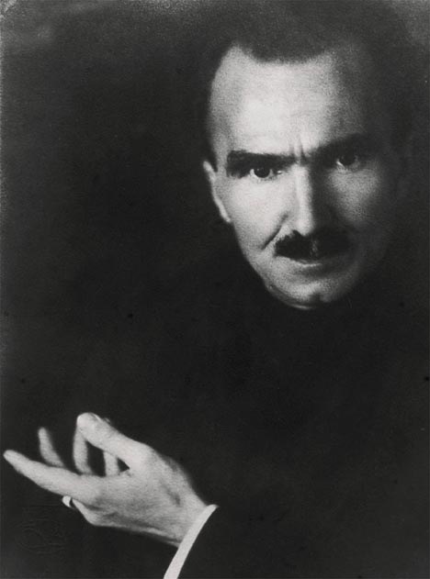
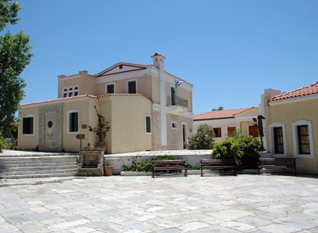
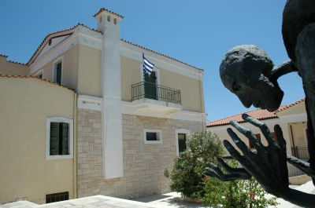
Heraklion is the birth city of Nikos Kazantzakis, one of the most famous Greek writers. Near our school is located a museum, dedicated to him. His tomb is in the center of Heraklion.

Slide 10
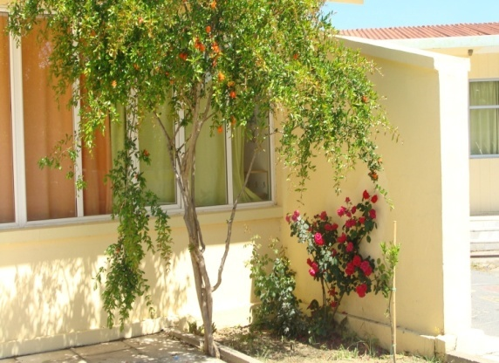
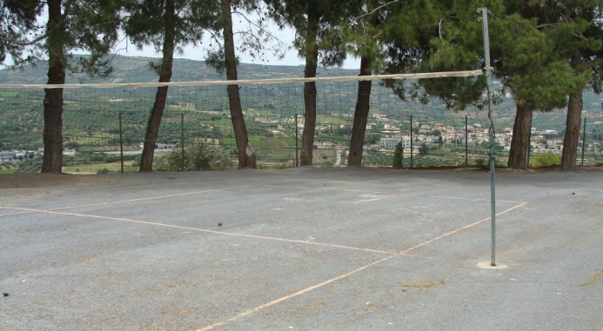
This is our school!! In our school we have got 110 pupils and 10 teachers.

Slide 11
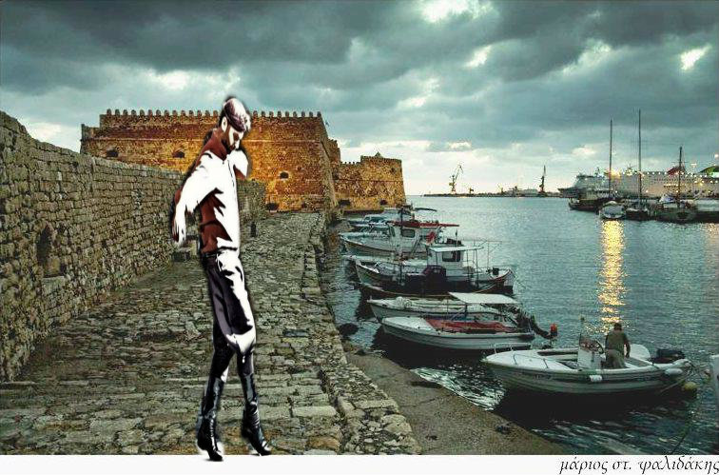
Warm regards from Crete!!

