Slide 1
THE GREEK FOOD
HIGH SCHOOL OF GENISEA GREECE
PETROS FULAXTAKIS

Slide 2
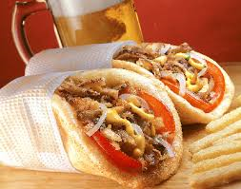
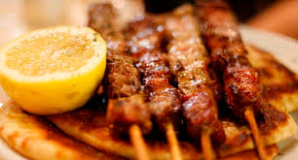
NUMBER 1 IT IS SUBLAKI

Slide 3
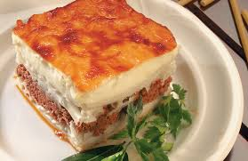
NUMBER 2 IT IS PASTITSIO

Slide 4
NUMBER 3 IT IS THE FASOLADA

Slide 5
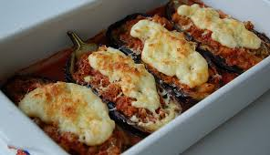
NUMBER 4 IT IS THE PAPOUTSAKIA

Slide 6
THE END

