Slide 1
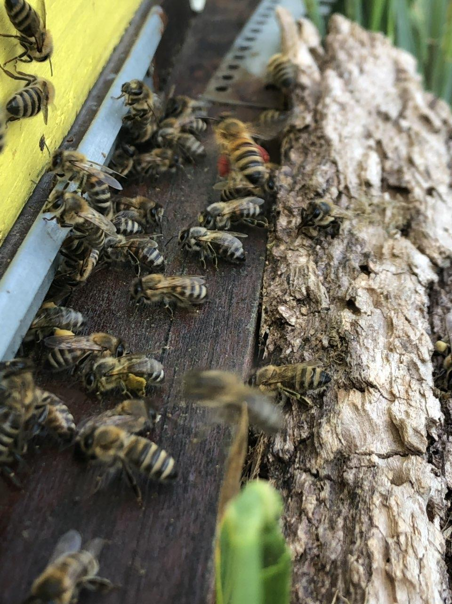
BEES
By:Lara Rončević

Slide 2
POLINATION
Bees are insects that flush flowers. We have many benefits. We have propolis, honey, pollen and poison. Einstein said that if all the bees disappear, people would stay for 3-4 years.

Slide 3
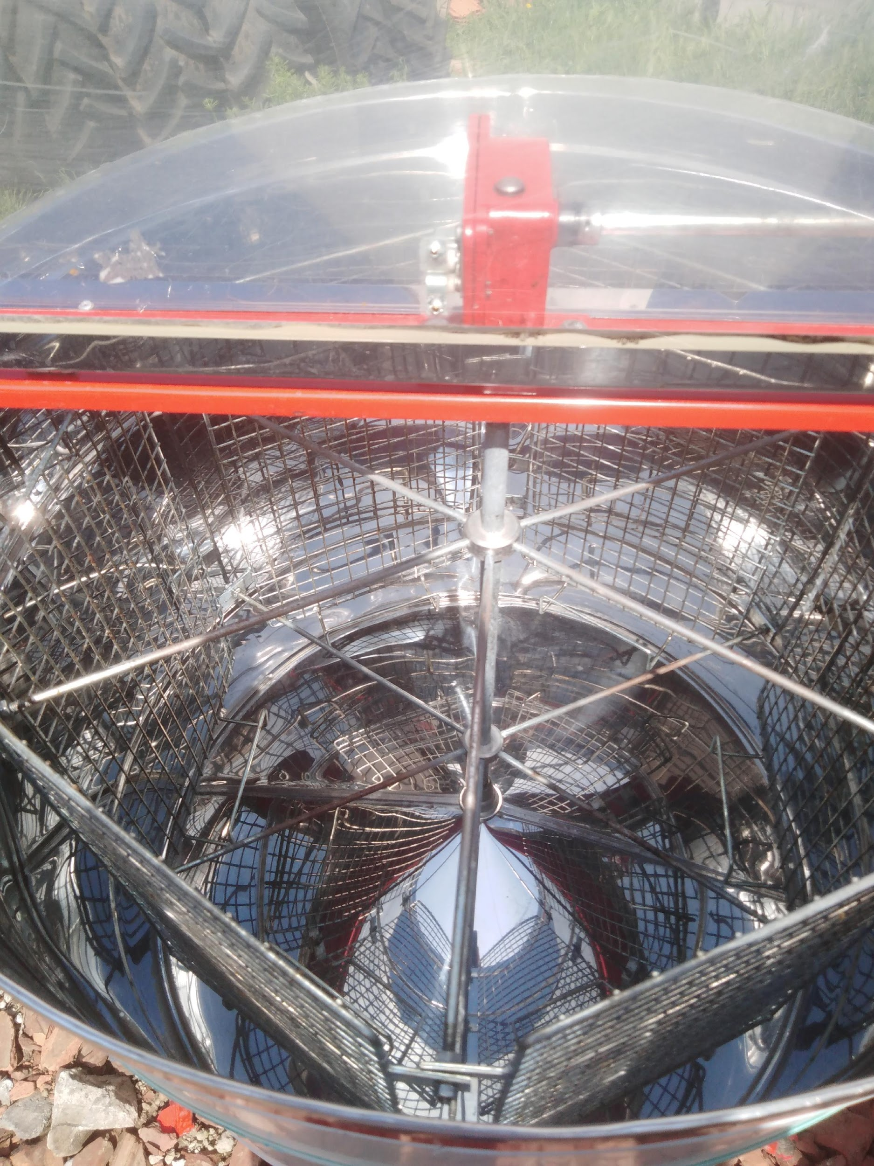
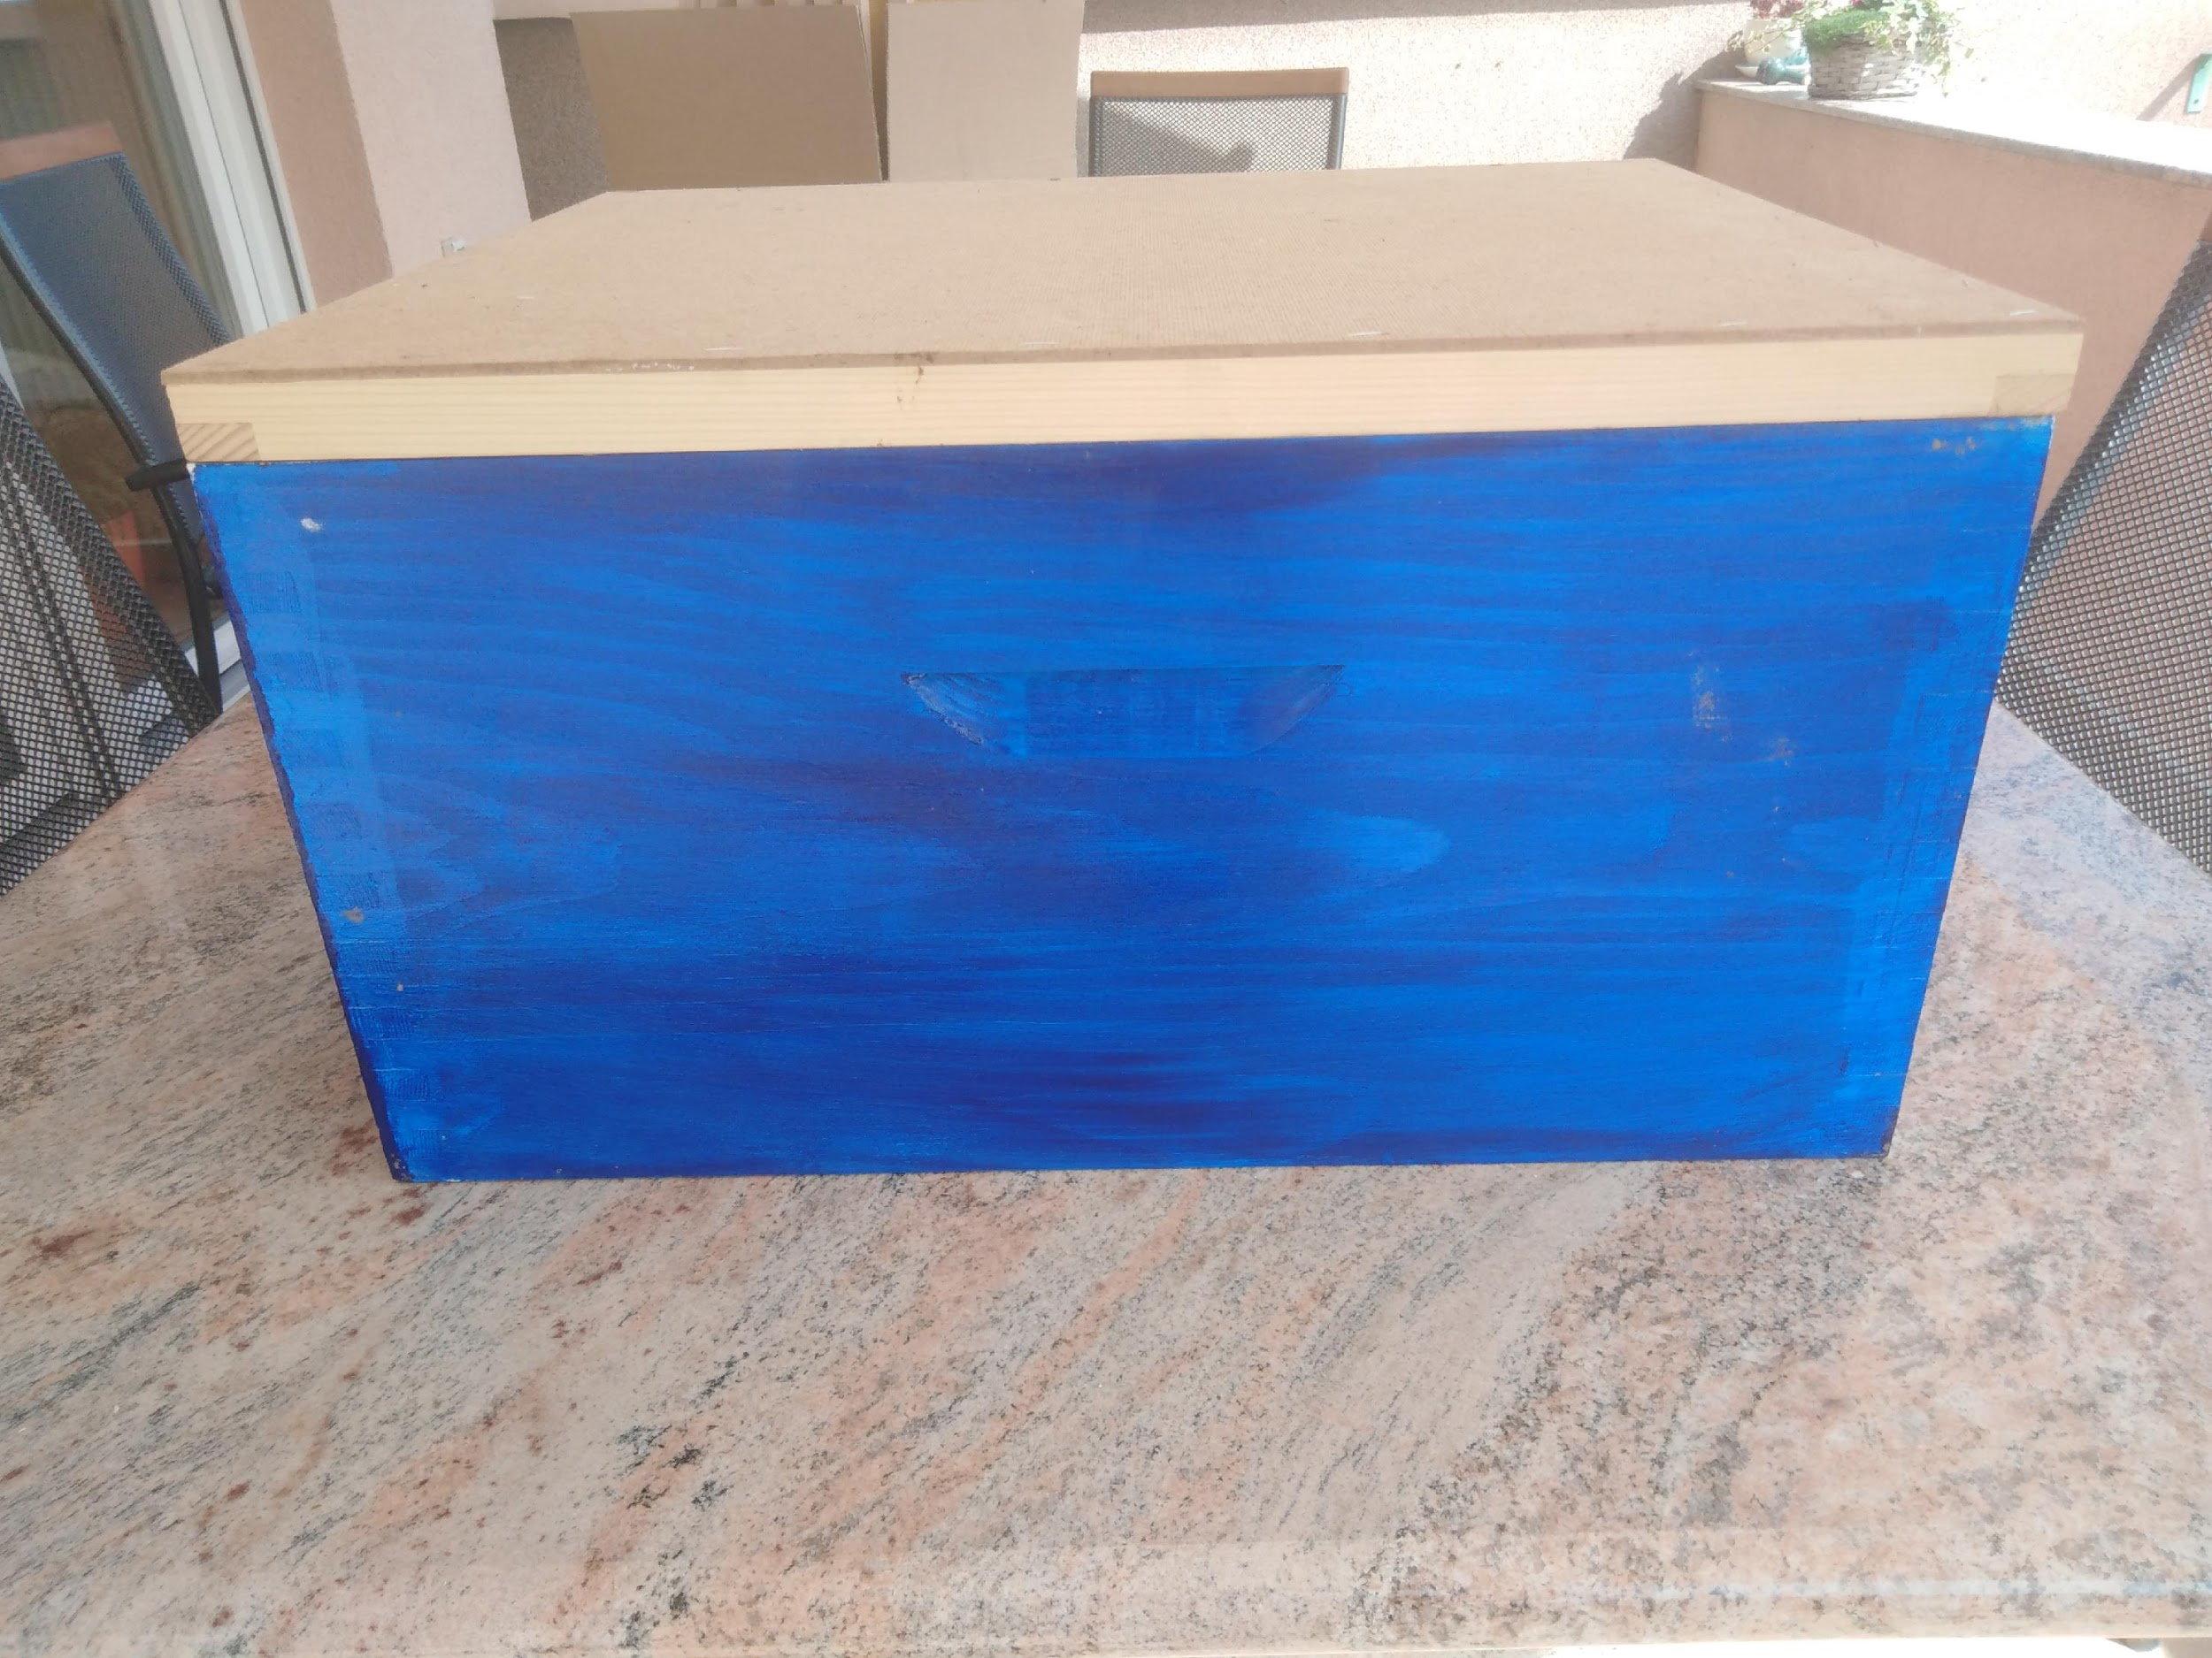
EQUIPMENTS for working with bees
Chloating a strain for honey continuation for the hive

Slide 4
POLLEN
POLLEN is a male stomach of a flower. It is a puddle that is what people are eating meat. They are covered with hairs that catch the pollen that is removed by the forelimbs and stored in the carts on the inside of the back legs.

Slide 5
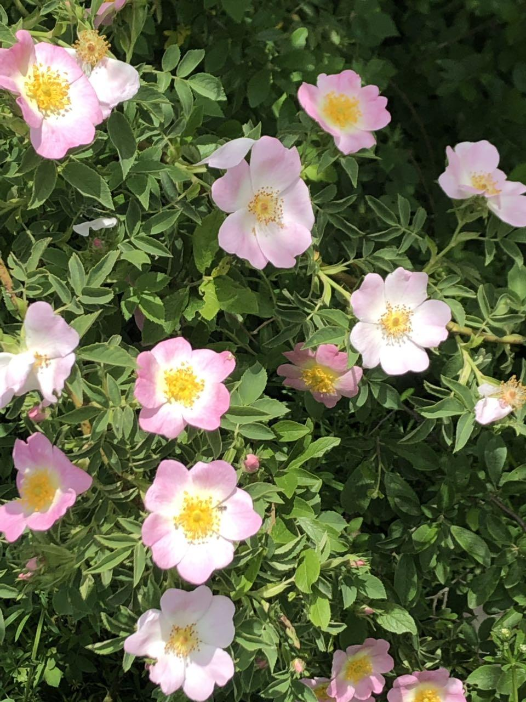
HONY

Slide 6
Eat honey as a food that you should not use as a medicine!

