Slide 1
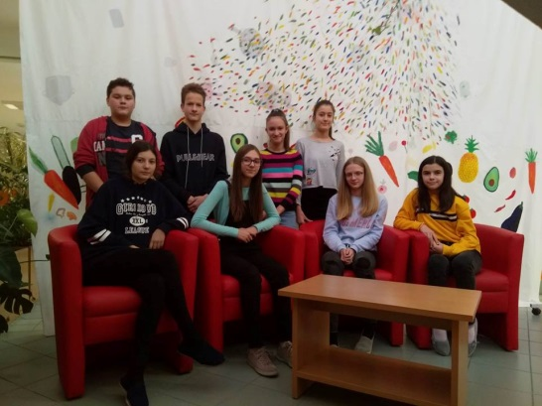
Team 1 7.b
TYPES AND CAUSES OF POLLUTION

Slide 2
Air Pollution
caused by the burning of fuel that directly releases hazardous chemicals into the air.
For example; the burning of coal releases sulphur dioxide, a poisonous gas responsible for acid rain.

Slide 3
Soil Pollution
caused by the release of industrial waste. Soil pollution is also caused by human acts like mining and deforestation etc.

Slide 4
Water Pollution
is caused by the direct incorporation of hazardous pollutants by large industries and factories that dispose off their waste in lakes and ponds.

Slide 5
Noise Pollution
Noise pollution is caused by the moving vehicles, man made machines and loud music.

Slide 6
7 Kinds of Environmental Pollution:
What are they?
What are they responsible for?
http://www.sustainablebabysteps.com/kinds-of-environmental-pollution.html?fbclid=IwAR0wO8v4olyj-4drqX0hqSzJkJIXksBYiRBJgU7gsRgiEi44ge8UkbJePUE

Slide 7
1.Air Pollution
According to the dictionary, air pollution is the contamination of air by smoke and harmful gases, mainly oxides of carbon, sulfur, and nitrogen. (And maybe by that smelly uncle.) Some examples of air pollution include:
Exhuast fumes from vehicles
The burning of fossil fuels, such as coal, oil, or gas
Harmful off-gasing from things such as paint, plastic production, and so on
Radiation spills or nuclear accidents
Air pollution is linked to asthma, allergies and other respiratory illnesses.

Slide 8
2. Land Pollution
Land pollution is the degradation of the Earth's surface caused by a misuse of resources and improper disposal of waste. Some examples of land pollution include:
Litter found on the side of the road
Illegal dumping in natural habitats
Oil spills that happen inland
The use of pesticides and other farming chemicals
Damage and debris caused from unsustainable mining and logging practices
Radiation spills or nuclear accidents
Land pollution is responsible for damage done to natural habitat of animals, deforestation and damage done to natural resources, and the general ugly-ing up of our communities. (So stop being a litterbug, eh?)

Slide 9
3. Light Pollution
Light pollution is the brightening of the night sky inhibiting the visibility of stars and planets by the use of improper lighting of communities. Some examples of what causes light pollution:
Street lamps that shine light in all directions, instead of with a hood to point light downward toward the street.
Extra, unnecessary lights around the home
Cities that run lights all night long
Light pollution uses more energy (by shining more light up instead of down, meaning you need brighter bulbs for the same amount of light), may affect human health and our sleep cycles, and most importantly, corrupts our kids telescopes and their curiosity. (I grew up in a city. My first no-light night in the country blew my mind. Let's not make that such a rare occasion!)

Slide 10
4. Noise Pollution
Noise pollution is any loud sounds that are either harmful or annoying to humans and animals. Some exmaples of noise pollution:
Airplanes, helicopters, and motor vehicles
Construction or demolition noise
Human activities such as sporting events or concerts
Noise pollution can be disruptive to humans' stress levels, may be harmful to unborn babies, and drives animals away by causing nervousness and decreasing their ability to hear prey or predators.

Slide 11
5. Thermal Pollution
Thermal pollution is the increase of temperature caused by human activity. A few examples of this include:
Warmer lake water from nearby manufacturing (using cool water to cool the plant and then pump it back into the lake)
Included in thermal pollution should also be the increase in temperatures in areas with lots of concrete or vehicles, generally in cities
These kinds of environmental pollution can cause aquatic life to suffer or die due to the increased temperature, can cause discomfort to communities dealing with higher temperatures, and will affect plant-life in and around the area.

Slide 12
6. Visual Pollution When a man throws an empty cigarette package from an automobile, he is liable to a fine of $50. When a man throws a billboard across a view, he is richly rewarded. - Pat Brown
Visual pollution is what you would call anything unattractive or visualing damaging to the nearby landscape. This tends to be a highly subjective topic. Some examples of visual pollution:
Skyscrapers that blocks a natural view
Graffiti or carving on trees, rocks, or other natural landscapes
Billboards, litter, abandoned homes, and junkyards could also be considered among three kinds of environmental pollution
Mostly, visual kinds of environmental pollution are annoying and ugly, although some may say they are also depressing, and they of course affect the surrounding landscape with the changes they cause.

Slide 13
7. Water Pollution
Water pollution is the contamination of any body of water (lakes, groundwater, oceans, etc). Some examples of water pollution:
Raw sewage running into lake or streams
Industrial waste spills contaminating groundwater
Radiation spills or nuclear accidents
Illegal dumping of substances or items within bodies of water
Biological contamination, such as bacteria growth
Farm runoff into nearby bodies of water

Slide 14
8. Understanding the Science That Shows the Environment Affecting Human Health
These kinds of environmental pollution are linked to health issues in humans, animals and plant-life. You can read more about how the environment is affecting our health here.
http://www.sustainablebabysteps.com/environment-affecting...

