Slide 1
Christmas cards
“Dante Alighieri”lower secondary school, Merlara
ITALY

Slide 2
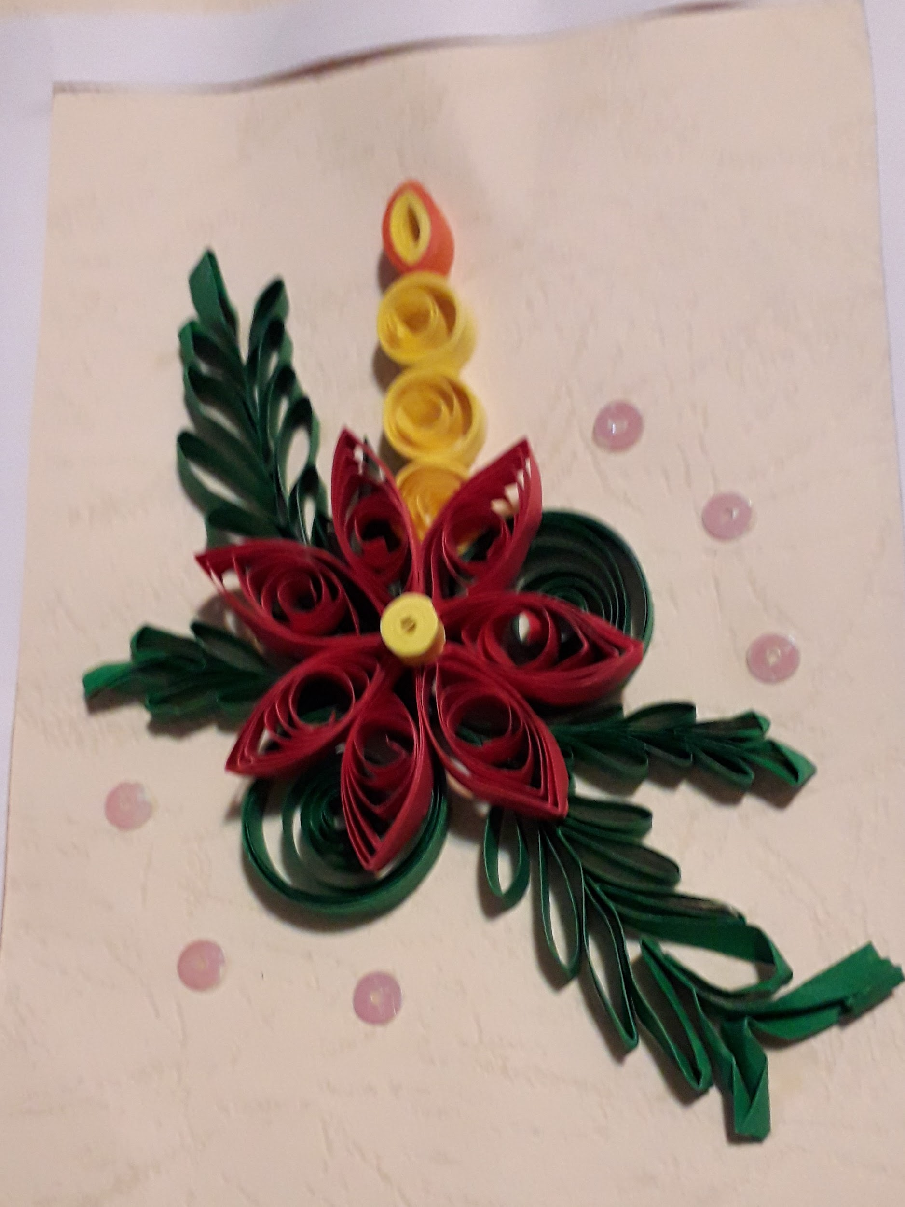
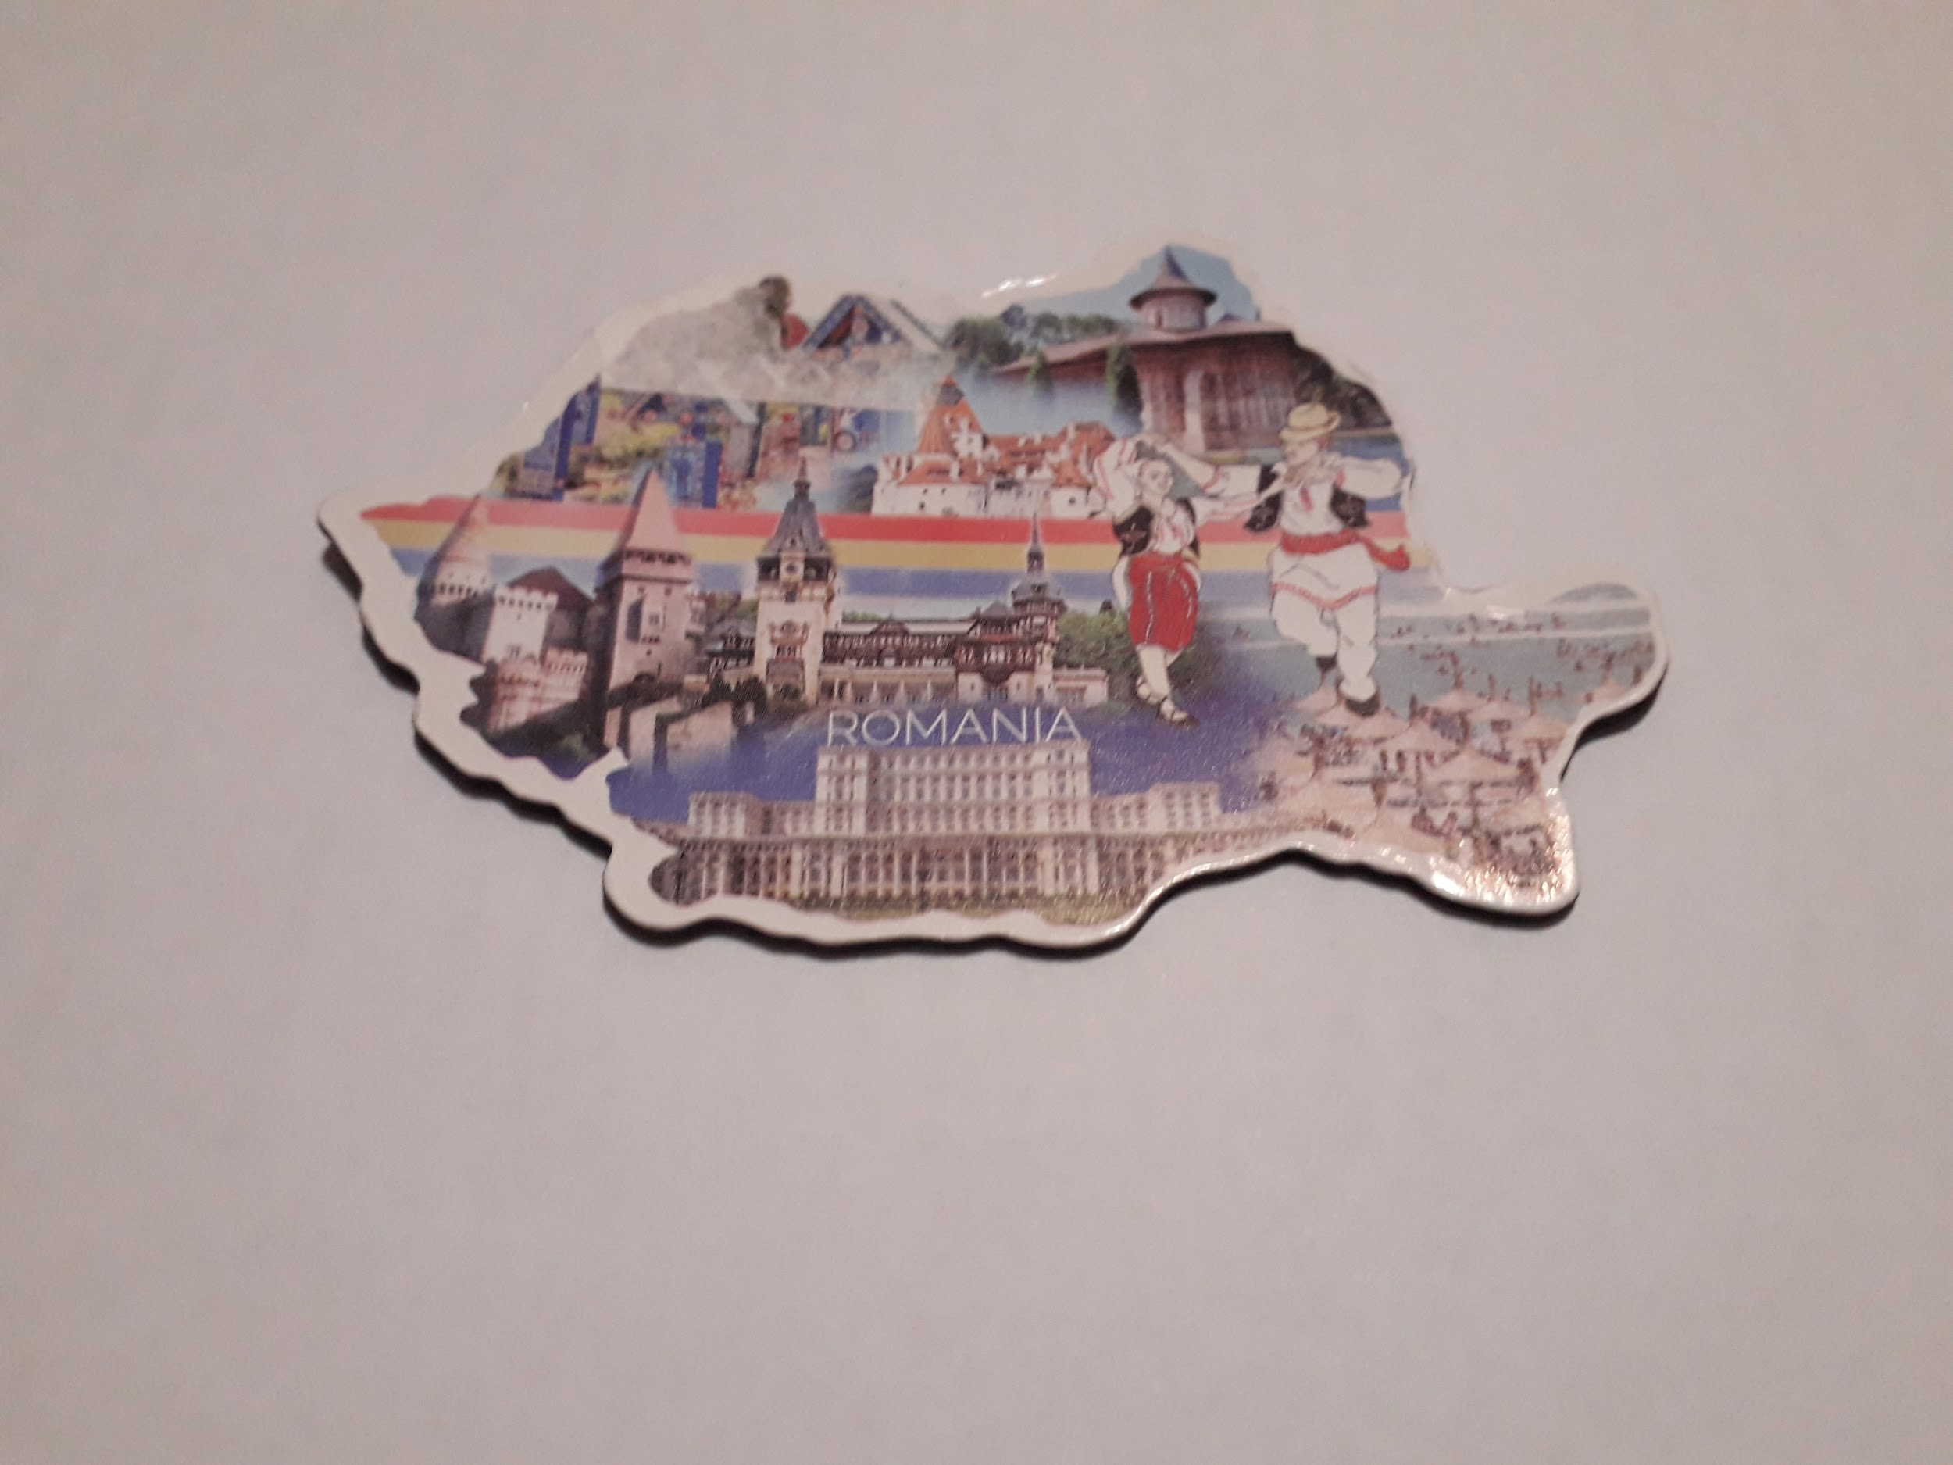
From Dragichi Cristina and her students, ROMANIA

Slide 3
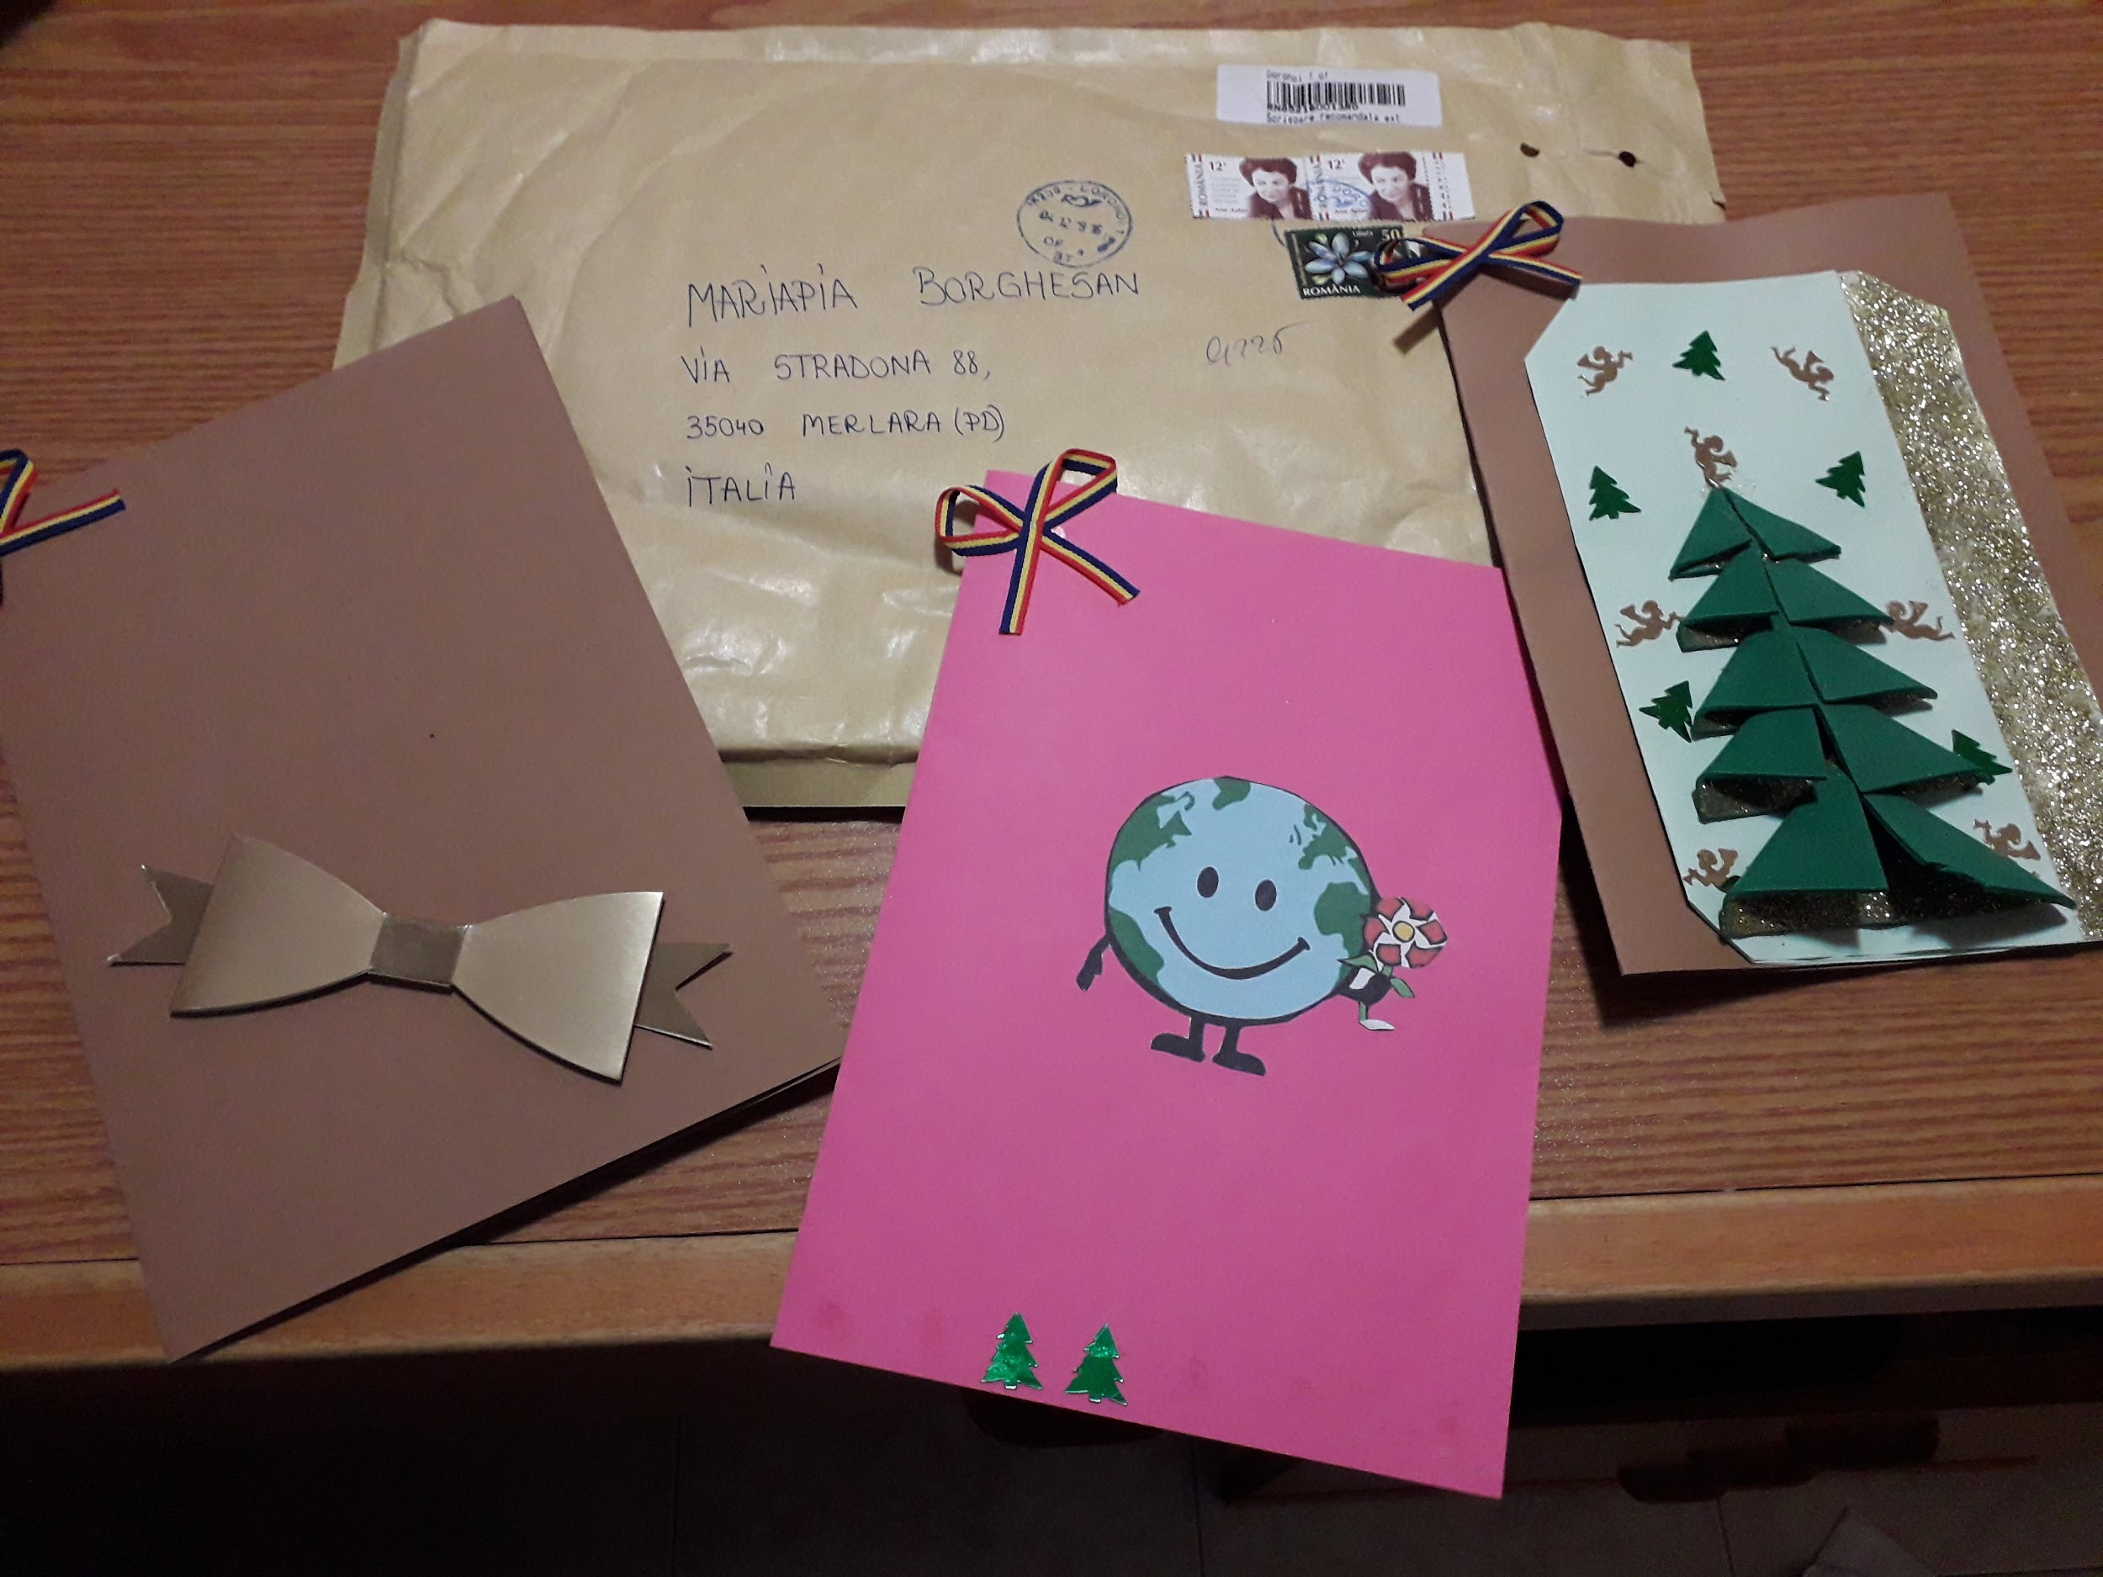
From Lidia and her students, ROMANIA

Slide 4
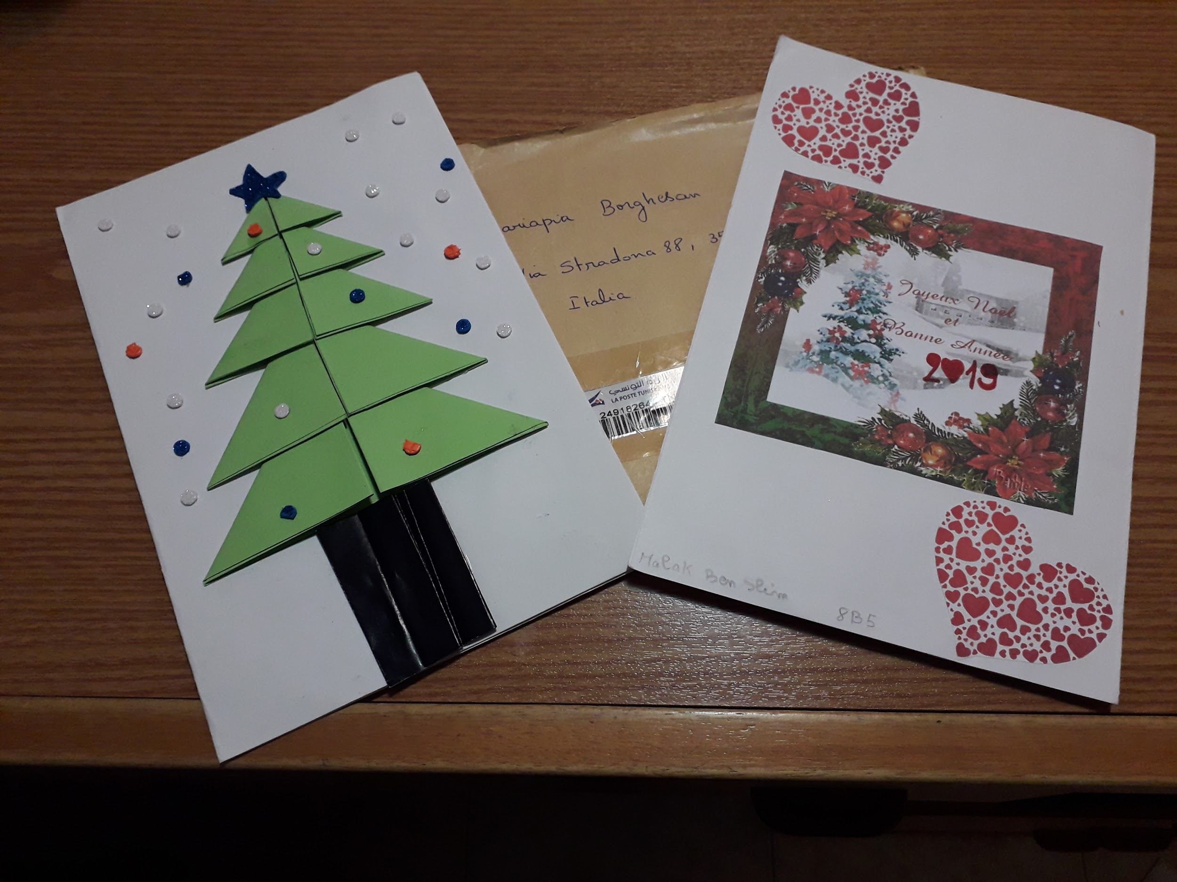
From Tunisia

Slide 5
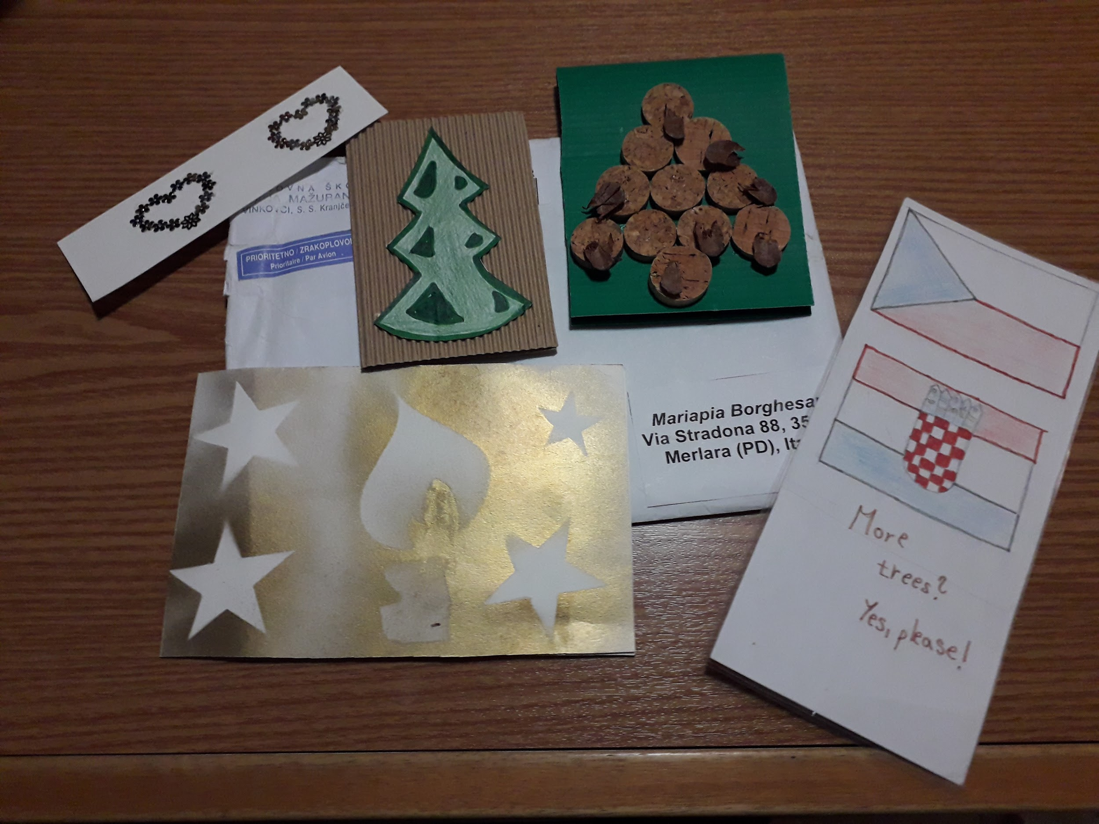
Cards from Vinkovci,
CROATIA

Slide 6
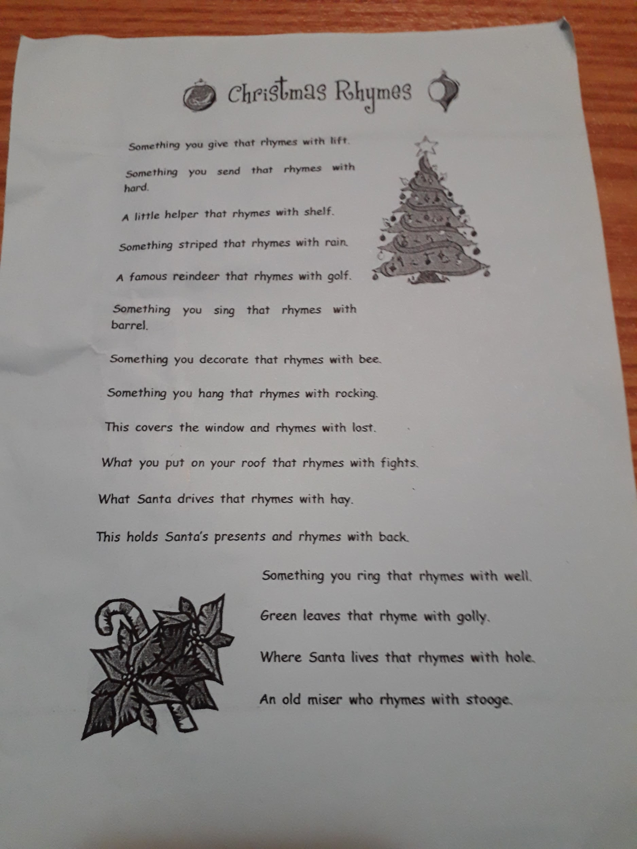
Also Christmas Rhymes from Vinkovici, Croatia

Slide 7
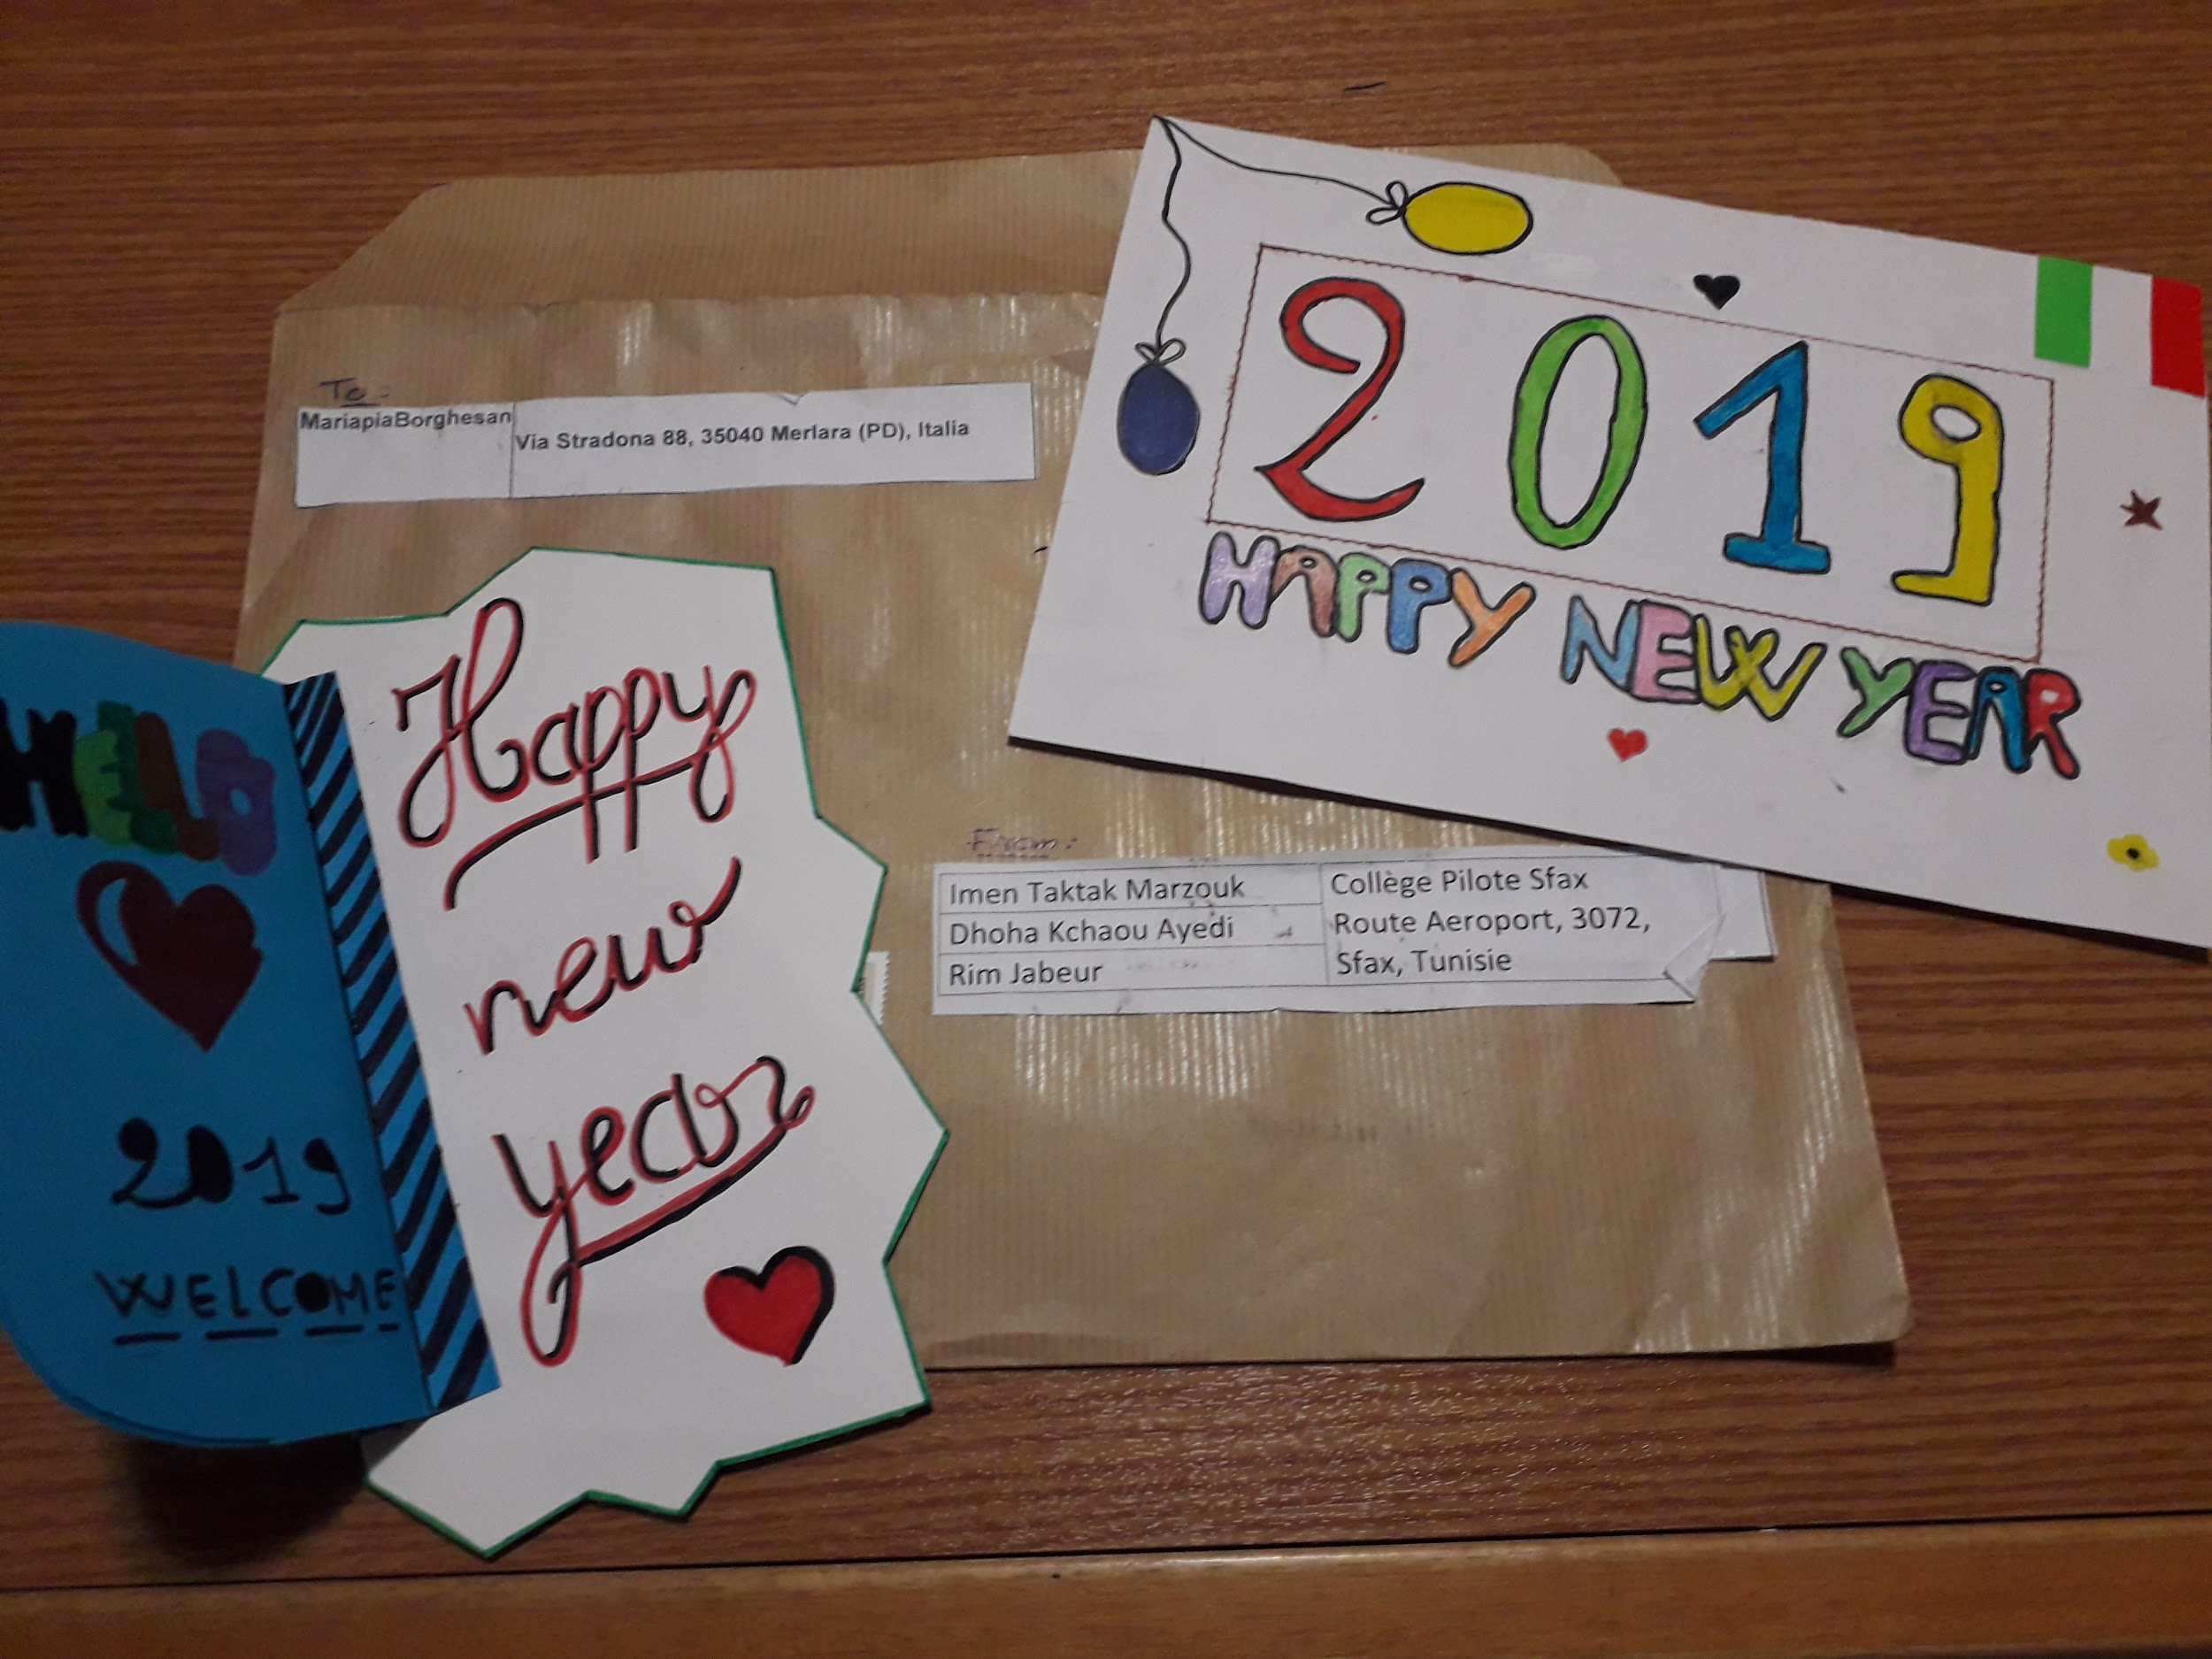
From Imen Marzouk and her students,
TUNISIA

Slide 8
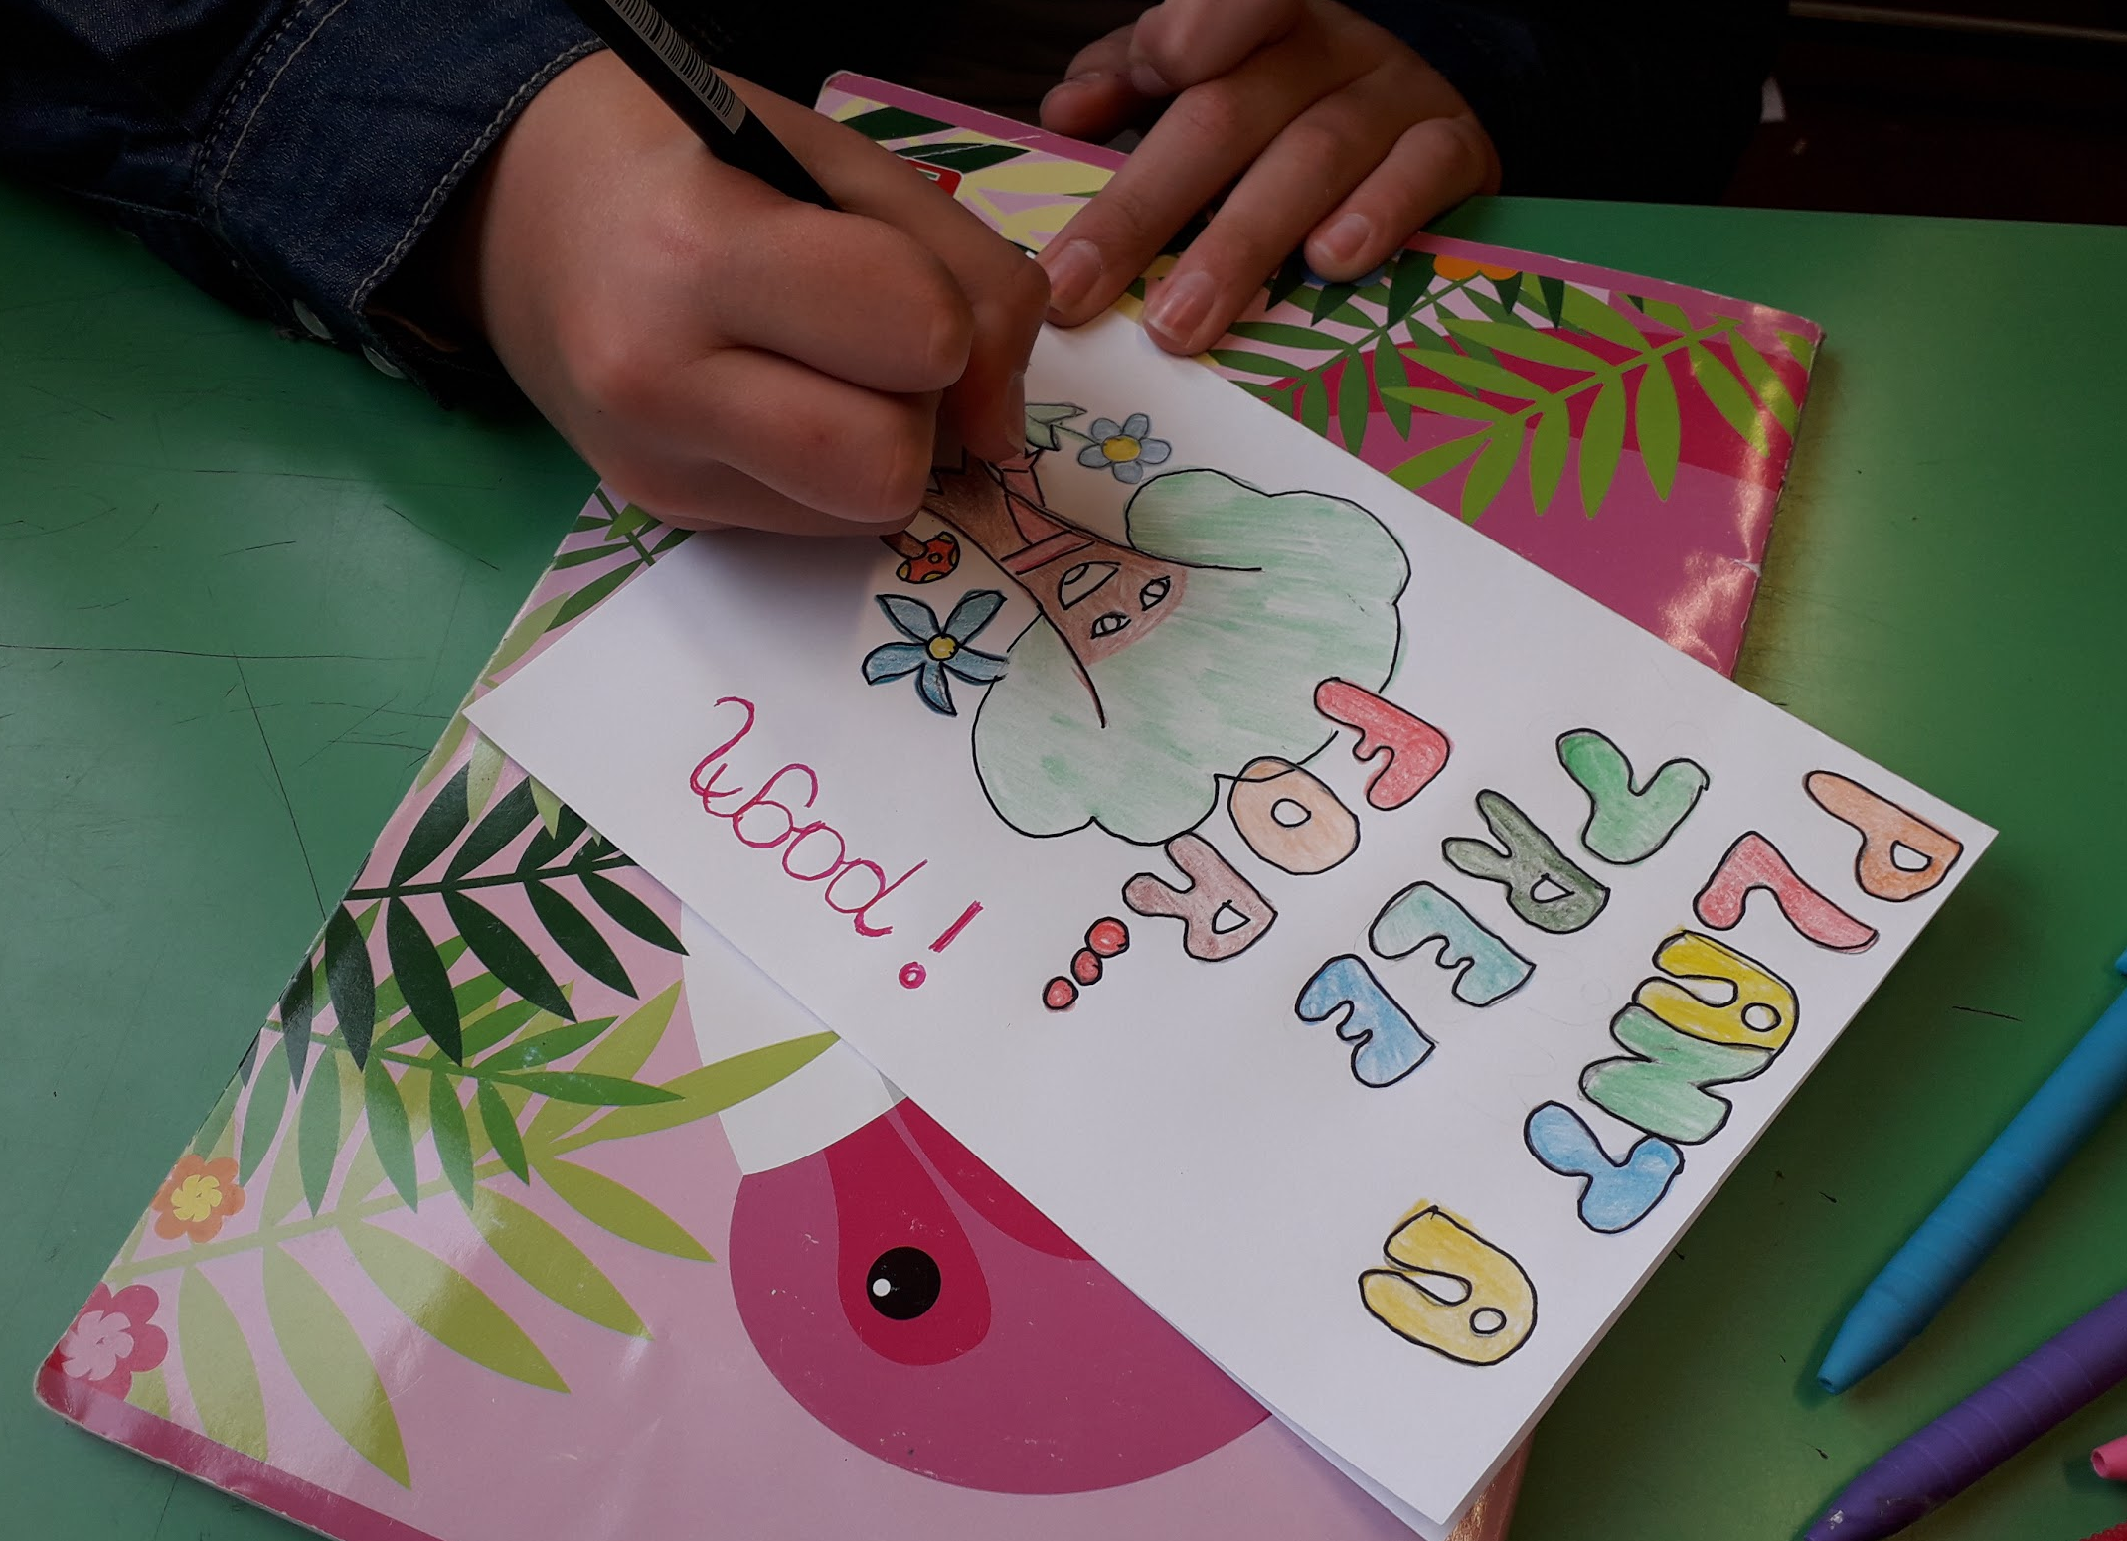
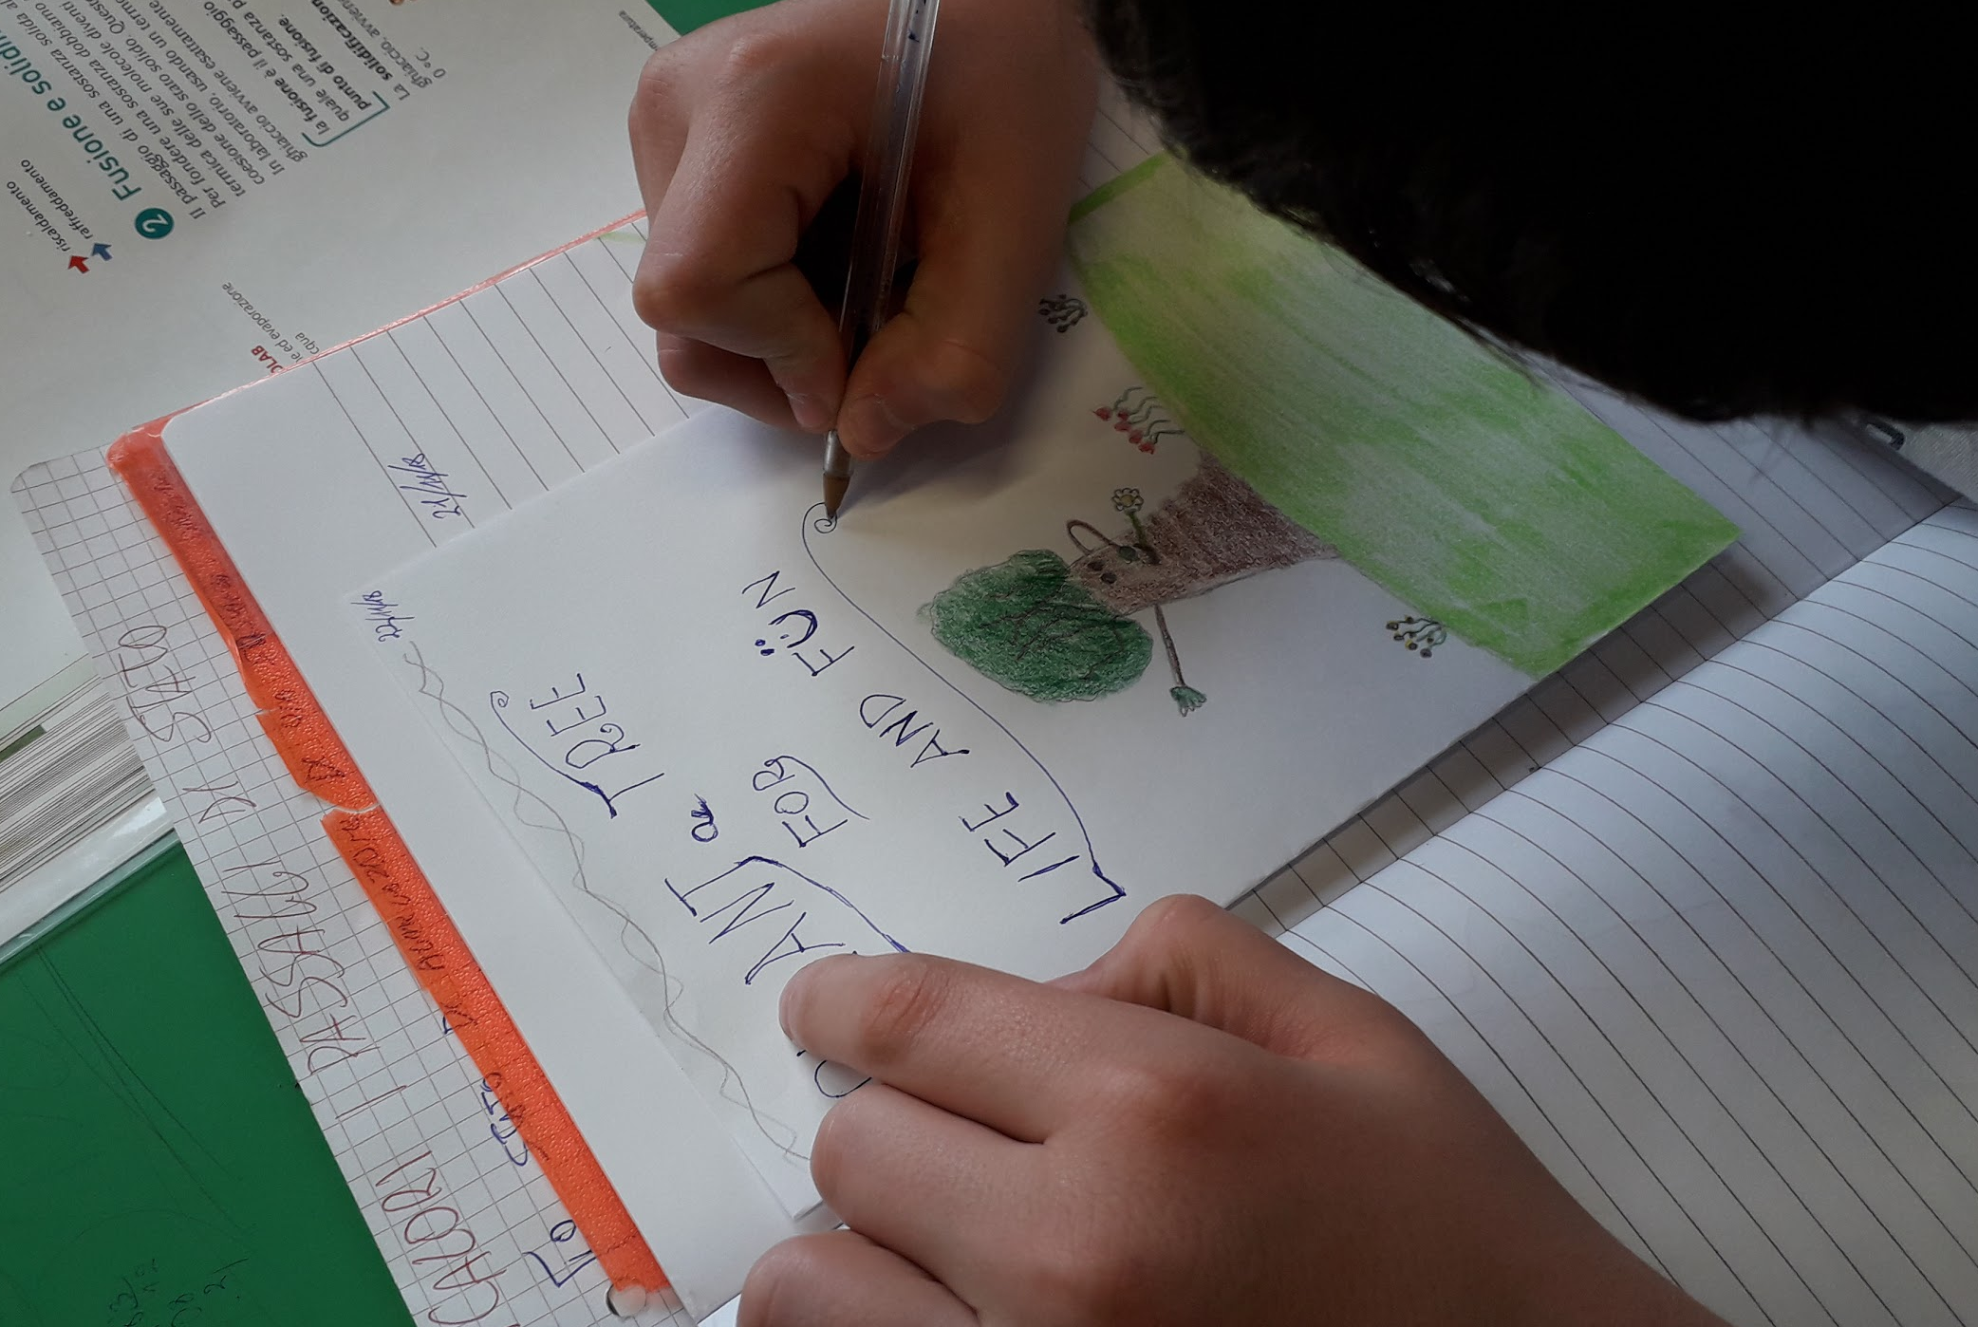
Preparing cards

Slide 9
