Slide 2
Online safety starts with you!

Slide 3
15 tips for you
to stay safe online

Slide 4
1
Privacy
and data protection
Don’t give anyone your password, name, address, the name of your school or any information about
your family.
2
Passwords
Don’t share your passwords
with anyone but your parents.
Always use strong passwords consisting of letters, numerals
and special characters. Use different passwords on
different sites.

Slide 5
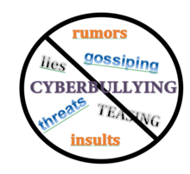
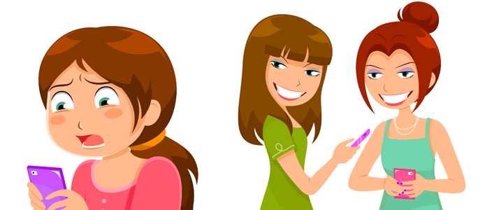
3
Copyright
We should respect each
other’s rights. Don’t copy or
share anything, don’t download music, films, images without the auther’s permission. Always give credits to the authers, copy
and paste the links.
4
Cyberbullying
Don’t respond to mean or insulting messages. Talk to your parents or teachers if you feel uncomfortable or upset with what you see on the
Internet.

Slide 6
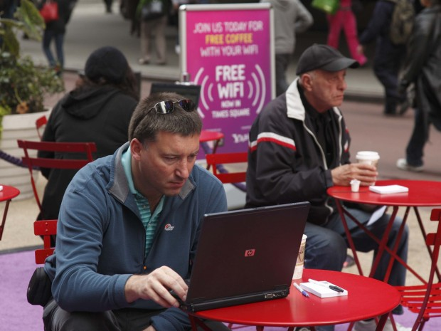
5
Public WI-FI
Free public Wi-Fi is never a
secure connection. Hackers make
use of the public Wi-Fi to steal information as it is very convenient. They may get access to our personal information, steal our identity or send us files infected with
malware.
6
Friends
Don’t talk to strangers on
the Internet. Be selective with
friend requests. If you don’t know
the person, don’t accept their request. It could be a fake account.
Don’t agree to meet an
online friend.

Slide 7
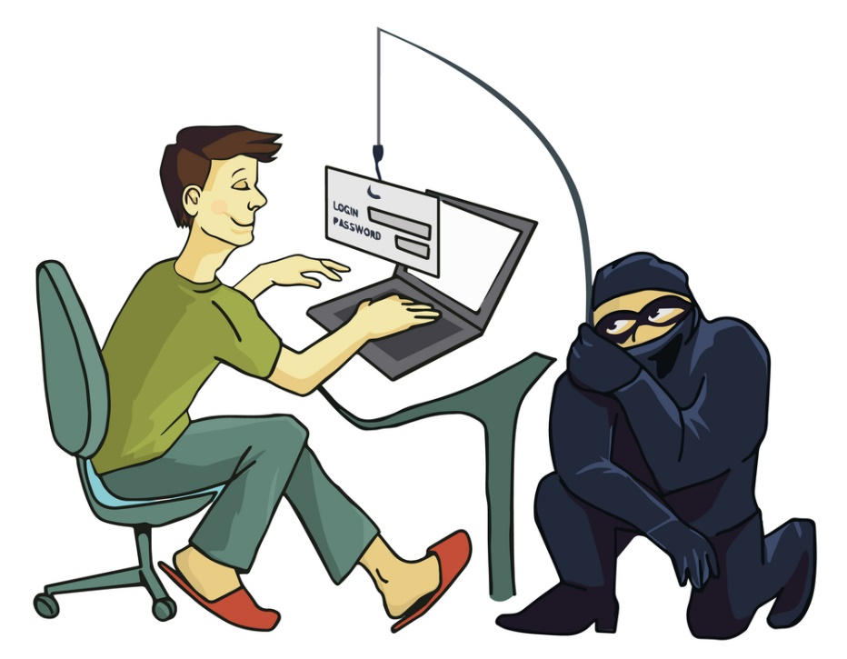
7
The
Golden Rule
Treat people the way you want
to be treated. Be kind and polite. Don’t hurt people’s feelings. Don’t start rumors. Never send a
message you would not say
face-to-face.
8
Phishing
Do not click on any link sent
by an unknown email address, do not share them with your contacts. They can contain viruses or malware. Don’t open pop-ups.
Use anti-virus
software.

Slide 8
9
Downloading
Talk to your parents before
you open an email attachment or download software. They sometimes contain viruses. Never open an attachment from someone you don’t
know.
10
Photos
You shouldn’t post photos
of other people without their permission. Always think before you post. Once you’ve shared something online you’ve lost control of it:
it can be copied, shared and
even edited!

Slide 9
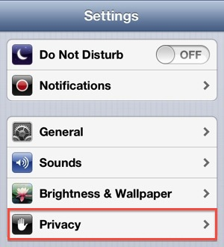
11
Social Networking
Switch off location sharing and
set your social media accounts to private. Don’t add people you don’t know and block anyone who
will send you nasty
messages.
12
Account
Settings
Regularly check your privacy
settings on social media. When you
use a public computer make sure you logout of the accounts you’ve accessed. Use a different password
for each of your social media accounts.

Slide 10
13
Updates
Always keep your devices updated. Cyber attackers thrive on outdated
devices because they don’t have
the most current security software.
Close the accounts that you no longer use. Regularly update
your passwords.
14
Reliability
Don’t believe everything you
read, make sure you know it’s coming from a reliable source. Very often fake news spread on the internet and the worst part is that most people
can't recognize it when
they see it.

Slide 11
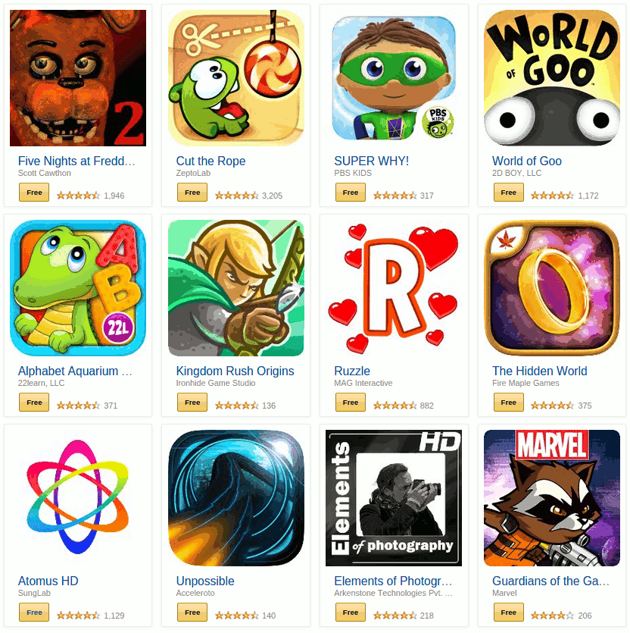
15
Free apps
The free apps related to shopping, gaming etc. are potential entry points for adware and spyware. Having a Reliable antivirus program installed
on your computer or smartphone
can help evade such
danger.

Slide 12
Presentation by Armine Safaryan

