Slide 1
THE HAUNTED MANOR
OPERA
by
Stanisław Moniuszko

Slide 2
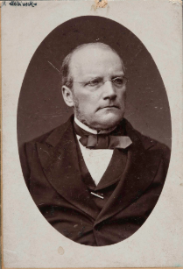
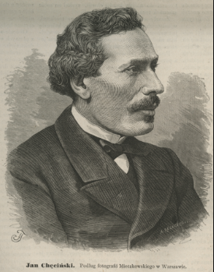
The Haunted Manor, opera in 4 acts was composed by Stanisław Moniuszko in 1864; the libretto was written by Jan Chęciński. It is considered Moniuszko’s best opera, and also the greatest among all 19th-century Polish opera scores.
In the second part of the 19th century Poland was partitioned by Russia, Prussia and Austria. The Polish culture struggled against Russification and Germanization policies. Many contemporary Polish writers, artists and musicians readily reflected that struggle, and this opera was one of the examples of that struggle.
Although The Haunted Manor is a romance and a comedy, it has strong Polish patriotic undertones, which made it both popular with the Polish public and unpopular – to the point of being banned – by the Russian authorities which controlled most of Poland’s territory. The plot of the opera takes place in a Polish country manor in the second part of the 17th century.

Slide 3
Manor house in w Kalinów - original location for the setting of “The Haunted Manor”

Slide 4
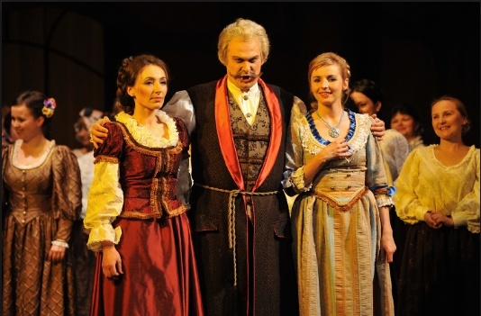
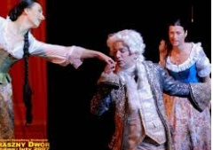
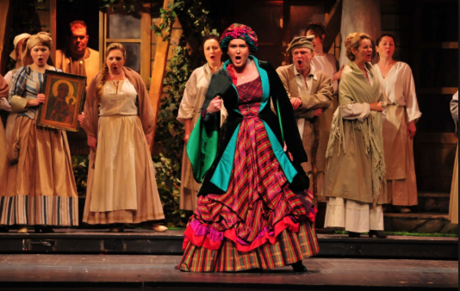
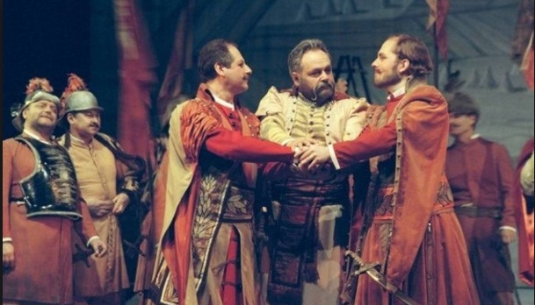
ROLES
The main opera characters are:
- Miecznik (The Sword-Bearer) -bass
- Hanna and Jadwiga (Miecznik's daughters) – soprano and mezzosoprano
- Pan Damazy (a barrister ) - tenor
- Stefan and Zbigniew (brothers) - tenor and bas
- Cześnikowa (aunt) - soprano
- Maciej (servant) - bass
- Skołuba (Miecznik’s servant) - bass
- Marta (brothers’ servant) - soprano
- Soldiers, peasants, hunters

Slide 5
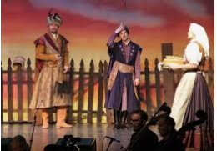
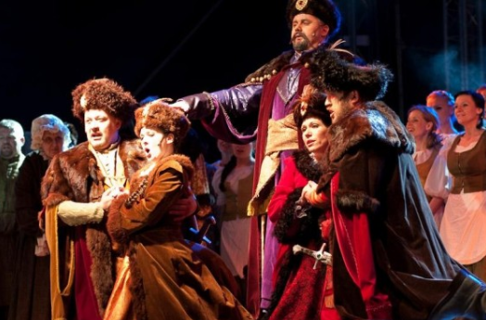
WHAT IS THE OPERA ABOUT?
The opera tells the story of two brothers - Zbigniew and Stefan, who return from a war. Convinced that their most important goal is to defend their country they make vows that they will never marry, because "whimpering children or wailing of wives" could distract them from going back to the battlefield. "For if I married a lovely woman, how could I leave her to go to war?".
But they meet two sisters on their way, fall in love with them and after a lot of adventures break their vows and get married .

Slide 6
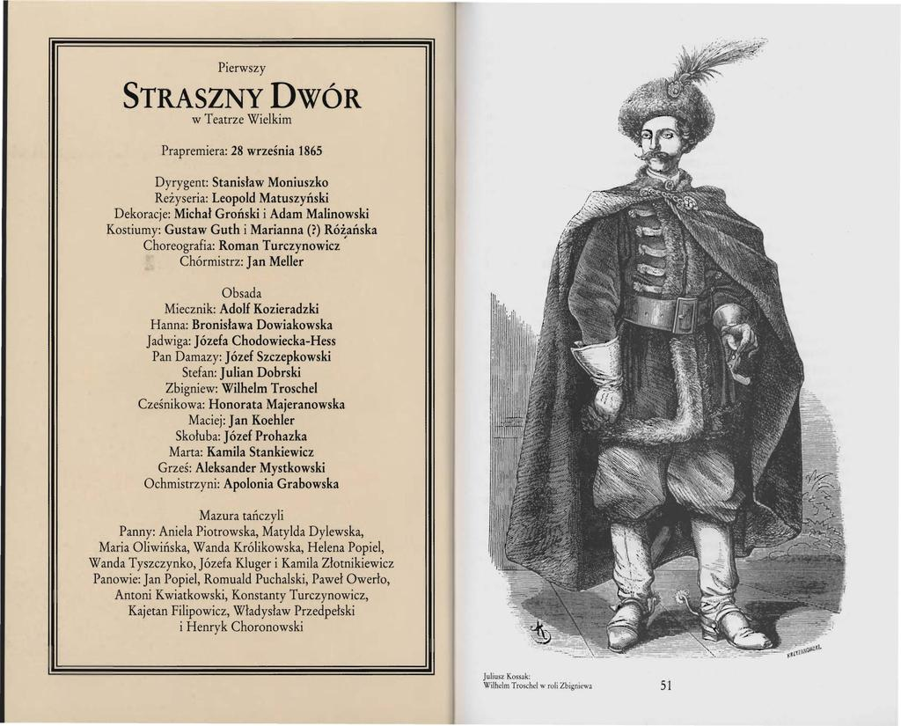
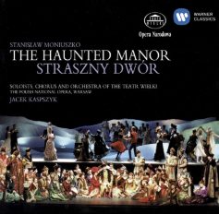
PERFORMANCE HISTORY
The Haunted Manor was first staged at the Grand Theater in Warsaw on September 28, 1865 and received only two more performances before being banned by the Russians.
An English language version of the opera was created in 1970. The world premiere of this English version was given by the University of Bristol Operatic Society in 1970. Nowadays the Haunted Manor is performed by different opera houses in Poland but it still is rather unknown outside our country.

Slide 7
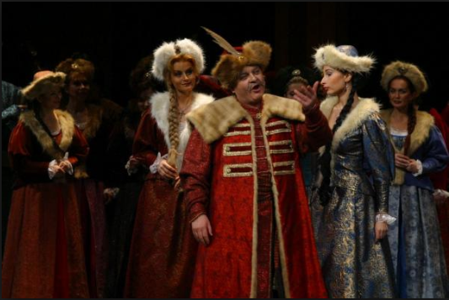
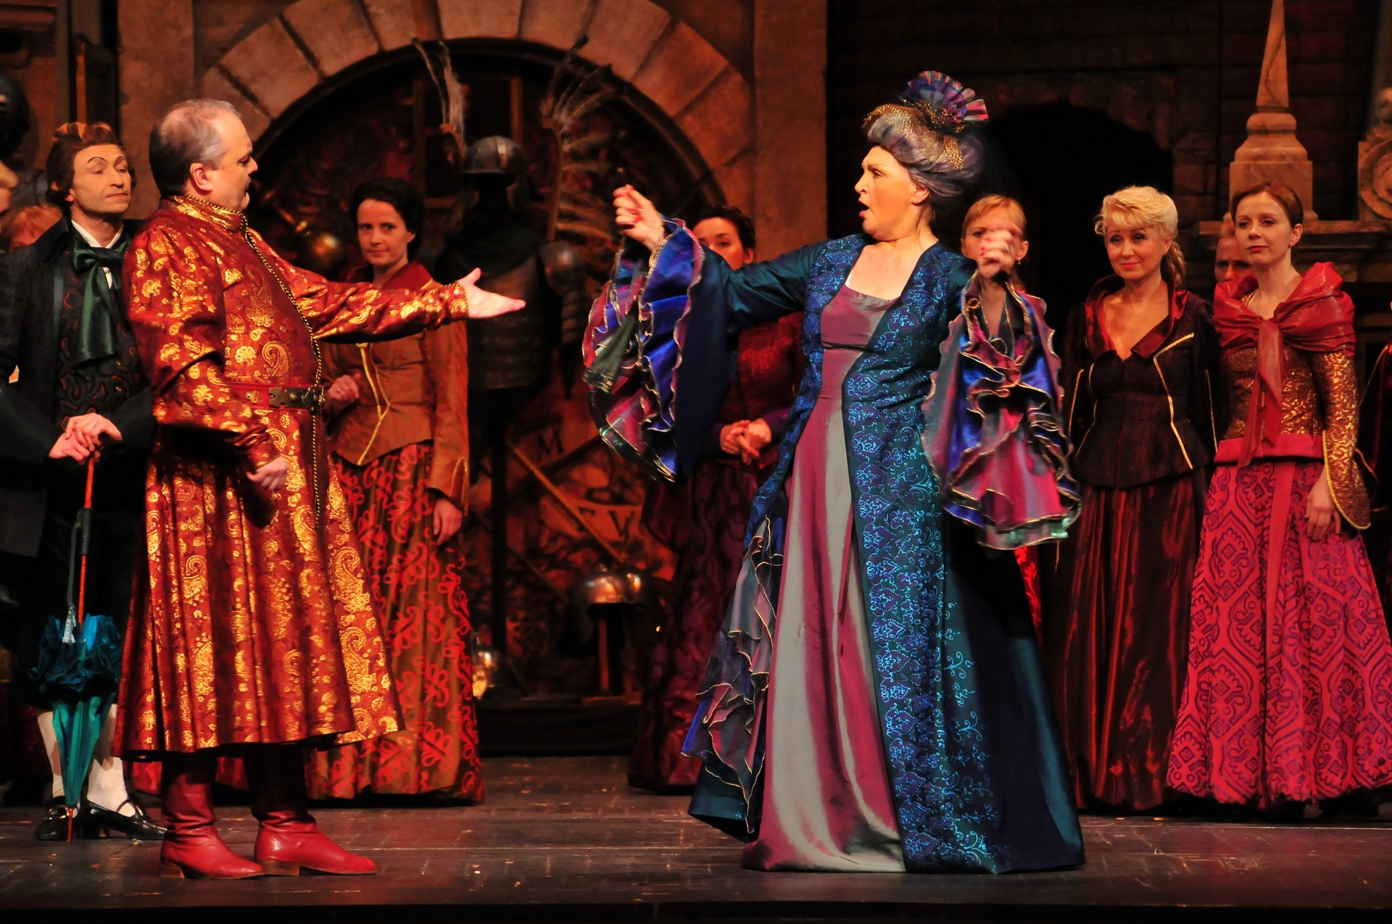
Libretto
Act I
Two brave soldiers, the brothers Stefan and Zbigniew, come home from war. They swear they will never marry, because they want always to be ready to fight for their country. But their aunt Czesnikowa, wants them to marry them off to two girls she has chosen for them. The brothers explain their vow, and inform her that they are off to visit Miecznik, (the “Sword Bearer”) - an old friend of their father.
Miecznik lives in a manor in Kalinów and he has two daughters Hanna and Jadwiga. Czesnikowa is sure that the brothers will fall in love with them, contrary to her own plans. She tries to put them off their visit by telling them that the manor is haunted, full of spirits and dread; but the young soldiers laugh at her words and leave for Kalinów.

Slide 8
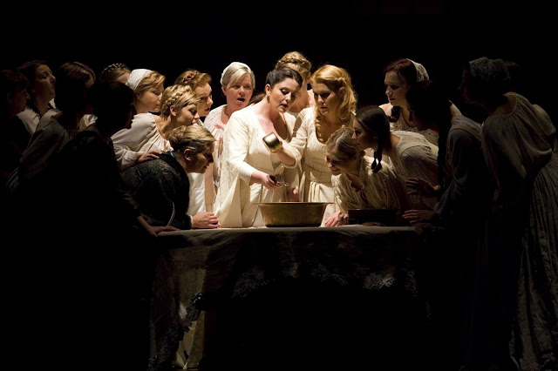
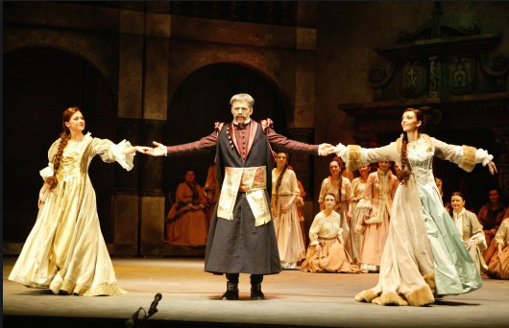
Act II
It is New Year's Eve and, in the “haunted” manor, Miecznik's daughters Hanna and Jadwiga are preparing for the customary fortune-telling to determine who will be their future husbands. Wax is melted, and they see the shapes of soldiers' helmets, pikes and chargers. Hanna is being courted by a foppish barrister, Damazy, who isn’t happy with the girl’s predictions. Miecznik explains that the type of husband he seeks for his daughters is a brave soldier and a patriot, mindful of customs and traditions — a description that Damazy does not measure up to. Czesnikowa arrives in advance of Stefan and Zbigniew, with the intention of portraying them as cowards in order to put Miecznik and his daughters off.

Slide 9
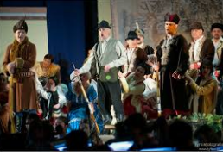
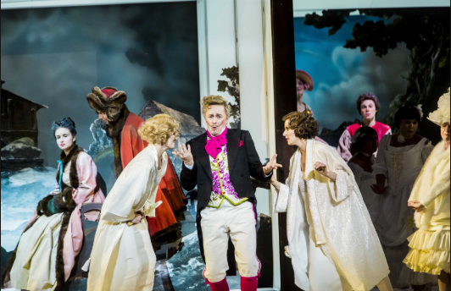
At that moment, a hunting party led by Skoluba arrives, and the hunters quarrel about the killing of a boar. Skoluba insists that he killed it, but it turns out that the boar was actually shot by the brave brothers who were just passing by on their way to Miecznik’s manor.
Stefan and Zbigniew arrive with their servant Maciej, and the two sisters decide to test out what Czesnikowa has told them by playing a trick on the brothers. Damazy has the same idea because he wants to eliminate his rivals and involves Skoluba, who had hoped to take credit for killing the boar and now resents the brothers' presence, in his plan..

Slide 10
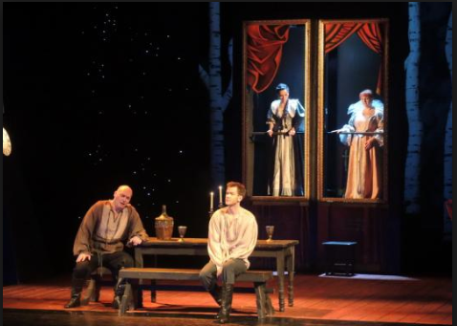
Act III
Skołuba tells Maciej how terrible and strange phenomena are taking place in the manor at night. When Skołuba leaves the room, the portraits of great-grandmothers begin suddenly to move on the wall. The perpetrators of this are Hanna and Jadwiga who are hidden behind the paintings. Maciej runs away but the brothers laugh at the superstitions and go to their rooms to rest.

Slide 11
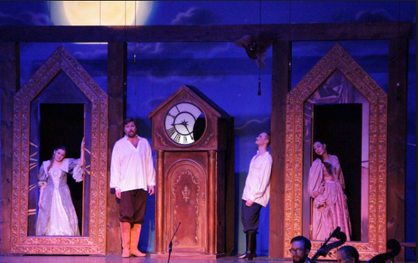
But Stefan is beginning to dream about Hanna's beautiful, blue eyes, and the mysterious chime melody (which is activated by Damazy hiding in the clock) reminds him of his dead mother. Zbigniew, unable to sleep, joins him and the brothers admit to each other that they have fallen in love with Hanna and Jadwiga, despite their vows.
After a while they notice movement behind the paintings and decide to find out what’s going on. Damazy comes out from his hiding place and, to save his skin, invents a story that the house is known as the `Haunted Manor' because horrible deeds were committed there in the past. The brothers decide they cannot stay, and make plans to leave straight away.

Slide 12
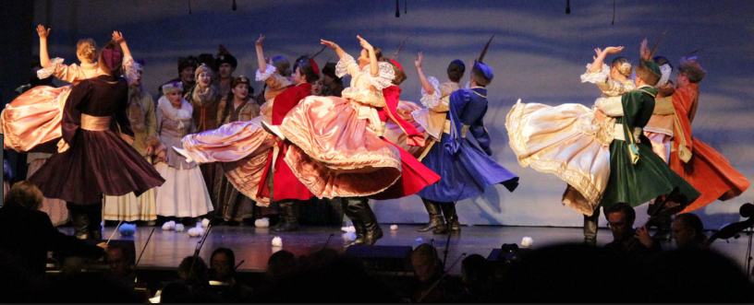
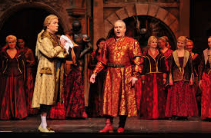
Act IV
The brothers tell Miecznik that they are about to leave and he believes them to be cowards after all; but Maciej tells him what happened at night and what are the real reasons for the brothers’ departure.
Suddenly a party of revellers and dancers burst into the house, one of whom is Damazy in disguise. Miecznik recognizes him and asks him why he had invented the story about the manor and misled the brothers. Damazy explains that he is in love with Hanna, and leaves hurriedly.

Slide 13
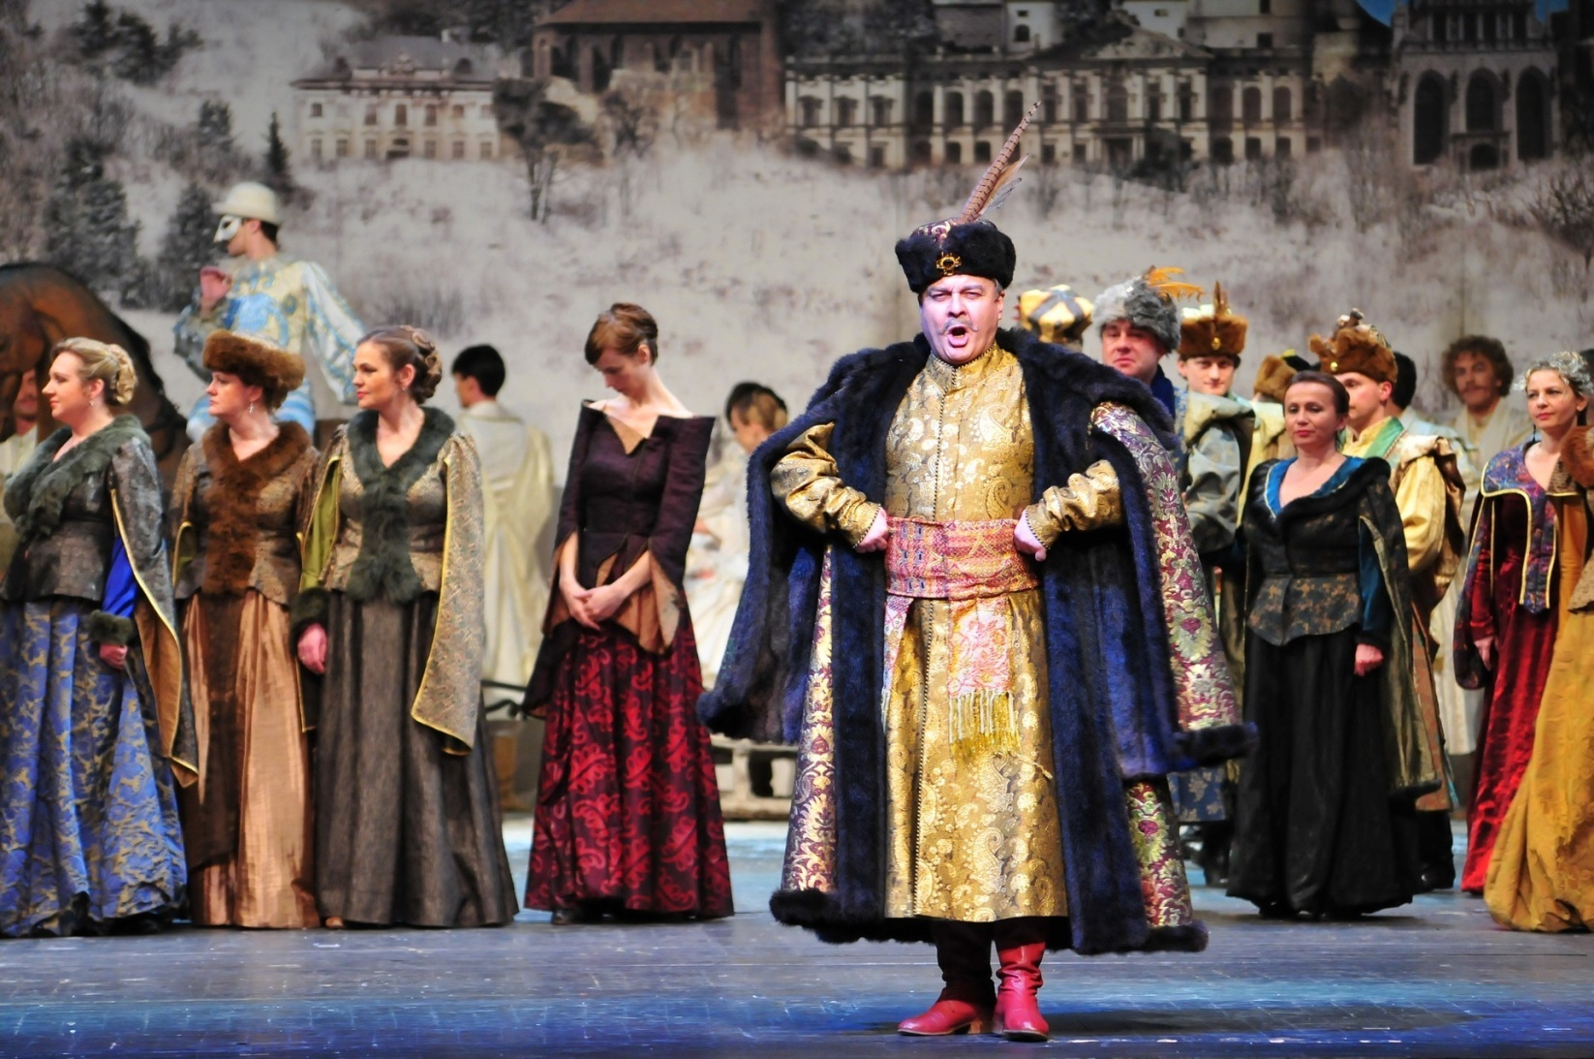
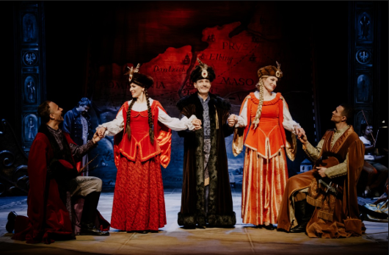
Miecznik then explains that his great-grandfather had nine beautiful daughters and that every man who came to the manor proposed to one of them. The envious mothers with unmarried daughters who lived nearby started talking that the manor was “haunted” and that it had magic powers. Stefan and Zbigniew apologize for their suspicions, and declare their love for Hanna and Jadwiga. Miecznik gives his blessing to his daughters and the brothers. Everyone is happy — except for the schemers Czesnikowa, Damazy, and Skoluba.

Slide 14
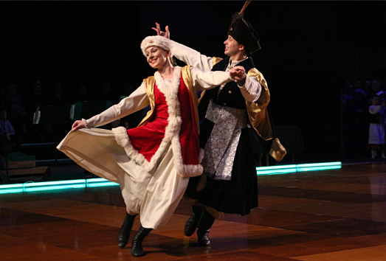
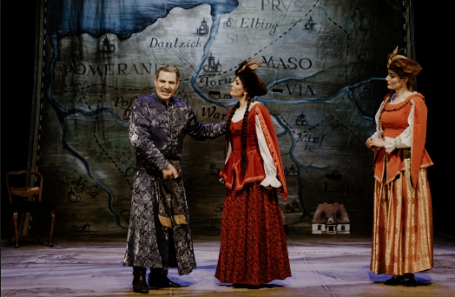
MUSIC IN THE OPERA
The music in the opera is full of references to Polish folklore, the best example of which is the final, fiery mazurka. In verbal terms, there are many references to the Sarmatian tradition - as in the Miecznik’s aria, who sings about qualities a real Pole should characterize: "He must be a brave man, love his country, be brave as a lion and be ready to die for his country." These words at a time when Poland was under partition were of special significance.

Slide 15
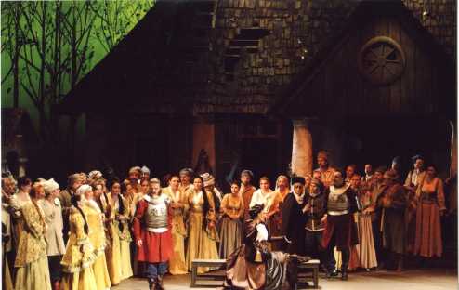
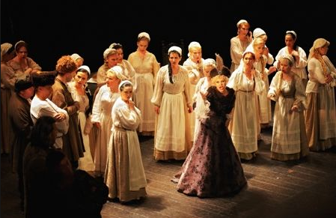
The Haunted Manor is praised for imaginative harmonies, excellent construction of group scenes, subtle but colorful instrumentation, melodic inventiveness of great sophistication, the composer’s individual operatic drama style, integration of Polish songs and dances (Mazurkas, Polonaises, Polkas, and Krakowiaks), and finally, the captivating Polish atmosphere.

Slide 16
THE END THANK YOU FOR YOUR ATTENTION!

