Slide 1
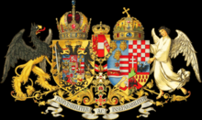
Culture in Austrio-Hungary Monarchy

Slide 2
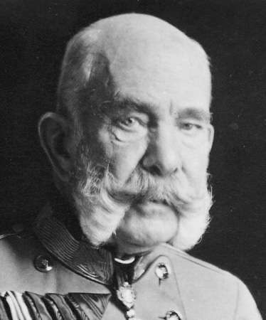
Usual things
1867-1918(Compromise- World War I)
Emperor is Franz Joseph I of Austria
It covered 621 538 km²
51 million people lived
National languages:German, Hungarian

Slide 3
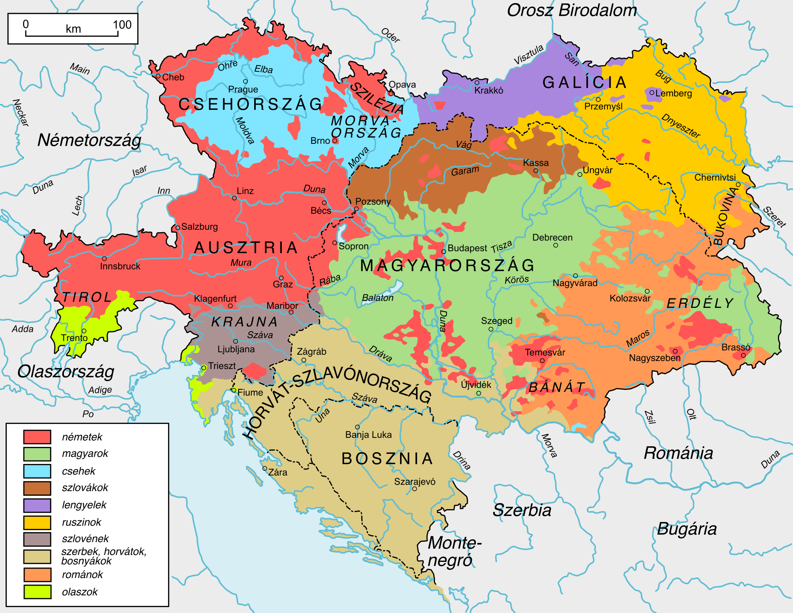
Nationals
Polish
Ukranien
Czechs
Slovakian
Szlovenian
Croatian
Serbian
Bosnian
Romanian
Italien
Hungarian
Austrian

Slide 4
Polishes in Austrio-Hungary Monarchy po polsku w Monarchia Austro-Wegierska
Language: Polish
Population: 4 976 804 people
Galician and Ladomerian Kingdom
Capital city: Lemberg
Famous people: Henryk Sienkiewicz, Wladyslaw Reymont, Marie Curie
Traditional custome: goral( same the Hungarian custome)

Slide 5
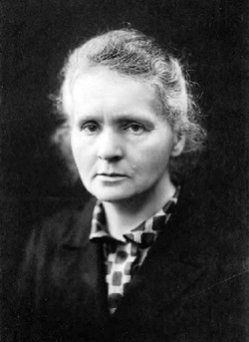
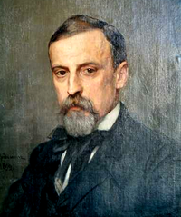
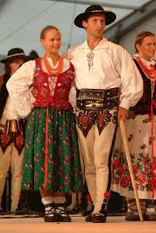
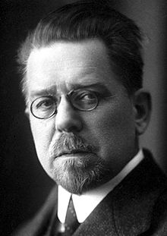

Slide 6
Czehs in Austrio-Hungary Monarchy Czehs v rakousko-uherské monarchii
Language: Czehs
Population: 668 000 people
Capital city: Prag
Important town: Brno
Famous people: Antonín Leopold Dvořák, Karel Čapek
Traditional custome: Kroj
Famous beer: Staropramen

Slide 7
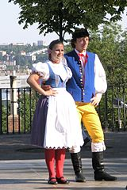
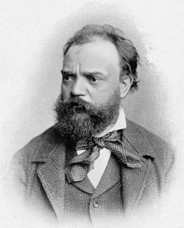
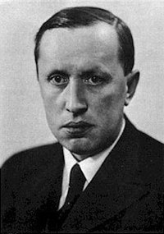

Slide 8
Slovakian in Austro-Hungary Monarchy Slovenský v rakúsko-uhorskej monarchii
Language: Slovakian
Population: 78 823
Capital city: Pozsony
Important towns: Pressburg, Presporok
Famous people: Hviezdoslav, Mikuláš Schneider-Trnavský
Traditional custome: bakonycsernei

Slide 9
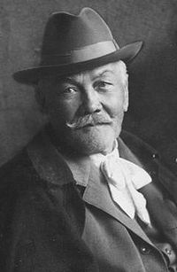
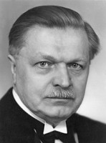
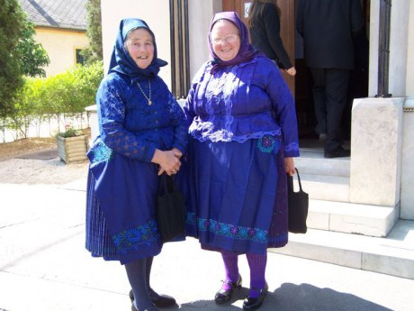

Slide 10
Romanian in Austro-Hungary Monarchy Română în monarhia Austro-Ungariei
Language: Romanian
Population: 260 689
Famous people: Mihai Eminescu, Mihail Sadoveanu
Traditional custome: 6 folklore breeds
Transilvania
Banat
Câmpiile de Vest
Zona Dunării
Basarabia
Ţara Românească

Slide 11
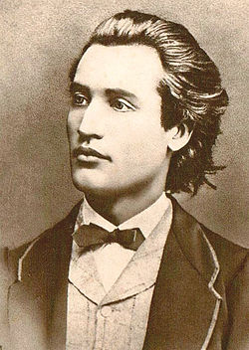
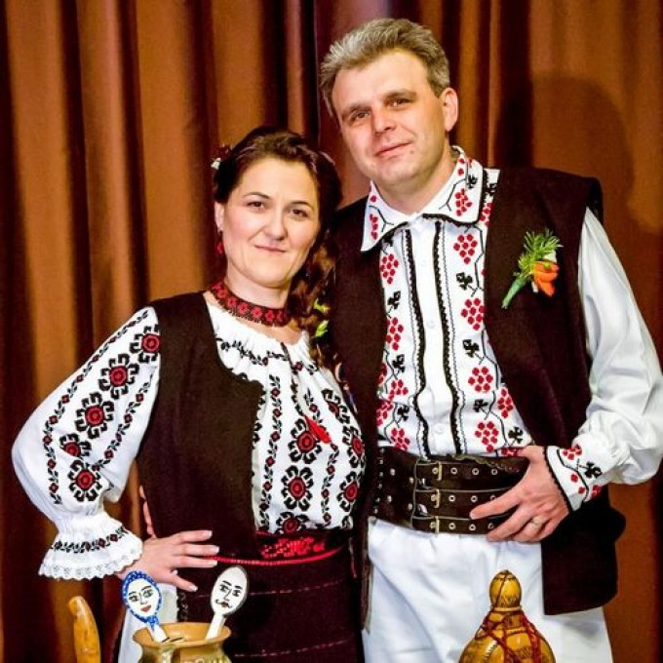
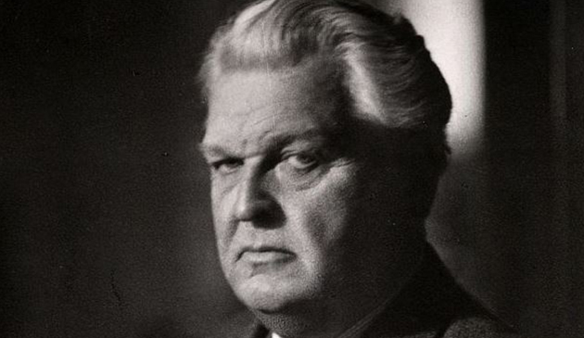

Slide 12
Croatian in Austrio-Hungary Monarchy Hrvatski u Austro-Ugarskoj Monarhiji
Language: Croatian
Population: 79 038 people
Capital city: Zagreb
Important town: Agram
Famous people: Marija Jurić Zagorka, Petar Preradović
Traditional custome: bezenyien

Slide 13
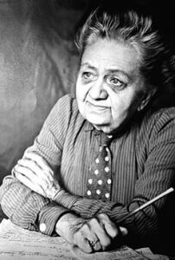
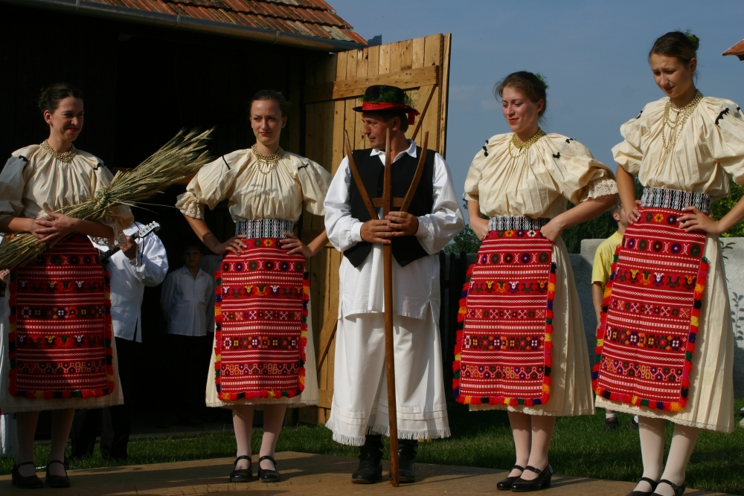
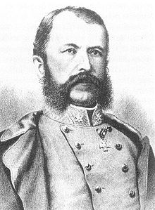

Slide 14
Serbian in Austrio-Hungary Monarchy Српска у Аустро-Угарској монархији
Language: Serbian
Population: 94 610 people
Capital city: Belgrad
Important town: Szabadka
Famous people: Nikola Tesla, Ivo Andrić
Traditional costume: Pomazi

Slide 15
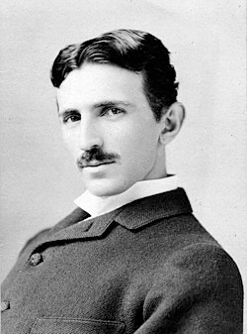
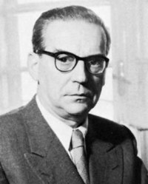
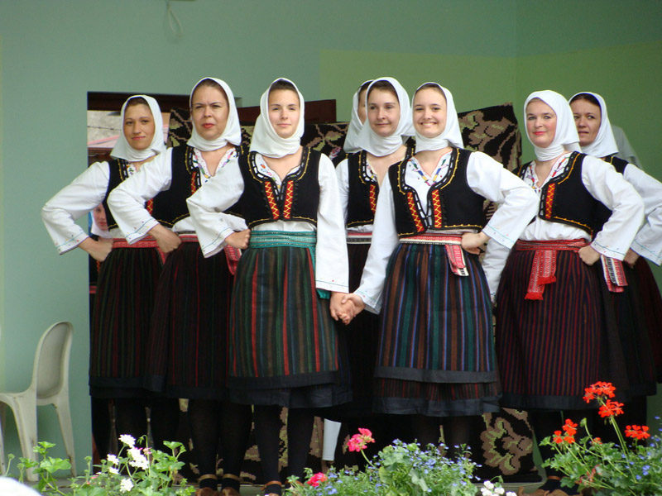

Slide 16
Italien in Austro-Hungary Monarchy Italia nella monarchia austro-ungarica
Language: Italien
Population: 229 510 people
Capitaly city: Triest
Famous people: Giuseppe Verdi
Traditional custome: Sardinian

Slide 17
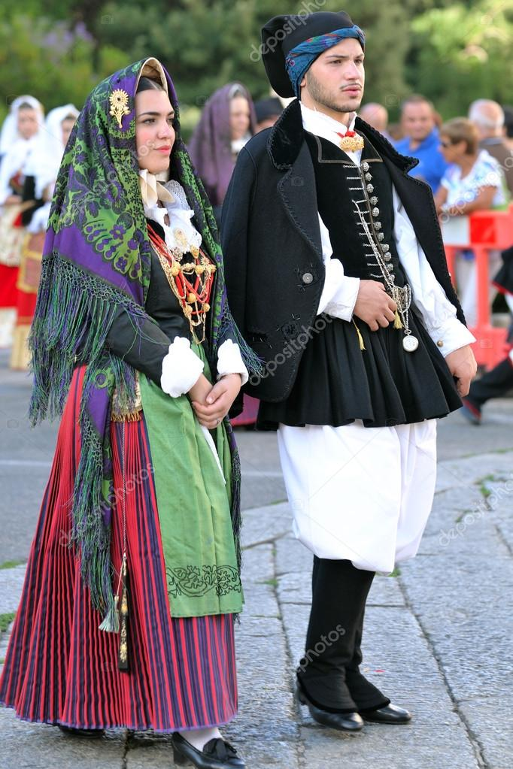
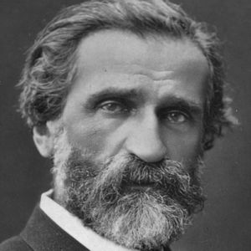

Slide 18
Austrian in Austro-Hungary Monarchy Österreicher in Österreich-Ungarn Monarchie
Language: German
Population: 2 083 630
Capital city: Vienna
Important towns: Salzburg, Insbruck, Graz, Linz
Famous people: Arnold Schönberg, Erwin Schrödinger, Robert Musil
Traditional custome: Wiesn Drindl

Slide 19
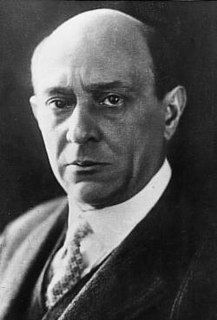
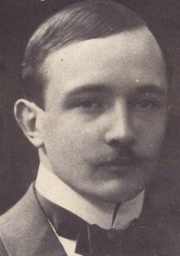
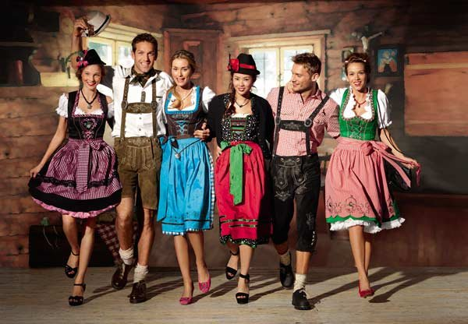
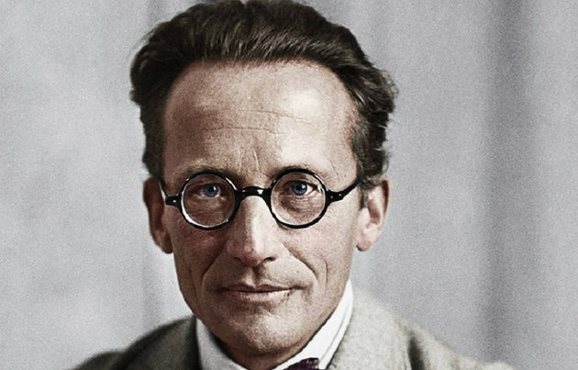

Slide 20
Hungarian in Austro-Hungary Monarchy magyarok az Osztrák-Magyar Monarchia idején
Language: Hungarian
Population: 1 232 026 people
Capital city: Budapest
Important towns: Szeged, Debrecen
Famous peope: Deák Ferenc, Tamási Áron, Kodály Zoltán
Traditional custome: Paloc, Mezőkövesdi

Slide 21
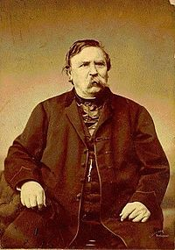
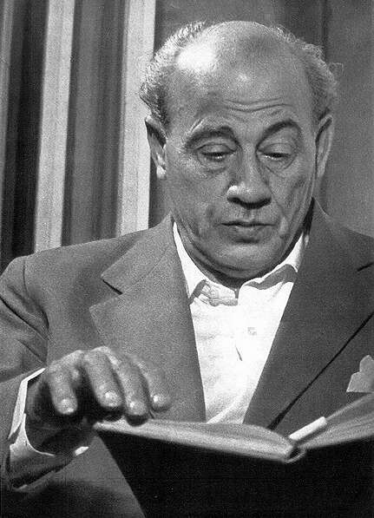
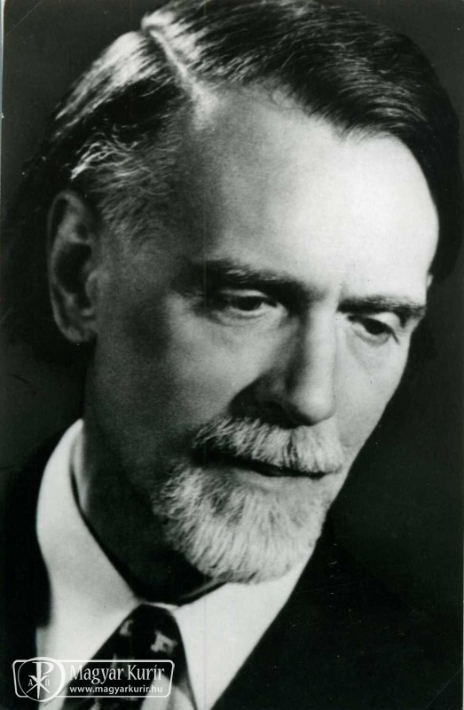
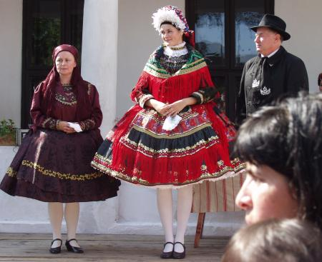

Slide 22
Source-string
https://hu.wikipedia.org/wiki/Osztr%C3%A1k%E2%80%93Magyar_Monarchia

Slide 23
Thanks for your watching

