Slide 1
Immigration in France
Einwanderung in Frankreich
Notes:
1

Slide 2
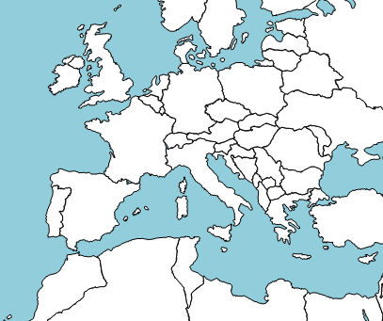
Countries of origin : immigration in France in 2012
Spain/Spanien
Italy /Italien
Portugal
Algeria/Algerien
Morocco
Tunisia/Tunesien
Turkey/die Türkei
Italy : 10,4 %
Portugal : 10,4 %
Spain : 7,3 %
Turkey : 3,8 %
Tunisia : 4,4 %
Morocco : 11 %
Algeria : 14,3 %
Notes:
2

Slide 3



French famous personalities
Beitrag der Einwanderer in Frankreich
Notes:
3

Slide 4
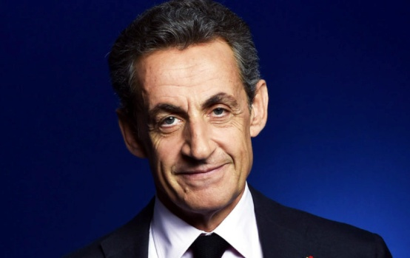
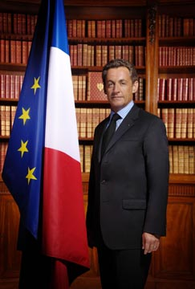
Nicolas Sarkozy
He was born in 1955.
He was the President of France from 2007 to 2012.
He had a parent from Hungary.
Notes:
4

Slide 5
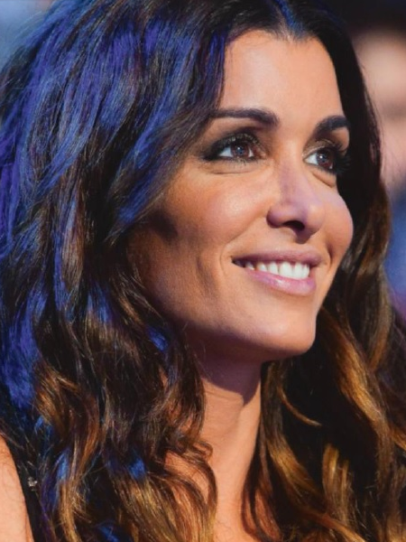

Jennifer
She was born in 1982 in Nice.
Her father is algerian and her mother is corsican
She is a singer.
She became famous thanks to a music show « Star academy »
Notes:
5

Slide 6
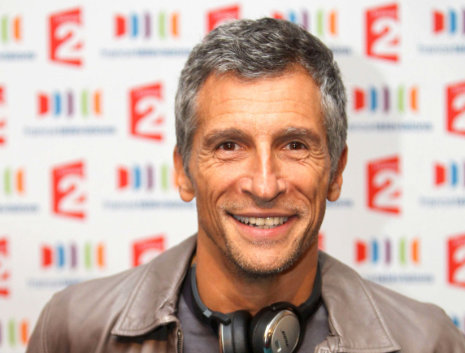

Nagui Fam
He was born on the 14th of November 1961 in Alexandrie (Egypt).
He is a radio host, a television producer and a comedian .
He is very popular in France.
Notes:
6

Slide 7
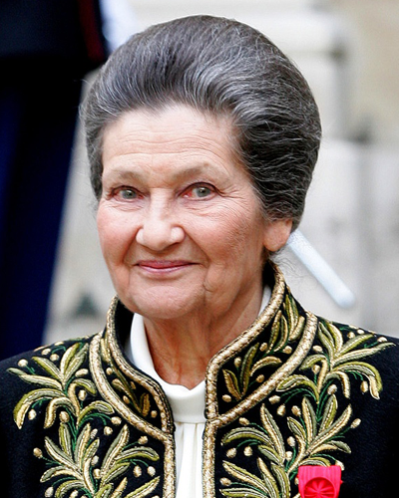
Simone Veil
She was born on the 13th of july 1927 in Jacob family and she married Antoine Veil.
She died on the 30 th june 2017.
Her father had Czech origins and they were jews.
During the second world war, Simone was deported in Auschwitz with her family.
She was the second woman minister in France in 1974. She worked for the woman rights.
Notes:
7

Slide 8
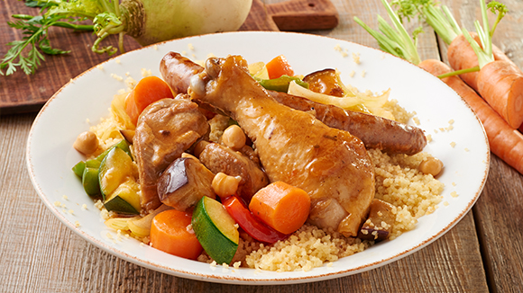
The couscous
Ingredients :
Olive oil
Couscous
Chicken
Chickpea
Tomatoes, carrots, courgettes.
It comes from Tunisia and Morocco
Notes:
8

Slide 9
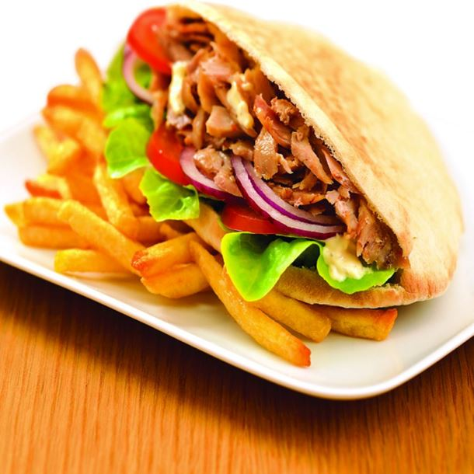
Kebab
Ingredients :
Bread
Lamb meat
Onion
Salad
Tomato
It comes from Turkey
Notes:
9

