Slide 1
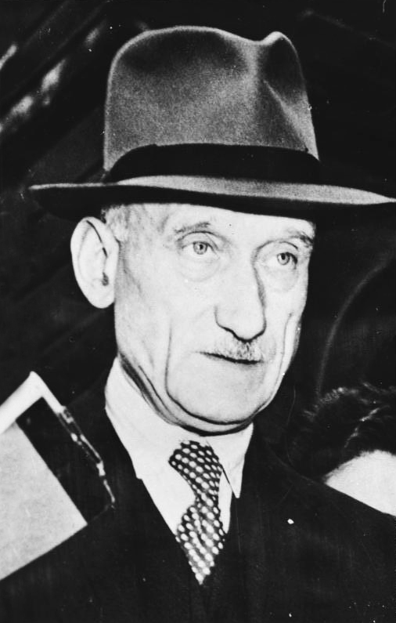
The predecessor to European Union
Country : Luxembourg
Robert Shuman :
He was born on 29 June 1886 in Luxembourg and he died on 4 september 1963 in France.
He is considered to be the father founder of the european construction with Jean Monnet, Konrad Adenauer, Johan Willem Beyen, Paul-Henri Spaak and Alcide De Gasperi.
Er wurde am 29.Juni1886 in Luxemburg geborenund starb am 4.Sept 1963.Er ist wie der Vater der europäischen Union betrachtet
Notes:
1

Slide 2
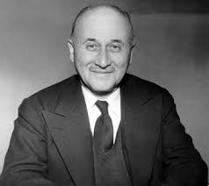
Jean Monnet
Country : France
He was born on 9 november 1888 in France and he died on the 16 of March 1979.
He worked to build an Union based on the model of the United States of America.
Er ist am 9.November 1888 in Frankreich geboren. Er starb am16. März 1979.
Er arbeitete für die Gründung einer Union wie in die USA.
Notes:
2

Slide 3
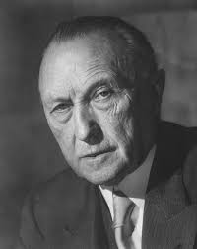
Konrad Adenauer
Country : Germany
He was born on the 5 of january 1876 in Germany and he died on the 19 of april 1967 in Germany.
He was the first federal chancellor to Germany Federal Republic.
Er wurde am 5. Januar 1876 in Deutschland geboren. Er starb am 19.April 1967 in Deutschland.
Er war der erste Bundeskanzler Deutschlands.
Notes:
3

Slide 4
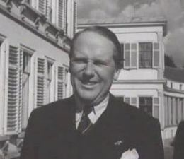
Johan Willem Beyen
Country : Netherland
He was born on the 2nd of may 1897 in the Netherland and he died on the 29th of april 1976.
He was a banker, a politician and a netherland diplomat.
Er wurde am 2.Mai 1897 in Niederland geboren und starb
Am 29. April 1976.
Er war Banker,Politiker,und Diplomat
Notes:
4

Slide 5
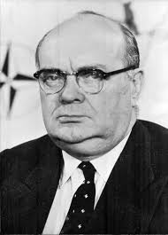
Paul-Henri Spaak
Country : Belgium
He was born on 25 january 1899 in Belgium and he died 31 july 1972 in Belgium.
He was many times minister in the gouvernements of Belgium ,and minister of international business and the first minister.
Er wurde am 25.Januar 1899 in Belgien geboren und starb 31 Juli 1972.
Mehrmals wurde er als Regierungsminister, Handelsminister und Premierminister ernannt.
Notes:
5

Slide 6
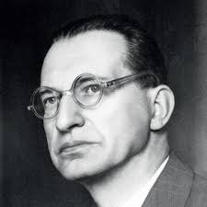
Alcide de Gasperi
Country : Italy
He was born on the 3 april 1881 in Italy and he died 19 aout 1954 in Italy.
He made the christian democracy. He was the president of the european council.
Er wurde am 3. April 1881geboren und starb am 19.August 1954.
Seine Partei war die christliche-Demokratie.Er war Ratsvorsitzende in Italien.
Notes:
6

