Slide 1
23rd Primary school of thessaloniki – greece - LET’S TALK ABOUT OUR ANCESTORS
OTHER ANCIENT GREEK HEROES

Slide 2
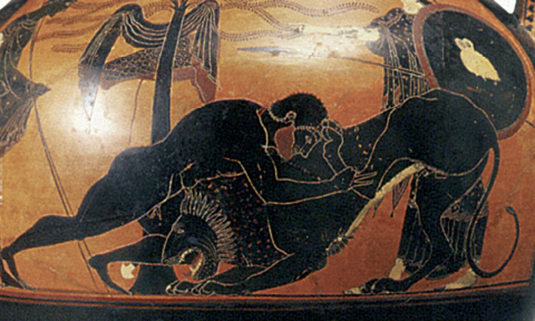
Heroes
A hero is in mythology and legend, a man or woman, often of divine ancestry, who is endowed with great courage and strength, celebrated for his or her bold exploits, and favored by the gods.

Slide 3
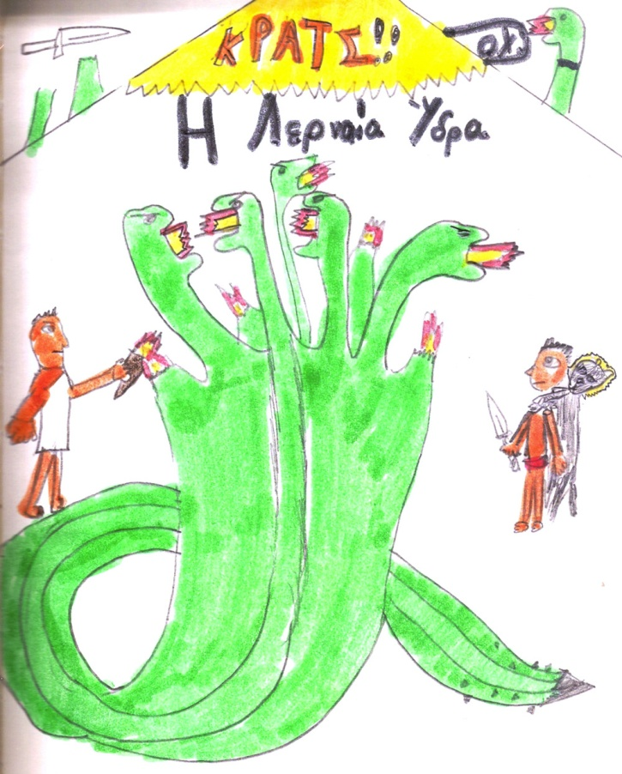
Hercules (Herakles)
Brave and powerful Hercules is perhaps the most loved of all Greek heroes. The son of Zeus and Alcmene, Heracles grew up to become a famed warrior. But Zeus's jealous wife, Hera, made him temporarily insane, and he killed his wife and children. As punishment Heracles performed twelve seemingly impossible labors. Heracles is often depicted wearing a lion skin and wielding a club.

Slide 4
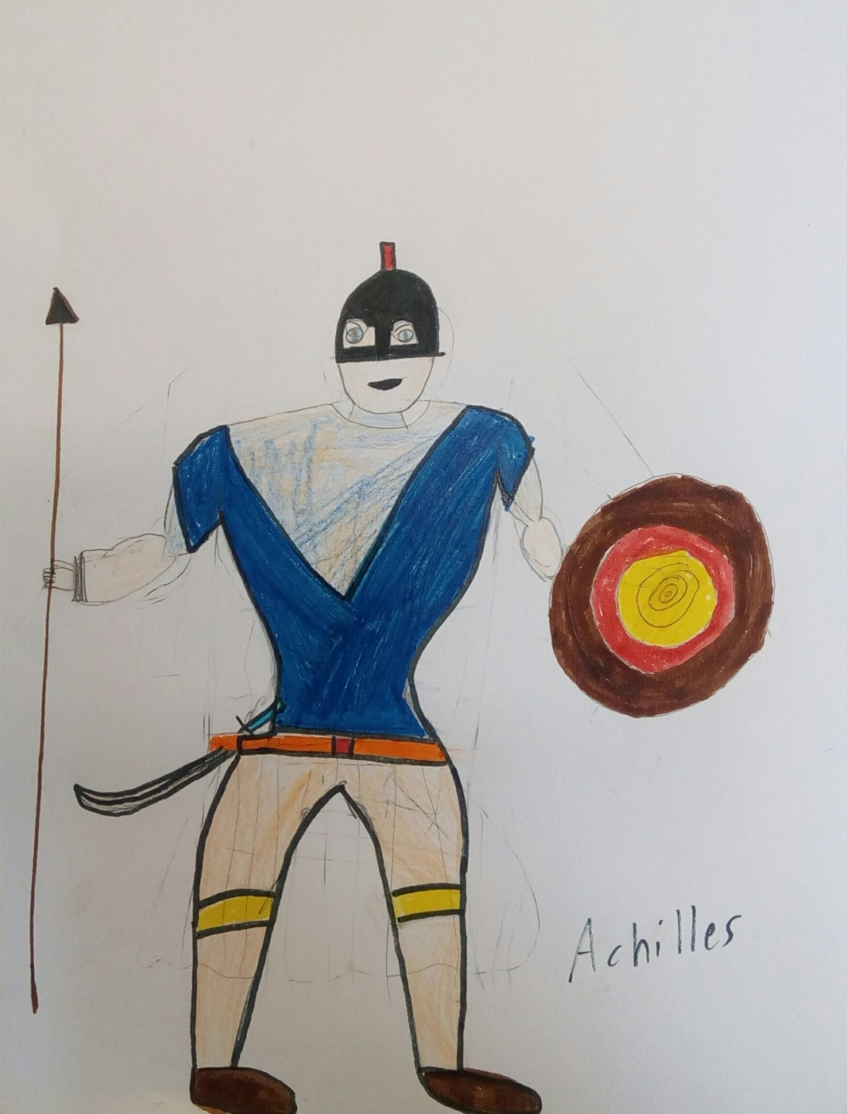
Achilles
Achilles was the strongest and most fearless warrior in the Greek war against the Trojans. As an infant his mother dipped him into the River Styx, which made him invulnerable everywhere but the heel by which she held him. For ten years Achilles was a great hero in the Trojan War. But in the end Paris, son of the Trojan king, fatally wounded Achilles in the heel. Today, the tendon that connects the calf muscles to the heel bone is called the Achilles tendon, and a small but dangerous weakness is known as an “Achilles heel.”

Slide 5
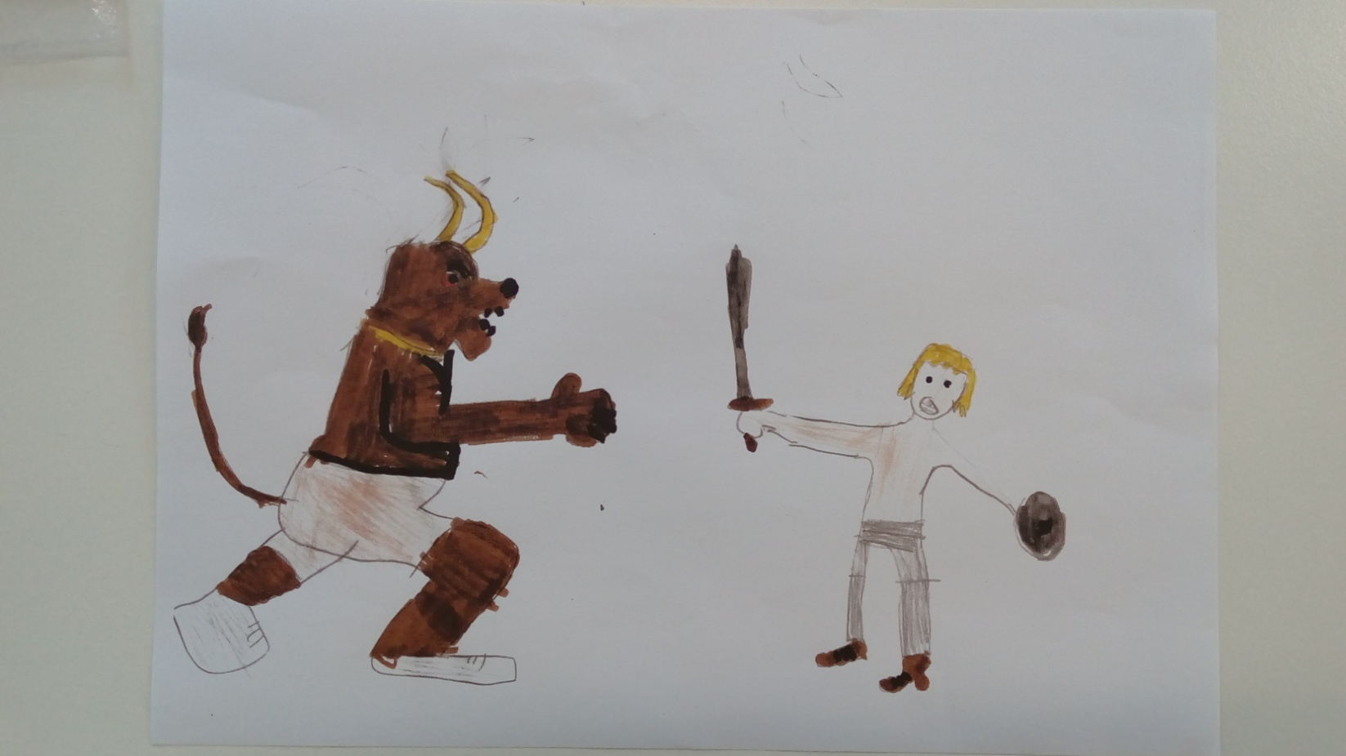
Theseus
Theseus was known for his triumph over numerous monsters, especially the Minotaur, which lived in a labyrinth on the island of Crete. Every year the people of Athens had been forced to send fourteen young people for the Minotaur to eat alive. But Theseus, using a ball of magic thread from the princess Ariadne, found his way in and out of the labyrinth and killed the beast. Theseus was the son of Aegeus, king of Athens. Later he became king of Athens and a famous warrior.

Slide 6
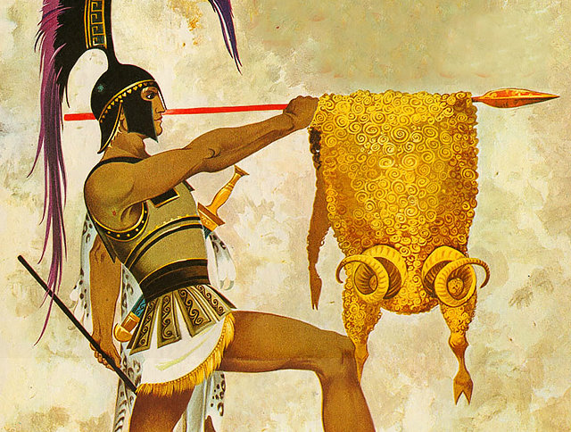
Jason
Jason was the leader of the Argonauts, the 50 heroes who sailed in search of the Golden Fleece. Jason's uncle, Pelias, had stolen the kingdom that should belong to Jason. He promised to return it only if Jason would bring home the Golden Fleece—the wool from the magical winged ram. On their journey Jason and the Argonauts faced down many dangers. They ultimately captured the fleece with the help of the sorceress Medea, who became Jason's wife.

Slide 7
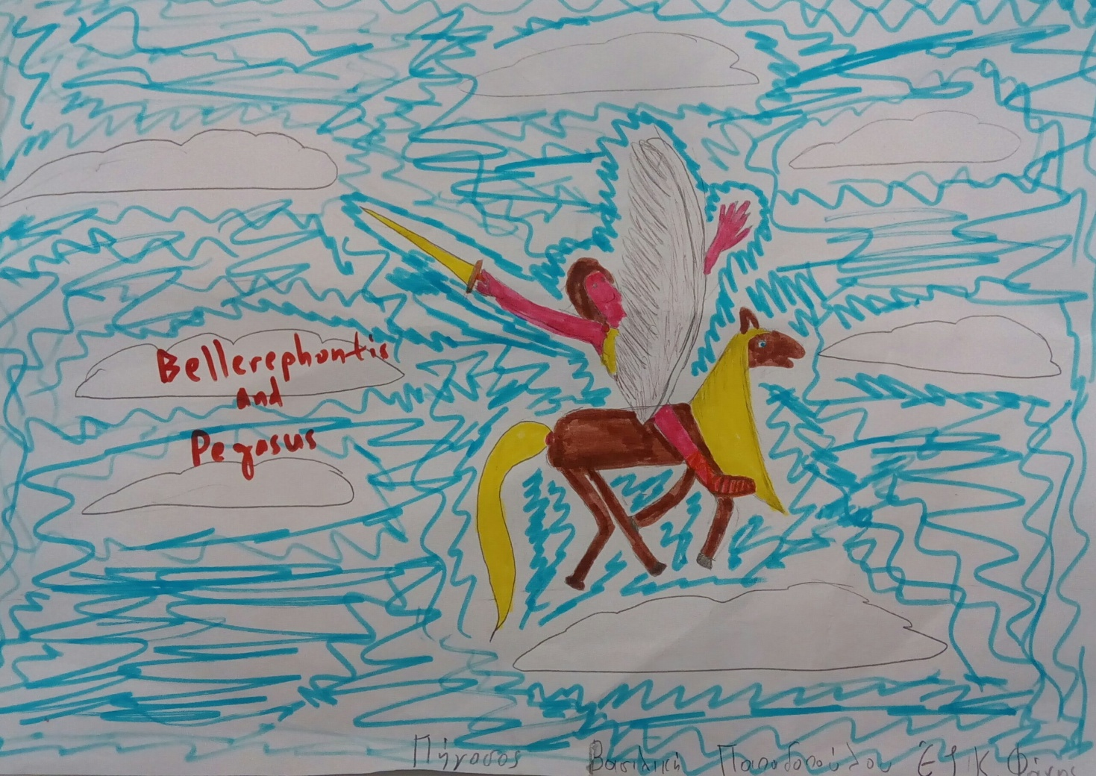
Bellerophontes
Son of Poseidon, he captured the winged horse Pegasos. He was later exiled for the murder of a family member and journeyed to the court of King Proetus in Argos for purification. But Proetus sent him off to King Iobates in Lykia with a closed letter requesting the youth be put to death. Iobates commanded him to slay the fire-breathing Chimera which was ravaging the land. He rode into battle against the beast on the back of Pegasos and slew it by driving a lead-tipped spear into its fiery gullet. The king then ordered him to subdue the barbarous Solymoi tribe, and later the Amazones, but again he proved victorious. Finally, Iobates commanded his guards to ambush and kill the youth, but he slew them all. The king was forced to acknowledge that Bellerophontes must be the son of a god and welcomed him into his house as his son-in-law and heir. Despite all of his successes, Bellerophontes was still not satisfied and sought to ascend to mount Olympus, where the Gods lived, on the back of Pegasos. Zeus was angered and sent a gadfly to sting the horse, causing it to buck and cast the hero back down to earth. After this he wandered the world alone, despised by both gods and men.

Slide 8
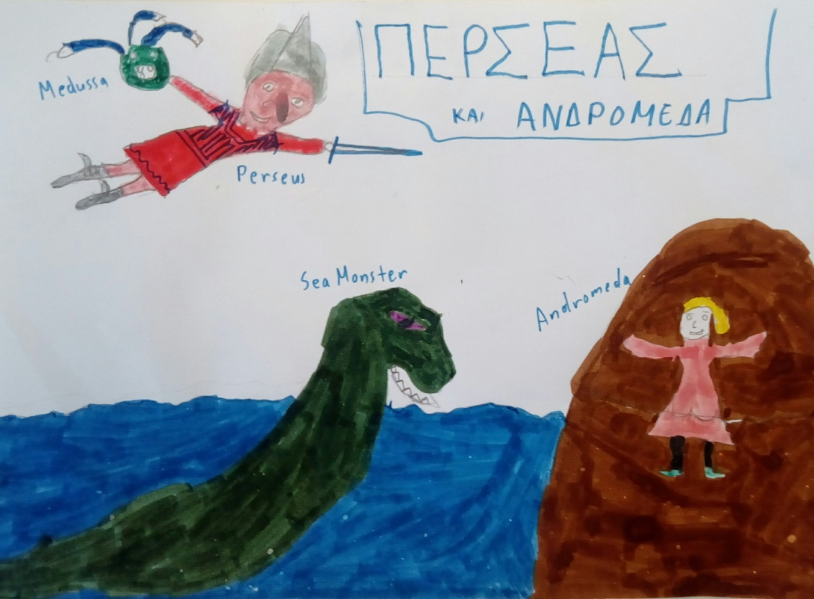
Perseus
The son of Zeus and the Argive princess Danae, Perseus completed dangerous feats with his quick thinking and talents as a warrior. Most famous was his slaying of the Gorgon Medusa. Because looking directly at the monstrous Medusa would turn a man to stone, Perseus killed her while watching her reflection in a mirror. After beheading the Gorgon with his sword he kept her head in his satchel. Later, to save the Aethiopian princess Andromeda, chained to a rock as a sacrifice to a sea-monster, from being eaten by the monster, Perseus pulled out Medusa's head and turned the creature to stone. He brought her with him back to Greece as his bride. Perseus was the ancestor of the royal houses of Mycenae and Sparta. His most famous descendant was Hercules.

