Slide 1
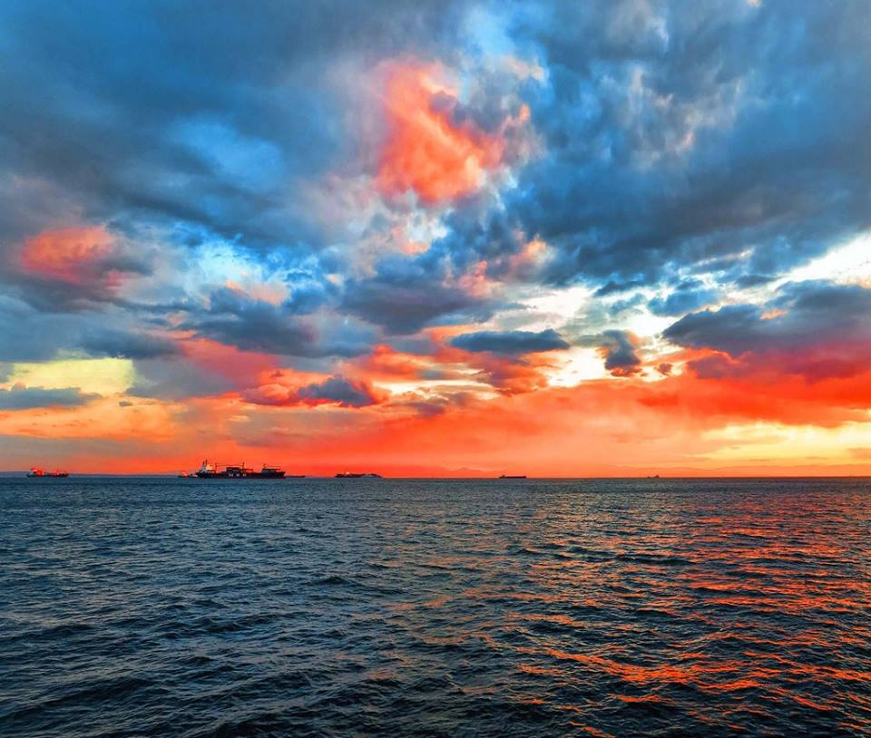
23RD PRIMARY SCHOOL of Thessaloniki, Greece
- Talking about
Our Ancestors

Slide 2
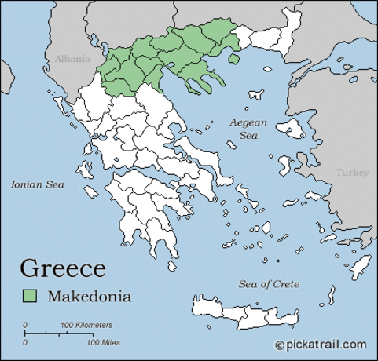
GREETINGS FROM GREECE a part of South-East Europe.
We live in Northern Greece,
in the region of Macedonia.

Slide 3
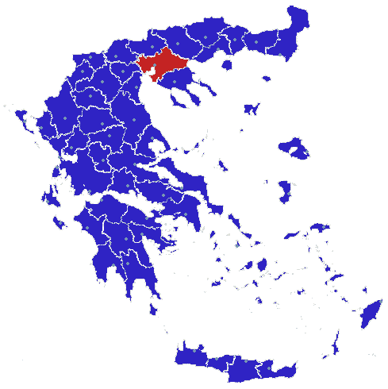
Our city is Thessaloniki!
Thessaloniki is a big and ancient greek city.

Slide 4
Thessaloniki was established by king Cassander of ancient Macedonia, in 315 BC. He gave our city his wife’s name, who was a sister of Alexander the Great and daughter of king Philip.

Slide 5
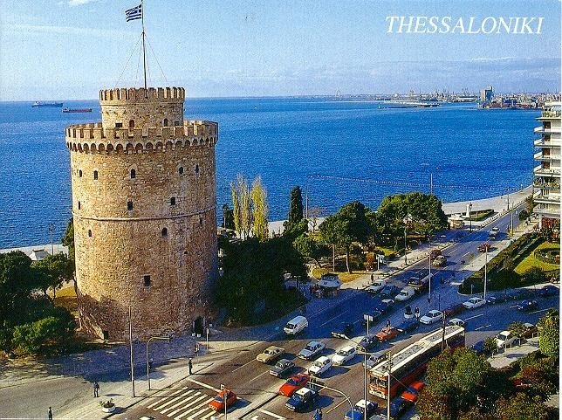
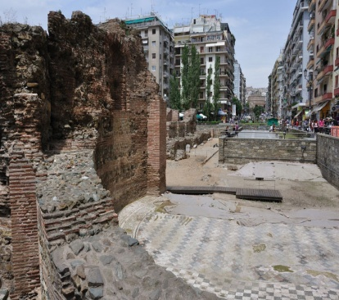
Thessaloniki remained a big and famous city through three empires: Roman, Byzantine and Ottoman.

Slide 6
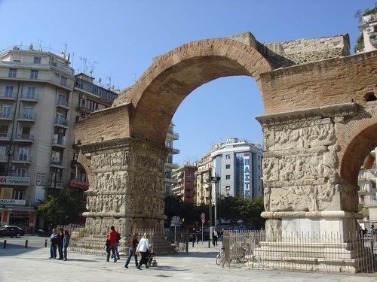
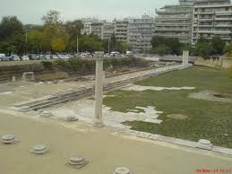
There are many ancient greek and roman remains, ruins and buildings,

Slide 7
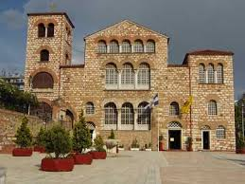
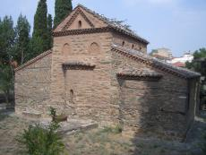
and many byzantine churches.

Slide 8
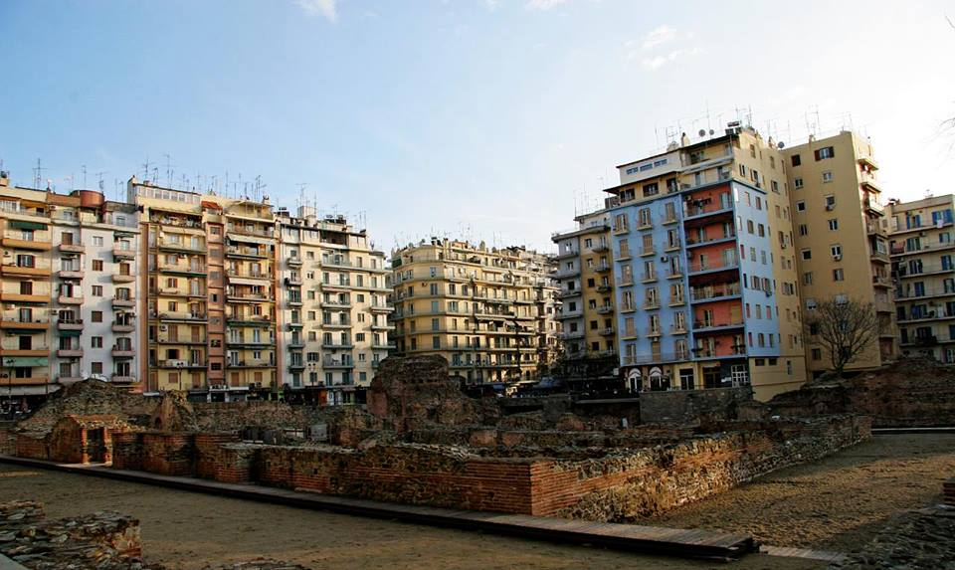
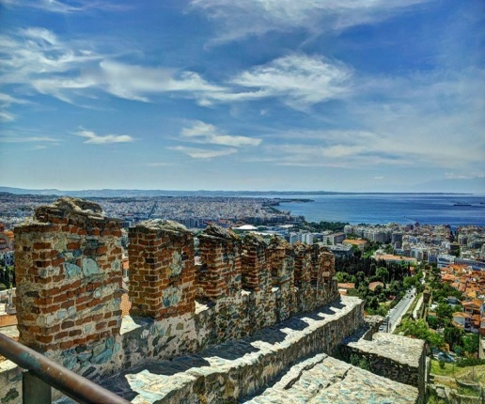
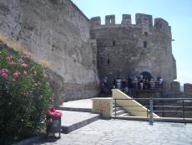
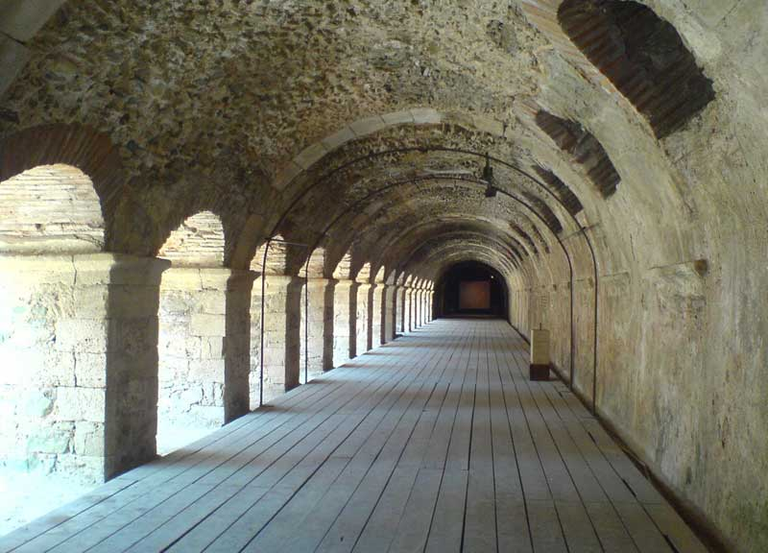
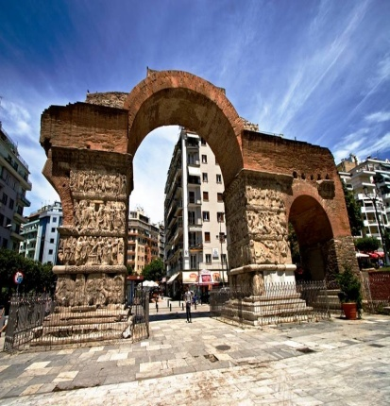
Our city is a living museum !

Slide 9
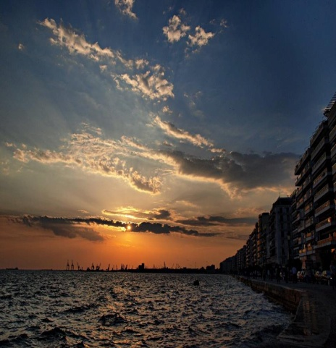
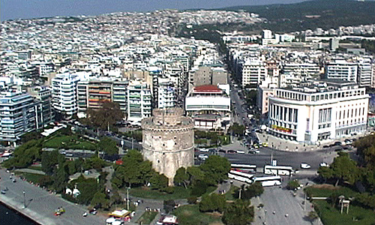
Thessaloniki is still a big and very beautiful city

Slide 10
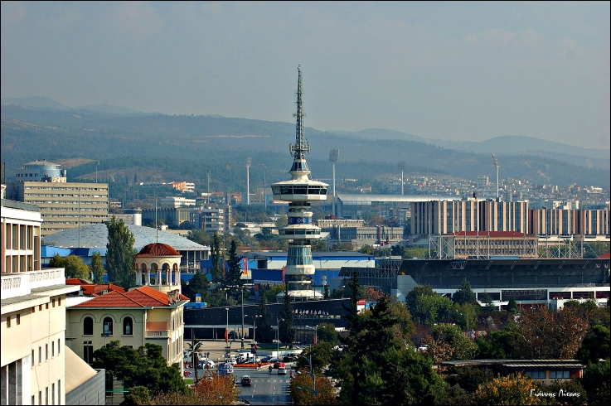
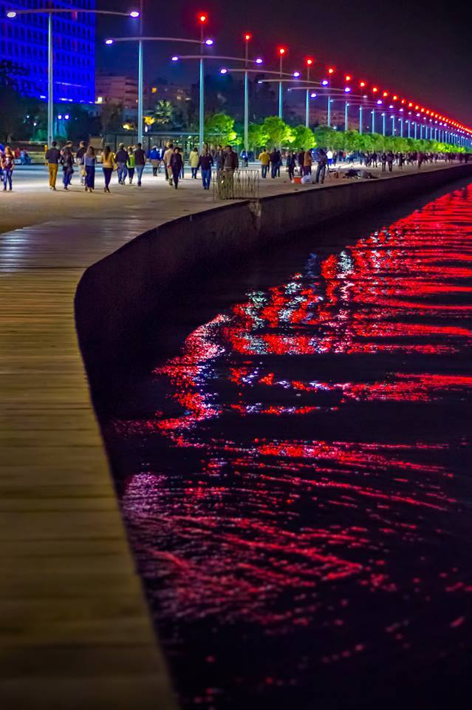
Its population nowdays is more than 800.000 people.

Slide 12
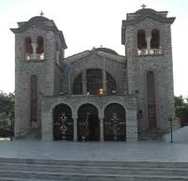
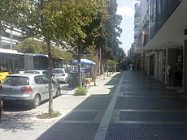
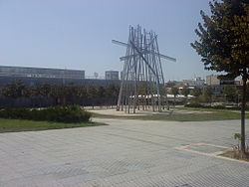
Τhis is our neighbourhood , Ano Toumba .

Slide 13
And this is our school, the 23rd Primary School of Thessaloniki.

Slide 14
Our school has 250 pupils and 28 teachers.

Slide 15
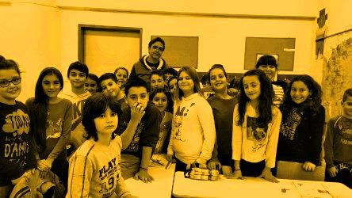
And we are the 1st class of the 5th grade.

Slide 16
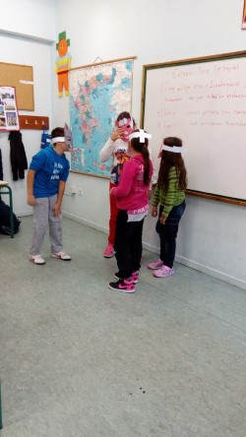
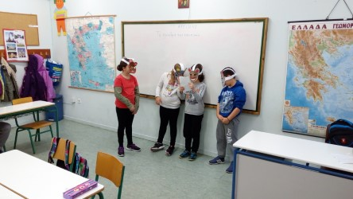
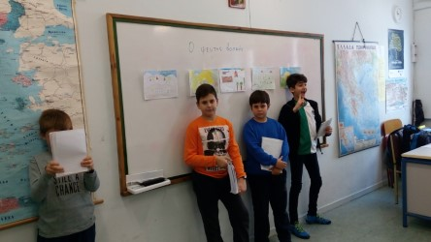
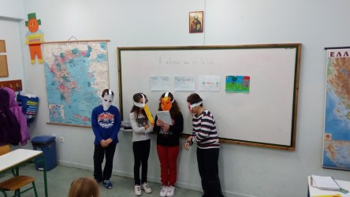
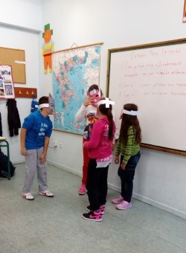
11 girls and 13 boys, 1 basic teacher (responsible for language & literature , maths , physics , history and religion), and 5 supporting teachers ( for english language, athletics , informatics , music & art )

Slide 17
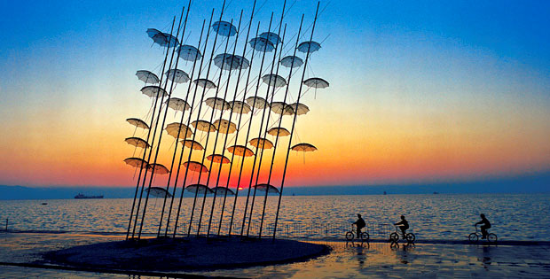
We hope we’ll all have a nice collaboration in our project, “Talking about our Ancestors”.

