Slide 1
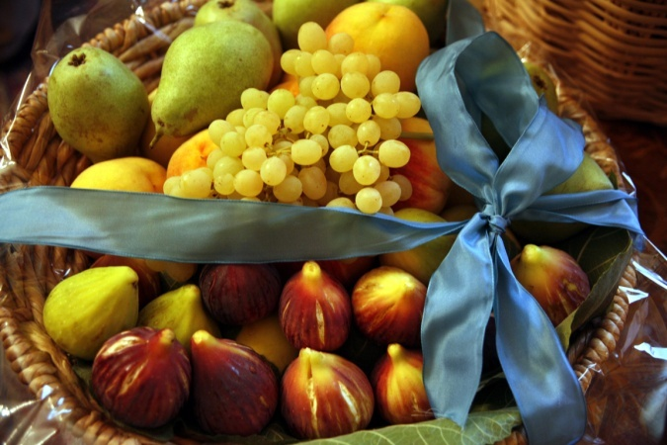
Ancient Greek Recipes
23rd Primary School of Thessaloniki – Greece
“Let’s talk about our Ancestors”

Slide 2
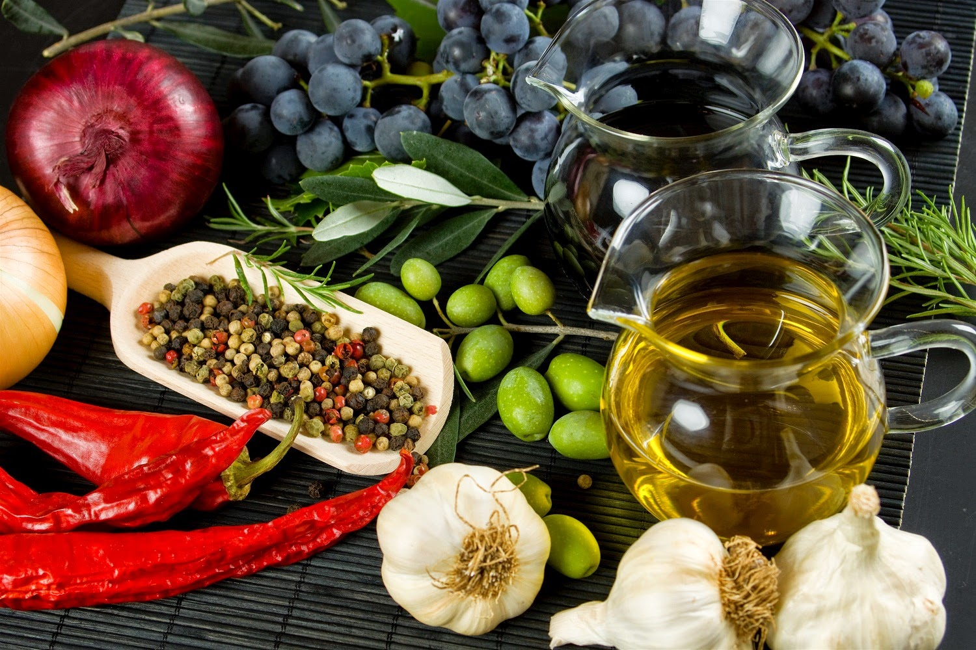
What Did the Ancient Greeks Eat?
The foods of ancient Greece were similar to foods we eat today but did not include many that have become important parts of modern Greek cooking. For example, tomatoes, peppers, potatoes, and bananas didn't arrive in Greece until after the discovery of the Americas in the 15th century, because that's where those foods originated. Lemons, oranges, eggplant and rice also arrived later. But the ancient Greeks enjoyed a varied diet, with a concentration on vegetables (Carrots, Onions, Cucumbers, Radishes, Bulbs, Cabbage, Asparagus, Garlic etc.), legumes, fruits (especially figs, grapes and apples), and fish - although meat was also eaten. Hunting brought game to the menu.
Meats were roasted on spits, cooked in ovens, and boiled. Fish was often cooked with cheese. Wine was watered down and sometimes garlic was added. The technique to make the very thin phyllo dough had been discovered sometime around the 4th century B.C.E., so it's likely that sweets like baklava were also eaten - but no sugar! Honey was the traditional sweetener, as were figs and products made from naturally sweet grapes.
The oldest known recipe is for slices of fish cooked with cheese and oil. Measurements were vague since it was presumed that a good cook would know the correct amounts. Men did the roasting of meats over coals or on spits (ancient barbecues), and women did the baking, boiling, and oven cooking.

Slide 3
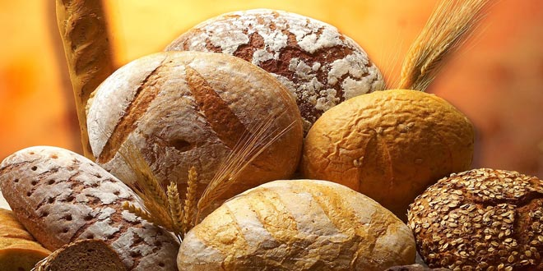
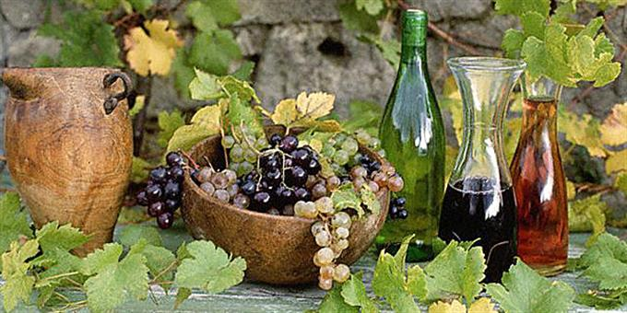
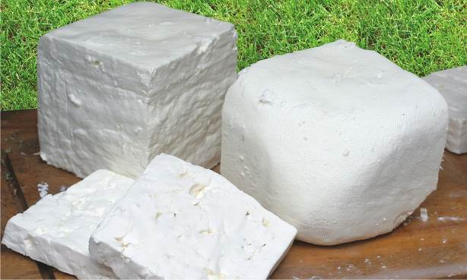
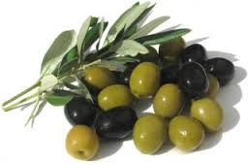
Breakfasts of the Ancient Greeks
Most ancient Greeks had the same thing for breakfast: bread dipped in wine. The bread was made from barley, the main source of all breads in ancient times.
It was probably hard, so the wine would soften it up and make it easier to eat. Sure, they could have used water, but where’s the fun in that?
The Greeks also ate something called teganites or lalanges, which would have resembled a pancake. These were made with wheat flour, olive oil, honey and curdled milk. They were usually topped with honey or cheese.
Lunchtime for the Greeks
They had more of that bread and wine! But they were drinking a bit more of the wine. Lunch was considered a midday snack, so it was common for the Greeks to dine on relatively light things like figs, salted fish, cheeses, olives and more bread.

Slide 4
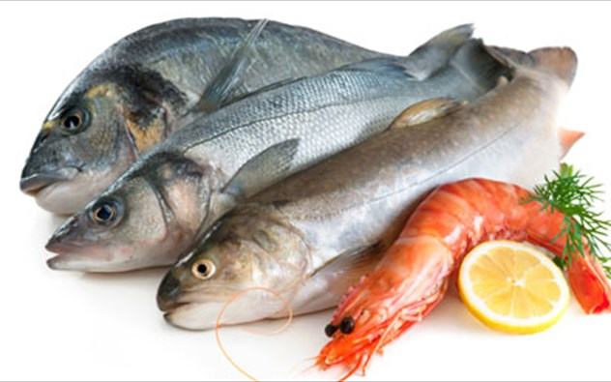
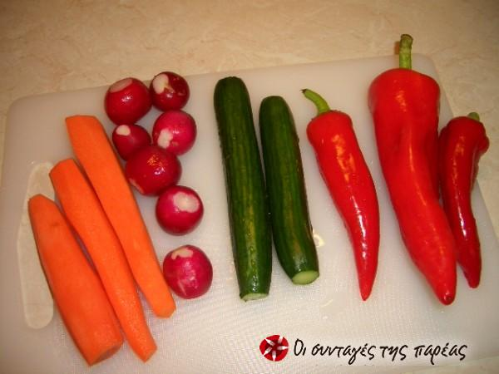
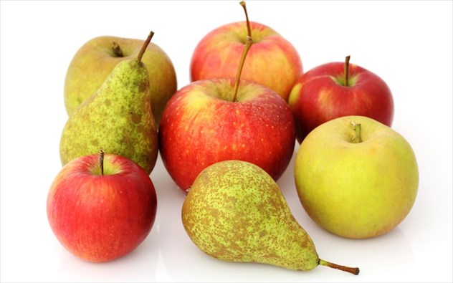
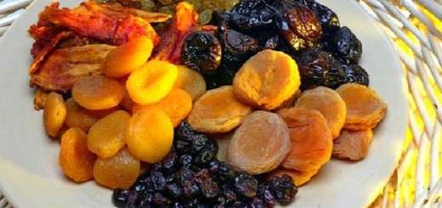
Time for Dinner
Dinner was and still is the most important meal of the day in Greece. In ancient times, it was when everyone would gather with friends and perhaps discuss things like philosophy or maybe just daily events. We said "friends," not "family“, because men and women normally ate separately. If a family had slaves, they would serve the men dinner first, then the women, then themselves. If the family didn't have slaves, the women of the house served the men first, then they ate themselves when the men were done.
Dinner was when most of the foods were consumed. The ancient Greeks would eat eggs from quail and hens, fish, legumes, olives, cheeses, breads, figs and any vegetables they could grow. They might include arugula, asparagus, cabbage, carrots and cucumbers. Meat was reserved for the wealthy.

Slide 5
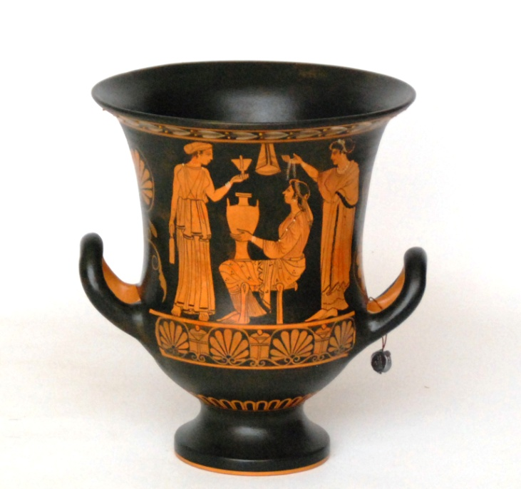
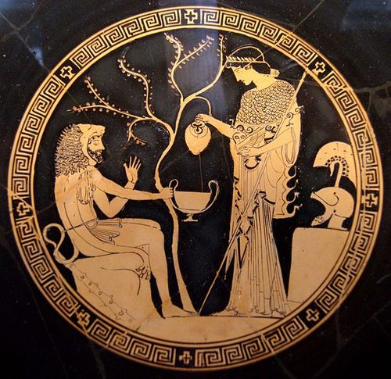
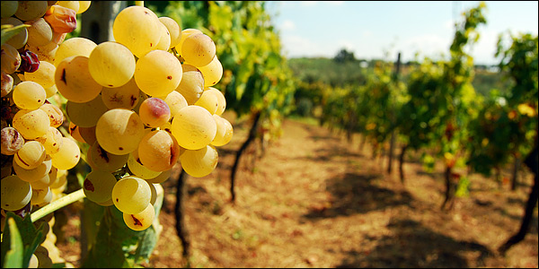
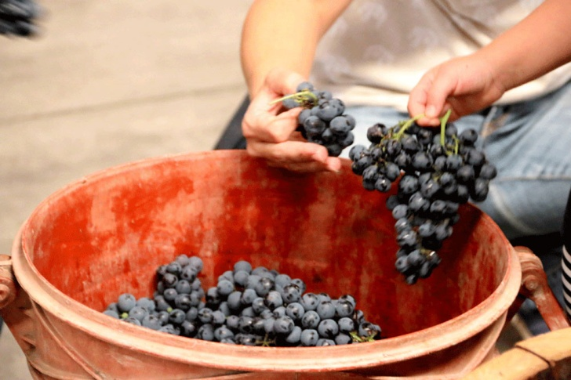
About That Wine Wine was the main drink of the ancient Greeks, other than water. Fetching the water was a daily task for the women of the house. The Greeks drank wine at all meals and during the day. We know they made red, white, rose and port wines, the main areas of production being Thasos, Lesbos and Chios. But the ancient Greeks didn't drink their wine straight. It was considered barbaric to do so. All wine was cut with water. The Greeks drank for the pleasure of the beverage, not with the intention of getting drunk. They also drank kykeon, a combination of barley gruel, water (or wine), herbs and goat cheese in an almost shake-like consistency.

Slide 6
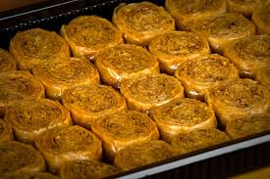
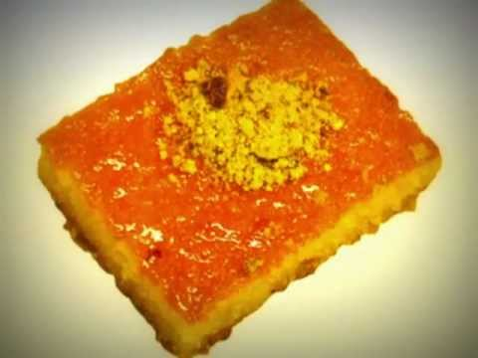
Top It All Off With Dessert
Raw sugar was unknown to the ancient Greeks, so honey was the main sweetener. Cheeses, figs or olives drizzled with honey provided a typical ending to an evening meal.
The Spartans
A lot of people wonder what the Spartans ate. Frankly, their diet was terrible. The Spartans were trained warriors, but their food left a lot to be desired. They ate something called melas zomos — black soup in English. It was made by boiling some pigs' legs, blood, salt and vinegar.
- To get a taste of ancient Greece, here are recipes that reflect both ingredients and cooking techniques of ancient times.

Slide 7
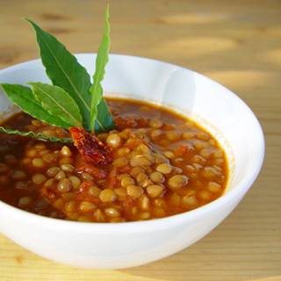
Lentil Soup
Ingredients
1 cup dry lentils
2 small leeks sliced
1 bunch cilantro
1 ½ tsp dry mint
Fresh ground black pepper
Olive Oil
Red wine Vinegar
Boil on low heat 1 cup of dry lentils over low heat with enough water to cover them and 1 inch above. Add the leeks and the fresh coriander (cilantro). In a small bowl mix the mint, dry coriander and the black pepper, add to the soup. Let it simmer until the lentils are soft, add vinegar and olive oil to taste

Slide 8
Fried Pancakes with Honey and Sesame Seeds
Ingredients
1 cup flour
1 cup water
2 tbsp honey
Olive Oil
1 tbsp sesame seeds
Mix the flour, water and 1 tbsp honey to form the batter. Heat some olive oil in a pan and add ¼ of the batter to the pan. When the mixture thickens, turn it 2 or 3 times until it is golden on both sides. Make 3 more pancakes with the rest of the batter. Serve with honey and sprinkle sesame seeds.
Similar to today’s: Loukoumades, a Greek doughnut fried in olive oil and drenched in honey.

Slide 9
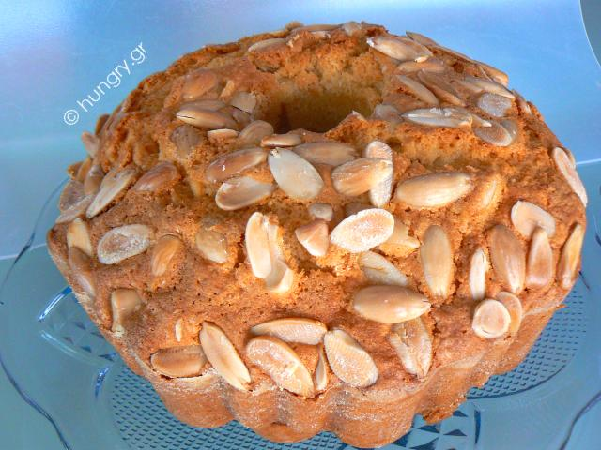
Nut Cake
Ingredients
1 cup shelled almonds
1 cup hazelnuts
1 tbsp bitter almonds (not available in the US, you can use regular almonds)
2 tablespoons poppy seeds
½ cup sesame seeds
7 tbsp honey
1 tsp fresh ground pepper
Olive Oil
Preheat the oven at 350 F. Mix all the nuts except the sesame seeds and bake them for a few minutes in the oven. Do the same for the sesame seeds and then let them cool down. In a small pot let 3 tablespoons of honey simmer for about 7 minutes, add the sesame seeds, mix well. Let it cool enough so that you can handle it, pour it on an oily surface and knead into a ball. Separate it into 2 pieces, roll 1 piece out with a rolling pin into a thin sheet that will fit in a shallow pan. Place the sheet on the bottom of the pan. Put all the nuts with the pepper in a blender or mixer and mix well for about 1 to 2 minutes. Boil the rest of the honey for 7 minutes and then add all the nuts and mix well. While it is still hot pour the nut and honey mixture in the pan on top of the sesame layer. Spread evenly. Roll the other piece of sesame seed dough into a sheet and cover the nut mixture. Let it cool off for 1 hour and then cut it small pieces.
Similar to today’s: Pasteli, a honey- sesame bar.

Slide 10
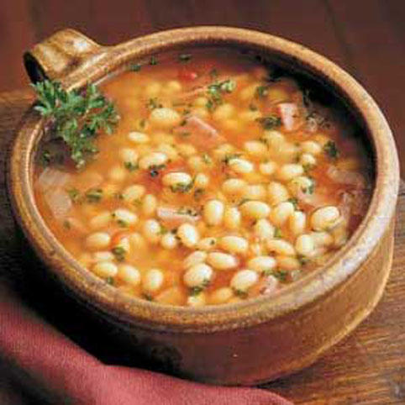
Ancient Bean soup
Ingredients
2 cups white beans
1/2 liter water
200 gr. lard
3 onions finely chopped
1/2 liter beef broth
2 garlic cloves
2 tablespoons olive oil
1 tablespoon honey
1/2 teaspoon coriander
1 bunch parsley
2 bay leafs
salt and pepper
Directions
Soak the beans in water over night.
Then boil them in a little water for 5 minutes.
Take the pressure cooker off the heat and cover for 1 hour.
Pour the beans and bay leaf into the beef broth and slowly boil for 2 hours.
Saute the onion in the lard and then add the parsley, the coriander, the salt and pepper.
Add this to the beans.
Add the honey and allow to boil slowly for a few more minutes.
Before serving, add the garlic cloves that have been passed through a garlic press and mixed with the oil.

Slide 11
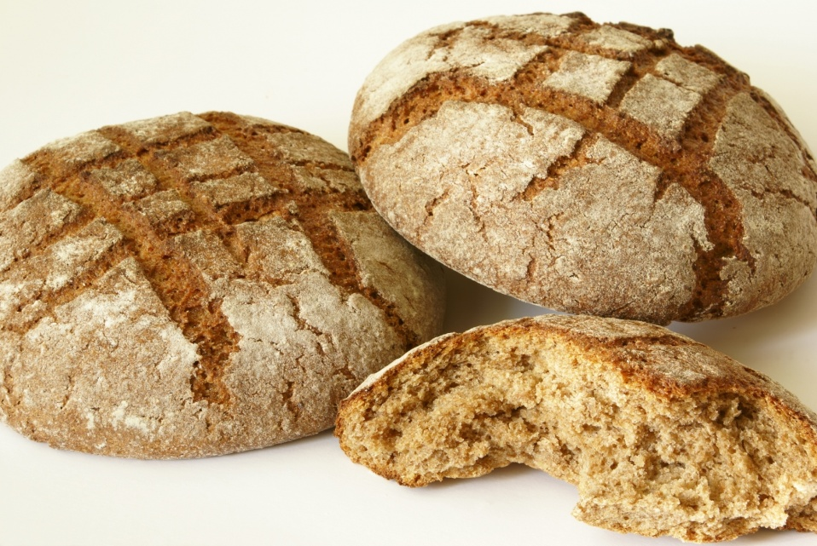
Archaic Bread
The earliest kind of Greek bread was a simple, flat, hard crusted hearth bread, coarse and heavy because the barley flour used in it had a low gluten content. This ancient recipe, described by Athenaeus in a third century book on cookery is still followed in the Near East. 2 cups warm water or scalded milk cooled to lukewarm 2 teaspoons salt 1 tablespoon honey 2 tablespoons olive oil 2 tablespoons barley meal 6 cups flour, barley or stone ground whole wheat Mix all ingredients except flour into a 2 quart jar. Place jar in a pan of hot water and let stand in a warm place free of drafts until fermentation begins--aproximately twelve hours or more. Replace hot water every 4 hours. Mix in 2 cups of the flour. Set aside once again in a warm place. Replace hot water in pan. A sponge should be formed in 4 to 6 hours. Put 4 cups flour in a bowl, make a well, and add sponge. Kneed well, lightly dusting your hands with flour until dough is smooth. Shape and put into oiled loaf pan. Cover with damp towel and place in a draft-free place to rise for 4 to 6 hours. It will not rise as high as modern breads. Bake in preheated oven at 375 F. for 10 minutes. Reduct to 350 F. 50 minutes.

Slide 12
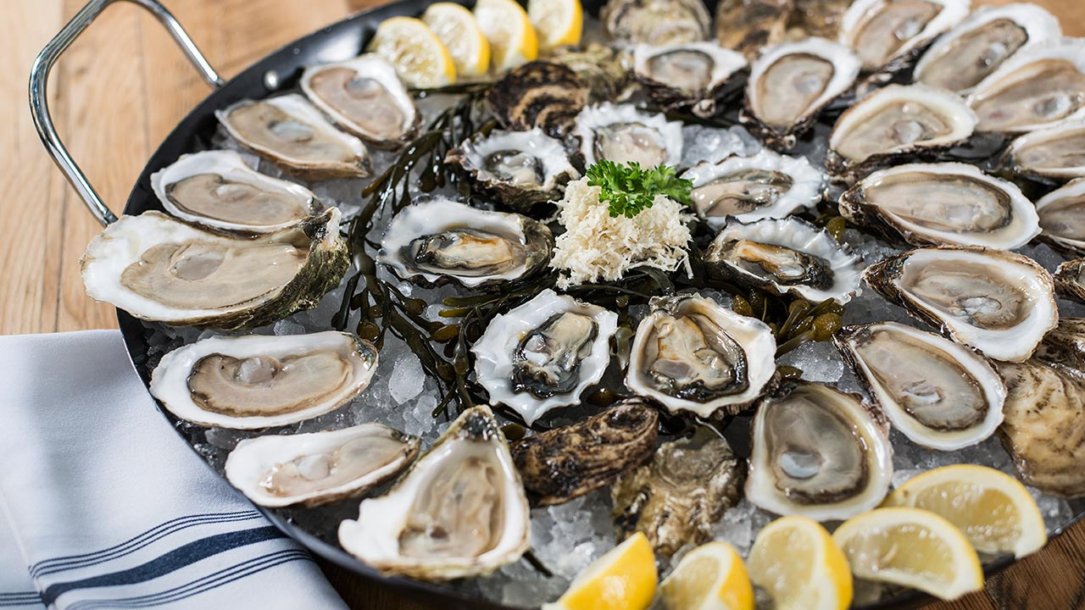
Boned Oysters
This recipe comes from Chares of Mytilene, Lesbos, a historian of the 3rd Century BC. "Use only the large Asiatic oysters caught in the Indian Ocearn, Black Sea, or the Persian and Arabian gulfs. Use the delicious white meat only. Discard the round white bone sometimes discovered inside the shell--or give it to some Persian. They seem to prefer these bones to gold; they call them 'pearls'." 1 dozen oysters, fresh or frozen 1 cup flour 1/2 cup oil salt and pepper to taste Drain liquid from jar. Roll in flour. Heat it until hot in a large frying pan. Fry oysters on medium-high heat for 5 minutes turning over once. Sprinkle with seasonings and serve.

Slide 13
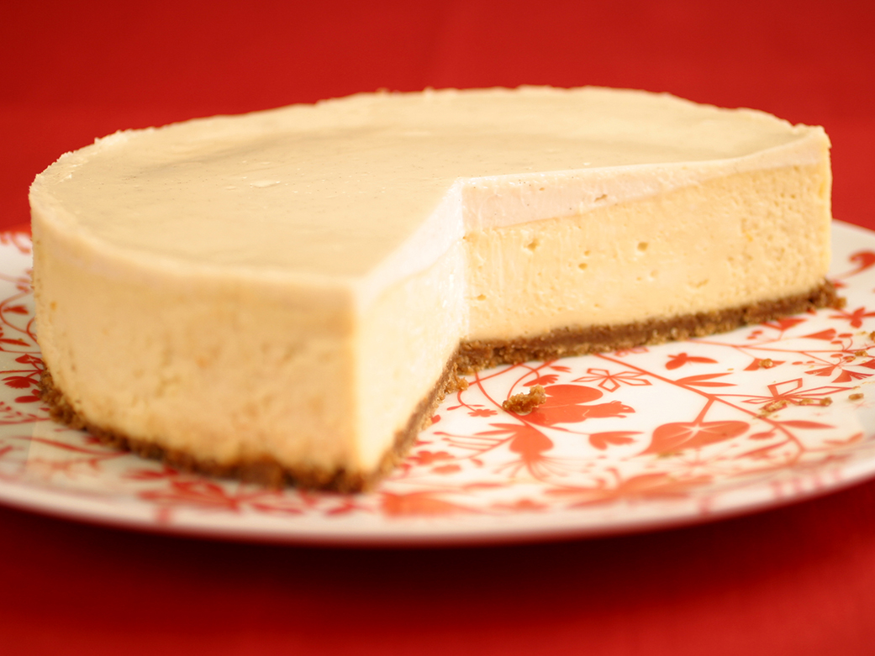
Athenian Cheese Cake
Thousand of years ago, the respected Greek poet and gourmet, Archestratus wrote "Forget all other dessert, there is only one: the Athenian cheese cake with Attica honey from Hymettus." Filling: 4 eggs, separated 12/ cup honey or sugar 1 lemon, juice and rind 1/2 cup flour 1 pond pot cheese, either small curd cottage, hoop mezithra or cream 1 cup sour cream or yogurt Crust: 1 cup crumbs from zwiback rusks, cookies or graham crackers 1/4 cup ground walnuts or almonds 2 tablespons oil or butter In a large bowl, beat egg whites until stiff (with a sprinkle of salt). In a blender blend yolks, honey, lemon juice, rind, flouid and cheese for a few seconds. Fold batter into egg whites using spatula. Fold in sour cream. In a separate bowl mix crumbs and nuts together. Grease the bottom and sides of a large cake pan or spring-form cake pan. Spread crumbs over bottom and sides. Pour mixture in cake pan and bake at 325 F. for 45 minutes. Chill in cake pan 6 hours before cutting and serving.

Slide 14
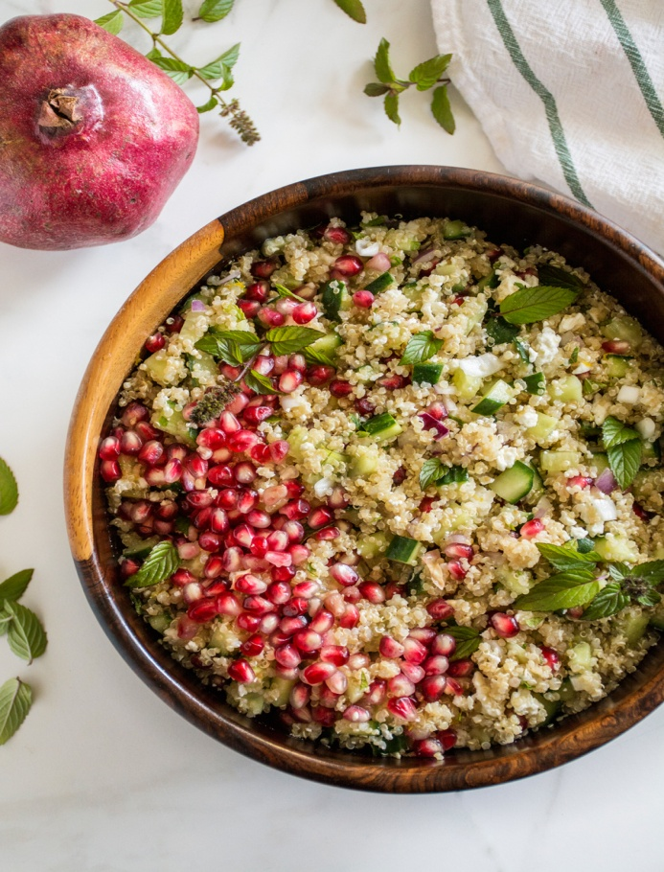
ANCIENT BULGUR SALAD WITH FETA AND POMEGRANATE
Components
For 4 people
1flitz. Groats
1 ripe pomegranate
1t. tablespoons walnuts
3-4 spring onions
1/8 bunch dill
70gram. feta cheese.
For the dressing.
2k.soupas oil
1t. tablespoons molasses
2k. soup pomegranate juice
Coarse salt
Pepper fresh.
Implementation.
Place the bulgur in a bowl, with two cups of water to soak for at least 3 hours and remove any additional items [stones]. We take a colander and drain well bulgur.
Cut in half pomegranate and one piece take the juice while the other part of the pour very carefully with a spoon to get all sporakia that exist within it.
Then wash thoroughly scallions and dill and after the dry finely chop. In a mortar hit the nuts to crack.
Take a large bowl and add into the bulgur, green onions, dill, the crumbled feta, walnuts, rhodium seeds and stir. Add salt and pepper as we want.
Beat separately in a small bowl materials for nresingk and pour the sauce and stir well to incorporate all ingredients.
Serve in equal portions sprinkling extra walnuts and pomegranates for more beautiful appearance.

Slide 15
