Slide 1
Volunteering in Finland/Lahti
IWE- LIVING TOGETHER IN THE 21ST CENTURY EUROPE
FINNISH TEAM PRESENTATION
MEETING IN CZECH REPUBLIC

Slide 2
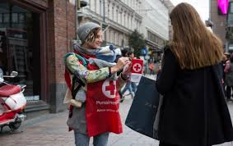
Volunteering in Finland
What does voluenteering mean?
= it means taking action for issues that you feel are important.
Voluenteering is supposed to bring joy to both sides
Who can volunteer?
Anyone
Regadless of age, where you live, gender, race
Why voluenteer?
You can learn new skills
experience joy
meet new people
get new experiences
very valuable for individuals and the community.

Slide 3
OTHER VOLUNTEERING POSSIBILITIES
General / social field
Citizen Forum
Caritas Finland
Finnish Red Cross
Finnish Red Cross multicultural activities
Save the Children
Familia
Federation of Mother and Child Homes and Shelters
Finnish Association for Mental Health
Yeesi
Guiding and Scouting
Environment and recycling
Kontti Recycling Department Stores

Slide 4
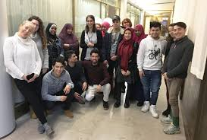
VOLUNTEERING POSSIBILITIES FOR IMMIGRANTS
Volunteering provides work experience and contacts. If you want, you can get a charity certificate. It can be helpful when you are looking for a job.
When you do volunteering, you can learn new things, for example more Finnish language.
If volunteering is included in your integration plan, You can get integration support when you do volunteering for a specific number of hours.
Volunteering can also be a first step towards to working life in Finland.
KVT (International voluntary service) organizes three-week volunteer camps
The basic idea of a volunteering camp is that volunteers from different countries work together on a project that benefits the local community.

Slide 5
https://www.pelastusarmeija.fi/?utm_campaign=Hyvantekevaisyys&utm_source=google&utm_medium=ppc&utm_term=%2Bvapaaehtoisty%C3%B6&utm_content=2259858xCjwKCAjwtuLrBRAlEiwAPVcZBlvU_GjAEFZSfZD1yb_zyCx4w2uD5OVyD88OgOMa-c964NSil6KGtxoCkP4QAvD_BwE
Environment grandma/grandpa (Goes to visit daycare centers and help support the kids enviroment and nature education)
Help in the "soup kitchen." (Place where they offer free food for those in need.)
Helping the immigrants learn Finnish as a teacher or as a tutor.
VOLUNTEERING IN LAHTI
httpsaadab://vapaaehtoistyo.fi/lahti/

Slide 6
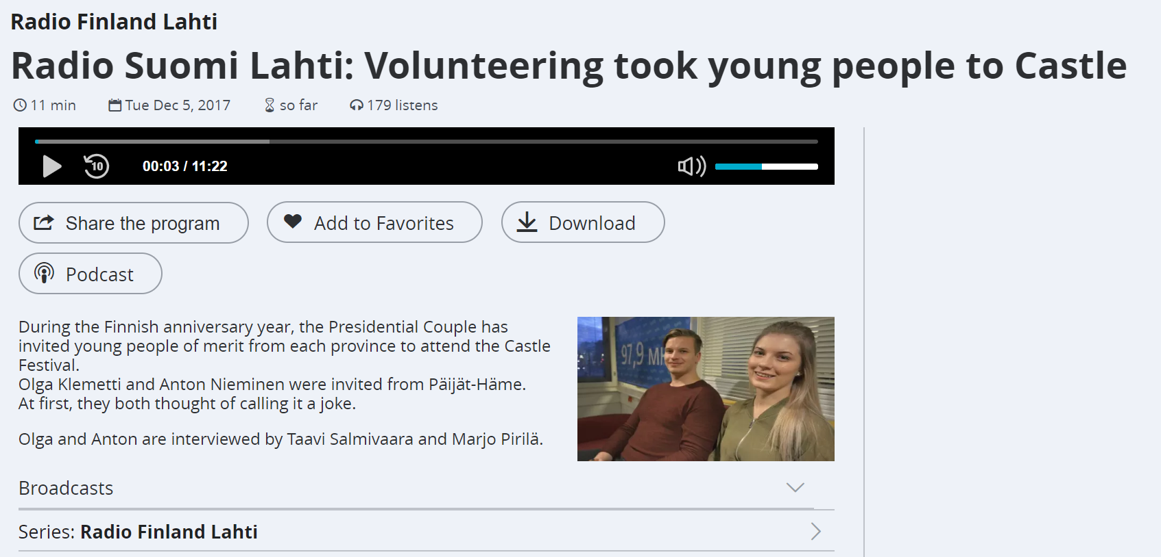
TWO KANNAS HIGH SCHOOL STUDENTS WERE AWARDED FOR THEIR VOLUNTARY WORK BY THE PRESIDENT

Slide 7
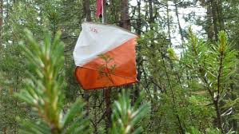
My volunteering in sports activities
Finnish volunteering in sports
I personally help with volunteering of my orienteering club
The "Evening orienteering"
Helping with the route and map design
FIS Nordic World Ski Championships 2017
Route patrol
Benefits

Slide 8
CAS
Creativity, Activity, Service
Enables students to enhance their personal and interpersonal development by learning through experience
Service - an unpaid and voluntary exchange that has a learning benefit for the student.
Many students volunteer at an animal shelter, a nursing home or a day care center

Slide 9
sources
https://vapaaehtoistyo.fi/
http://www.kansalaisareena.fi/citizen-forum-finland/volunteering/
https://www.kvtfinland.org/vapaaehtoistyo-ulkomailla/
https://wwf.fi/vaikuta-kanssamme/vapaaehtoistyo/
https://www.punainenristi.fi/hae-tukea-ja-apua/suomeen-kotoutumiseen
http://www.kierratyskeskus.fi/files/7308/Vapaaehtoistyo_suomessa_taitettu_19913VETYvv.pdf
https://www.kvtfinland.org/yhteista-ymmarrysta/

