Slide 1
Gdansk, Poland 24th – 30th November 2019
By the Finnish team

Slide 2
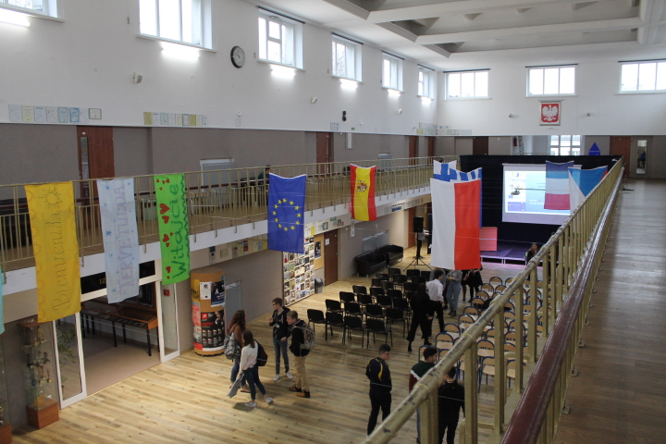
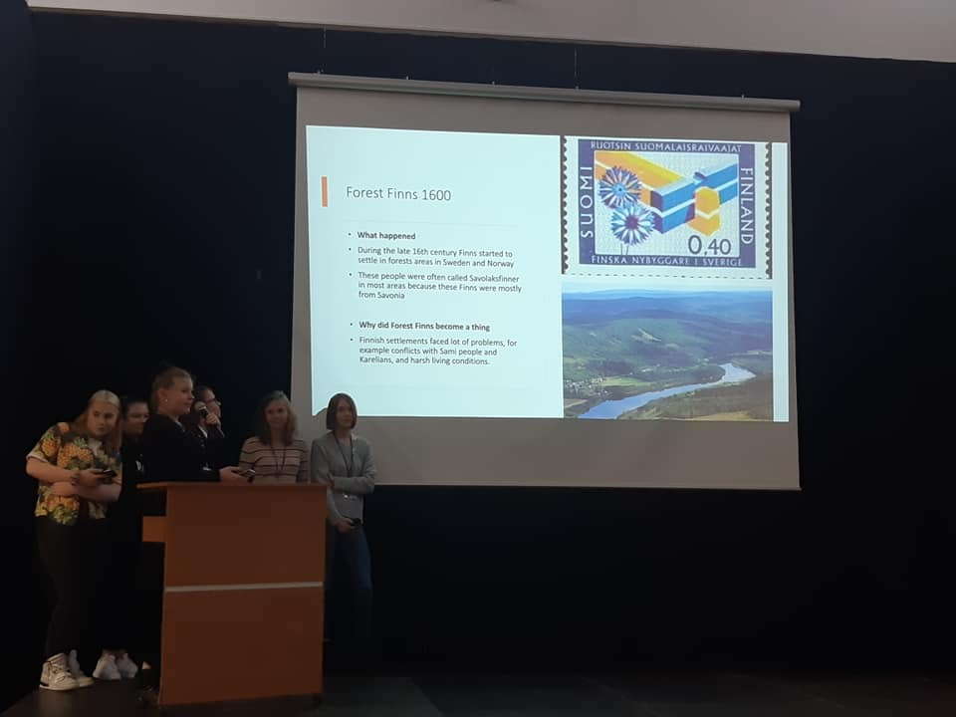
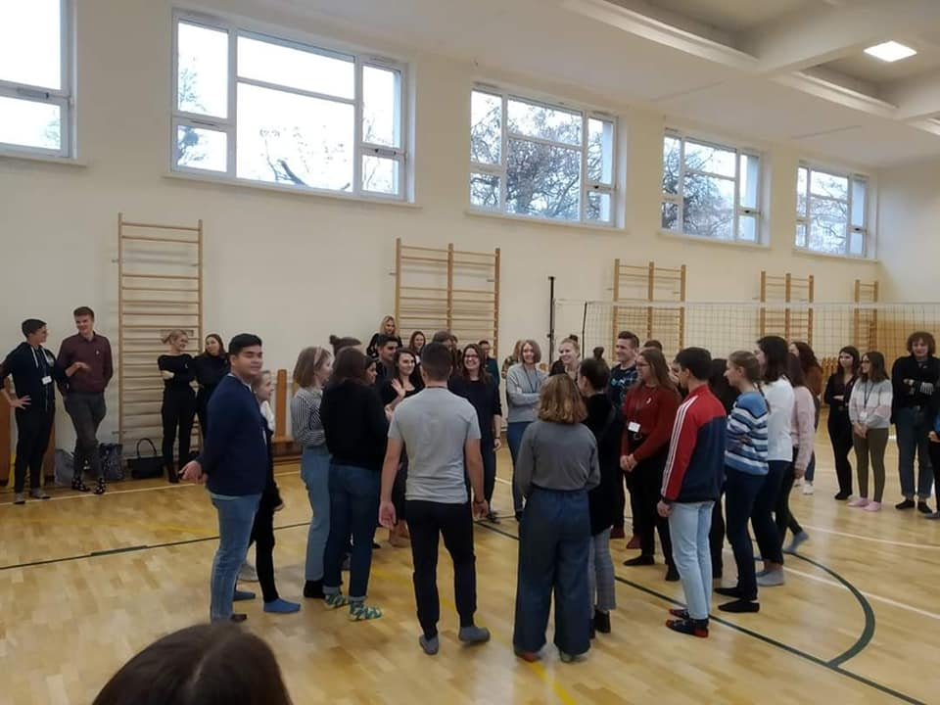
On Monday we started at 8.30 am. We had a few speeches in our opening ceremony and also all the teams had their own history presentations. They were interesting! We did some ice-breaking activities both with whole group and in our project work teams. In the evening we walked in Gdynia doing some tasks in these teams. We took a lot of more or less creative photos. I think that it was a good start for the week.

Slide 3
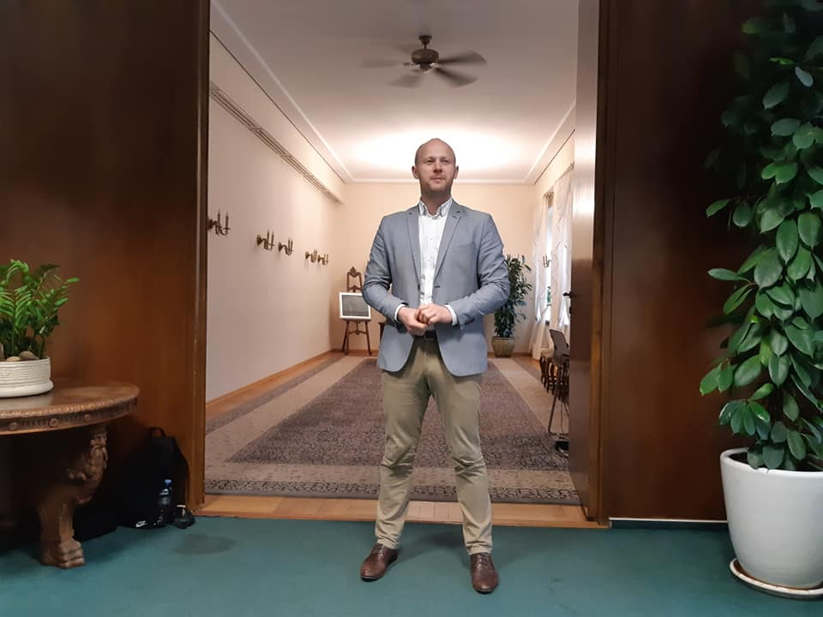
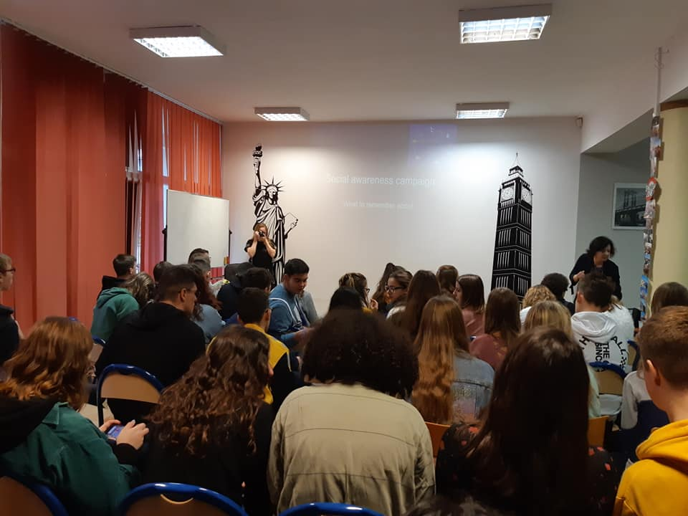
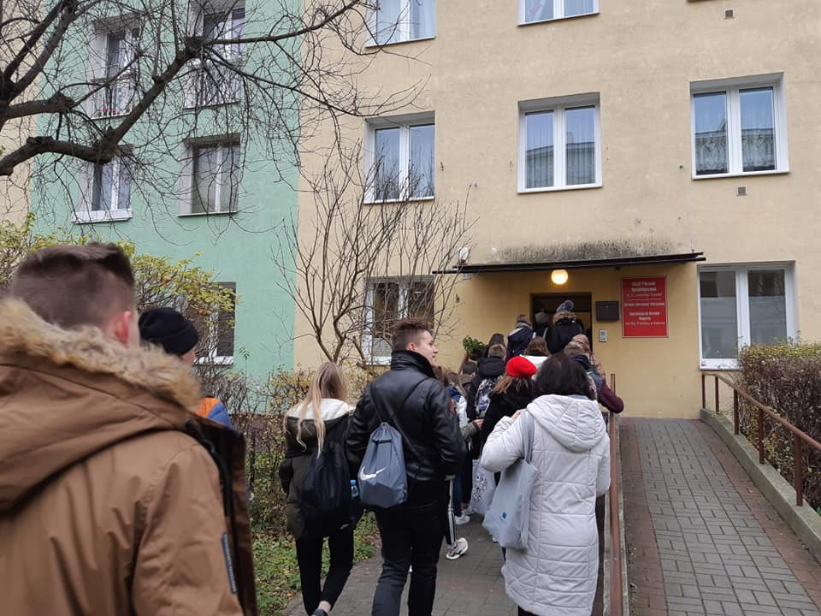
On Tuesday we went to the City Hall at morning. There we listened a speech and then we went to the MOPS. After we ate at restaurant and we came back to school for making our project in groups. After we have some free time and for example we went to the bowling with my host family.

Slide 4
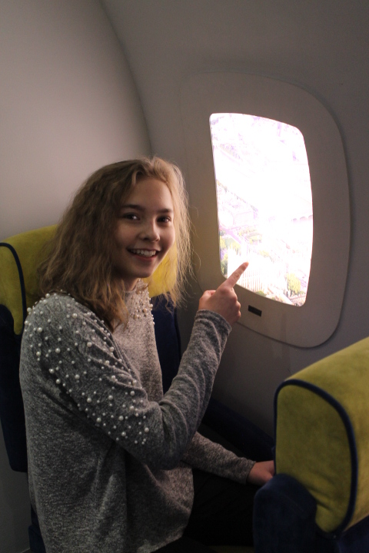
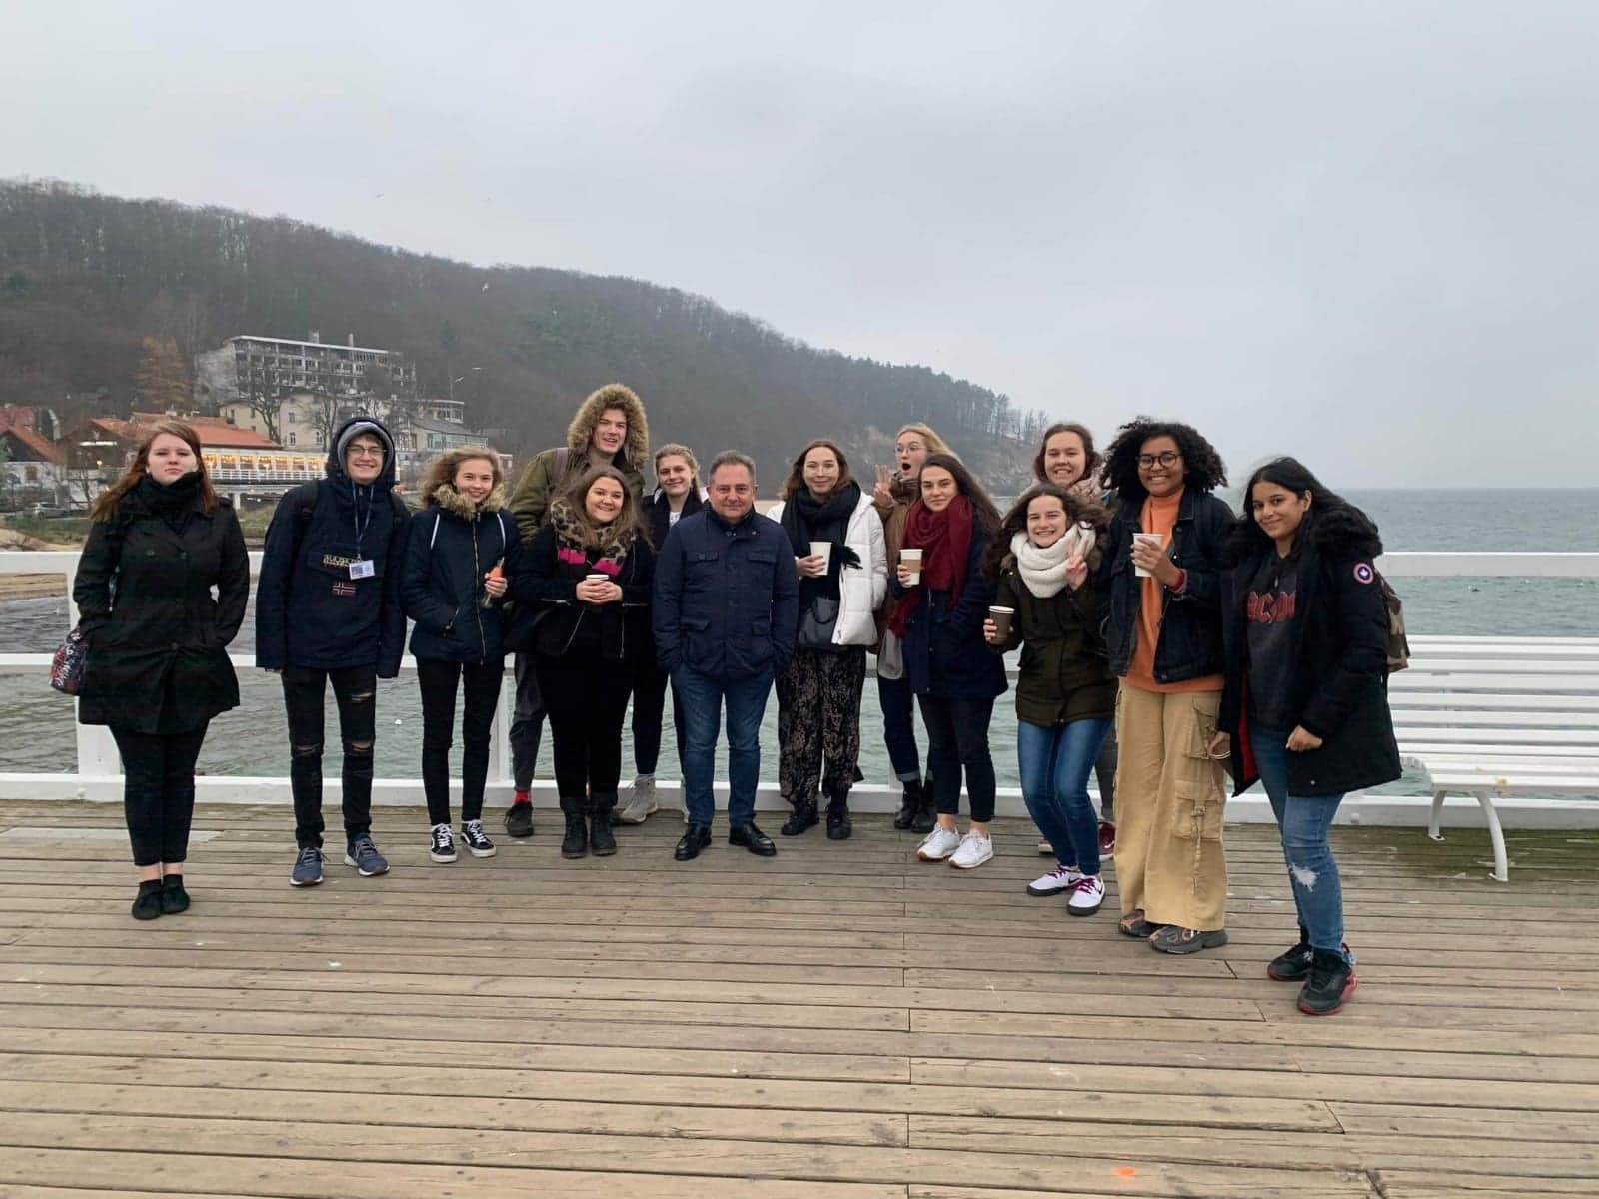
On Wednesday our school day started a bit later. We gathered to the Emigration Museum in Gdynia at 9.45.
There we were supposed to shoot videos that were part of the outcome of the meeting in Poland. After that we could go see the exhibition which had for example ships, old Polish homes and machines on display. After that we had work shops where we got to know famous Polish people connected to movie industry. That day we had tomato soup and pasta as a lunch. After the official "school day" had ended, we went to a nice part of Gdynia with a group of people from Erasmus. We went to a beach, a cafe and up to a nearby cliff which had a nice view. We also met apparently a famous Polish cook and we took a picture together with him. In the evening a group of Erasmus people gathered to my host's guest house and we spent some time together talking, singing and dancing. The day especially the evening was so nice and I got a lot of new friends!

Slide 5
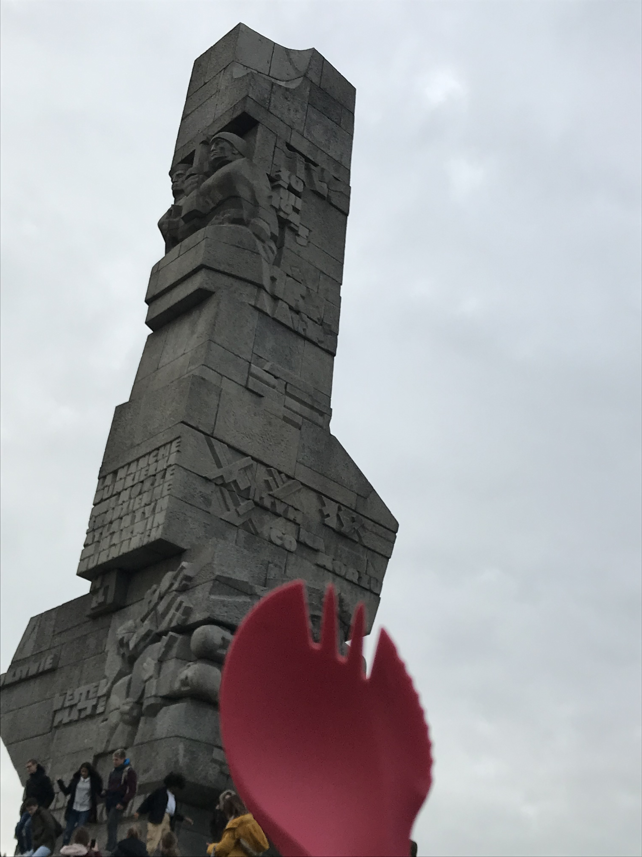
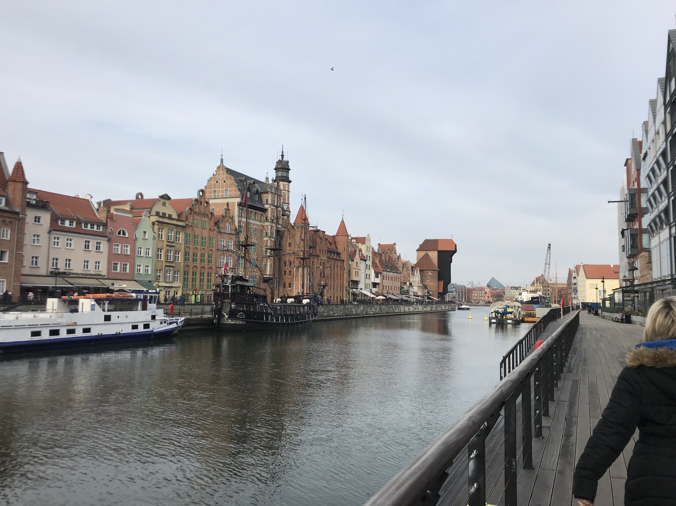
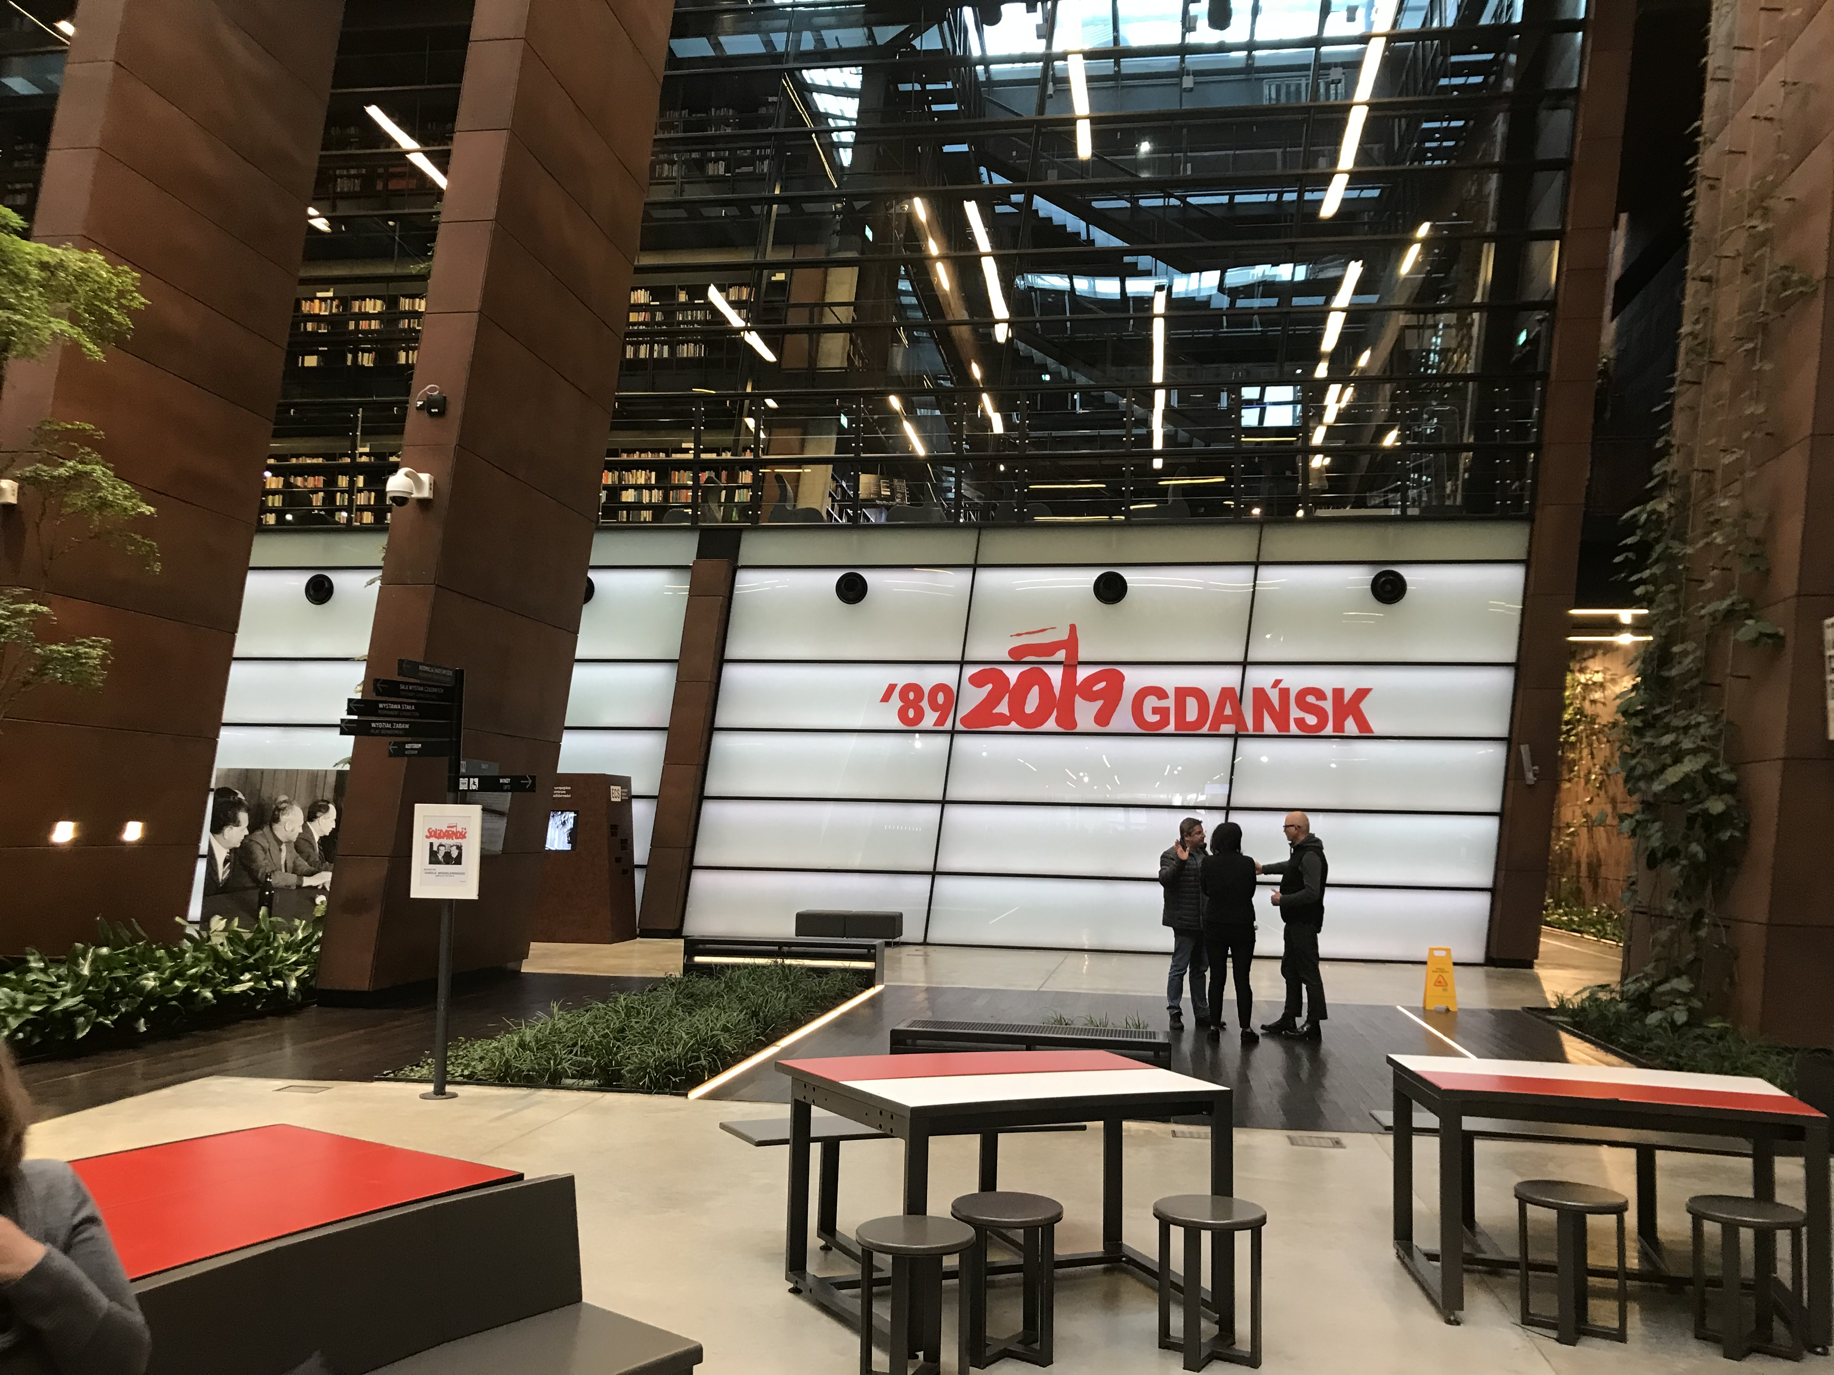
On Thursday we spent the day in Gdansk. First we visited the Biology department of the University of Gdansk. There we saw an amber exhibition, fish, plants and an ant colony. Then we went to the Museum of Solidarity and had a guided tour there. Then we went to visit the old town of Gdansk and went to eat lunch by the river. We ate pirogi, some meat and potato pancake. After lunch we visited the Westerplatte monument where World War 2 started. Then we were allowed to do what we wanted so we went to visit the Christmas Market in Gdansk, visited a cafe and went to the Riviera shopping mall in Gdynia by train.

Slide 6
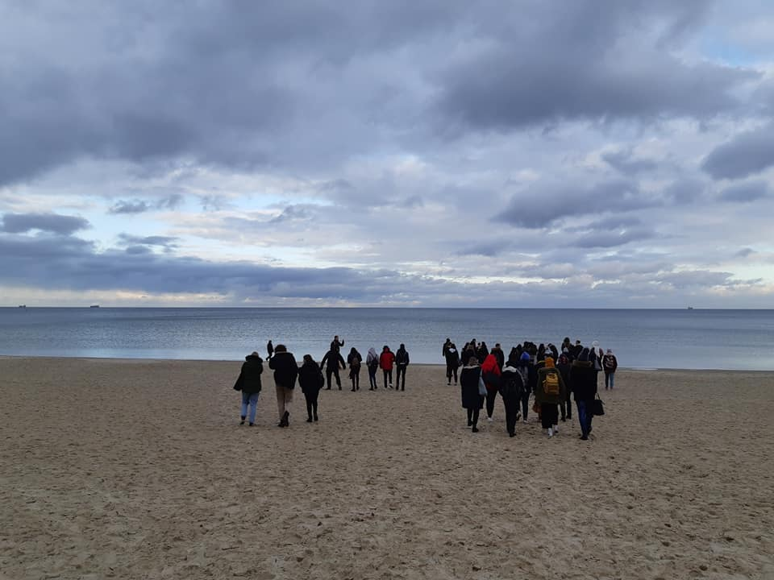
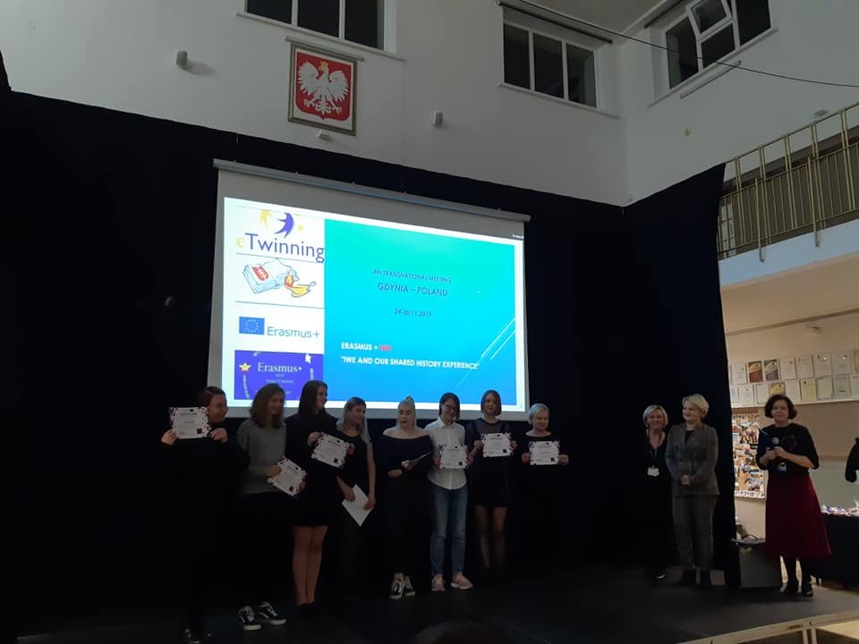
Friday

