Slide 1
“«I»dentity – «We»dentity :Living together in the 21st century Europe”
MEETING IN CZECH REPUBLIC:
"We´dentity and volunteerism in Greece"

Slide 2
Volunteering- Definition
Volunteering:
an altruistic activity where an individual or group provides services for no financial or social gain "to benefit another person, group or organization".
renowned for skill development
intention to promote goodness or to improve human quality of life.

Slide 3
Common profile of Volunteers in Greece (1)
Mrs Anda Alamanou, Director of the Bureau, Sponsorship and Communication in Klimaka, and Director Of a Project Supporting Homeless people
Volunteering as an optional hobby
Volunteering is a unique, instant, action.
It isn’t focused on a certain goal
It is only an action of friendship without repetition
It is habitual during Christmas Time when people are more willing to offer things or services to persons in inferior position

Slide 4
Common profile of Volunteers in Greece (2)
Mrs Anda Alamanou, Director of the Bureau, Sponsorship and Communication in Klimaka, and Director Of a Project Supporting Homeless people
Volunteering as an opportunity for unemployed persons to find a job
Volunteering as a long – lasting action
Do Volunteers have a constant interest in offering ?

Slide 5
Why don’t we want to be a volunteer ?
Mrs Natacha Chatziri, Director HRM in «Medecins sans Frontieres”
Volunteerism should be taught to children when they are very young
Volunteerism should be a main part during the education of children.
In Greece , we don’t support strongly the education for volunteerism.
Volunteerism is only a small part of Greek culture.
Newspapers, tv and radios don’t promote primarily actions of volunteerism very often. As a result , volunteerism isn’t a high priority as it should.

Slide 6
Athena’s experience in a Volunteer Support Program for Underage Refugees in Belgium :13 May 2019
“For me this was the first workcamp I participated in. It was an amazing experience and I recommend it to everyone.
Travelling to another country, getting to know other cultures, working with people I did not know until yesterday ,I opened my horizons.
They helped me think differently, with more understanding of the different, with more love for the unknown. They reminded me that we are all citizens of the same world,
that we are all mobilized by the same basic needs:
acceptance, belonging, the expression of what we are, love.

Slide 7
https://metadrasi.org/
NGO for the refugees and immigration
They help the refugees and the children travel safely according to the laws for Human Rights
Established in Greece since 2010

Slide 8
Action Aid
Action Aid is a international NGO whose primary aim is to work against poverty and injustice worldwide.
It was founded in UK in 1972. Now Action Aid counts 15 million volunteer employees in 45 different countries.

Slide 9
www.actionaid.gr/
In Greece Action Aid was founded in 1998 with the type of children fostering.
Action Aid Hellas organizes programs and trips all over the world with purpose to fight for human rights (education, food, water e.t.c.)

Slide 10
Actionaid - Awards
In September of 2003, UNESCO honored Action Aid for the educating program for adults with the award against illiteracy.
In 2006 Action Aid got the highest rank, among ten NGOs and won the first place from the ONEWORLD TRUST.
Action Aid has won many other awards on national or international level .

Slide 11
ELIX
Elix is a Greek volunteering N.G.O. founded in 1987 in Athens.
Environmental protection
Culture's heritage preservation
Non-formal education
Strength of the social cohesion

Slide 12
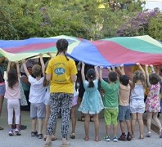
ELIX’S contribution
150 volunteers from all over the world who are taking part in programs named:
“Summer in the City”
“This Summer is Ours”
Those programs help immigrated families for a better life.

Slide 13
ESTIA – A new chapter in the lives of refugees in Greece, in Tripolis as well.
UNHCR, the UN Refugee Agency works with the Greek Government, the local authorities of Tripolis and NGOs to provide urban accommodation and cash assistance to refugees and asylum-seekers in Tripolis through ESTIA.
ESTIA: The Emergency Support To Integration and Accommodation programme
It is funded by the Asylum, Migration and Integration Fund of the European Union.

Slide 15
parnonas.gr/programma-estia
Urban accommodation in Tripolis provides a normal daily life for refugees and asylum seekers, facilitates their access to services, including education, and the eventual integration for those who will remain in the country.

Slide 16
parnonas.gr/programma-estia
The host population also benefits from embracing diversity through peaceful coexistence as well as the renting of their apartments.

Slide 17
parnonas.gr/programma-estia
Cash assistance restores dignity and empowers refugees and asylum-seekers who can now choose how to cover their basic daily needs. It also contributes directly to the economy of the host community through the purchase of services and goods.

Slide 18
ALMA ZOIS
ALMA ZOIS is a non-profit organization founded in 1988 for women who had suffered from breast cancer.
They have helped a lot of women since. Nowadays through their programms such us psycological help to patients from women witn same experience and providing information about prevention and early diagnose, they are saving lives.

Slide 19
UNICEF
United Nations International Children’s Emergency Fund
was created by the United Nations General Assembly on 11 December 1946
provide emergency food and health care to children and mothers in countries that had been devastated by World War II

Slide 20
www.unicef.org
Unicef’s mandate was extended to address the long-term needs of children and women in developing countries everywhere

Slide 21
World Wild Fund (WWF)
WWF was founded on 29 April 1961 . WWF started out as a small group of people who were lovers of wildlife and developed into one of the most powerful , independent organizations for the protection of the environment .
Τhe goals of wwf : extremely multidimensional and it is shaped by two basic goals
Improving the management of the natural environment
2) Reduction of human fingerprints
WWF has an active presence in more than 100 countries and over 5,000,000 worldwide promoters .Τhe mission of wwf is to build a future where human and nature live harmoniously .

Slide 22
ARCTUROS
ARCTUROS is an ecological NGO organization which focuses its efforts on saving the brown bear and its habitat.
The organization also undertakes the rescue of bears kept captive in inhumane conditions.
Located in the village of Aetos, there is an enclosed section of forest where the bears are transfered to be cared and studied until they are able to be released back into the wild life .

Slide 23
GREENPEACE
Greenpeace is a non-profit enviromental organization with offices in over 39 countries and an international coordinating body in Amsterdan.
Goal : to «ensure the ability of the Earth to natural life in all its diversity». Focuses its campaigning on worlwide issues: climate change, deforestation, overfishing, commercial whaling, genetic engineering, anti-nuclear issues.

Slide 24
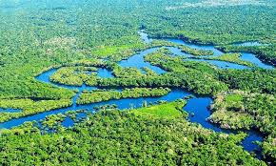
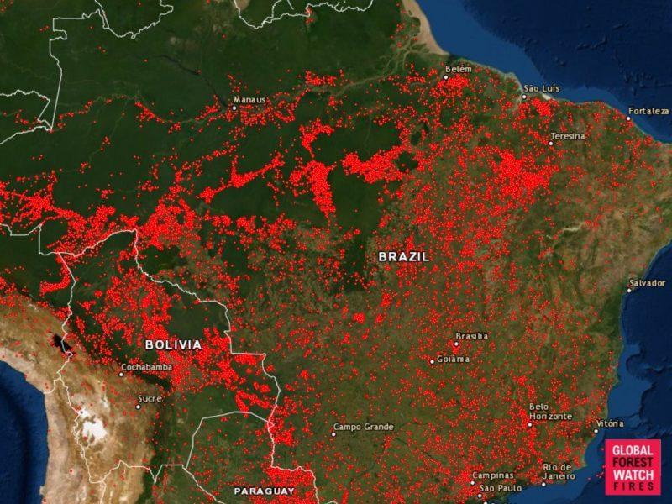

Slide 25
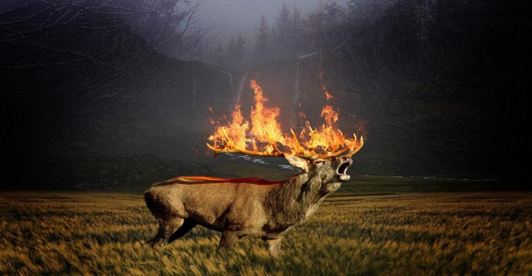
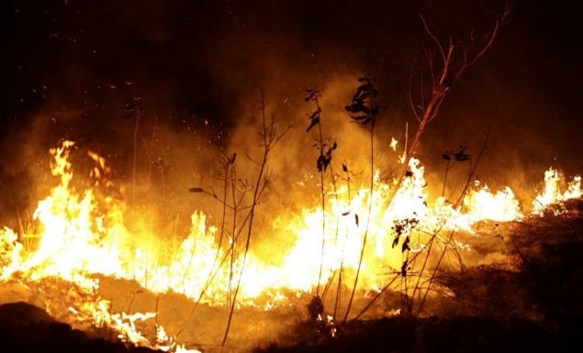
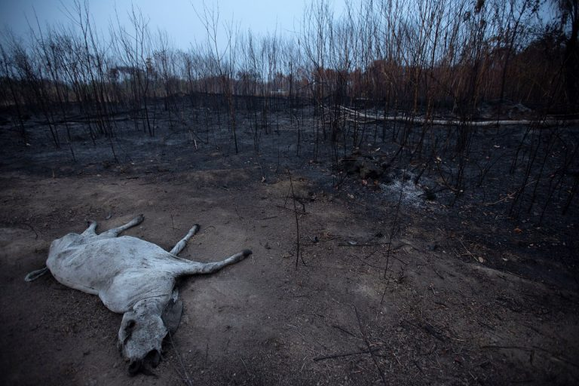

Slide 26
Thank you for your attention !

