Slide 1
Education system of the Czech Republic
Adéla Předešlá
Tomáš Gajda
Martin Machálek
Ludvík Pelán

Slide 2
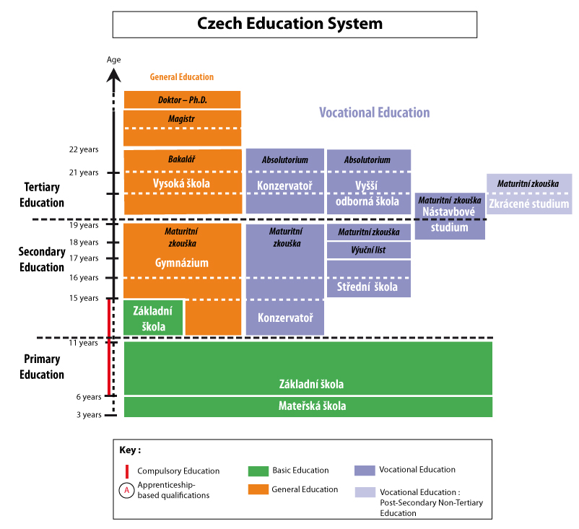
Summary of Education
Primary
Kindergarden
Secondary
Tertiary

Slide 3
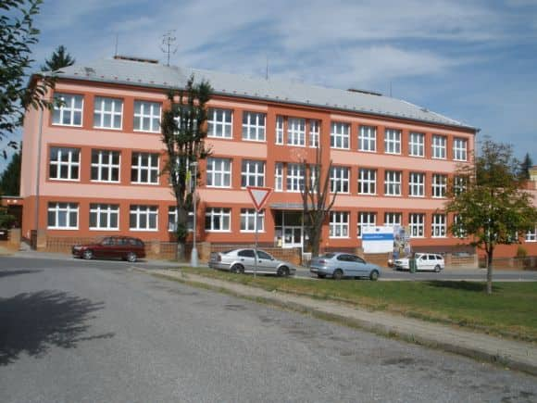
Primary Education
Children go to a nine year elementary school
In 5th, 7th or 9th grade they can choose go to a Gymnasium or a Vocational school
Gymnasium = General High School

Slide 4
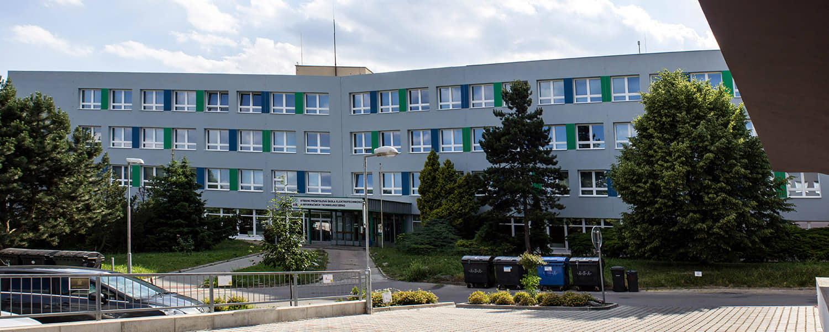
Secondary Education
High School graduation = Maturita
Specialized Schools
for example in IT, agriculture, etc.
Trade Schools (aprenticeship)
no Maturita
3 year school focused on trades
Gymnasium

Slide 5
Maturita
Exam at the end of High School
Serves as a diploma
Necessary for University
Subjects depend on
your specialization
Your decision (noncompulsory subjects)

Slide 6
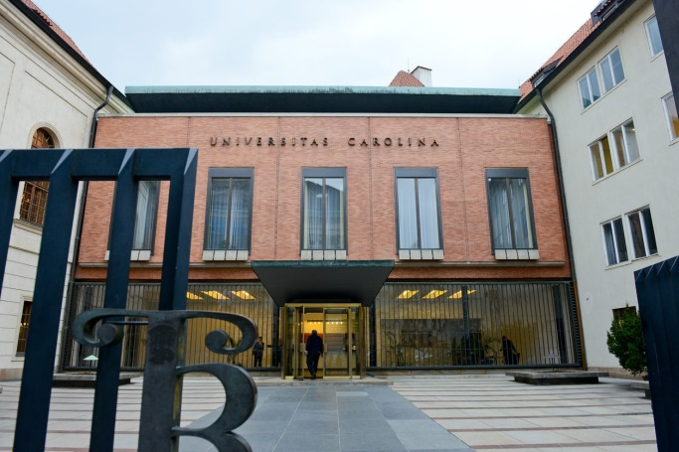
Tertiary education
Universities
Bachelor's degree programs (Bc.)
Master's degree programs (Mgr., Ing. MUDr., MVDr.)
Doctor study programs (Dr., Th.D.)
Higher professional schools

Slide 7
Autumn holidays
Christmas (winter) holidays
Mid-term break
Spring holidays
Easter holidays
Summer holidays

Slide 8
Source
[online]. [cit. 2019-01-07]. Dostupné z: https://en.wikipedia.org/wiki/Education_in_the_Czech_Republic
[online]. [cit. 2019-01-07]. Dostupné z: https://anglictina-maturita.cz/education-system-of-czech-republic-otazka-z-anglictiny/
[online]. [cit. 2019-01-07]. Dostupné z: https://www.google.cz/imghp?hl=cs&tab=wi

Slide 9
Thank you for your Attention
That’s all folks

