Slide 1
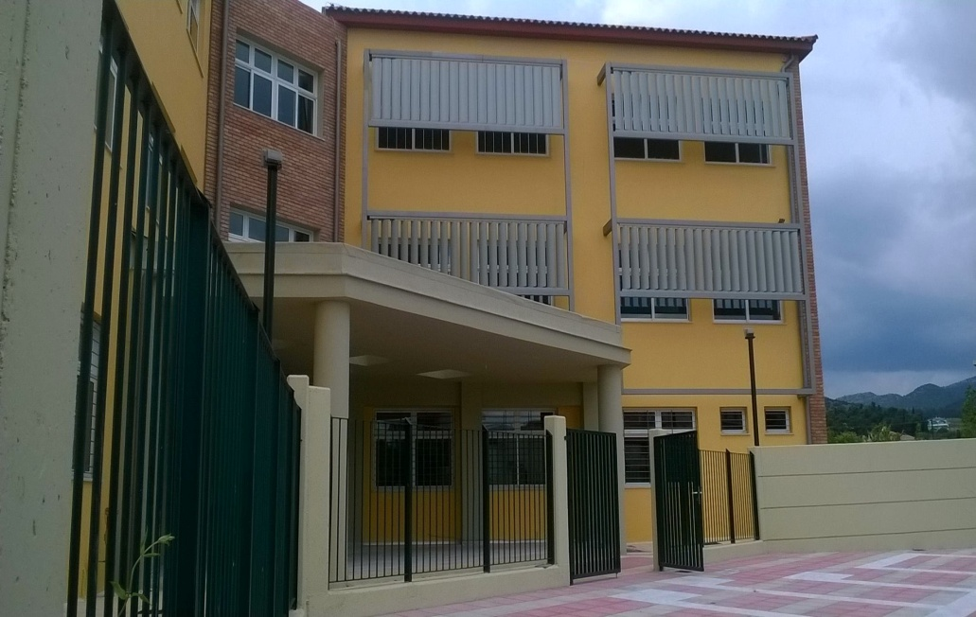
“«I»dentity – «We»dentity :Living together in the 21st century Europe”
THE PRESENTATION OF GREECE

Slide 2
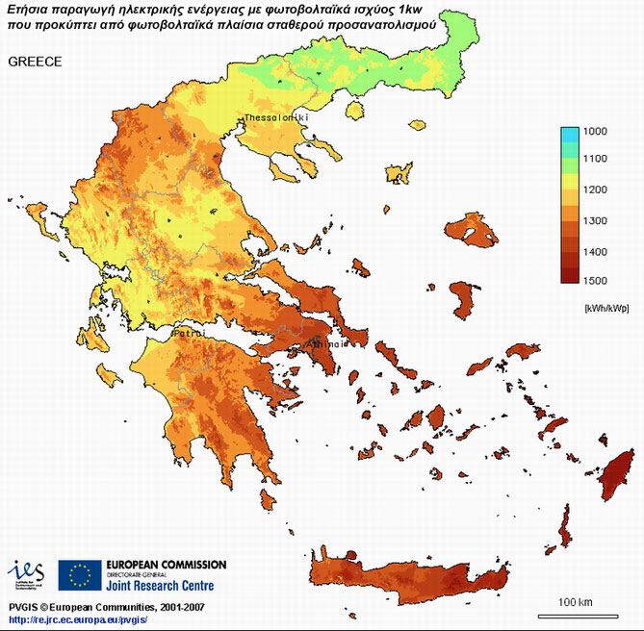
Greece
When people hear the word ‘‘Greece’’ they immediately think about the sea, the sun and all of the sightseeings. But many of them do not know what an important role Greece has played for modern Europe.

Slide 3
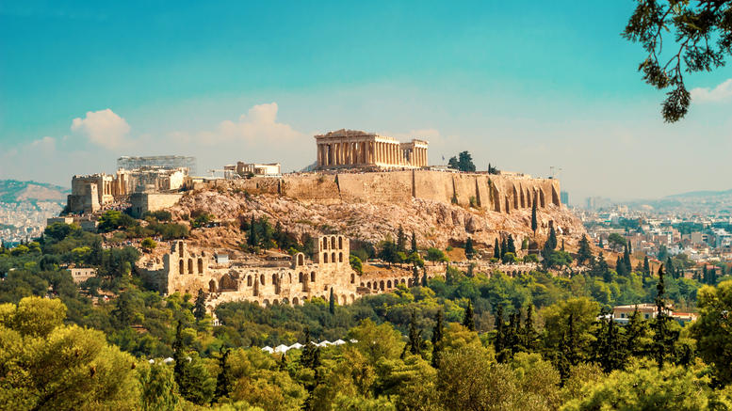
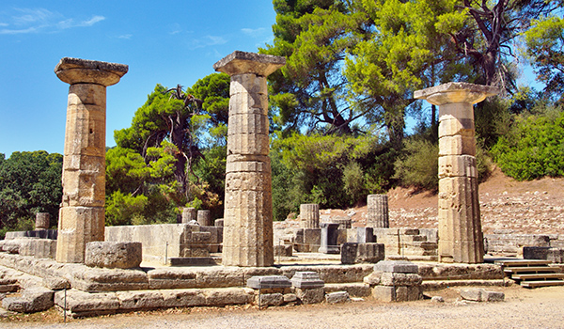
Ancient Greece
From ancient times Greeks had already developed their civilization. For example, they invented the theatre and democracy. Moreover the Olympic Games took place in Greece.

Slide 4
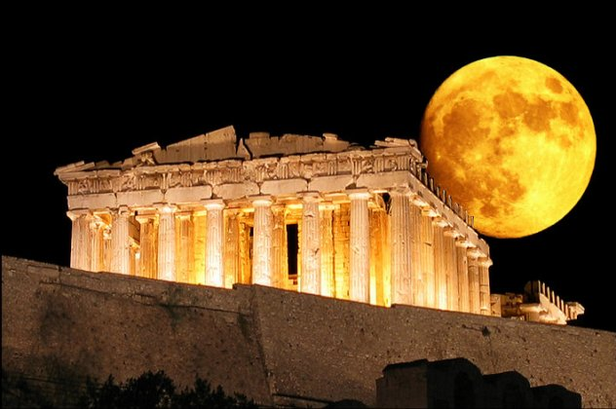

Slide 5
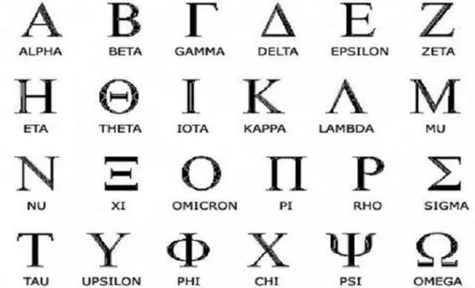
The Language
Many Greek words are used in other languages, for example “democracy”. However, that was Alexander The Great’s achievement, because 2000+ years ago, he took over a large part of the world. This is the reason why the Greek culture and language spread widely.
Notes:
HOWEVER, THAT WAS ALEXANDER THE GREAT'S ACHIEVEMENT, BECAUSE 2000+ YEARS AGO, HE TOOK OVER A LARGE PART OF THE WORLD. THAT IS THE REASON THE GREEK CULTURE AND LANGUAGE SPREAD WIDELY.

Slide 6
δημοκρατία démocratie demokracie
Demokratian demokracja democracia

Slide 7
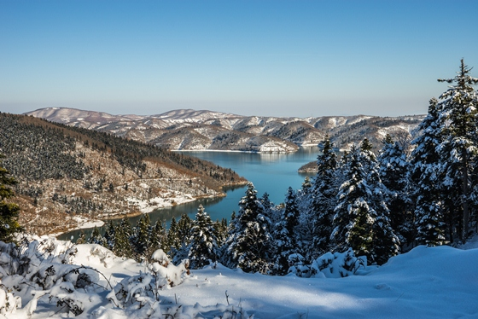
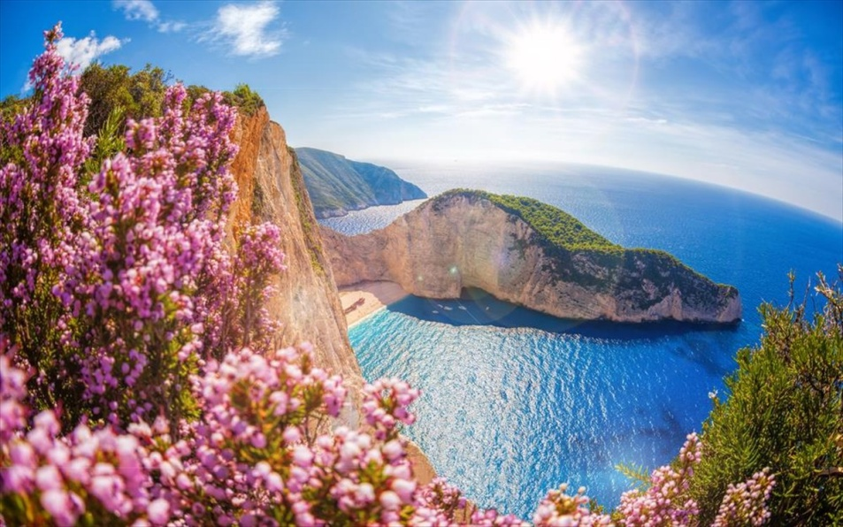
The Nature
Greece is one of the few countries that combines the mountain and the sea at the same time. Whenever you come to Greece there will always be something to do or to see.
Notes:
WHENEVER YOU COME TO GREECE, THERE WILL ALWAYS BE SOMETHING TO DO OR TO SEE.

Slide 8
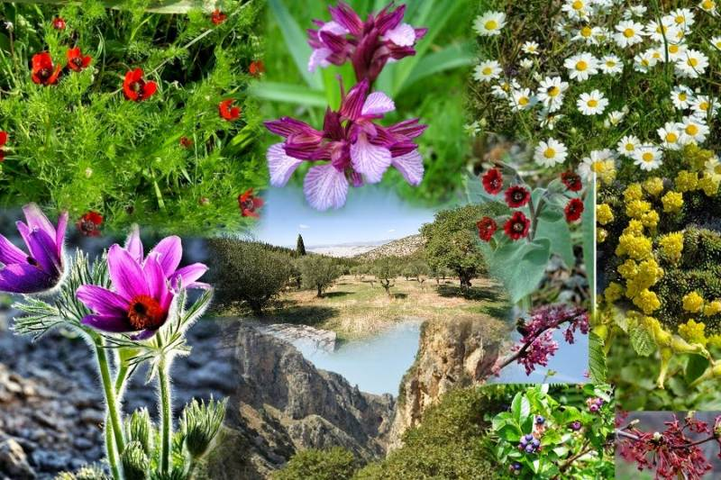
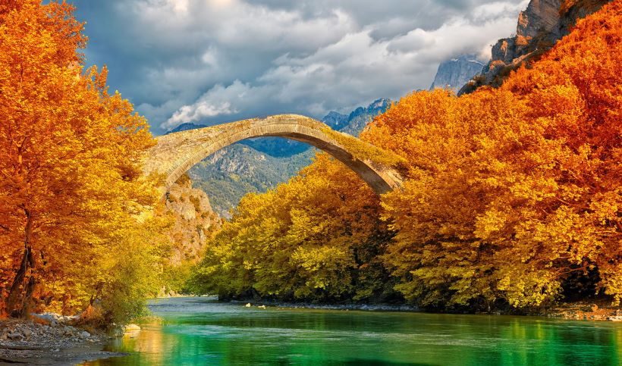

Slide 9
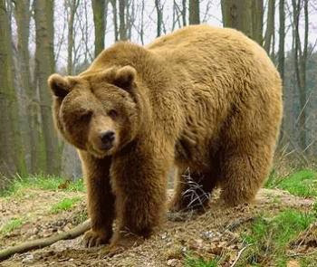
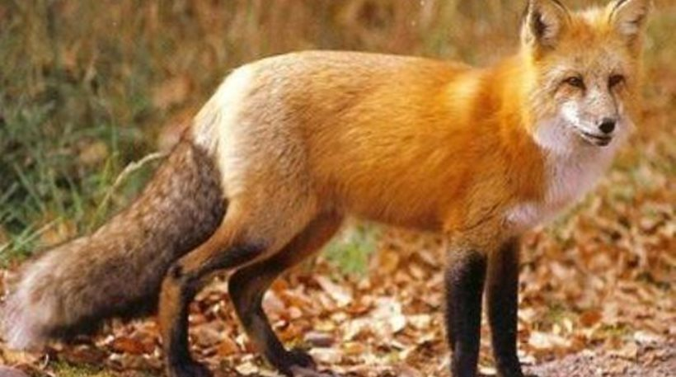
Wildlife
It is very common to see animals wandering around. Some animals though are quite rare to see. In every region you can see different animals.

Slide 10
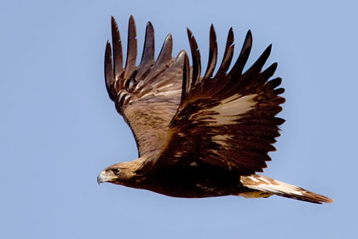
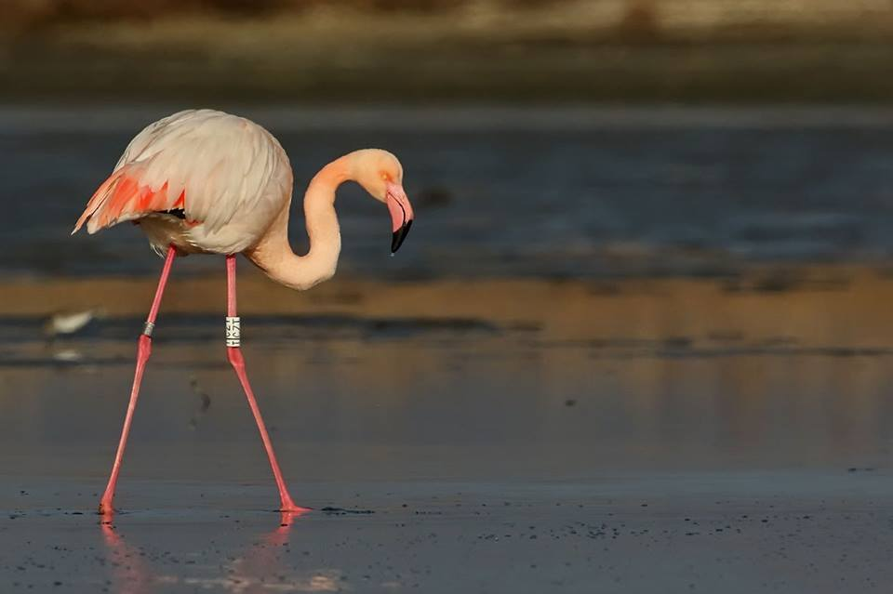
Birds
Greece has also unique birds, however most of them live here for half a year. But there are some birds that live here throughout all the year like eagles and owls.

Slide 11
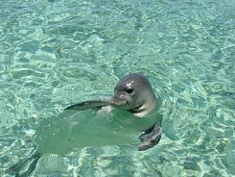
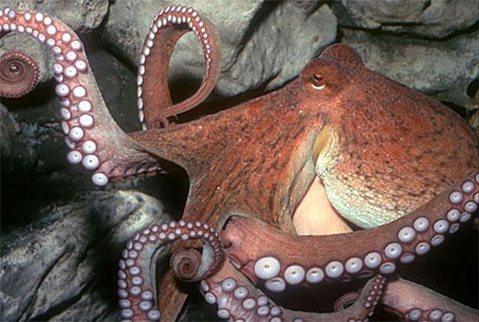
Underwater Life
As you already know the sea is not only for swimming. Extinct animals also live in the sea, like seals and sea turtles kareta kareta. Furthermore many kinds of fish live in the sea too! It is also common to see octopuses hiding beneath rocks.
Notes:
ΝΑ ΑΛΛΑΞΕΙ Η B ΠΡΟΤΑΣΗ ΩΣ ΕΞΗΣ :
EXTINCT ANIMALS ALSO LIVE IN THE SEA, LIKE SEALS AND SEA TURTLES KARETA KARETA.
ΝΑ ΑΛΛΑΞΕΙ Η Γ ΠΡΟΤΑΣΗ ΩΣ ΕΞΗΣ :
FURTHERMORE MANY KINDS OF FISH LIVE IN THE SEA TOO!
IT IS ALSO COMMON TO SEE OCTOPUSES HIDING BENEATH ROCKS , παραμενει το ιδιο.

Slide 12
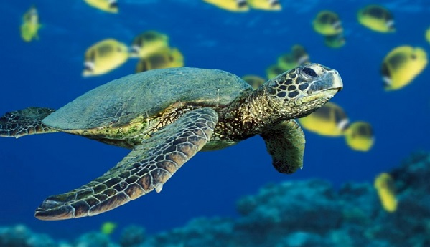

Slide 13
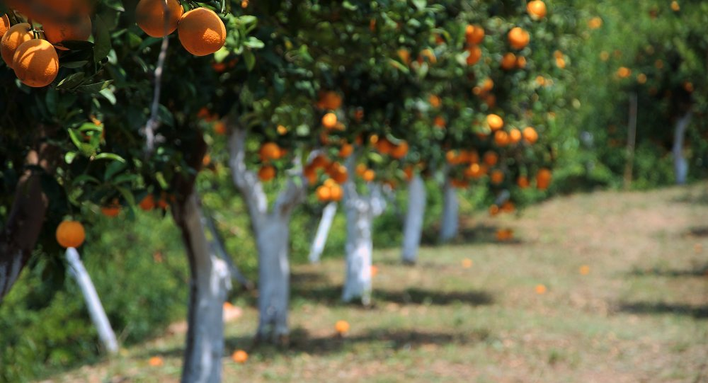
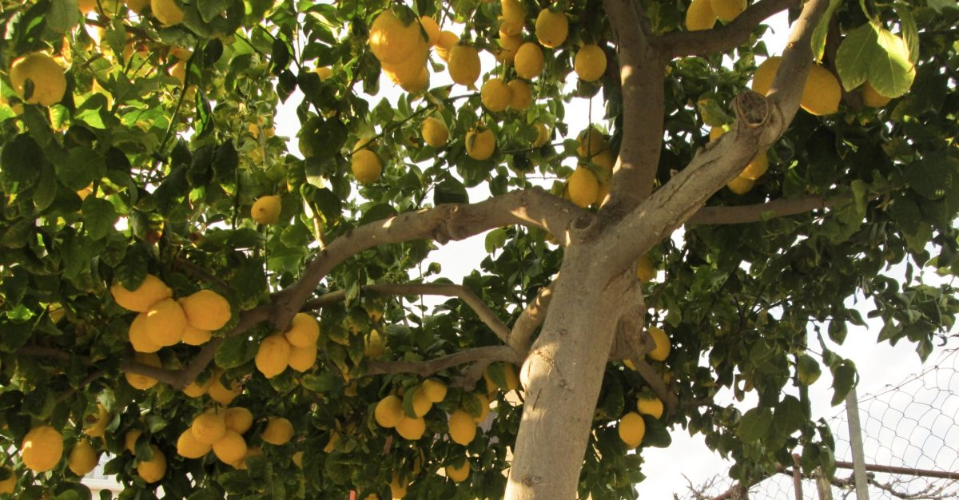
Agricultural Life
A big part of Greece is producing and selling varied products like lemons, oranges and olive oil. This is actually hard work and requires a lot of effort and strength. Another popular product is honey, which is also hard to harvest.
Notes:
ΑΠΟ ΤΗΝ ΤΕΛΕΥΤΑΙΑ ΠΡΟΤΑΣΗ ΠΡΕΠΕΙ ΝΑ ΦΥΓΕΙ ΤΟ Α. ΔΗΛΑΔΗ ΝΑ ΓΙΝΕΙ :
ANOTHER POPULAR PRODUCT IS HONEY, WHICH IS ALSO HARD TO HARVEST.

Slide 14
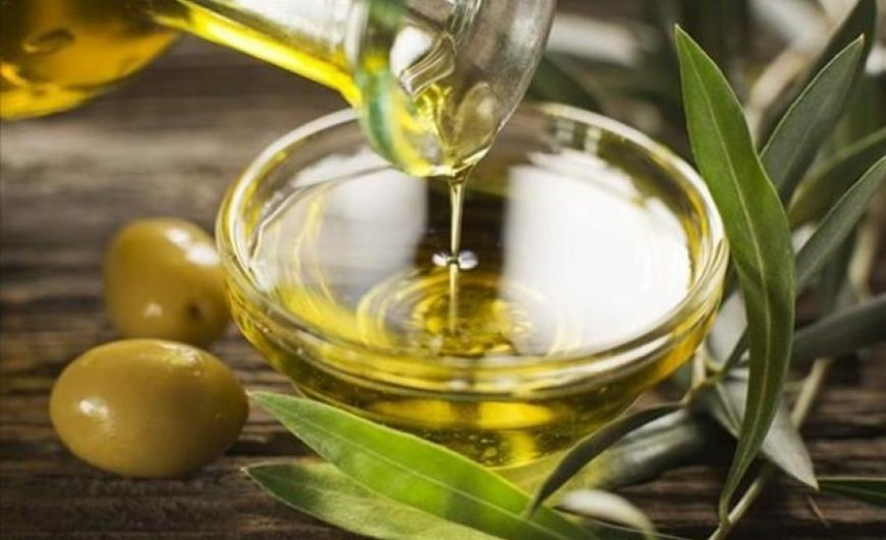

Slide 15
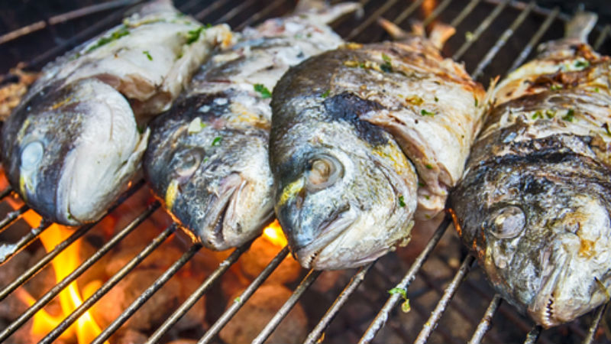
Greek Cooking
Greece has a lot of traditional meals that are known even in Europe. Most of the meals are based on the Mediterranean diet. A very known food is fish, but it is cooked in a different way than in the other European countries. Furthermore some fast foods are quite known, for example ‘‘Gyros’’.
Notes:
ΣΤΗΝ ΤΕΛΕΥΤΑΙΑ ΠΡΟΤΑΣΗ ΤΟ ALSO NA ΑΝΤΙΚΑΤΑΣΤΑΘΕΙ ΜΕ ΤΟ MOREOVER ;H TO FURTHERMORE. ΟΙ ΛΟΓΟΙ ΕΧΟΥΝ ΑΝΑΦΕΡΘΕΙ ΠΑΡΑΠΑΝΩ.
Furthermo

Slide 16
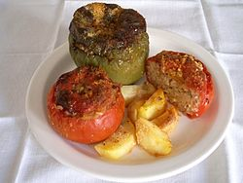
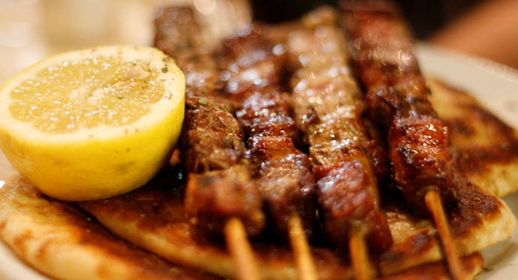
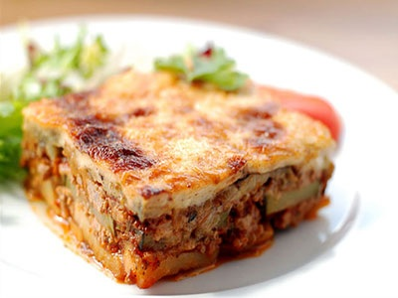
“Gemistá”
“Souvláki”
“Mousaká”

Slide 17
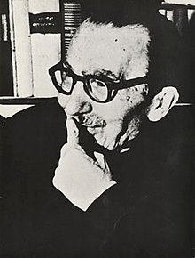
Poetry and Literature
Greece is also known for its poetry and literature. Greek writers had a critical influence on modern literature. One of the most famous authors is Nikos Kazantzakis. His novels are translated in to over 40 different languages. Other well known authors are Dionisios Solomos, Nikos Gatsos and Odysseas Elytis.

Slide 18
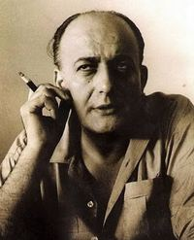
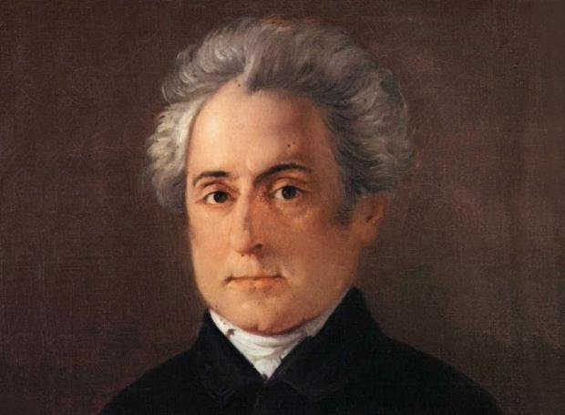
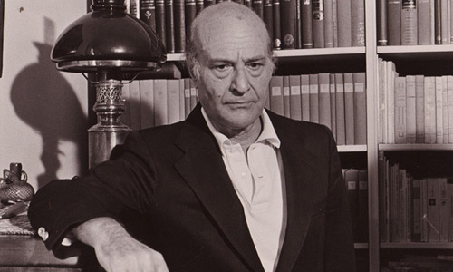
Dionisios Solomos
Nikos Gatsos
Odysseas Elytis

Slide 19
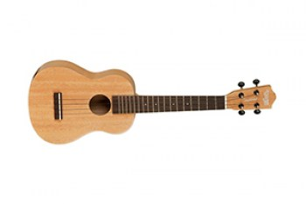
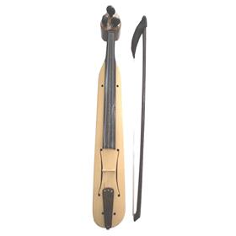
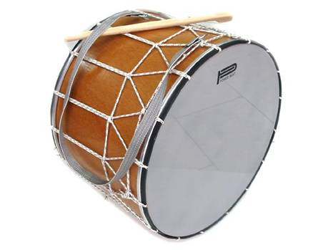
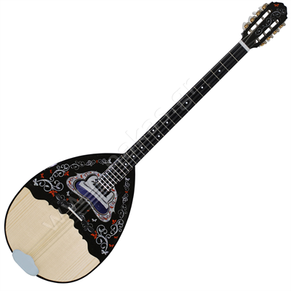
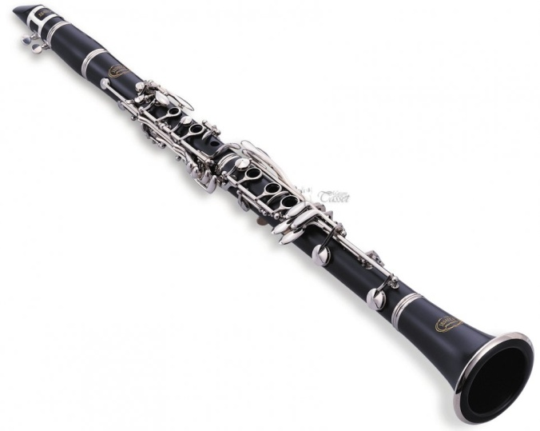
Greek Music
Every country has its own unique music and every kind of this music is special, but I think that we Greeks enjoy it even more. Three traditional Greek instruments are the bouzouki, the guitar and the clarinet. In some islands, like Ikaria, it is popular to hear a violin or a lyre playing the melody. Last but not least there are also a variety of drums that keep the rhythm.

Slide 20
Welcome to the Music School of Tripoli
Created By Tasos Metaxas
Thank you for your attention and we hope you will have a great time here!

