Slide 1
Erasmus+

Slide 2
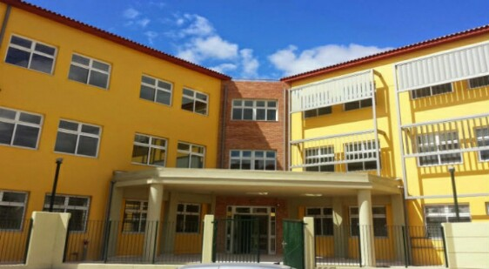
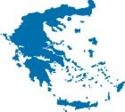
MUSIC SCHOOL OF TRIPOLIS
KA2 ERASMUS + project 2018- 2020:
“ IWE ERASMUS + 2018-2020” “ ‘I’ dentity –‘We’ dentity: Living together in the 21st century Europe”
PRESENTATION “ THE GREEK EDUCATIONAL SYSTEM ”

Slide 3
Greece Overview
Regional and Local Levels
At regional level, the Regional Education Directorates oversee the implementation of the national educational policy.
At local level, the Directorates of Primary and Secondary Education supervise all schools in their area. In their turn, school units make sure they run smoothly.
Teachers
Educational officials of the country are Higher Education graduates.
The main route into teaching in primary schools is to take a 4-year degree in a pedagogical department.
In secondary schools, most teachers follow a 4 or 5-year subject-based degree at a teacher education faculty.

Slide 4
Stages of the Education System
Compulsory education in Greece lasts 11 years and extends from the ages of 4 to 15. The stages of the Greek education are mainly three:
1. Primary Education
2. Secondary Education
3. Tertiary Education
Lifelong Learning

Slide 5
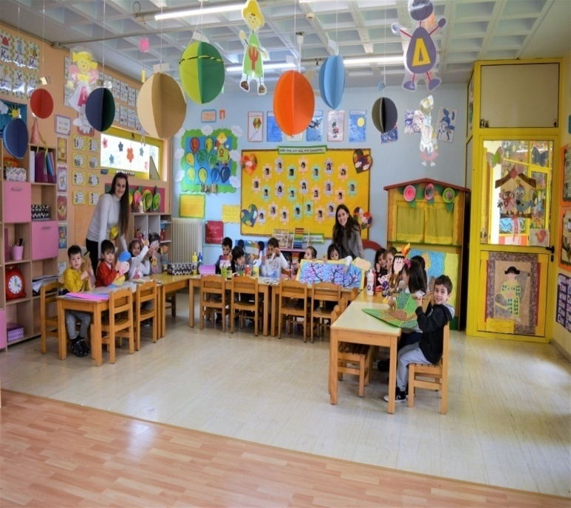
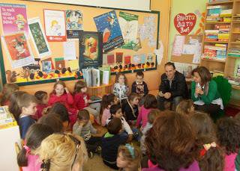
1. Primary Education
Primary Εducation includes Pre-primary and Primary schools.
Pre-primary School
Pre-primary Εducation in Greece has become compulsory for all 4-year-old children, since school year 2018-2019. Over the span of 3 years, the two-year pre-school education will become compulsory in all municipalities of the country and children will enrol in Pre-primary Schools (Nipiagogeia) at the age of 4.
Infant Centres (Vrefikoi Stathmoi), Infant/Child Centres (Vrefonipiakoi Stathmoi) and Child Centres (Paidikoi Stathmoi) represent early childhood care. They are run under the remit of the Municipal Authorities. They cater for children between the ages of 2 months and up to 4 years old.
Primary School
Primary Education is the next stage. Primary School (Dimotiko Scholeio) spans 6 years. It concerns children in the age range of 6-12 years.
Since school year 2016-2017, there is a Single Type of All-day Primary School with a new revised daily timetable.
SPECIAL EDUCATION
Primary School for students with Special Needs Ediko Dimotiko Scholio

Slide 6
2. Secondary Education
Secondary Education includes two cycles of study:
Lower Secondary School
The first one is compulsory and corresponds to Lower Secondary School (Gymnasio). It lasts 3 years. It provides general education. It covers ages 12-15
It is a prerequisite for enrolling at General or Vocational Upper Secondary Schools. Parallel to Day Gymnasio,
Evening (Esperino) Gymnasio operates. Attendance starts at the age of 14.
Experimental Junior High School Piramatiko Gymnasio
Music Junior High School Mousiko Gymnasio
Arts Junior High School Kallitechniko Gymnasio
Multicultural Junior High School Gymnasio Diapolitismikis Ekpedefsis
SPECIAL EDUCATION
Junior High School for students with Special Needs Ediko Gymnasio

Slide 8
Upper Secondary School
The second one is the optional General or Vocational Upper Secondary School (Geniko or Epaggelmatiko Lykeio). It lasts 3 years . Pupils enrol at the age of 15
There are two different types:
General (Geniko) Lykeio. It lasts three years and includes both common core subjects and optional subjects of specialisation
Experimental High School Piramatiko Lykio
Music High School Mousiko Lykio
Arts High School Kallitechniko Lykio
Multicultural High School Lykio Diapolitismikis Ekpedefsis
Vocational (Epaggelmatiko) Lykeio. It offers two cycles of studies:
The secondary cycle
The optional post-secondary cycle, the so-called “Apprenticeship Class”.
Parallel to day Lykeia, there are 4-year Lykeia:
Evening General (Esperina Genika)
Evening Vocational (Esperina Epaggelmatika). The minimum age for enrolment is the age of 16.
SPECIAL EDUCATION
Special Vocational Education & Training Institutes Ergastiria Epagelmatikis Ekpedefsis & Katartisis

Slide 9
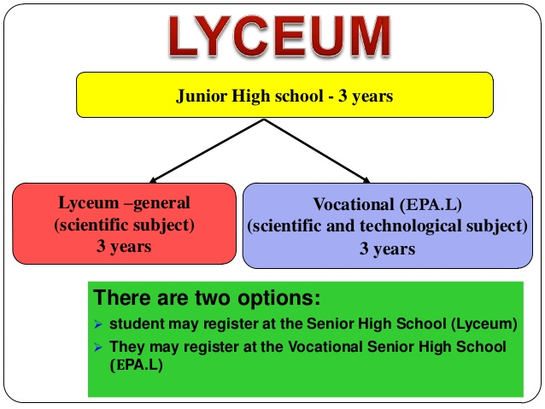
High Schools offer a combination of General Education courses and Advanced Placement courses. Students who wish to pursue studies in Higher Education take Panhellenic exams in a specific number of Advanced Placement courses which fall into one of the following categories: Humanities, Science, Technology. This is considered to be a tough and highly competitive exam process that students go through in order to ensure education at a higher level.

Slide 10
3. Tertiary Education
Higher education is the last level of the formal education system from the age of 18. Most undergraduate degree programmes take 4 academic years of full-time study.
Postgraduate courses last from one to two years, while doctorates at least 3 years.
HE comprises:
The University Sector (Panepistimio):
Universities
Polytechnics
The School of Fine Arts.
The Technological sector
Technological Education Institutions (Technologika Ekpaideftika Idrymata)
The School of Pedagogical and Technological Education (ASPETE).
School of Fine Arts Scholi Kalon Technon
Look 4 studies
Hellenic Open University Elliniko Anichto Panepistimio

Slide 11
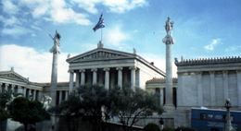
Tertiary Education
National and Kapodistrian University of Athens (Athens University) 1836

Slide 12
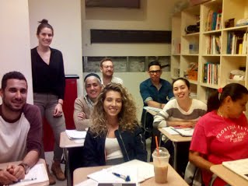
Lifelong Learning Lifelong Learning in Greece takes place in Lifelong Learning centers which are usually supervised by Municipality services. These centers offer a variety of courses, aiming at both formal and informal education. On the other hand, Vocational Training Institutes and Vocational Training Schools often adapt their curriculum to suit the needs of their adult students and of the labor market. Finally, Second Chance Adult Education Schools cater for those students who have dropped out of school at some point in their life, but wish to continue with their studies at a later date.
Lifelong Learning
Lifelong Learning Centers Kentra Dia Viou Mathisis
Second Chance Adult Education School Scholio Defteris Efkerias
VOCATIONAL EDUCATION
Vocational Training Schools Scholi Epagelmatikis Katartisis
Vocational Training Institutes Institouta Epagelmatikis Katartisis

Slide 14
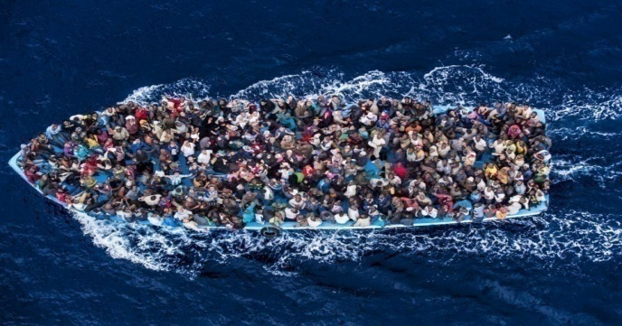
Access to education for refugees and asylum seekers in Greece.

Slide 15
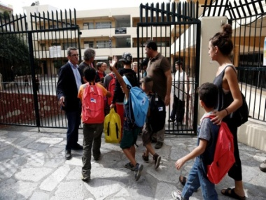
Access to education for refugees and asylum seekers in Greece.
Can my children access education in Greece?
Yes, if you are an asylum seeker, or a recognized refugee, or a beneficiary of subsidiary protection, your children may access the national education system under similar conditions as Greek nationals.
.

Slide 16
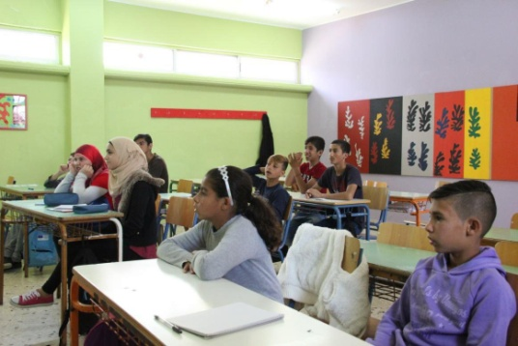
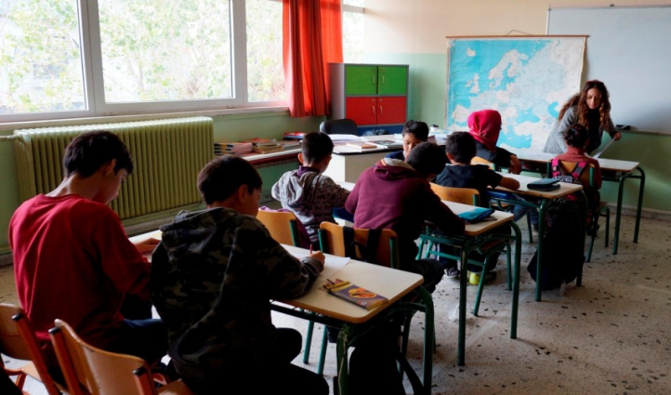
Is education compulsory in Greece? Education is compulsory for all children in Greece, including refugees and asylum seekers, boys and girls, who are aged between 5 and 15 years old. Compulsory education includes pre-primary (one year), primary and lower secondary education.

Slide 17
2017-2019 afternoon classes organized by the Ministry of Education
16 lower secondary education (Gymnasio) schools for refugees and asylum seekers : 300 children
23 pre-primary schools for refugees and asylum seekers: 539 children
45 Primary education (Demotiko) schools for refugees and asylum seekers : 1187 children

Slide 18
2017-2019 Reception classes provide additional support, in particular for Greek language comprehension.
Lower secondary education (Gymnasio) schools for refugees and asylum seekers : 900 children
Upper secondary school (Eniaio Lykeio) and technical vocational school (TEE):
699 children
Primary education (Demotiko) schools for refugees and asylum seekers : 3692children

Slide 19
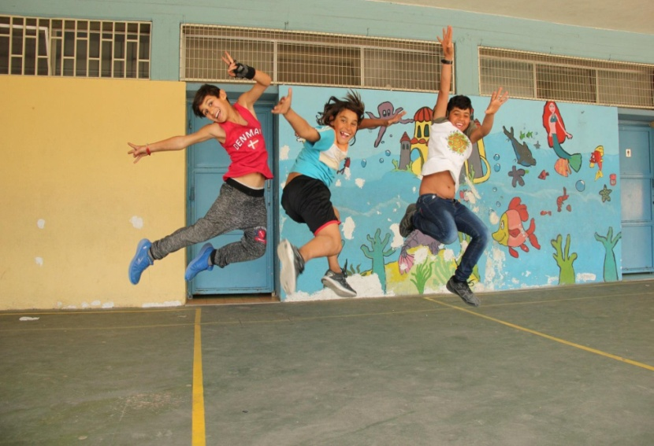
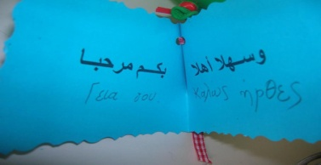
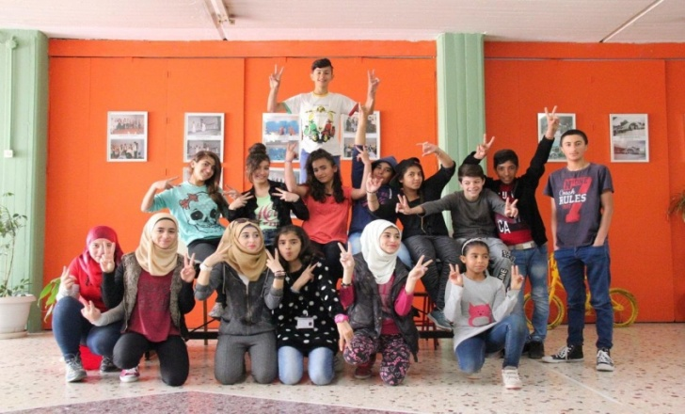
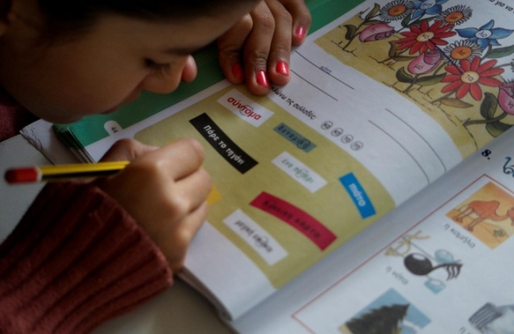
https://www.refugee.info/greece Services Greek classes for adults Homework support and educational activities for children and parents Language and computer lessons After-school educational program for children Greek language classes for children and adolescents Psycho-social support and social services

Slide 20
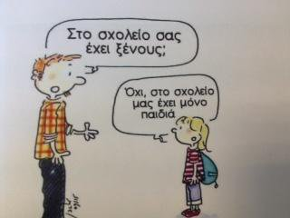
Do you have any refugees and asylum seekers in your school ?
Greek schools open for refugees…
No, in our school we have only kids
“The Greek language course is my favourite, and I don’t find it difficult to learn. I have Greek friends at school. When the bell rings and we go outside for a break, we play with the ball in the school yard all together. I like going to school so much! I dream of becoming a doctor when I grow up,” said 10-year-old Younes, from Iraq.

Slide 21
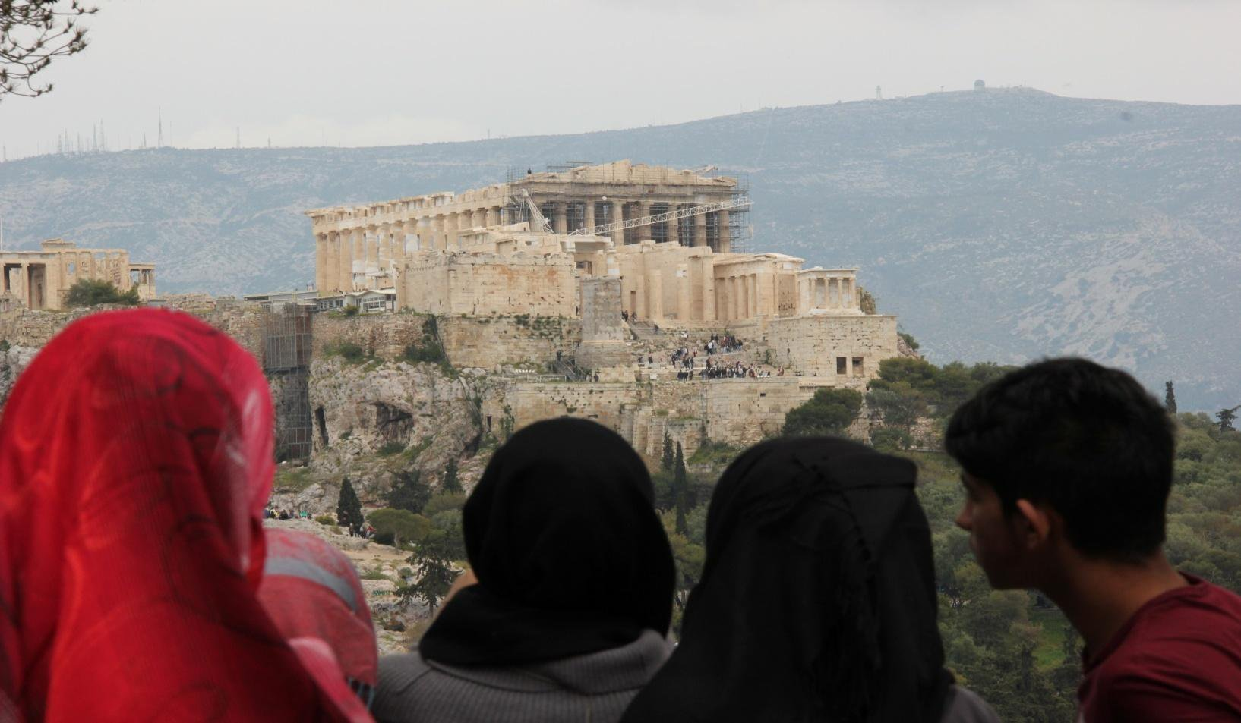
Have a great school year, everyone!

Slide 22
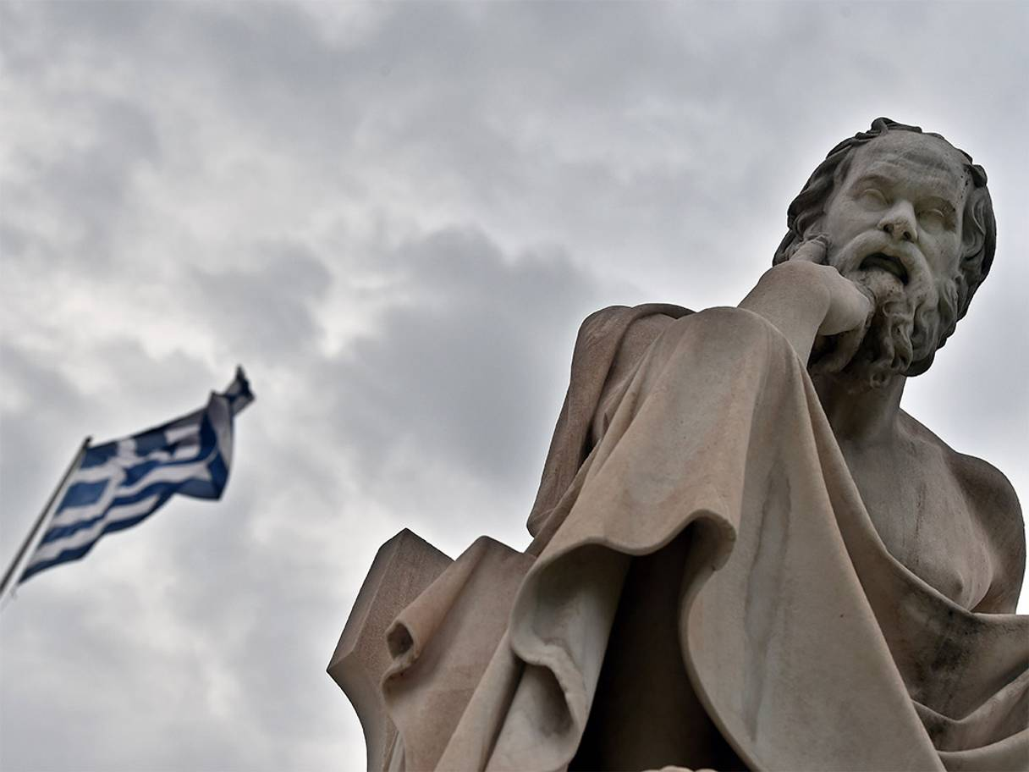
THANK YOU FOR YOUR ATTENTION !
Greek philosopher Socrates formulated an educational system based on critical thinking.
“The only true wisdom is in knowing you know nothing.”
Socrates

