Slide 1
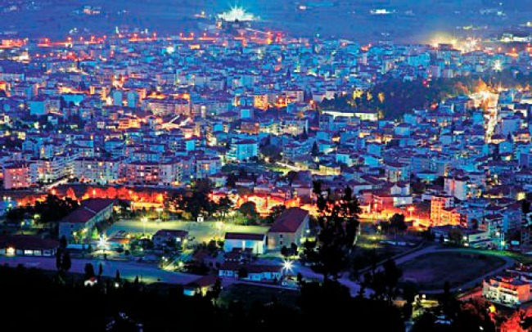
“«I»dentity – «We»dentity :Living together in the 21st century Europe”
THE GREEK PRESENTATION OF
TRIPOLIS
MARCH 2019

Slide 2
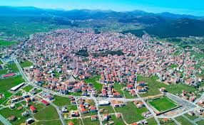
Tripoli the capital of Arcadia

Slide 3
Basic information
Tripoli is a city in the central part of Peloponnese, in Greece. The homonym municipality has around 47,000 inhabitants.
The city of Tripolis has a mediterranean climate.
It is in a broad montane basin at about 650 m in altitude and surrounded by thickly wooded mountains on all sides.
The tallest and closest of which is Mount Mainalon to the northwest.
Notes:
Tripoli is the seat of the recently founded University of Peloponnese with two departments of the Sciences and Technology School and one department of the Economics and Administration School.

Slide 4
History of Tripoli
Before the Greek War of Independence, under the Ottoman name of "Tripoliçe", it was one of the Ottoman administrative centers in the Peloponnese.
Tripolis was one of the main targets of the Greek insurgents during the said war, who stormed it on 17 October 1821, following the bloody Siege of Tripolitsa

Slide 5
Tripoli (The last two centuries )
Tripoli had a big growth because of her geographical position in:
economy
administration
tourism
education

Slide 6
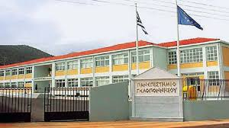
Τripolis University
Tripolis university is the headquarters of Peloponnisos universities
It contains two departments
economy
computer science

Slide 7
Αrchitecture

Slide 8
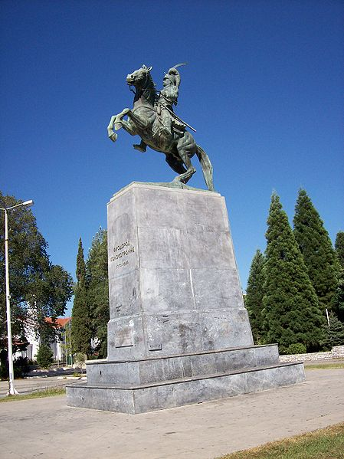
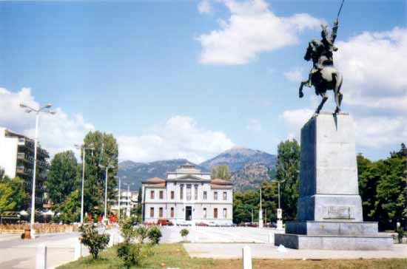
Statue of Theodoros Kolokotronis
This statue is placed in Areos square

Slide 9
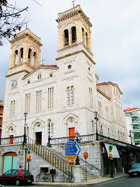
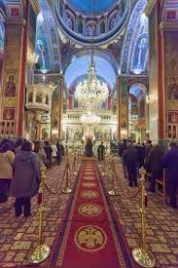
Church of Agios Vasilios Our Metropolitan Cathedral
It is the only church made only with white
marble.
And it is the only church
which has stores
below it

Slide 10
cultural buildings
Τripoli has a lot of cultural buildings like :
Kostas Kariotakis house
Tripolis cultural center
Tripolis town hall
Tripolis old court

Slide 11
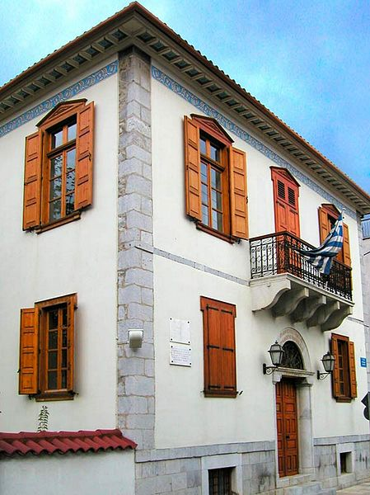
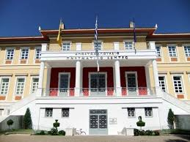
Tripolis cultural center and Kostas Kariotakis house

Slide 12
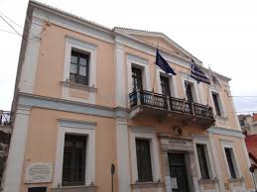
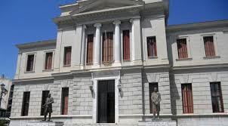
Tripolis town hall and old court

Slide 13
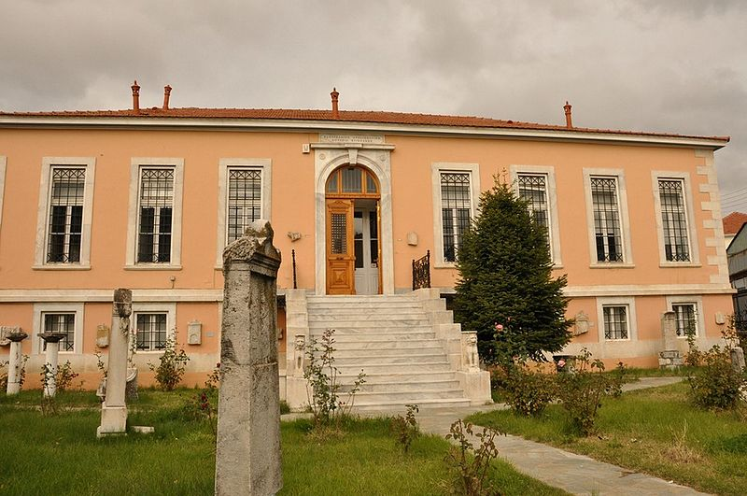
Tripolis Archaeological Museum
Archaeological museum
is one of the major tripolis
sightseeing
Notes:
εχει πραγματα απο την αρχαια αρκαδια

Slide 14
Notable people
In Tripoli they lived big personalities who had big effect in greek history during 19th to 21th century
Theodoros Kolokotronis (General)
Kostas Karyotakis (Poet)
Yiannis Malliaropoulos (politician)
Yiannis Kouros (athlete)

Slide 15
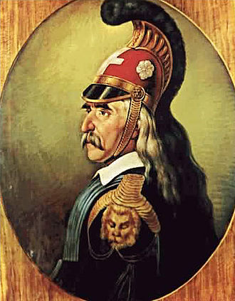
Theodoros Kolokotronis
Theodoros Kolokotronis was a
greek general in Greek War of
Independens

Slide 16
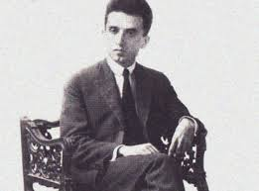
Kostas Karyotakis
Kostas Karyotakis is considered one of the
important most Greek poets of the 1920s

Slide 17
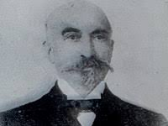
Yiannis Malliaropoulos
Ioannis Malliaropoulos was a Greek physician and politician
he donated Malliaropoulio theater

Slide 18
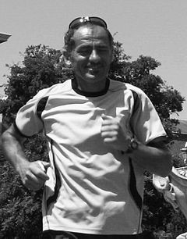
Yiannis Kouros
Yiannis Kouros is a Greek ultramarathon
runner.
He holds many men's outdoor road world
records from 100 to 1,000

Slide 19
Sports teams
Tripoli hosts three sport clubs with presence in the higher national divisions in Greek football and basketball. These teams are :
Panarkadikos at Football
Asteras Tripolis at Football
Arcadikos at Basketball

Slide 20
Military
Tripoli is home to the two largest Armed Forces bootcamp centers of Greece, one for the Hellenic Army and one for the Hellenic Air Force
251 Army Training Battalion (Greek)
124 Basic Training Wing (Greek)
https://en.wikipedia.org/wiki/Hellenic_Air_Force

Slide 21
thank you for listening
i hope that you enjoyed our presentation about tripoli
And learnt something new about tripoli
This project was made by:
Mixail davlantis

