Slide 1
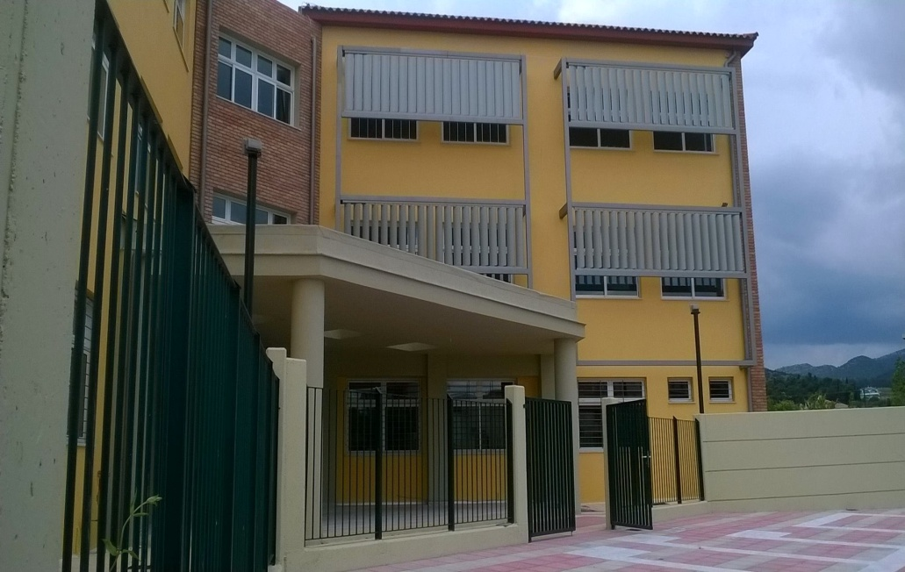
“«I»dentity – «We»dentity :Living together in the 21st century Europe”
THE PRESENTATION OF
MUSIC SCHOOL OF TRIPOLIS

Slide 2
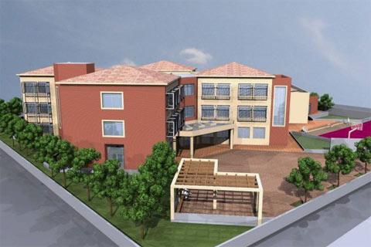
THE NEW BUILDING
New bioclimatic building
5.500 m²
Three floor building
Stairs and elevator
25 classrooms
Auditorium for concerts
Insulated building ( sound proof )
Computer lab, Science lab, studio, library

Slide 3
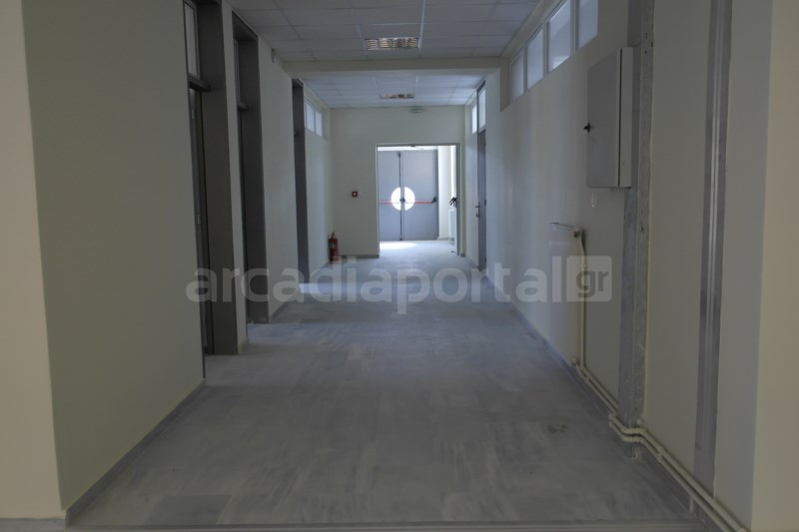
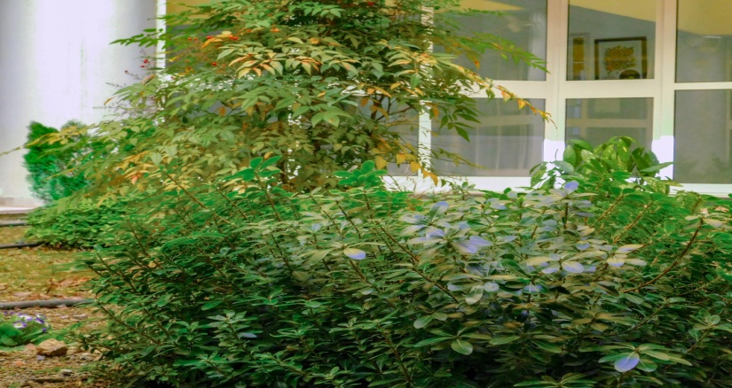
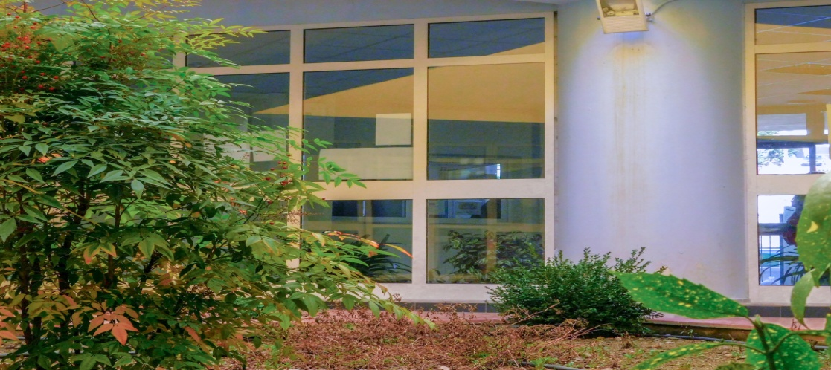
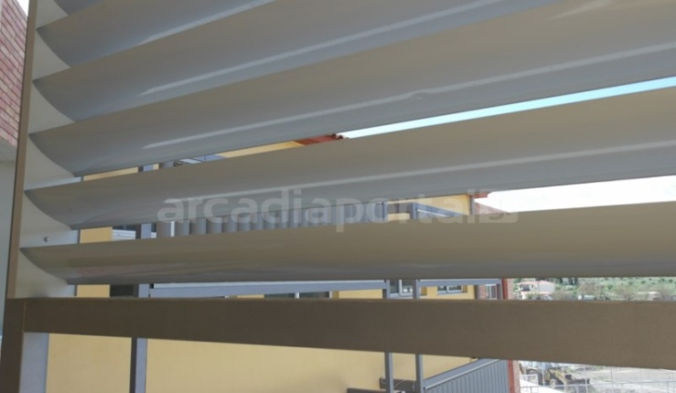
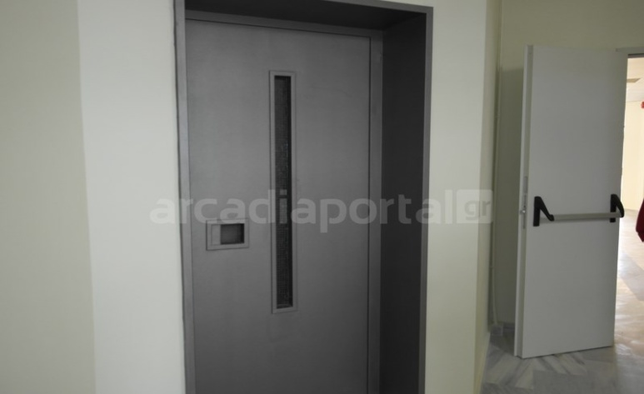
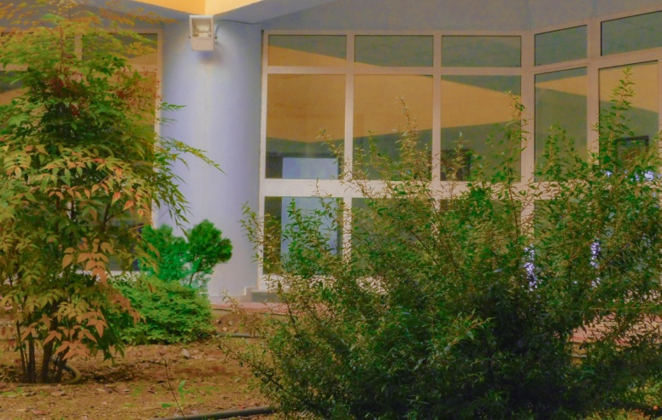
Χωροταξία

Slide 4
11 September 2016 First day in this new building
Public School ( Gymnasium and Lyceum level )
Same Curriculum as the general schools (same books, way of teaching, grades)
Entrance examination ( Music Talent )
It has 3 grades ( 3 grades gymnasium and 3 grades lyceum level )
General and musical education co - exist
( The same school subjects and studies in Classical Music, choir, musical instruments and Greek traditional music – Byzantine)

Slide 5
You get marks from the first grade twice a year and you take an exam in June for the next grade
You give concerts twice a year too !
The students are obliged to get high marks if they want to follow their studies at music school next year.
Students at the lyceum level can apply for any University they are interested in
Their studies are certified at the general and the musical level
If a student fails at general education or at a musical lesson, then he / she must leave school and attend another general school in town.

Slide 6
General Education
Religious Education Ancient Greek Ancient Greek : Odyssey Modern Greek
Literature
History, Sociology Maths
Science, Chemistry, Biology Geography
English
German or French Physical Education Computer Science
Arts History of Arts
Theatre
Project

Slide 7
Musical Education
Theory of musical scales – the tonic system/ Solfege Theory of Byzantine music Harmony of Music
Morphology of Music Choir
Byzantine Choir Orchestra Piano lessons
Tampouras lessons
Other instruments lessons
“Music is a heart’s soul and a mind ’s wings” , Ancient Platon

Slide 8
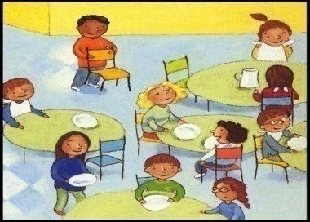
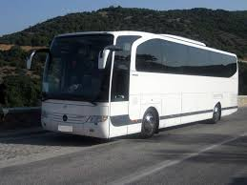
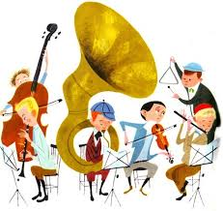
Classes with only 20 students
The musical lessons are free of charge
Free transportation from and to school by bus or even by taxi
Free lunch to the students daily due to the many hours of operation
All the students participate in concerts or other cultural events getting the chance to practice everything they learn at school

Slide 9
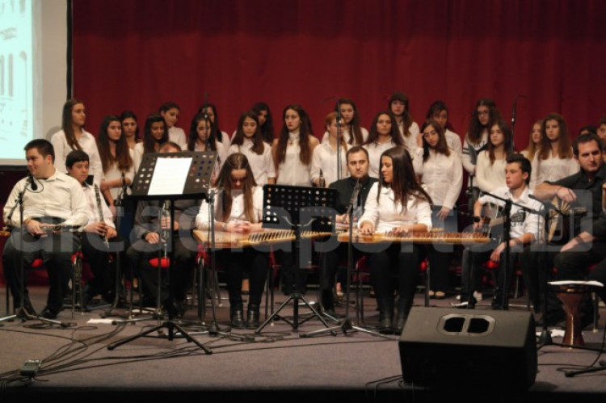
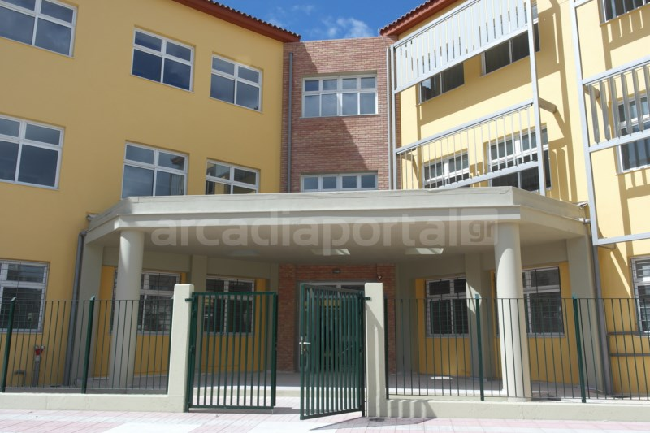
ACTIVITIES Concerts Erasmus+ Euroscuola Choir Festivals Projects for the environment, Health, Society Educational visits at the museums, national libraries, Hellenic Parliament Competitions for students in and out of school Sports Competitions

Slide 10
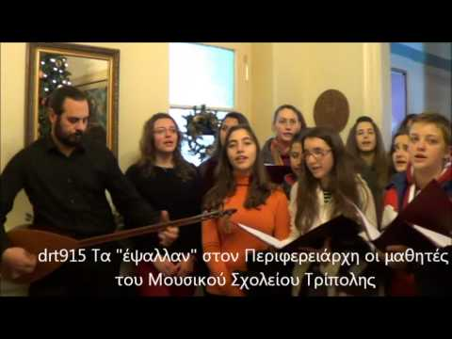
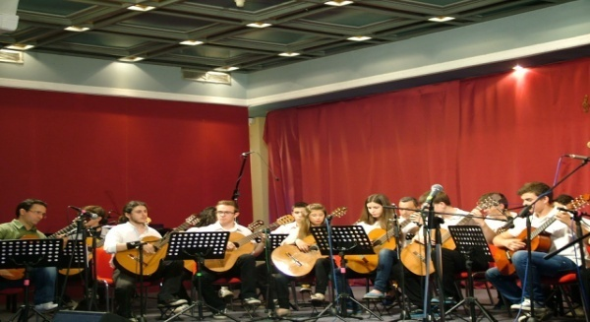
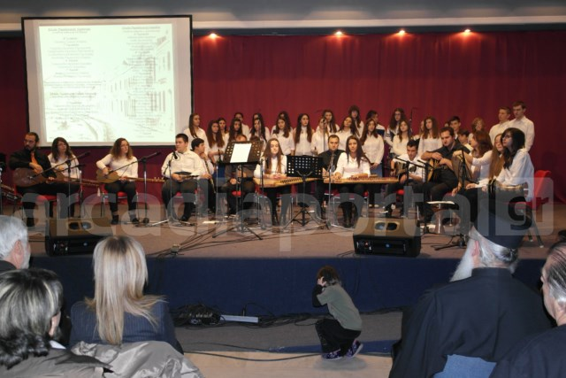
Στιγμιότυπα μαθητικ

Slide 11
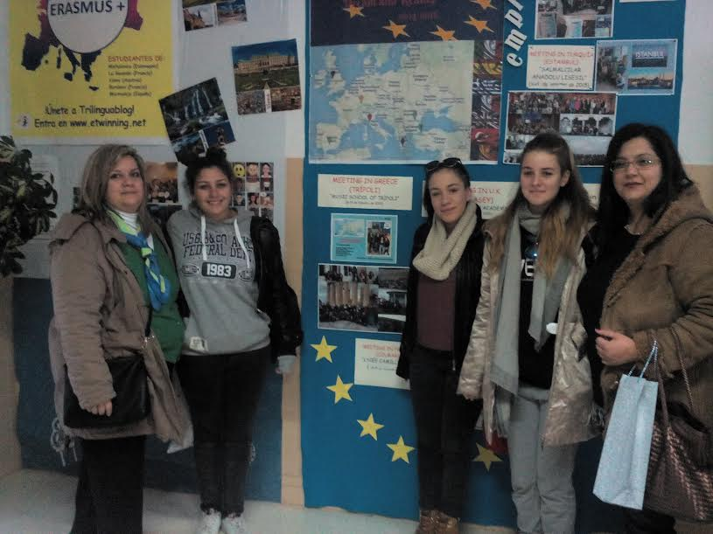
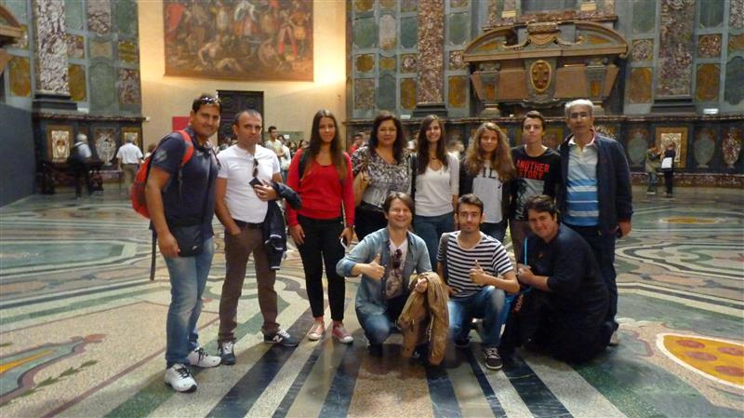
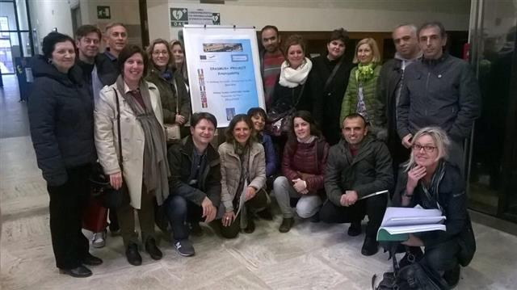

Slide 12
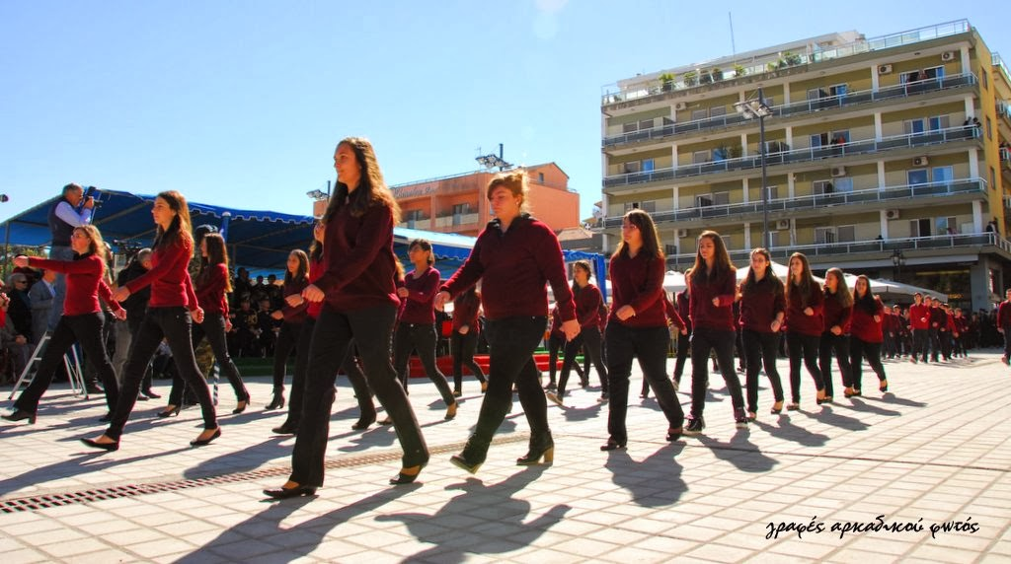
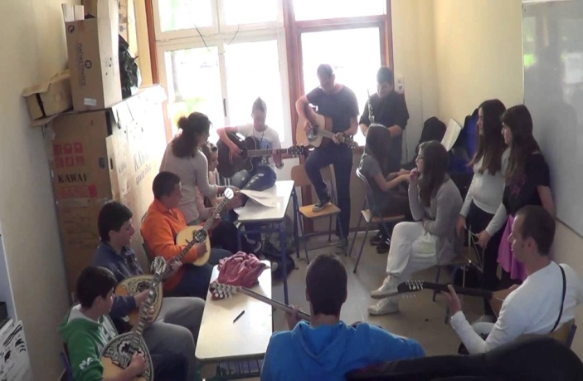
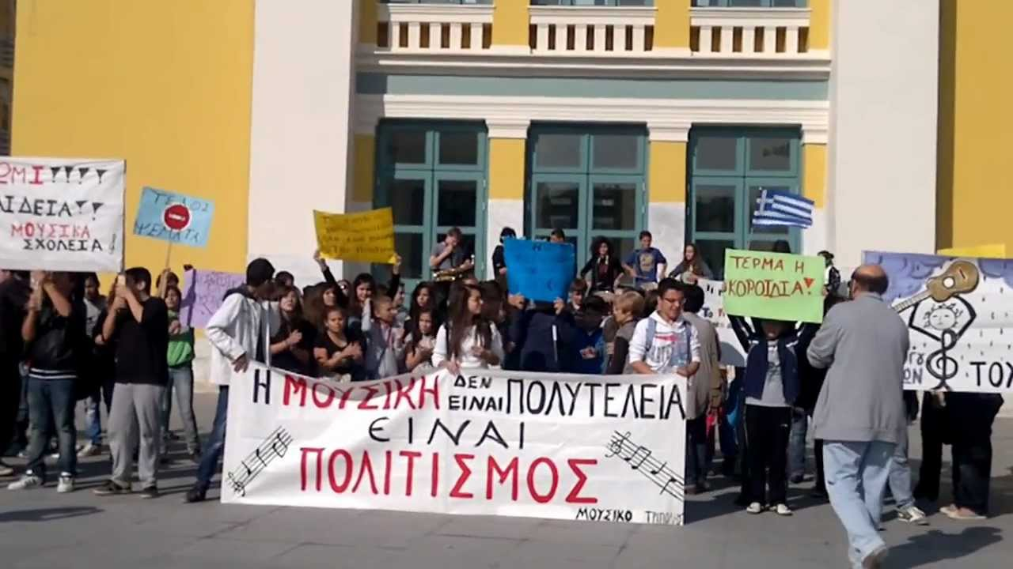
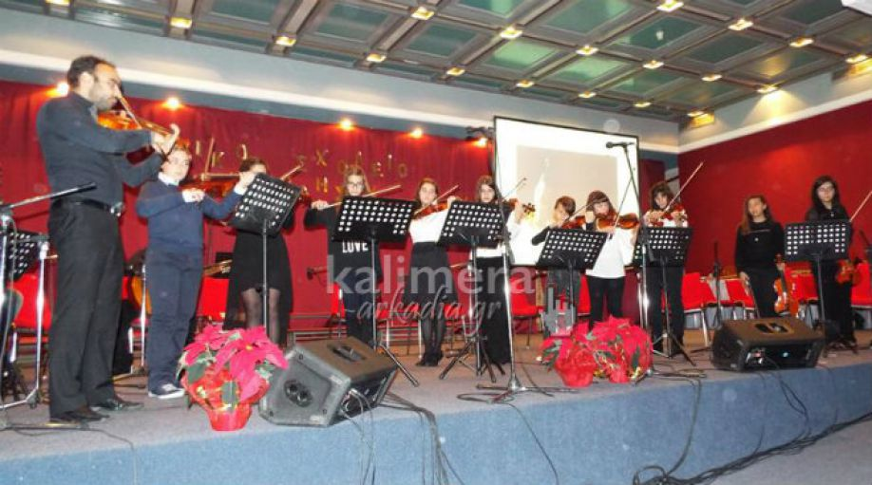

Slide 13
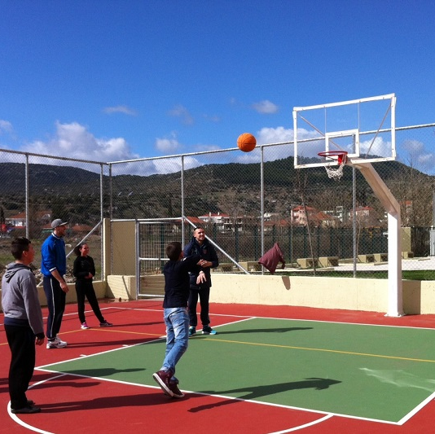
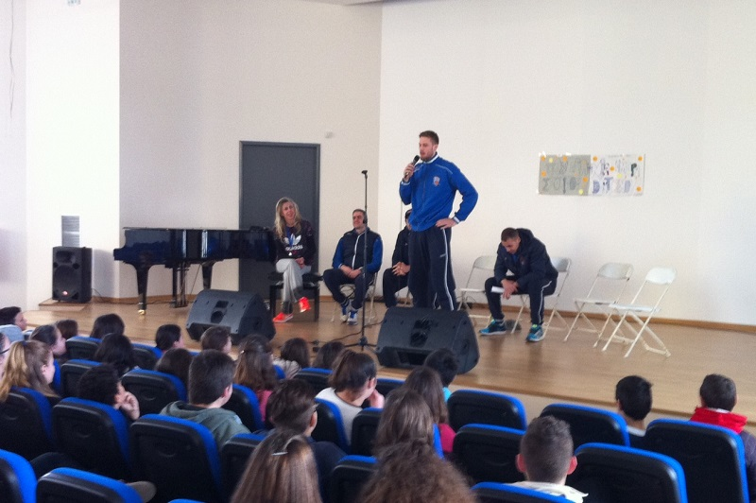
The Local BASKETBALL TEAM “ Arkadikos” visited our school

Slide 14
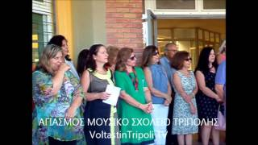
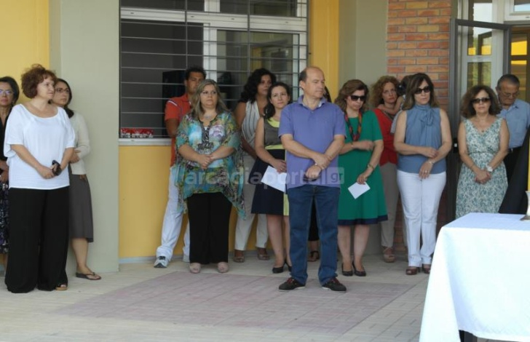
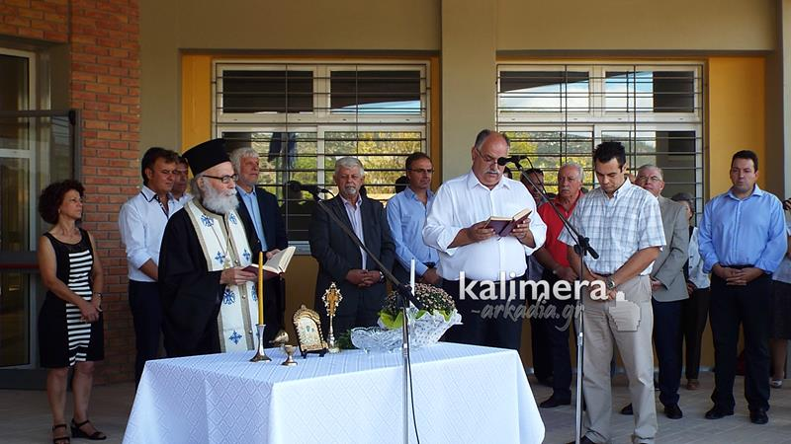
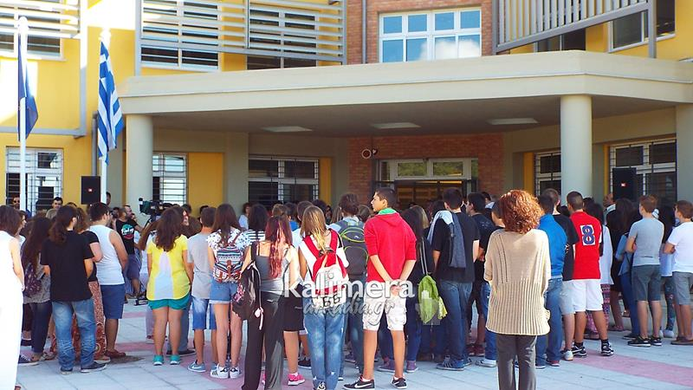
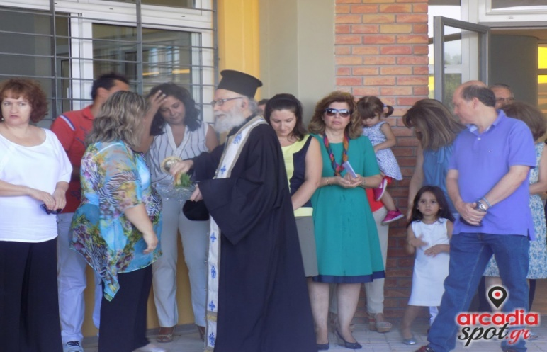
Σεπτέμβριος

Slide 15
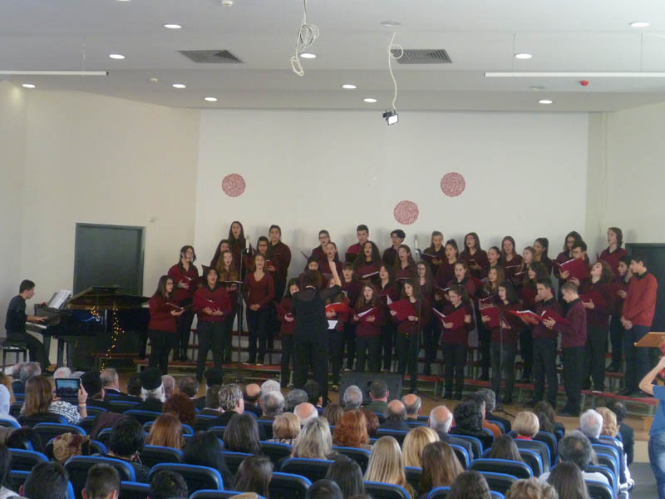
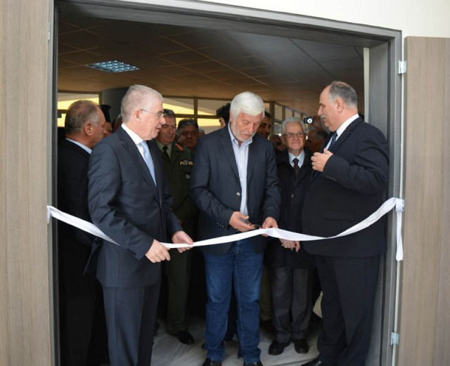
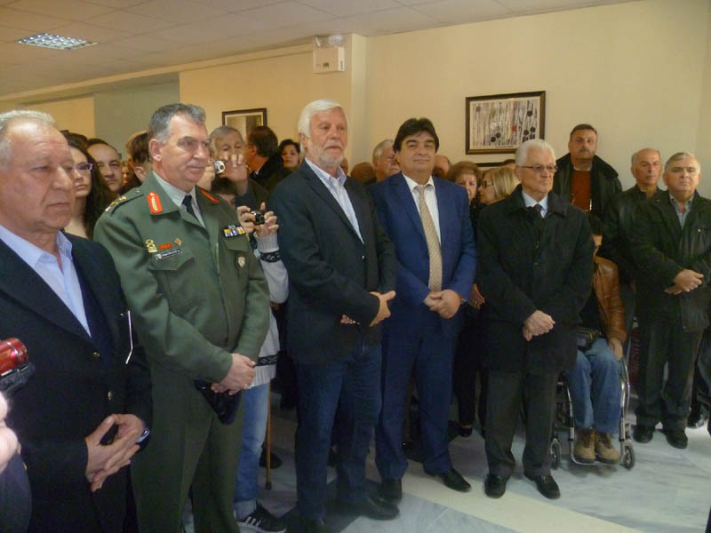

Slide 16
Have you paid attention ?

