Slide 1
Czech Republic and South Moravia, our school and study programmes
Made by Czech students

Slide 2
Where is South Moravia?
Right here

Slide 3
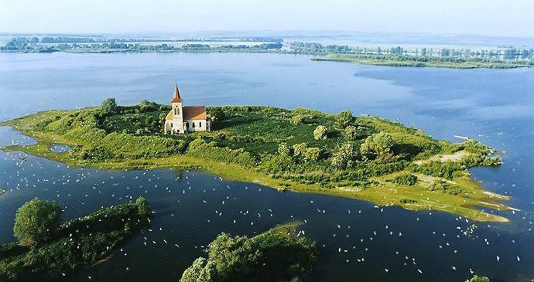
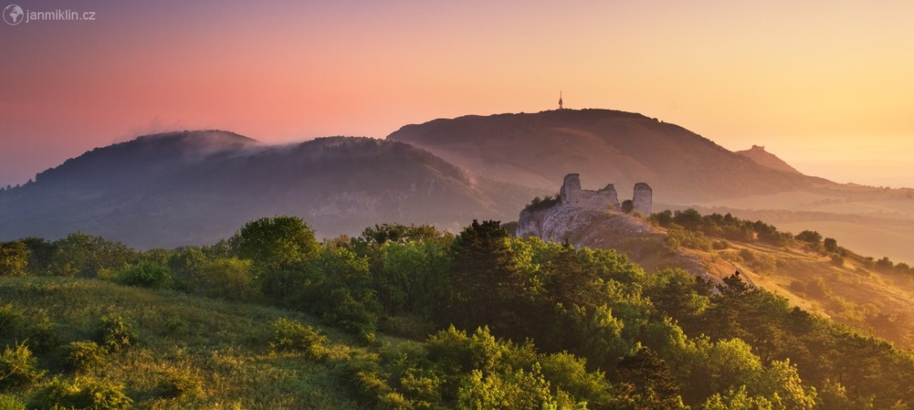
South Moravia facts
Low unemployment
Capital Brno – multicultural city of students
Lots of Wineyards around Pálava hills
Really big Lake Mušov [Mushov]
Mušov
Pálava

Slide 4
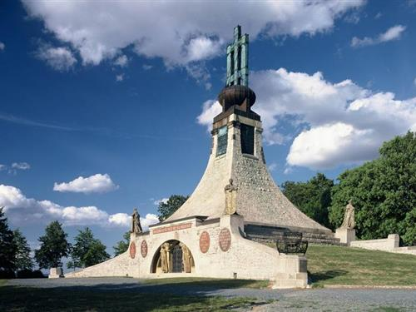
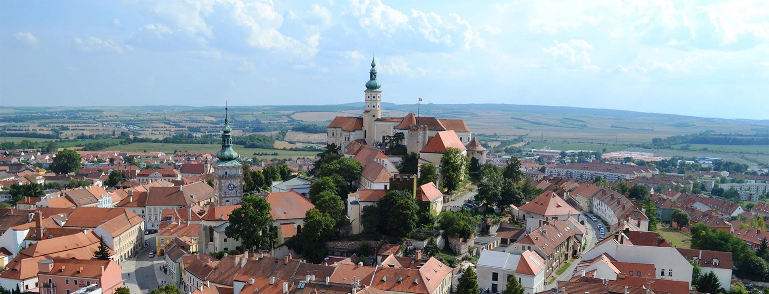
Historical towns (Slavkov,Mikulov, Znojmo, Břeclav)
Lots of Villages
Weird dialects
Slavkov u Brna
Mikulov

Slide 5
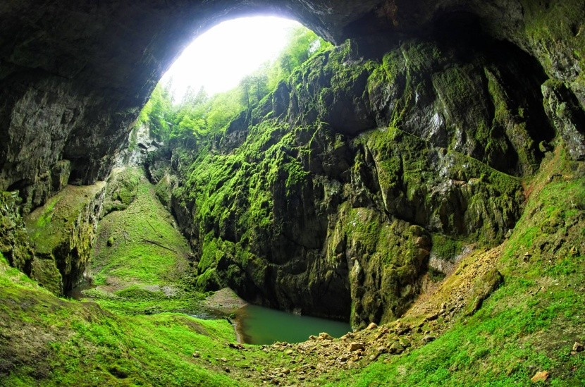
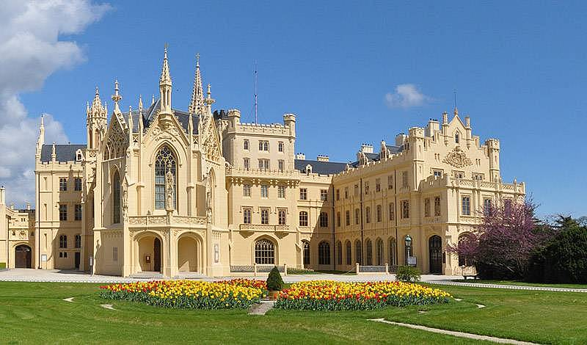
South Moravia facts
Beautiful old palaces, castles
South Moravia is pretty flat
Caves in Moravian Karst
Lednice palace
Moravský kras

Slide 6
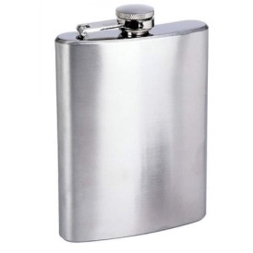
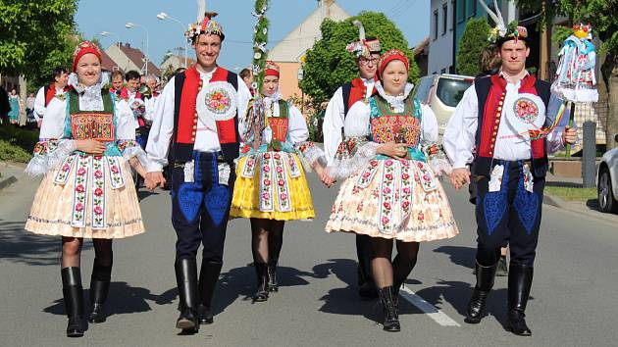
Hody (local feasts) and Wine (sometimes all kinds of Alcohol ☺)
Feasts are very popular in Moravia
Its our tradition to dance polka, wear folk costumes and taste local wines,
Polka is style of dance, which is danced mostly at the Feasts

Slide 7
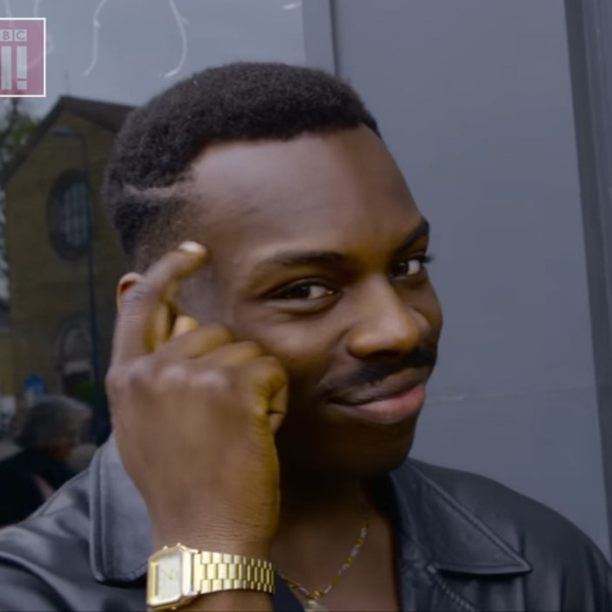
Beer is cheaper than water, but wine is cheaper than beer, so that means nobody drinks water (simple logic)

Slide 8
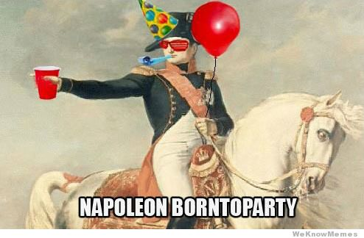
What is the best thing about South Moravia?
Us (Southmoravians)
Wineyeards.Wine.
Nice and friendly
people

Slide 9
What is the worst thing about South Moravia?
„Astronomical Clock“ in Brno. You can see what it looks like.

Slide 10
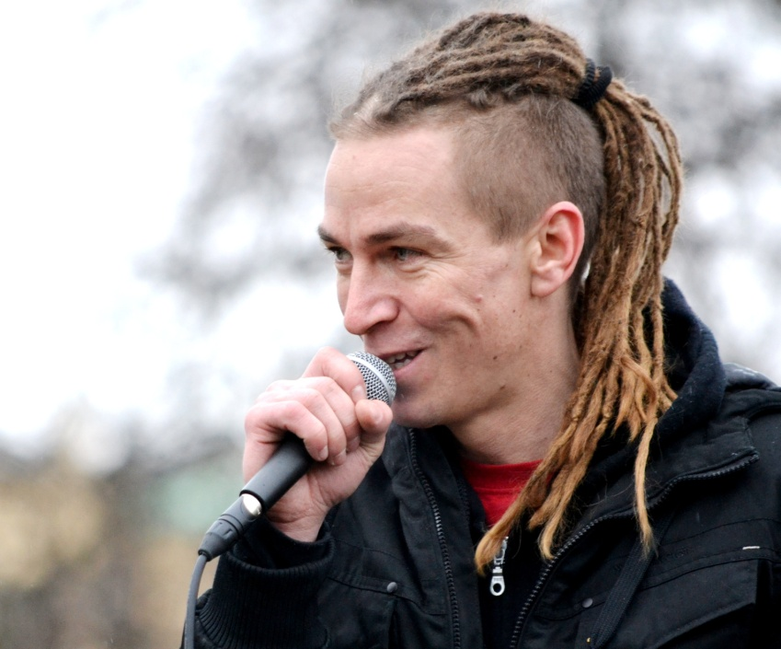
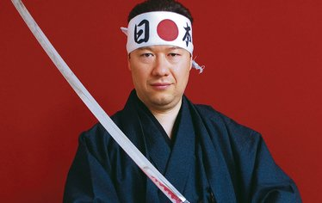
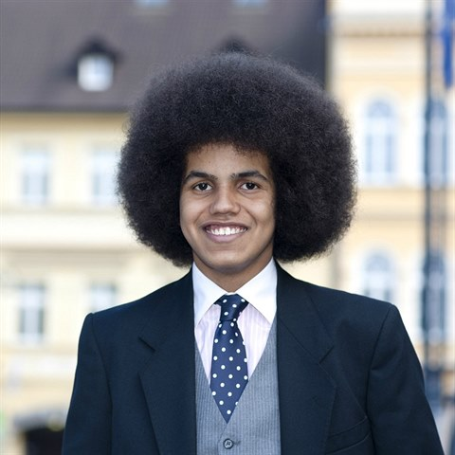
What about Politics? Are there any special ones?
No☺

Slide 11
BRNO
Our city

Slide 12
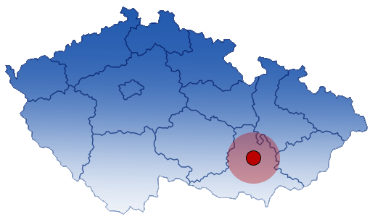
BRNO TRIVIA
We have 380 000 inhabitants
Brno is placed in South Moravian region
The area of Brno takes: 230,22 km²
We pay with Czech crowns
1€ = 25,76Kč

Slide 13
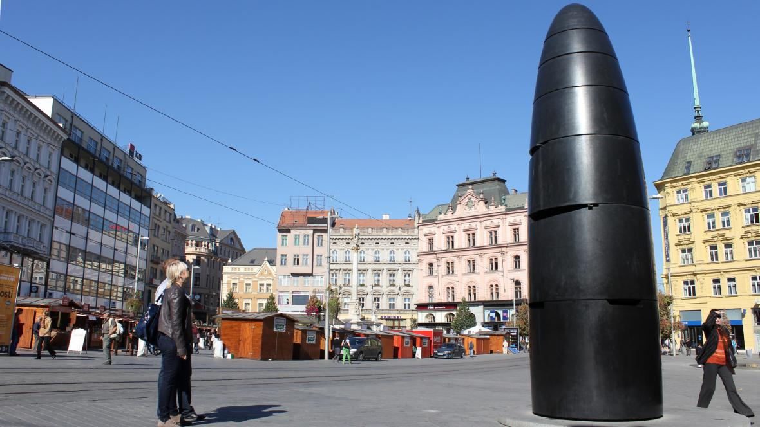
Astronomical clock
It cost around 12.000.000Kč = 470.000€
Its placed on Náměstí Svobody
Every day at 11:00 it releases a glass marble

Slide 14
CASTLE AND FORT ŠPILBERK
It was built in 13th century
It was used as a prison
Now it’s only a tourist attraction

Slide 15
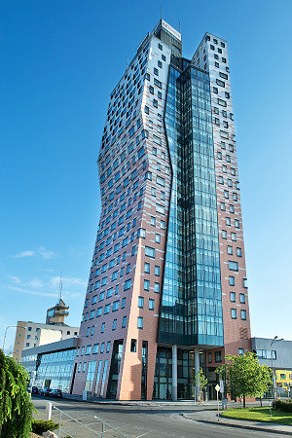
AZ TOWER
Tallest building in Brno
111 m/364 ft tall
It is used as office and residential spaces

Slide 16
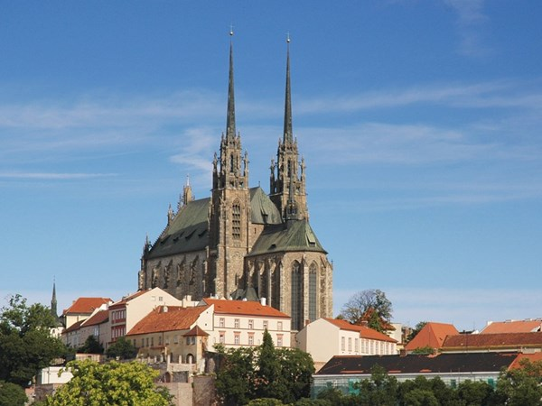
PETROV
Is in the centre of Brno
It is on one side of Czech crown coin
It was build in 12th century

Slide 17
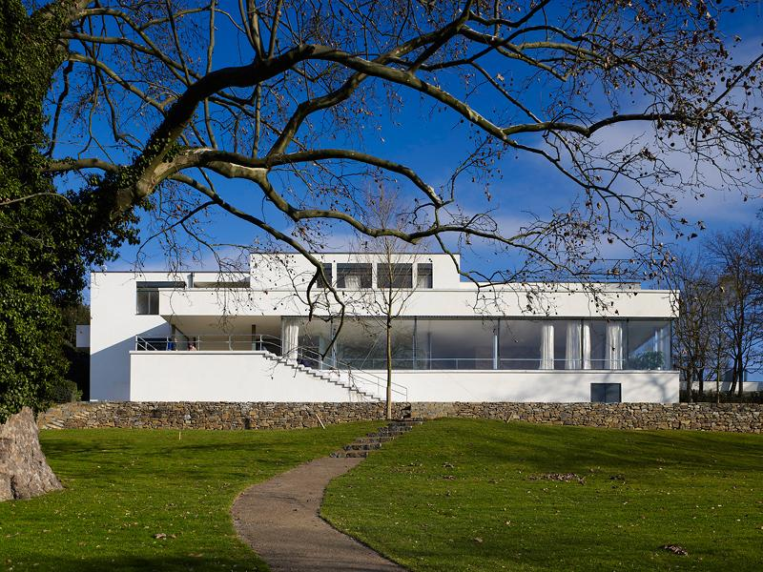
VILLA TUGENDHAT
It was build in summer 1929
It took 14 months to build
It is one of the most known villa
It is not available to buy- on UNESCO list

Slide 18
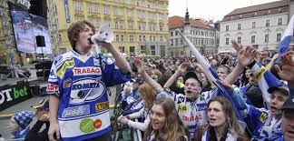
HC KOMETA BRNO
Profesional hockey team of Brno – People are proud of it!!
Most successful hockey team in the Czech Republic
They have won 2 Czech championships in a row

Slide 19
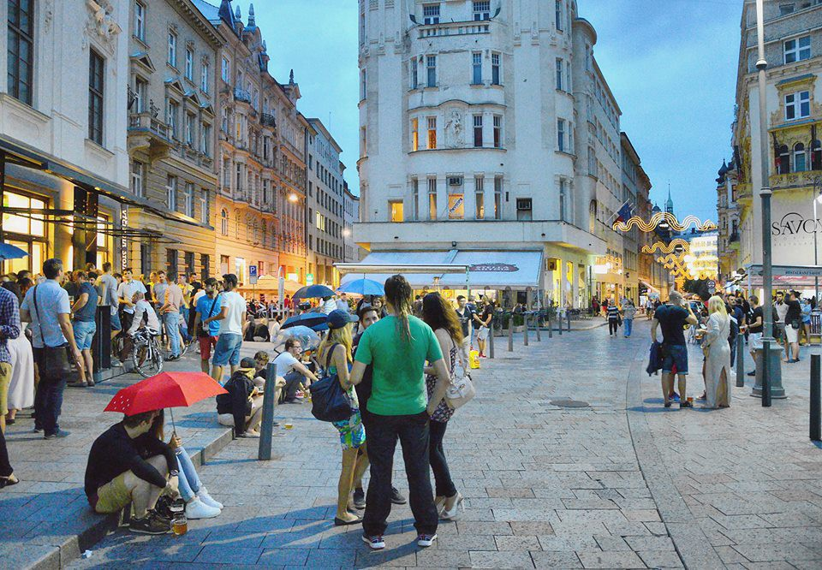
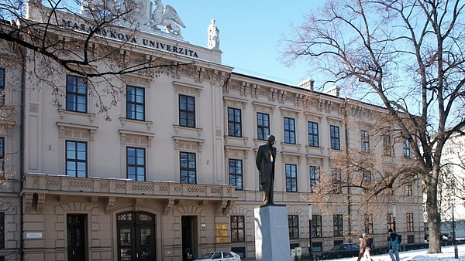
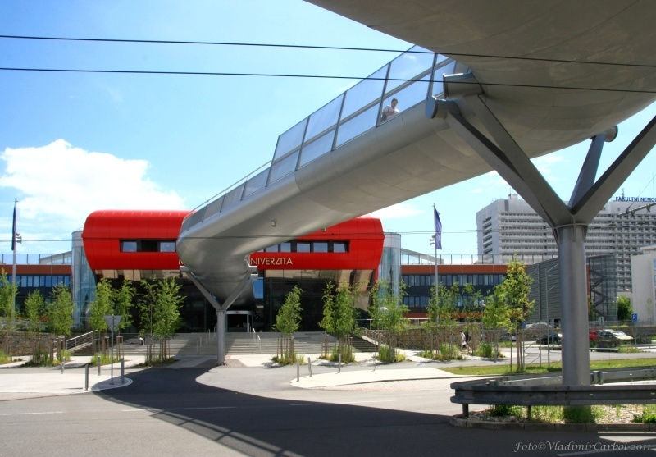
Brno is a students city
Brno has around 70 000 university students every year

Slide 20
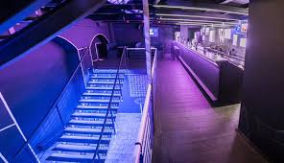
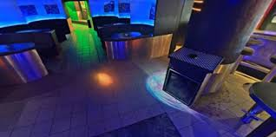
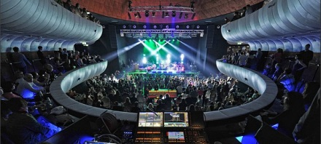
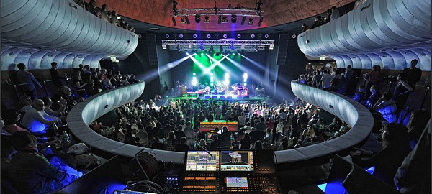
CLUBS
Young people like to visit these clubs:
Watt Club
Tabarin
Caribic
Sono
Mandarin

Slide 21
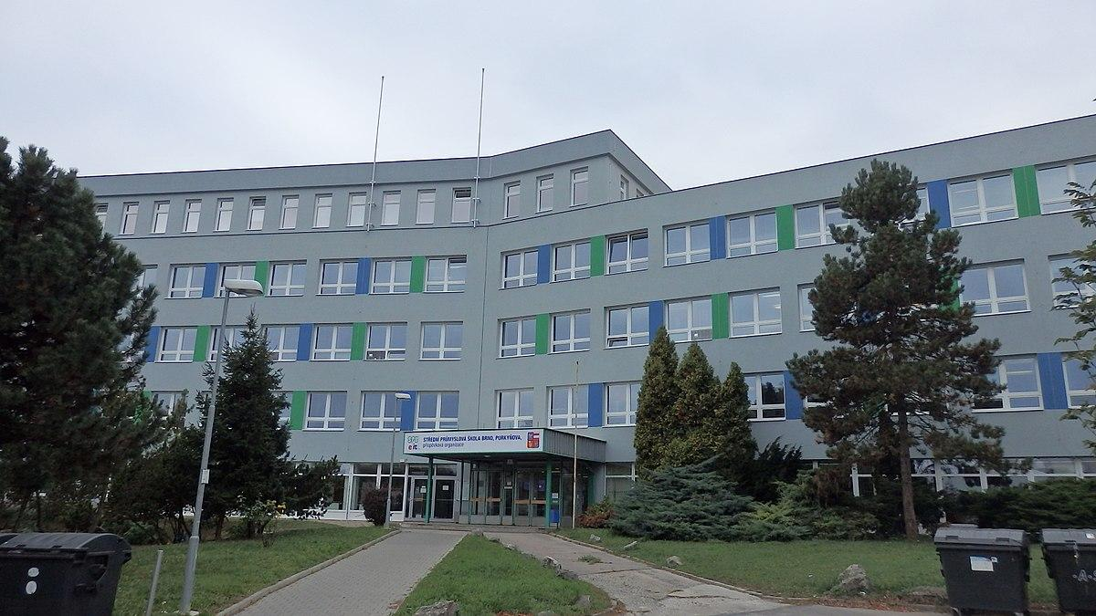
OUR SCHOOL
SSP Purkyňova
SSP Purkyňova

Slide 22
The past of our school
The history of our school goes back to 1949 when it was created as a school for apprentices for the company Tesla Brno.
The current building in the first picture was built in 1984 . And it has been the main building ever since.
In 2013 we merged with another big technical school

Slide 23
The present times
Our school has over 1300 students
We have many study progammes ranging from IT to economics, those two being the main programmes.
For IT we have four main specializations:
- Programming
- Graphics and Web design
- Automation
- Networking

Slide 24
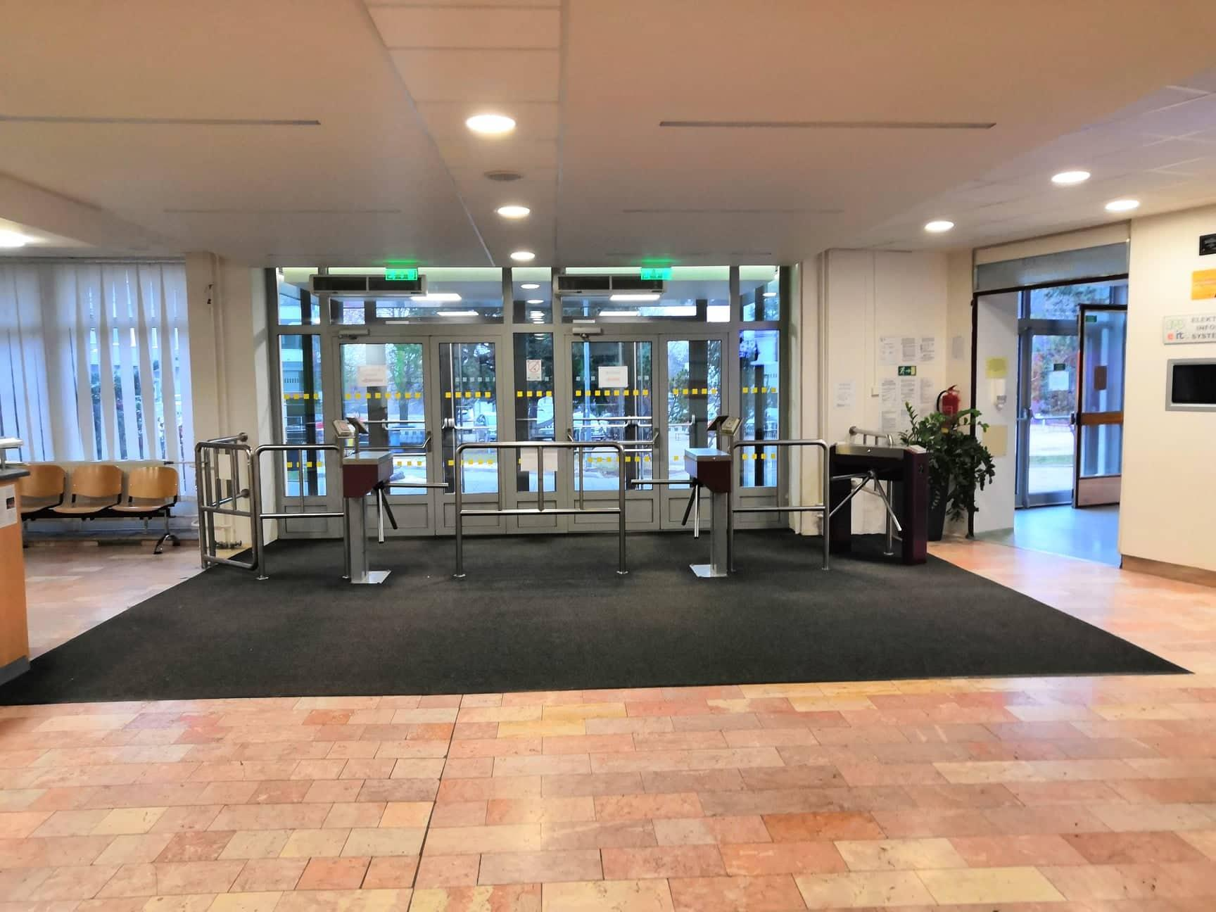
How our school looks inside
Main entrance

Slide 25
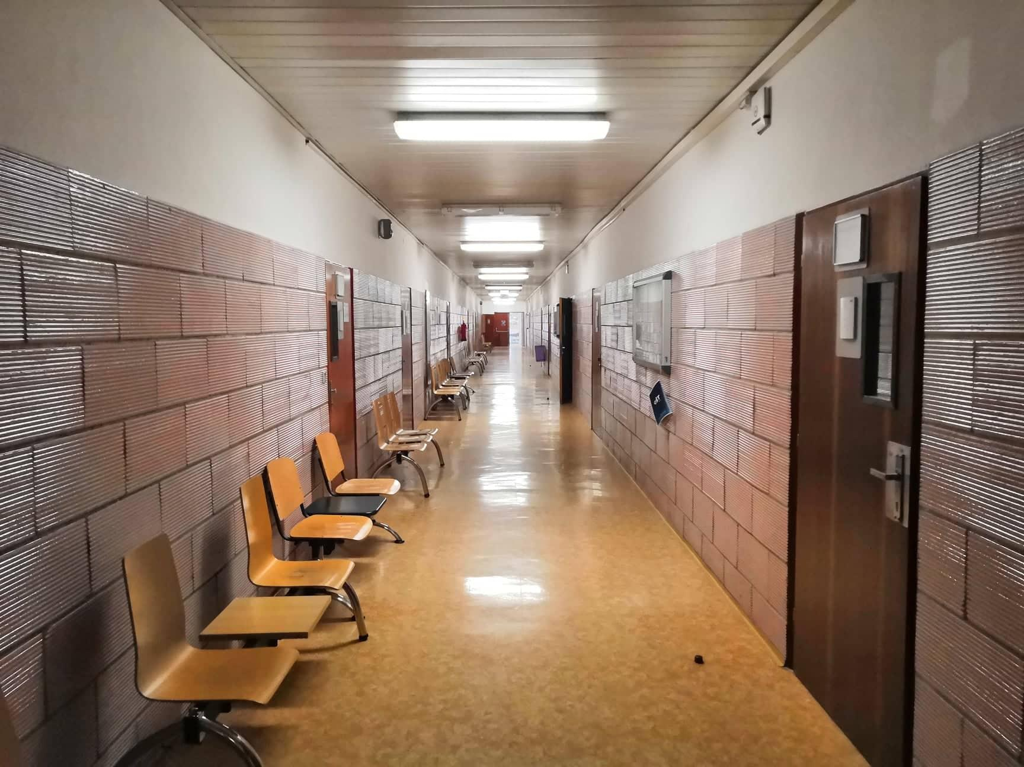
Hallway

Slide 26
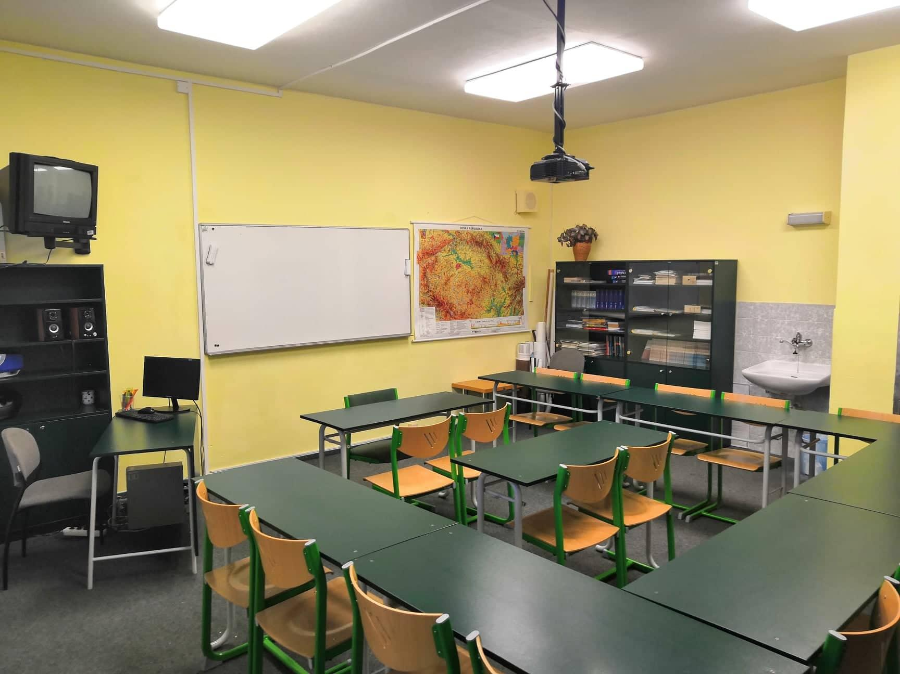
Language class

Slide 27
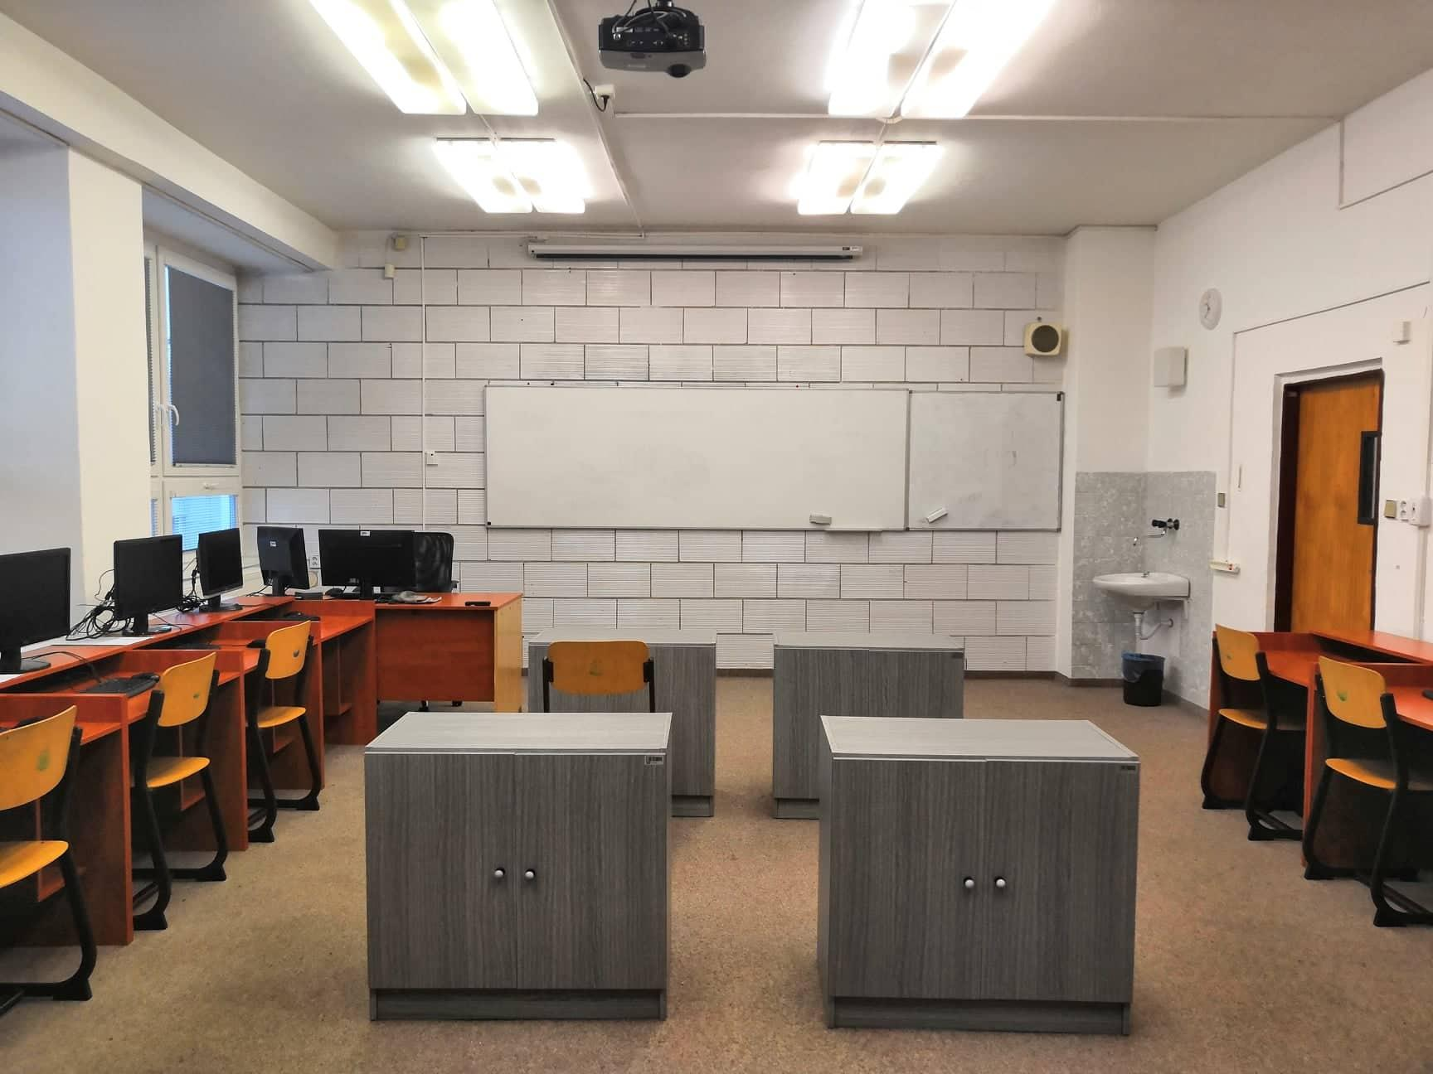
Computer class

Slide 28
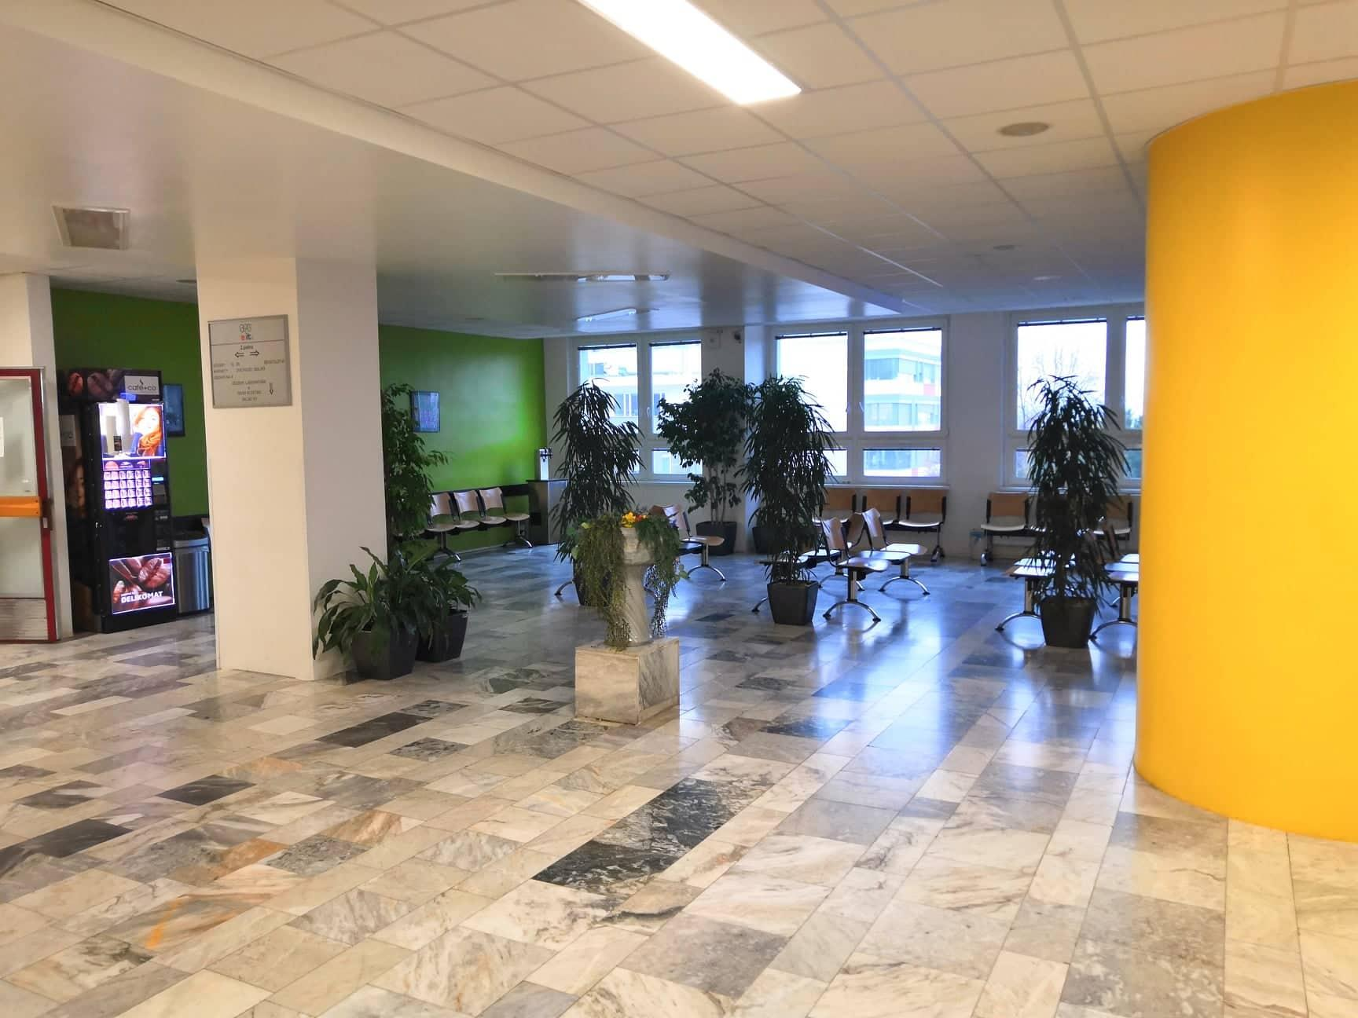
Lobby area

Slide 29
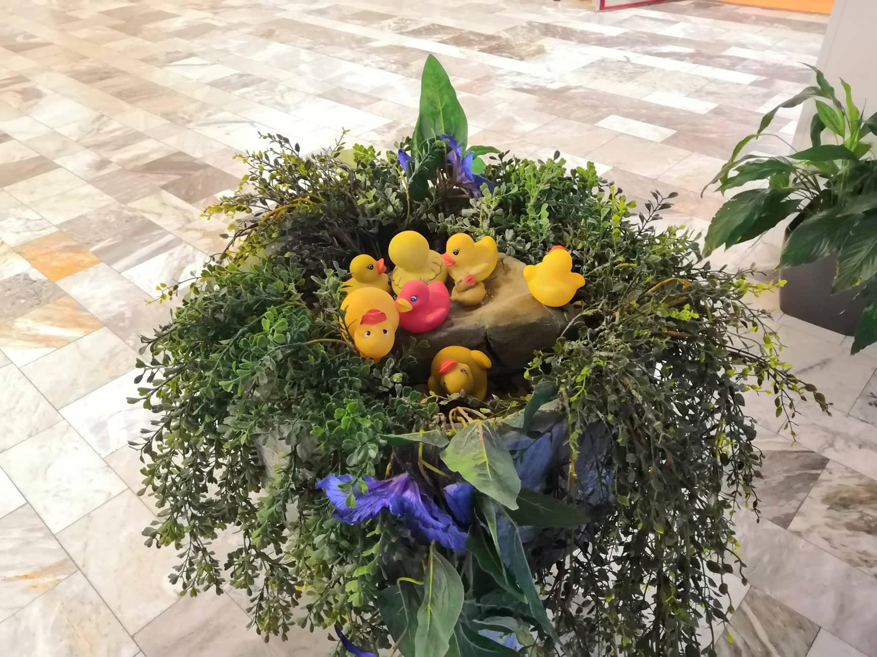
Our unofficial mascot
Rubber ducks

Slide 30
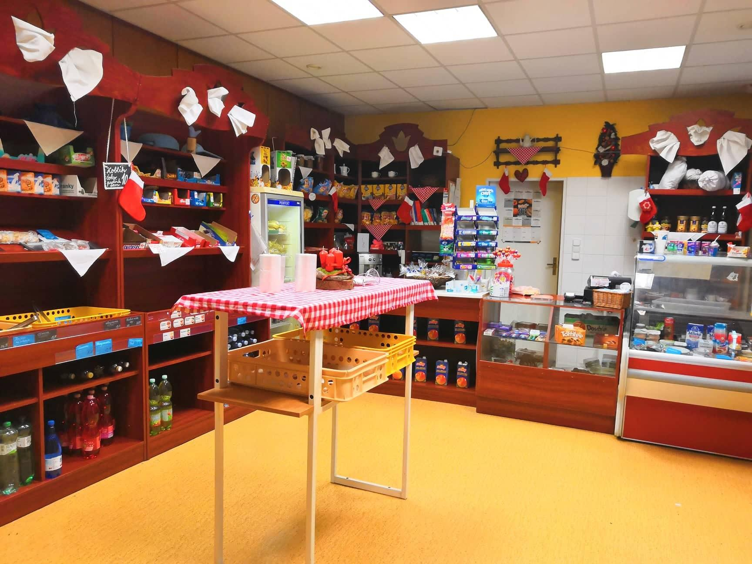
Most important – Our cafeteria

Slide 31
Study programmes in our school
Střední průmyslová škola Brno, Purkyňova, příspěvková organizace

Slide 32
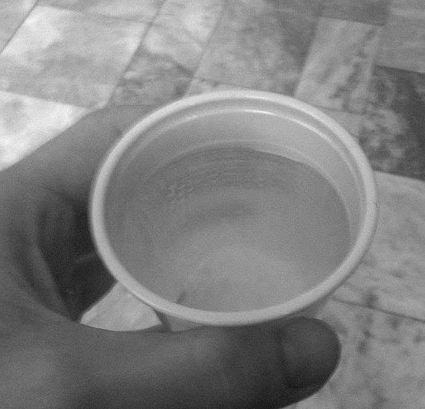
Basic information
We‘re a state school
We have more than 1200 students
Many study programmes
Our school has a great soda water for free ☺

Slide 33
Study programmes
IT
Electrotechnics
Social administration
Economics & business
Ecology

Slide 34
Information technologies
Installation, repair and maintenance of the PC
Design and management of computer networks and IT resources
Creation of websites, work with graphical material, advertising, company presentation, presentation of data, programming
Automation, control and regulation of the production process

Slide 35
Economics
knowledge of basic economic concepts and principles business activities
making business correspondence
accounting and tax records
teaching world languages
basic orientation in legal standards

Slide 36
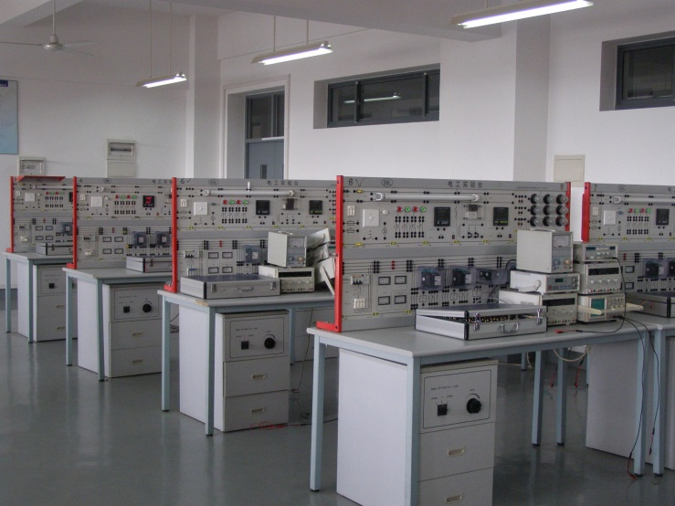
Electrotechnics
network traffic analysis
securing network elements against unauthorized access input
Installation, repair and maintenance of the PC
Design and management of computer networks and IT resources
creating websites, working with graphs material, advertising, company presentation, presentation data processing, programming

Slide 37
Thank you for your attention

