Slide 1
-
Career Activities

Slide 2
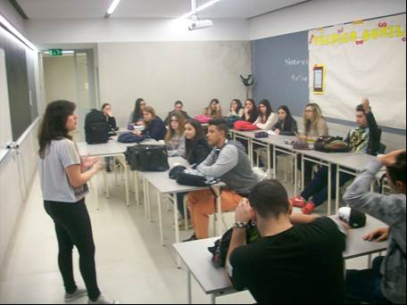
Activities applied during the year and their result – Activity C1
Concerning the graduated students’ seminars, these went on trying to induce a comfortable informal environment, and the assisting students posed questions about the information passed on by the graduated student concerning her career.

Slide 3
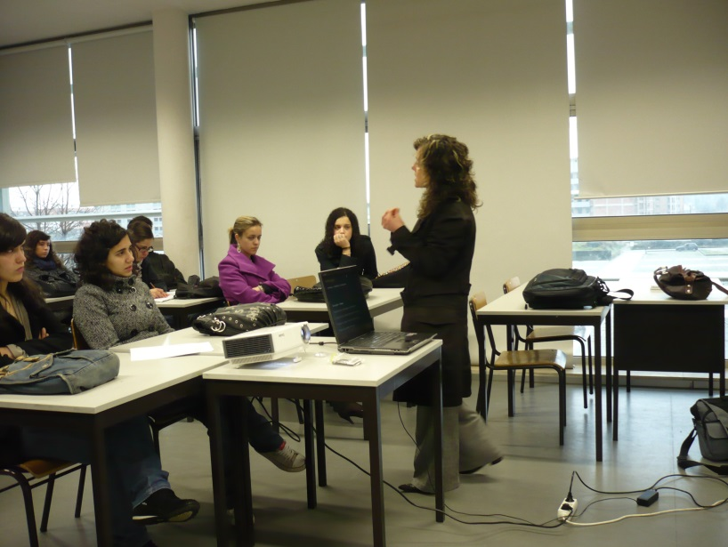
Activities applied during the year and their result – Activity C1
Concerning the career seminar, a guidance counsellor was the lecturer and the theme was discussed and the career options were discussed concerning the several areas present.
The technician was open to questions posed by students, what allowed an interactive atmosphere that privileged the free exchange of ideas and speaking, enabling the professional to dismount some preconceived ideas and motivate students to pursue studies aiming a career .

Slide 4
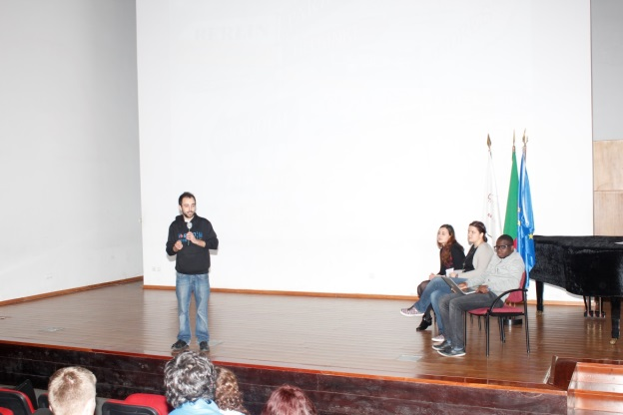
Activities applied during the year and their result – Activity C1
Was organized, also, the career day, in which an workshop on career was the stepstone for a discussion on careers.
This event central piece was a professional of the motivation and guidance that showed the assistants how to face frustration and to be resilient but, also the career options they could consider in future.

Slide 5
Activities applied during the year and their result – Activity C1
Together with this lecturer were three graduated students, that gave their opinion on the career options they took and the value of the course diploma, in order to motivate the public.

Slide 6
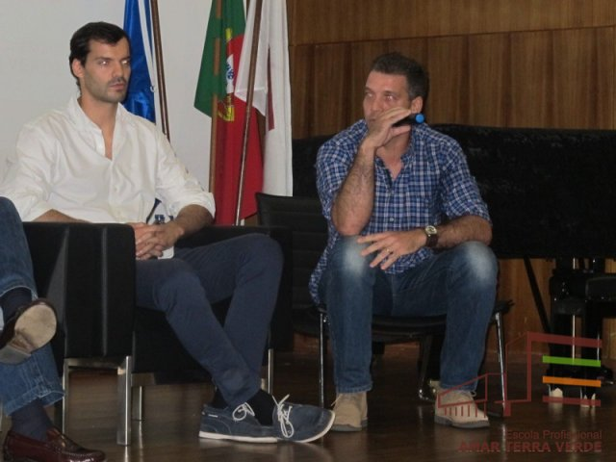
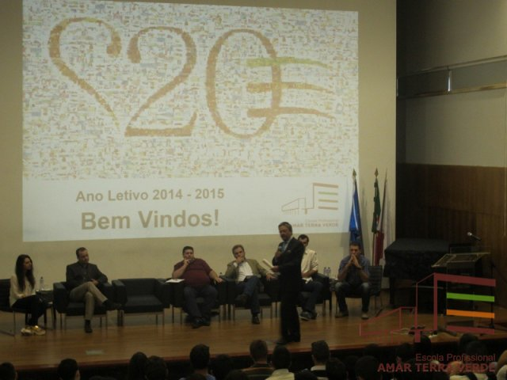
Other Activities applied during the year and their result – Activity C1
We had also meetings and workshops with entrepreneurs in order to discuss and adapt our students’ profile;
Invitation to ex-students, graduated in the school and successful in their career to share the benefits of studying in our school through a lecture;

Slide 7
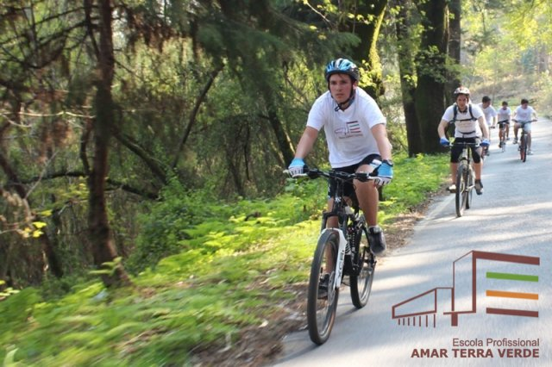
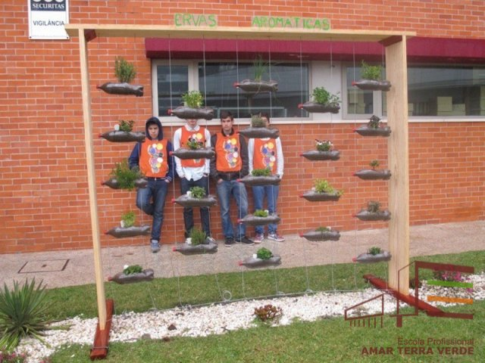
Other Activities applied during the year and their result – Activity C1
Open week for Vocational motivation – all students work to show their course to visitors from other school;
Meetings with representatives from several institutions (governmental and non/governmental) and organizations (local, regional and national);
Several study visits.

