Slide 1
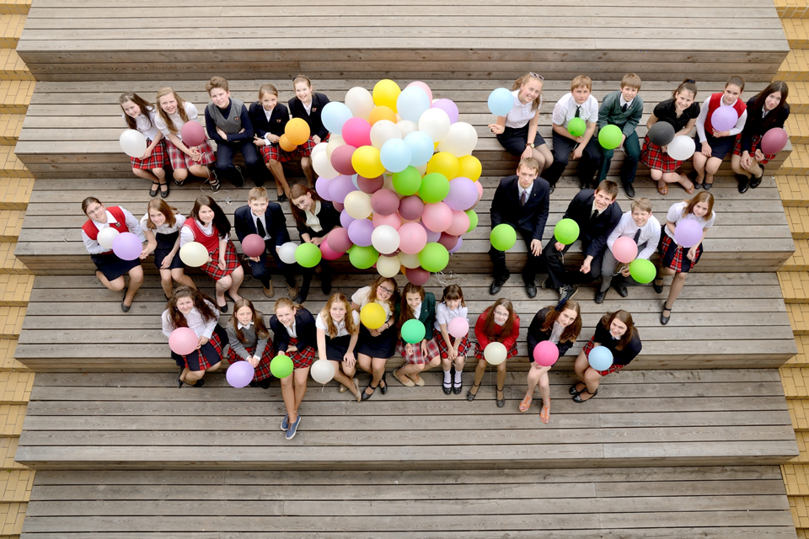
School - a friendly place to study and to be
Rūta Balčiūnaitė
Social pedagogue,tutor 5th-8th grades

Slide 2
Dropouts: common reasons
Poverty.
Family factors.
School climate. Lack of motivation. Poor academic achievements.

Slide 3
Poverty.
Family factors.

Slide 4
REPUBLIC OF LITHUANIA
LAW AMENDING THE LAW ON EDUCATION
Article 29. Admission to a school, changing schools and transferring to another school
1. A person shall have the right to choose a state, municipal or non-state school and to change schools.
9. A child under 16 years of age may not terminate study in compulsory education programmes.

Slide 5
Article 47. Parents' (guardians', curators') rights and duties
2. Parents (guardians, curators) must:
3) co-operate with the school principal, other education provider, teachers, and other specialists who provide special, psychological, social-pedagogical, special-pedagogical assistance, healthcare in dealing with the issues of children's learning and follow their recommendations;
6) ensure the child's preparation for school, his learning according to the primary and basic education curricula until he reaches the age of 16;
7) ensure child’s punctual and regular school attendance; if the child cannot attend the school, immediately inform the school.

Slide 6
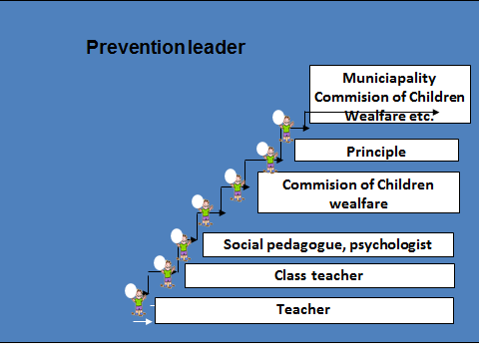
Prevention ladder
Headmaster

Slide 7
Article 36. Transportation, dormitories, meal service
8. Learners shall receive meals free of charge in accordance with the procedure and in the cases laid down by the Law of the Republic of Lithuania on Social Assistance for Pupils.
Kaunas jesuit High School: Free education for students with low family income (10 -15 % of students).

Slide 8
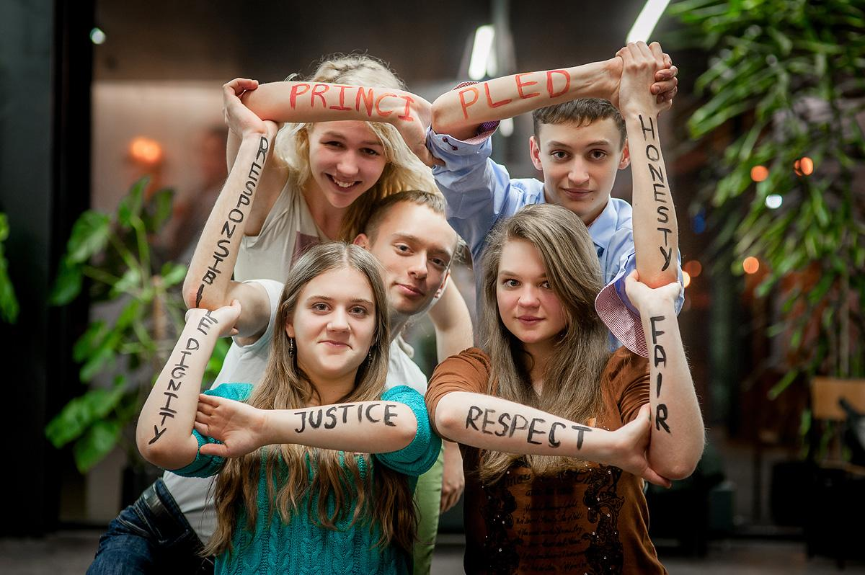
III. School climate

Slide 9
School
What are my best memories from the school?
What? Who?
Why didn’t sometimes I want to attend school/lesson/activities?

Slide 10
Lesson
School must record daily attendance of students in the e.diary till 10 a.m.
The class teacher once a week checks the statistics of lessons attendance of class students in the e.diary. Conversation with student, parents etc.
Attendence sheet (conversation and reflection with tutor).
Learning and behavior problems: the consultations for students and parents.

Slide 11
Listen & hear
Cura personalis - Care for every student.
Prevention ladder
Headmaster

Slide 12
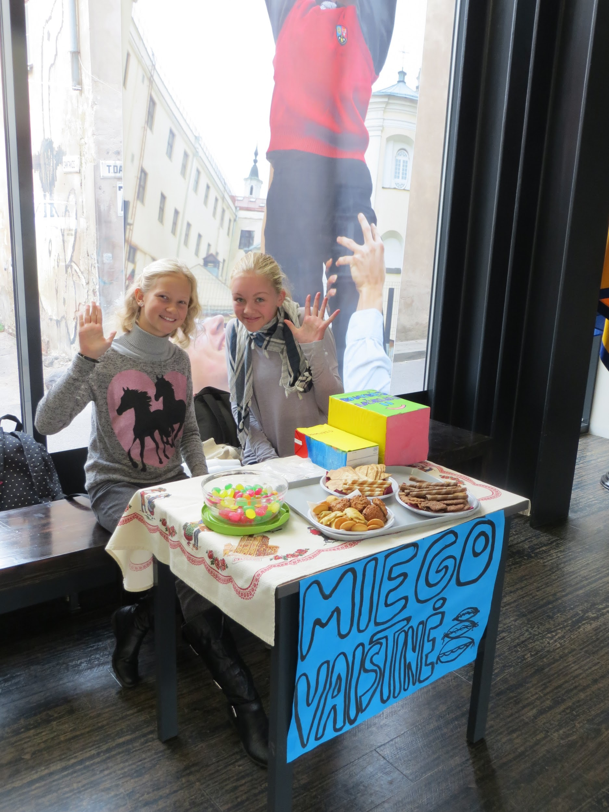
The day of Spiritual Health
Conversations.
Different activities.

Slide 13

Watch & see
Olweus bullying prevention program.
The main task: to create a safe and friendly school.

Slide 14
Individual level
Teachers public spaces monitoring system.
Reactions to situations: to stop students, to talk with students, to inform the class teacher, parents etc.
The system of encouragement and discipline.

Slide 15
2. Community level
Research is organized once a year.
Class meetings are organized twice per month.
Communication with parents.
The leader of discipline.
Study and supervision groups for all workers in school. The task of SSG: to build the culture of conversation and to develop the ability to find common decisions in the community.
The fenced school.

Slide 16
The program of adaptation
Community building camp (in September for 5th grade students).
Retreats (in September-October for 9th grade students).
Individual conversation with students.
Research of school children's well-being.

Slide 17
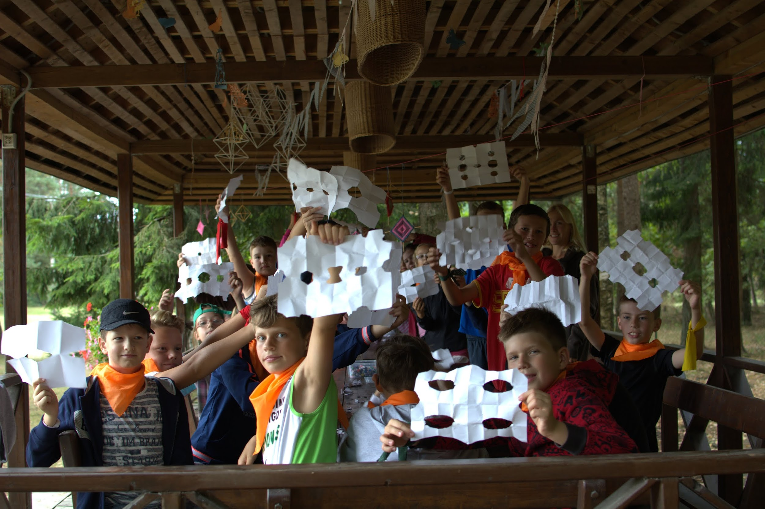

Slide 18
Social practice activities = education/formation of men&women for others
5th grade: We help to KJG community.
6th grade: Ecology.
7th grade: We care about others.
8th grade: Projects for people from a social exclusion group.
9-11th grade: social practise in different organizations in Kaunas (40 - 60 hours per year).

Slide 19
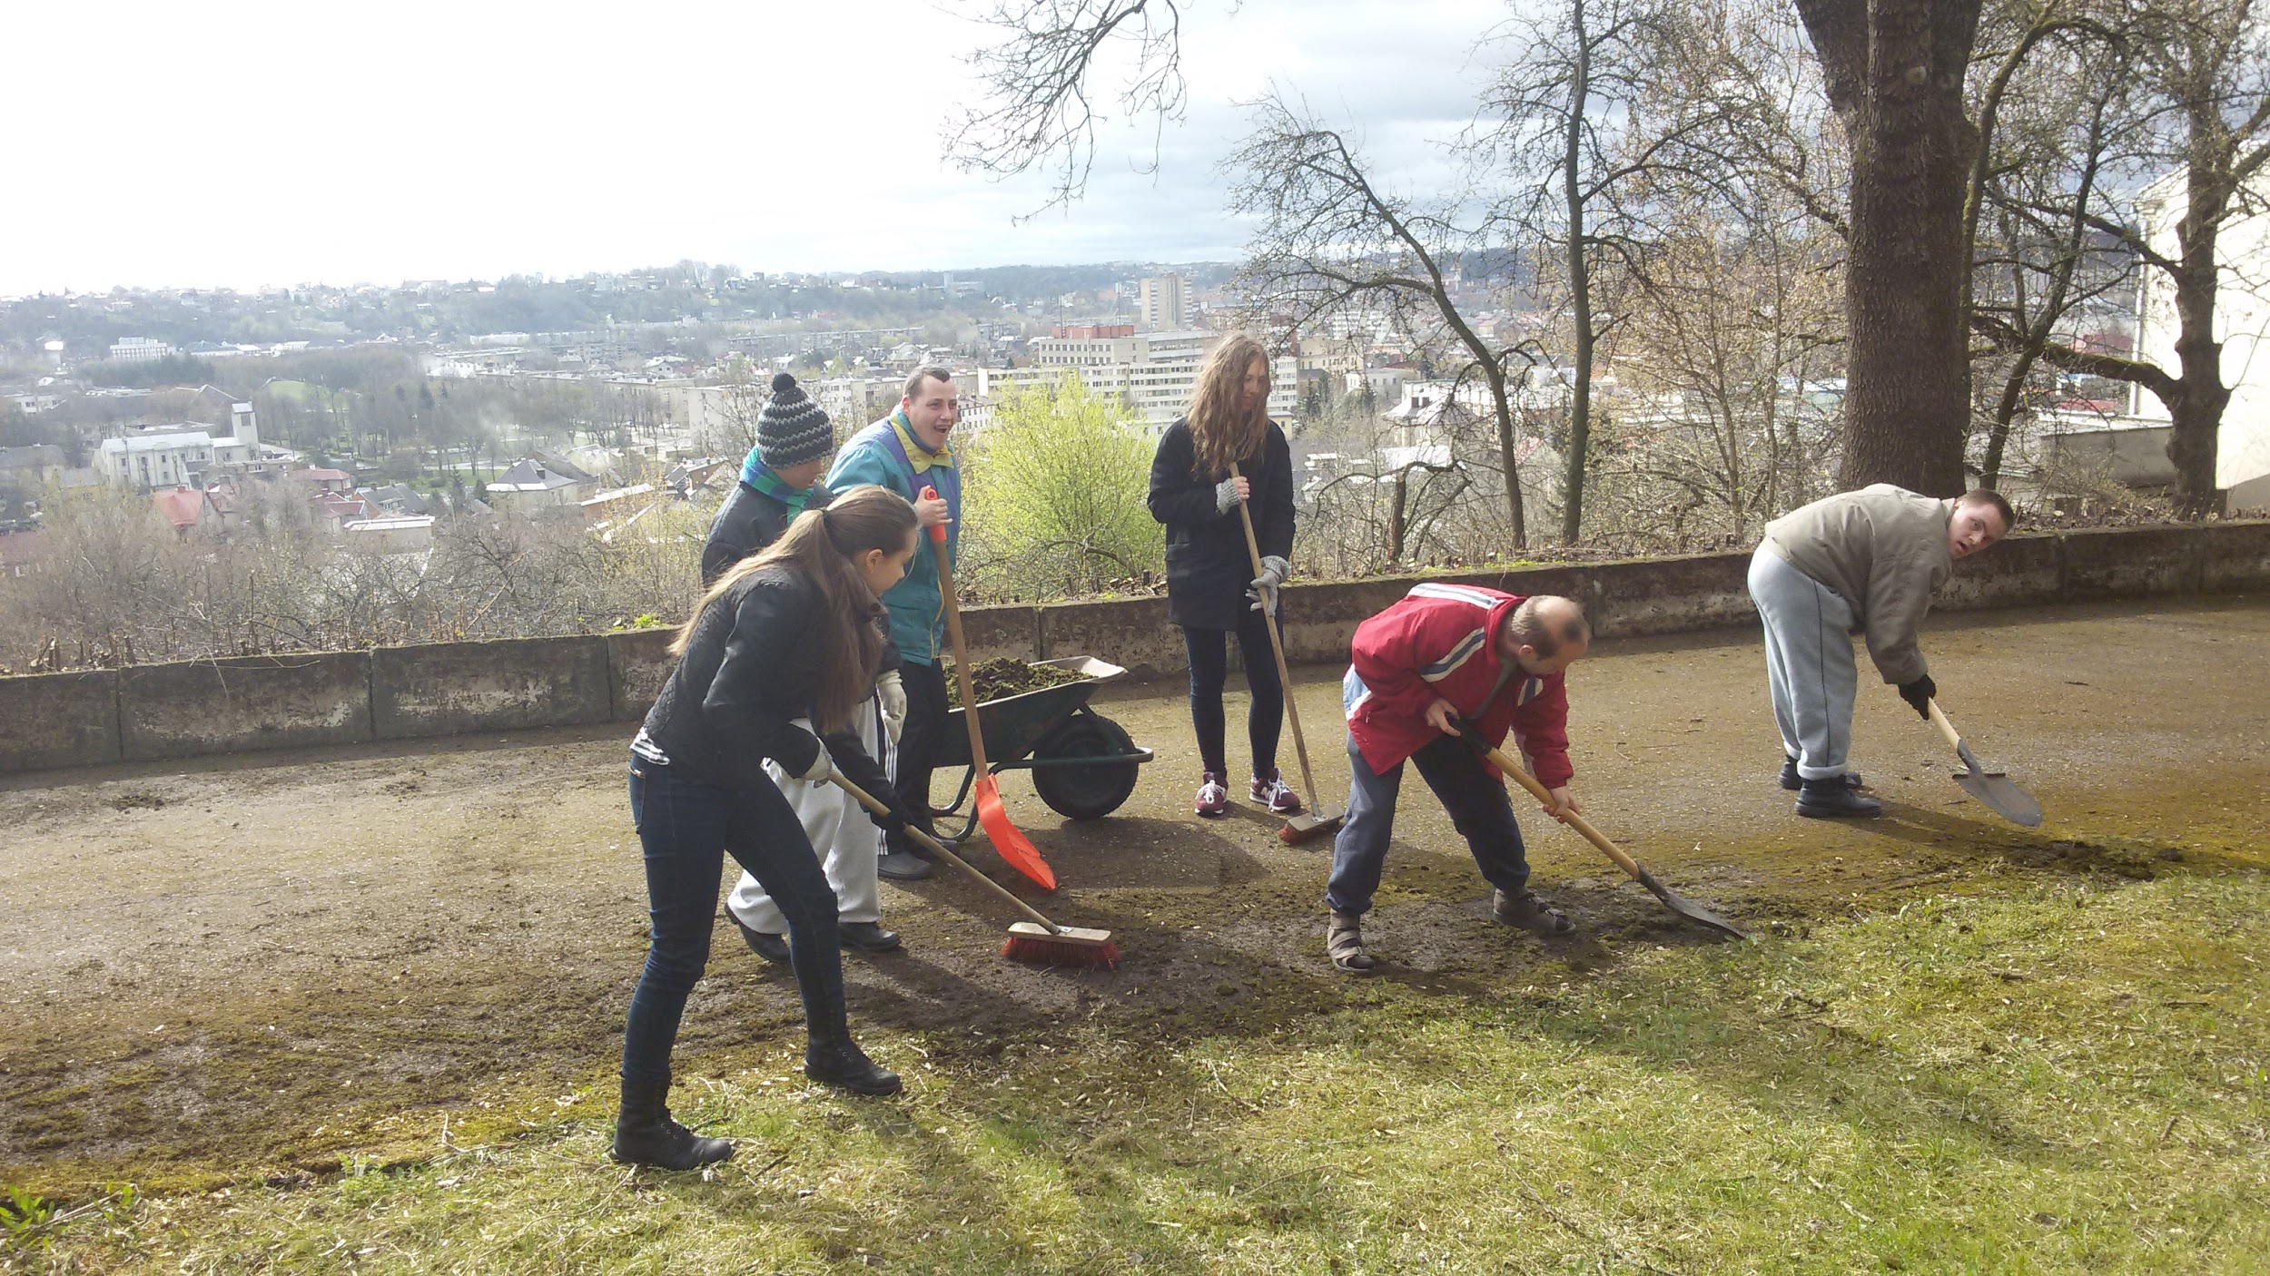

Slide 20
II. Value education programmes: 5-12 grade students
5th grade: We are a community.
6th grade: To rejoice in life.
7th grade: Becoming mature - the time of challenges.
8th grade: Pilgrimage.
9th grade: Stronger than hatred.
10th grade: My inner landscape.
11th grade: Kairos.
12th grade: TEK.

Slide 21
Prevention day
The task
to give knowledge + to develop skills + to form attitude based on values = we believe it helps to students do the right decisions in life.
The lectors: parents, alumni, NGO, Universities.

Slide 22
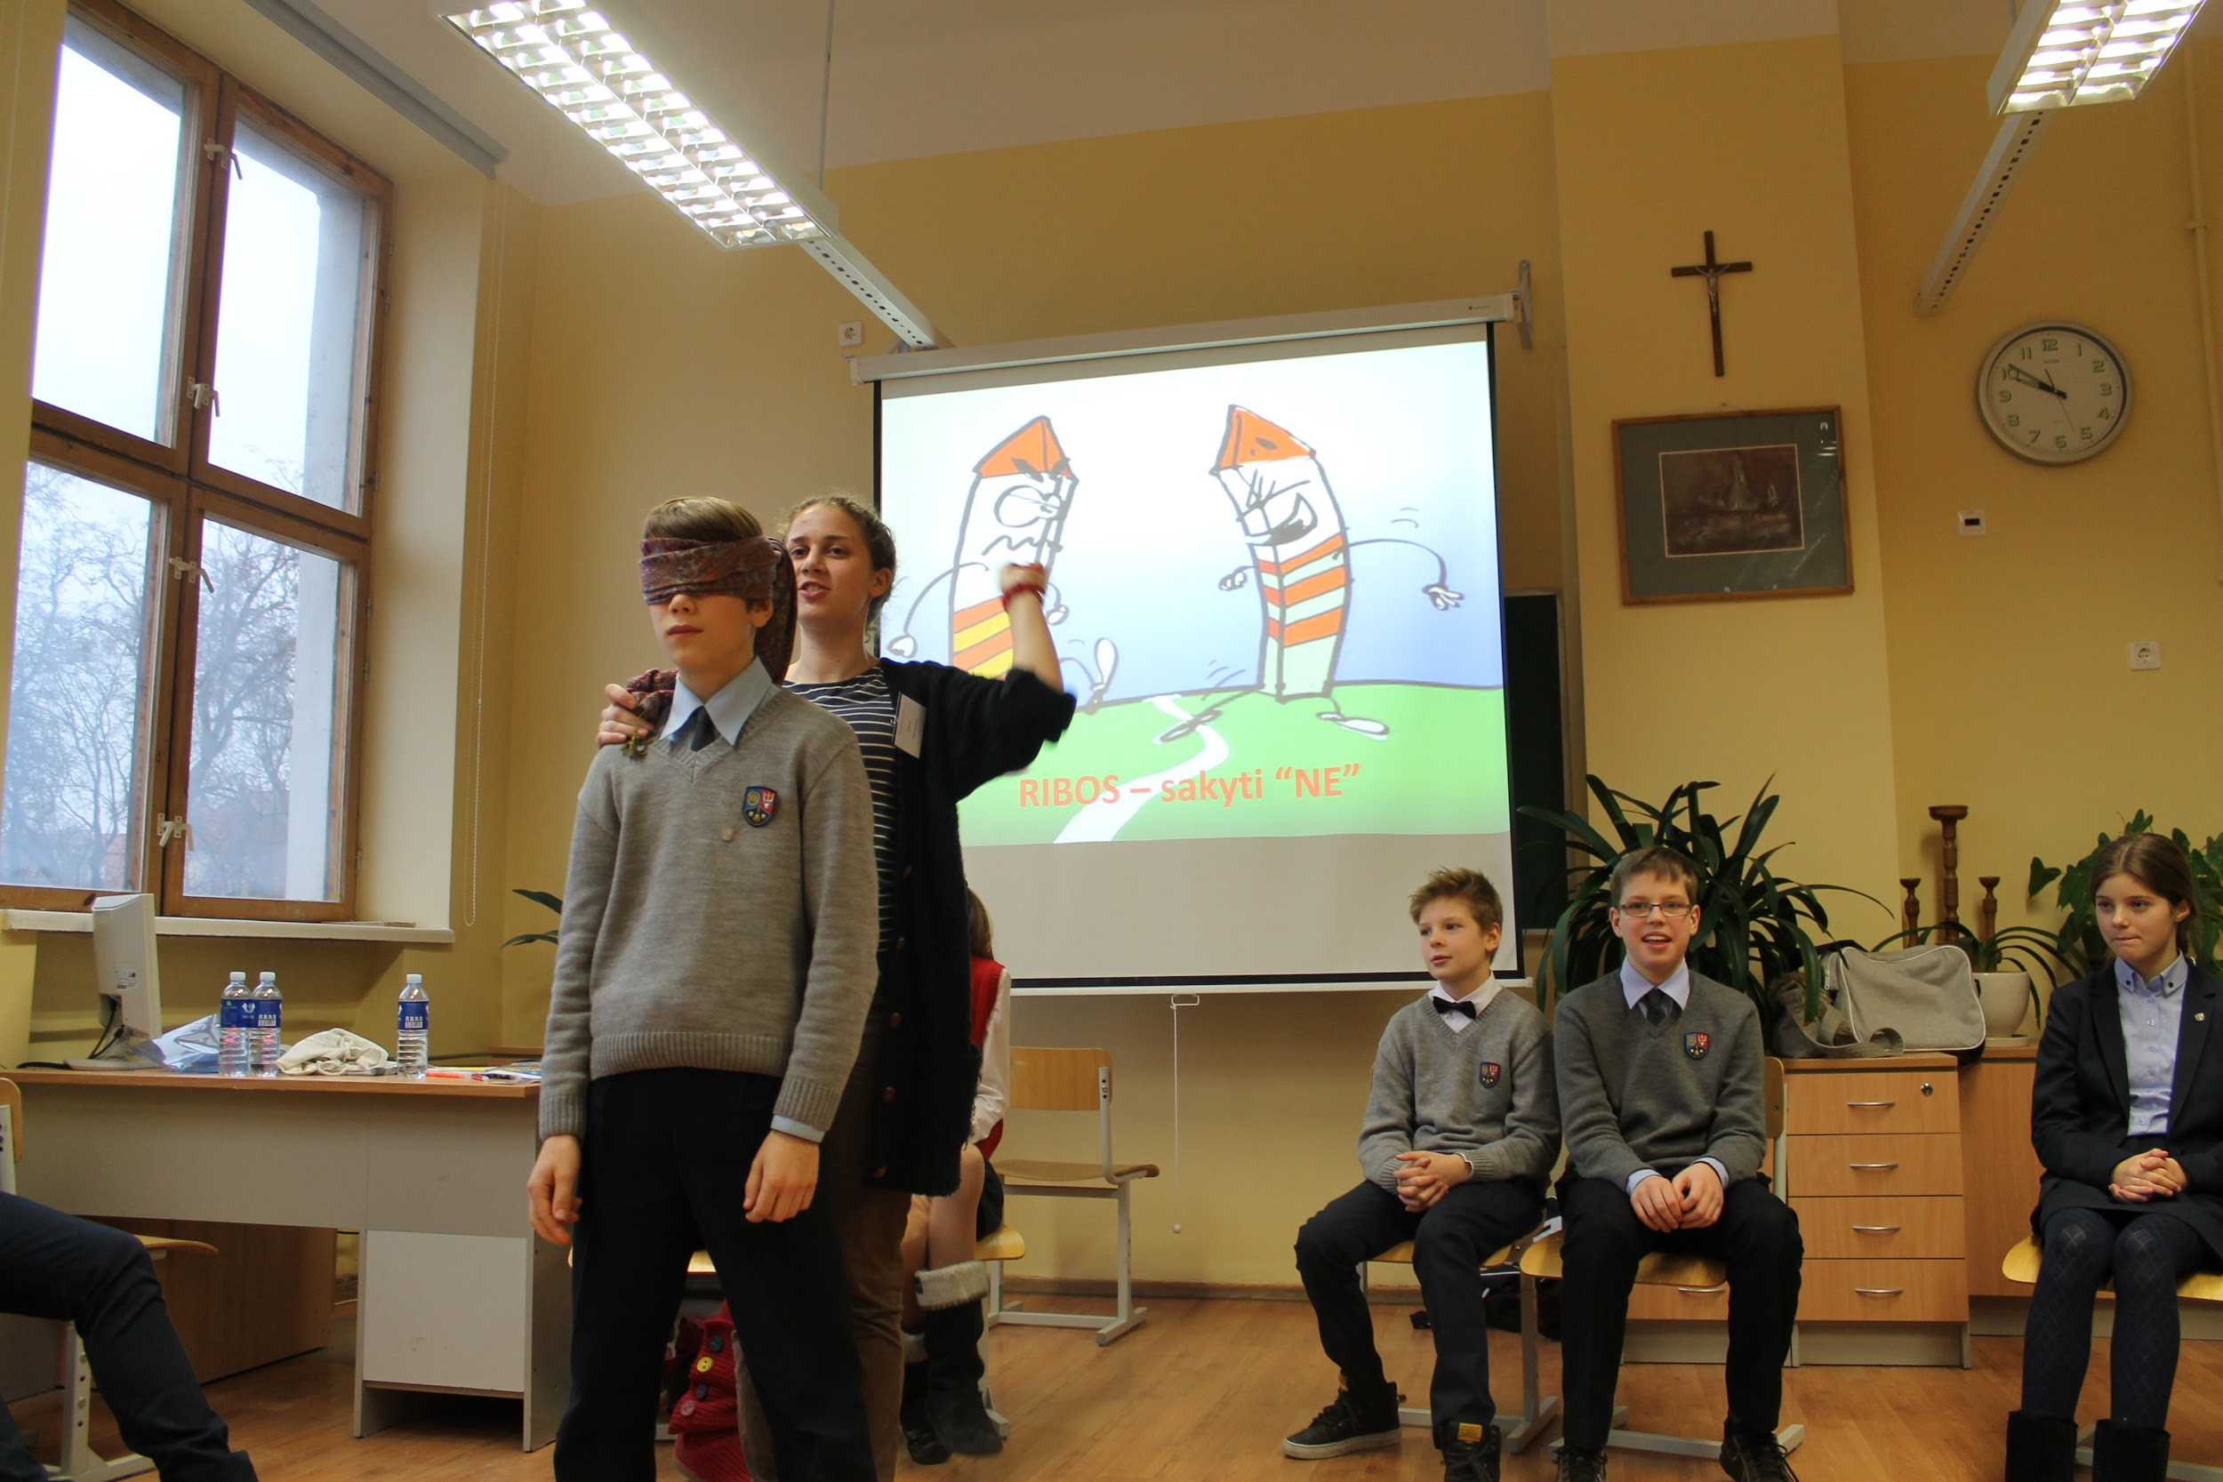

Slide 23
Topics
Friendly internet.
Developing communicational skills: how to solve conflicts, to cope with stress, my fears, crisis etc.
Meeting and learning from inspiring personalities: Projects “The Mission to Siberia”, “Ambersail”, travelers, writers, journalists, businessmen etc.
Tobacco, alcohol and drugs prevention.
Healthy life.

Slide 24
School - a friendly place to study and to be
Participation in different projects, competitions etc.
Prevention programmes.
Value education programmes.
Social practise activities.
The system of encouregment and discipline.
Non-formal education.

