Slide 1
I.I.S.S. ENRICO FERMI
LECCE

Slide 3
1959

Slide 4
2014

Slide 5
CULTURAL LANDMARK IN THE FIELD OF TECNOLOGY

Slide 6
Mechanics

Slide 7
Mechatronics

Slide 8
Energy

Slide 9
Electrical Engineering

Slide 10
Information Technology
and Telecommunications

Slide 11
Transport and Logistics

Slide 12
Lyceum of
Applied Sciences

Slide 13
SCHOOL STAFF

Slide 14
HEADMASTER
Teaching
Staff
Administrative
Staff
School
Maintenance
Staff
125
17
13

Slide 15
HEADMASTER
Giuseppe Russo
Nuclear Engineer
Maths Teacher 1984
Headmaster 1993
…in our school 2007

Slide 16
Students
1127
Students Background
Well Organized
Families
Disorganized
Families
Special Needs Students

Slide 17
School Courses of Study
BIENNIUM
Mechanics
Mechatronics
Energy
Electrical Engineering
Electrotecnics
Information
Technology
Transport and Logistics
Telecommunications
Information
2 years general learning progremme
3 years specialized learning
programme
Technological
Branches
Air Navigation

Slide 18
LESSONS
Start 8:00
Break 11:00 -11:10
Finish 12:00 or 13:00 or 14:00
6 Days a week

Slide 19
SCHOOL SUBJECTS BIENNIUM
Italian
Chemistry
Maths
Physics
Religion Education
Physical Education
History and Geography
Technology and Technical Drawing
Law
English
Applied Sciences and Technologies
Information Technology

Slide 20
SPECIALIzed SUBJECTS

Slide 21
Mechanics & Mechatronics
Mechanics, Machines and Energy
Drawing, Design and Industrial Organization
Mechanical Technologies of Process and Product
Systems and Automation

Slide 22
Energy
Mechanics, Machines and Energy
Energy Systems, Design and Industrial Organization
Mechanical Technologies of Process and Product
Systems and Automation

Slide 23
Air Navigation
Electrotechnology, Electronics and Automation
Mechanics and Machines
Air Navigation Science
Navigation Laws
Logistics

Slide 24
Electronics
Electronic and Electric Systems Design
Automation Systems
Electronics and Electrotechnics

Slide 25
Information Technology & Telecommunications
Systems & Networks
Project Management &
Enterprise Organization
Technologies & Design of Telecommunications and Information Systems

Slide 26
Lyceum
Italian
Science
Maths
Physics
Religion
Physical Education
History and Geography
Arts
Philosopical studies
English
Information Technology

Slide 27
SCHOOL MAIN GOALS
Increasing the quality of school (It must be inclusive and motivating)
Encouraging Students’ human and cultural growth
Reinforcing the students’ positive attitude to education
Giving the students equal opportunities
Being a landmark for the scientific and technological education
Creating a connection with local enterprises (labour market)

Slide 28
School Activities
And Experiences
Carried Out To Prevent
Early School Leaving

Slide 29
Assisted Pathways of School-Work
The national project: “Percorsi assistiti di alternanza scuola-lavoro”, a supported training within the work-related learning designed to prepare students for a continual innovative and specialized professional development. It’s a specific training course designed to improve the skills acquired from the core curriculum, guaranteeing the education of subjects connected with professional
skills.

Slide 30
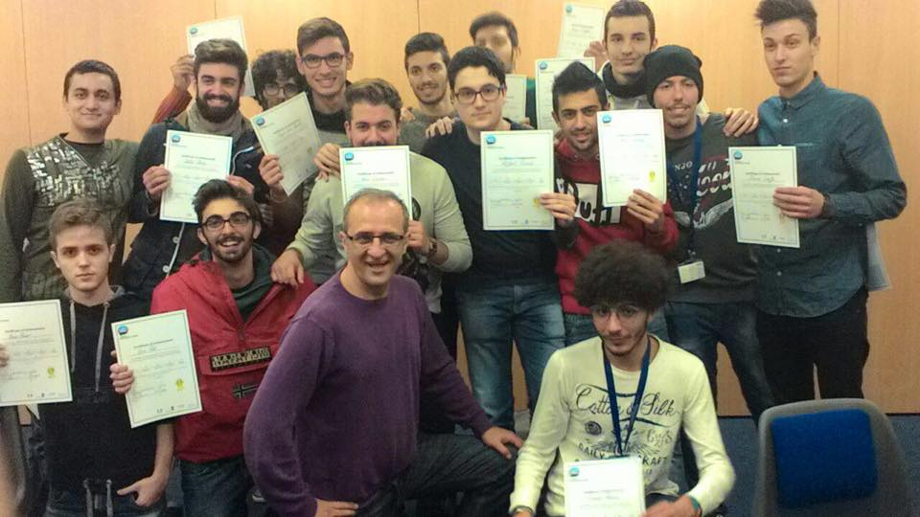
P.O.N. C1
School Good Practice
The national project P.O.N. C1 is a national operative programme for the disadvantaged regions,
whose objective is to give students a strong initial educational background in order to balance their
social, cultural and economic disadvantages. This project aims at improving the students’ foreign
language skills and at certificating their linguistic competences on the basis of the European levels
of the Common European Framework of Reference for Languages. This project gives the opportunity to our students to attend a four week English course in UK or Ireland and at the end of
the course they take the certification exam, for the linguistic portfolio useful for their studies abroad
or for their future career.

Slide 31
P.O.N. C5
The National project P.O.N.C5, a national operative programme for the disadvantaged regions. It consists of a work placement in an enterprise in Italy or abroad lasting four weeks and whose objective is to acquire specific competences required by the labour market. The students carry out a valiant work experience and when the traineeship is abroad the students also improve the knowledge of the economic and social culture of that country.

Slide 32
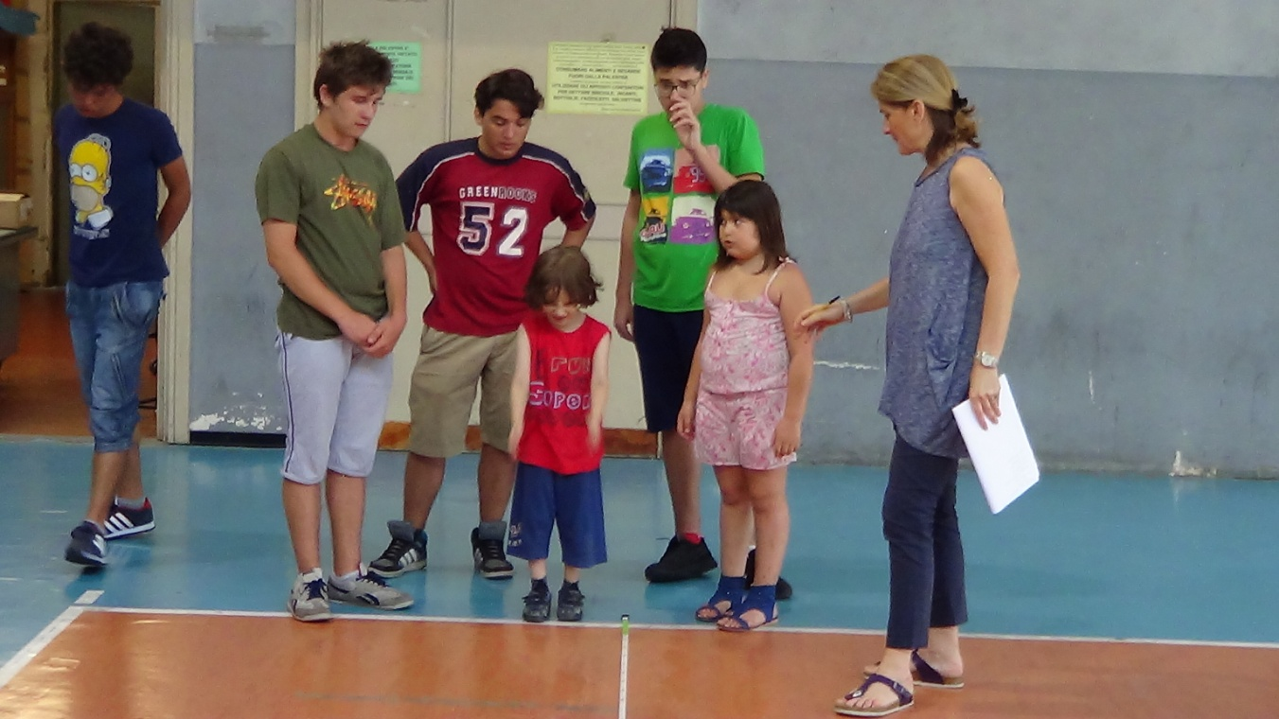
Action F3
The national project: Programmazione dei Fondi Strutturali 2007/2013. Azione F3 is a sort of experimental educational action carried out in social and cultural severe exclusion areas and addressed to students at risk of being excluded from the educational system. Its innovation is represented by the synergy between different systems: schools, institutions, social organizations joined together to maximise the available resources following the logic of inter professional collaboration and of supportive community. This project aims at improving the quality of education through peer education and learning in contexts methods

Slide 33
Regional Project “Diritti a Scuola”
An action aiming at qualifying the school system, at preventing early school leaving by fostering school success and at combating the plight of failing schools. It is regional project addressed to deprived/ disadvantaged students as a top priority and it intends to develop the key competences, including basic skills and transversal skills in Mother
Tongue and Maths

Slide 34
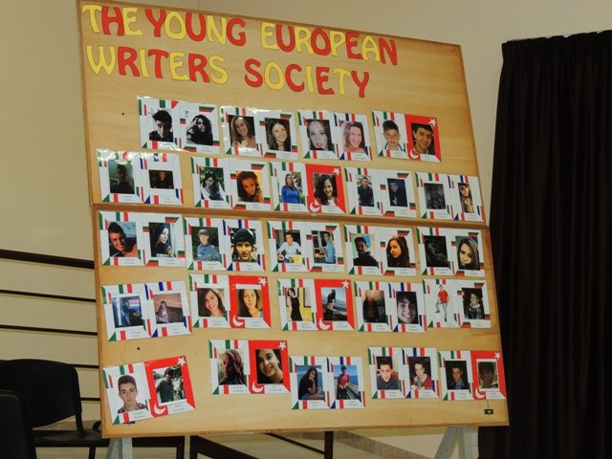
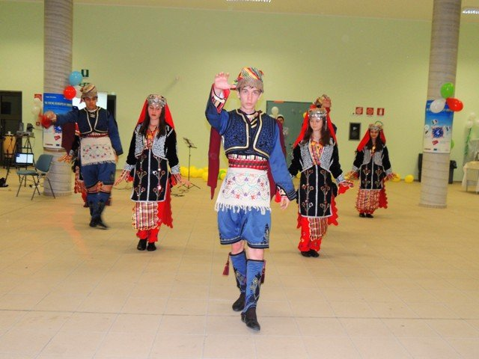
Comenius
Comenius 2007-2009 Teaching Tolerance in One Europe
Comenius 2010-2012 Welcome to my Town/Region
Comenius 2012-2014 The Young European Writers Society

Slide 35
Photos

Slide 42
...All Together Now!

