Slide 1
OUR ISLAND-CYPRUS

Slide 2
Cyprus got its name from the Latin word for copper, Cuprum because large deposits of copper ore were found on the island at that time.
Cyprus got its name from the Latin word for copper, Cuprum because large deposits of copper ore were found on the island at that time.

Slide 3
CITIES OF CYPRUS
Cyprus is classified into six major cities with their suburbs, according to the constitution of 1960. These major cities are: Nicosia, Limassol, Larnaka, Paphos, Famagusta, Kyrenia.

Slide 4
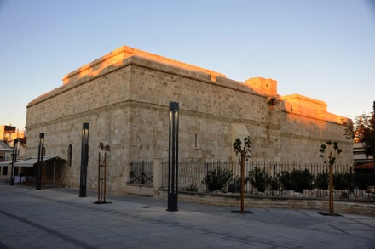
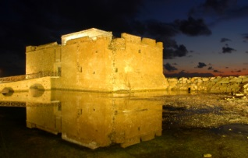
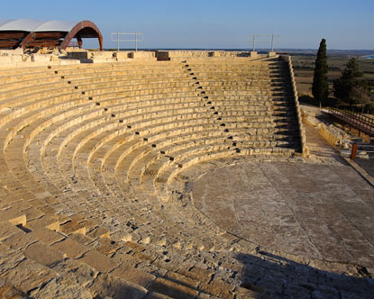
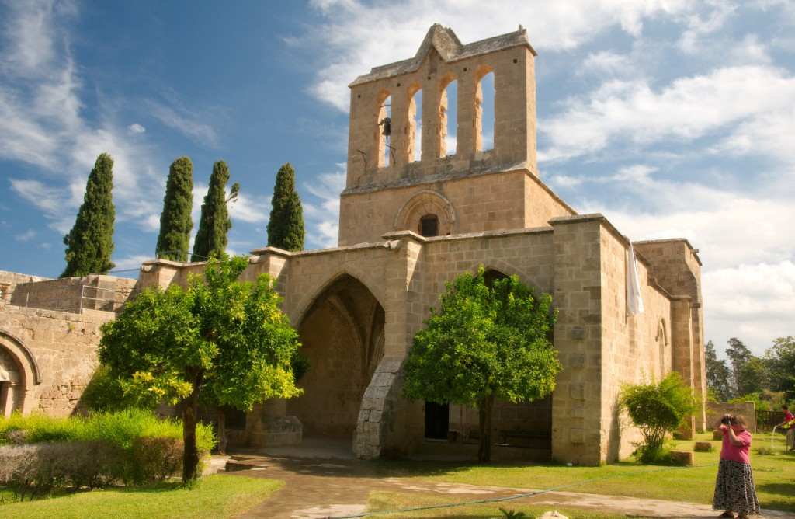
Limassol castle
Paphos castle
Bellapais
Curium

Slide 5
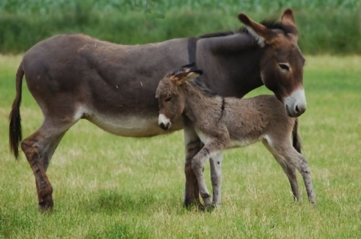
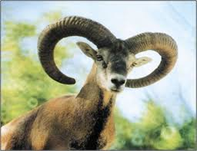
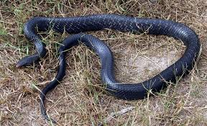
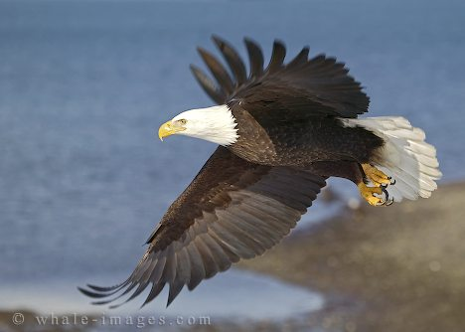
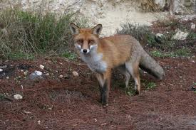
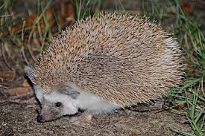
FAUNA OF CYPRUS

Slide 6
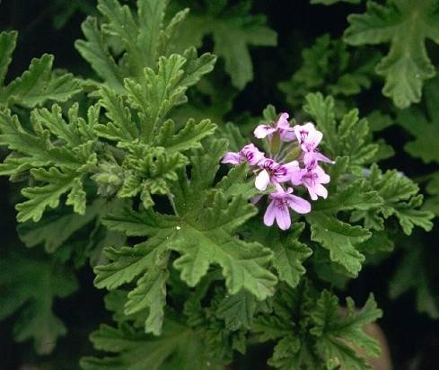
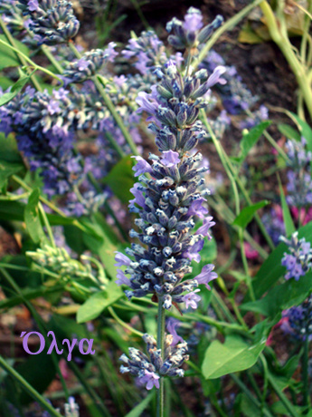
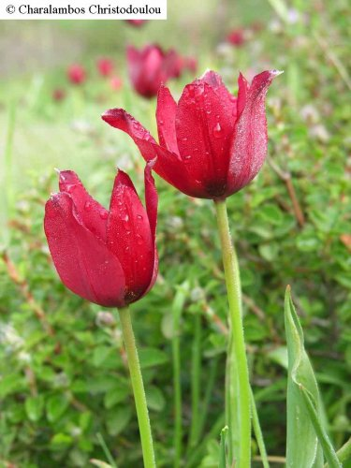
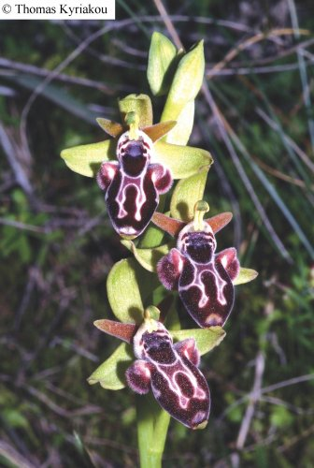
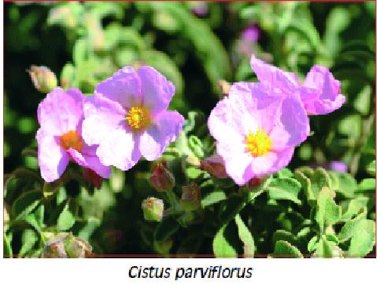
FLORA OF CYPRUS

Slide 7
Paphos –Our region
Paphos is the place where you will find the comforts of the modern world and the wonders of ancient civilization. This is the ultimate relaxing destination you’re looking for. Experience Paphos today and you’ll certainly be coming back for more.

Slide 8
Near palaepaphos at the seaside of Petra tou Romiou is the modern mythical birthplace of aphrodite,the Greek goodness of love and beauty. Old paphos became the most famous and important place for worshipping Aphrodite in the ancient world. In paphos where extensive fine mosaics are a major tourist attraction. Finally the most beautiful is the castle in Kato paphos where tourist visit every day….

Slide 9
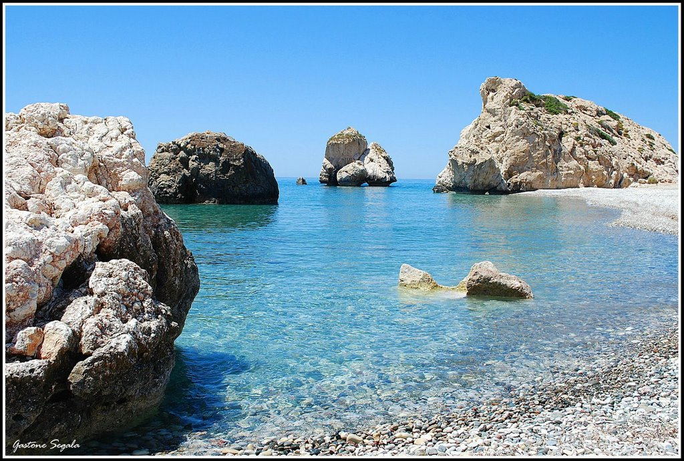
Petra tou Romiou
In Greek mythology it is said that the birth place of Aphrodite, who is the goddess of love and beauty.

Slide 10
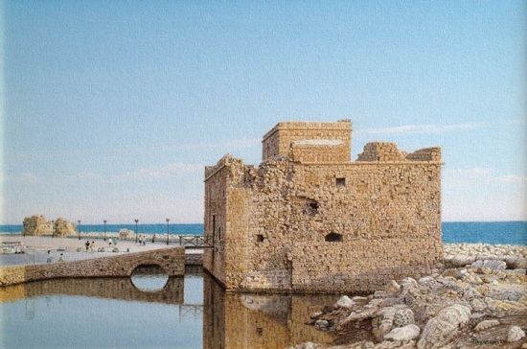
Paphos sights
Paphos sights-Paphos mideval castle
The Paphos castle is located in the port city. Originally built by the Byzantines as a fort to protect the harbor. Throughout the centuries has been used, initially as a fortress and prison Today the castle is used for cultural events held each year in September.

Slide 11
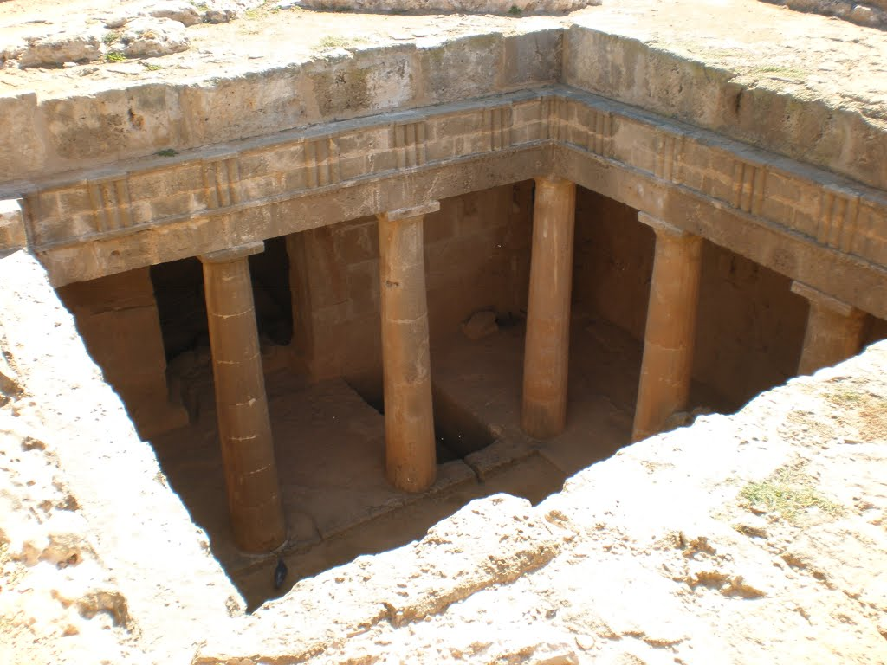
Tombs of the Kings
Tombs of the Kings
Sources say there are tombs of rich people in the Roman era. The tombs dating from the 4th century.

Slide 12
Polis Chrysochous
The Polis is one of the most beautiful and romantic areas of Cyprus near the locations where the goddess of love and beauty, Aphrodite met her lover Adonis. It is built on the northwest side of the Akamas and the famous Baths of Aphrodite. The area of Polis richly endowed by nature, combining green, mountain and sea.
The Polis is the ideal holiday place for fans of the original seeking rest and tranquility in a pleasant and friendly environment, which blends mountains, sea and plain with a wonderful healthy climate, a mild winter, a particularly warm, clear sea and sandy beaches.

Slide 13
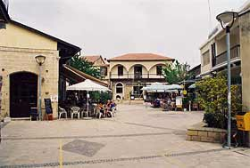
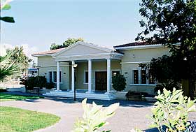
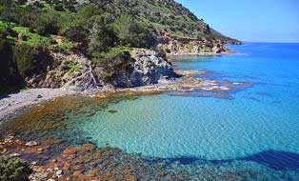
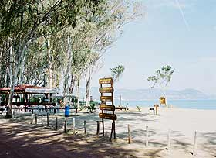
Polis sights
Museum of Polis
Polis square
Akamas Peninsula
Camping site

Slide 14
Latchi Harbour
The Latchi on the promenade is the picturesque harbor of Polis, known throughout Cyprus for its fresh fish. Old was a small port of exportation mainly carob. The old stone carob warehouses have now been converted into restaurants, fish taverns and places of recreation. From the beginning Latchi short cruises to the Akamas. Also, the port provided facilities for water sports.

Slide 15
Baths of Aphrodite
On the same way as Akamas penisnula, is the place where Aphrodite met het lover Adonis, the Baths of Aphrodite. It is a very beautiful area in the nature and a short excursion nobody visiting the area should miss.

Slide 16
Lyceum and Technical School of Polis Chrysochous
Our school’s history:
Middle School Education Polis worked the year 1949-50. In 1983 with the separation of the secondary schools in high schools, the three largest classes housed in the Technical School of Polis. The City Technical School was founded in September 1963 by a decision of the Greek Communal Chamber to serve the needs of the Lake Mine and the Polis area in general. The new school building was built with a donation of Greek government and inaugurated in 1966. since then housed therein. Since 1983 the School was renamed High School and Technical School of Polis Polis. In 2005 the building was renovated and became classrooms and laboratories fully equipped for all specialties for both high school and technical school.

Slide 17
Students and teachers
The school community is consisted of 444 students
Female: 257
Male: 187
&
72 teachers

Slide 18
Some pictures of our school..

Slide 19
The Cyprus Educational System
3-5 Years Pre-Primary Education - Optional
6-12 Years Primary Education
12-15 Years Gymnasium
15-18 Years Lyceum
15-18 Years Technical education: Theoretical/Practical Section
Universities/Polytechnics/Colleges/Institutions
Compulsory education
Optional

Slide 20
Primary Education
Primary education constitutes the
fundamental stage of education, which puts the
foundation for the harmonious development of
children.

Slide 21
General Secondary Education
Public Secondary Education offers a six years programme of instruction for children aged
12 to 18 .
It has got a general educational orientation,
which is compulsory for the first three years.
In the last three years it follows a more
flexible and diverse orientation in two
directions:
a. Comprehensive Lyceum and
b. Technical Education.

