Slide 1
Ignatian Pedagogical Paradigm
Kaunas Jesuit High School
Erasmus + Strategic School Partneship
High School Drop Outs: ‘One is too many’
20015

Slide 2
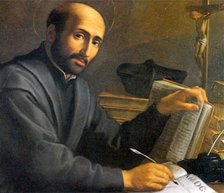
Ignatian Pedagogical Peradigm St. Ignatius Loyola (1491-1556): The Founder of the Jesuits
The main focus is on:
a person
his/her inner life
the quality of knowledge
The avenue to shape a person’s knowledge, skills, capabilities, and values.

Slide 3
The core of the Paradigm
Context
What needs to be known about learners (their environment, background, community, and potential) to teach them well?
Experience
What is the best way to engage learners as whole persons in the teaching and learning process?
Reflection
How may learners become more reflective so they more deeply understand what they have learned?
Action
How do we compel learners to move beyond knowledge to action?
Evaluation
How do we assess learners’ growth in mind, heart, and spirit?

Slide 4
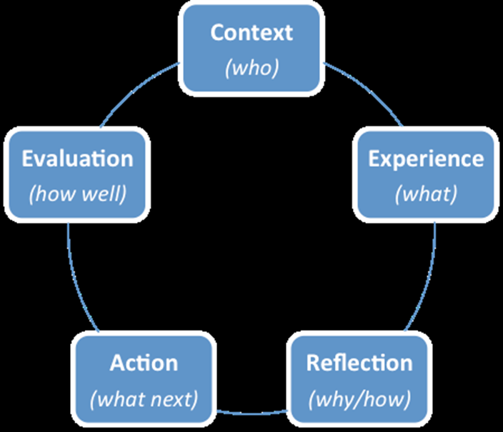
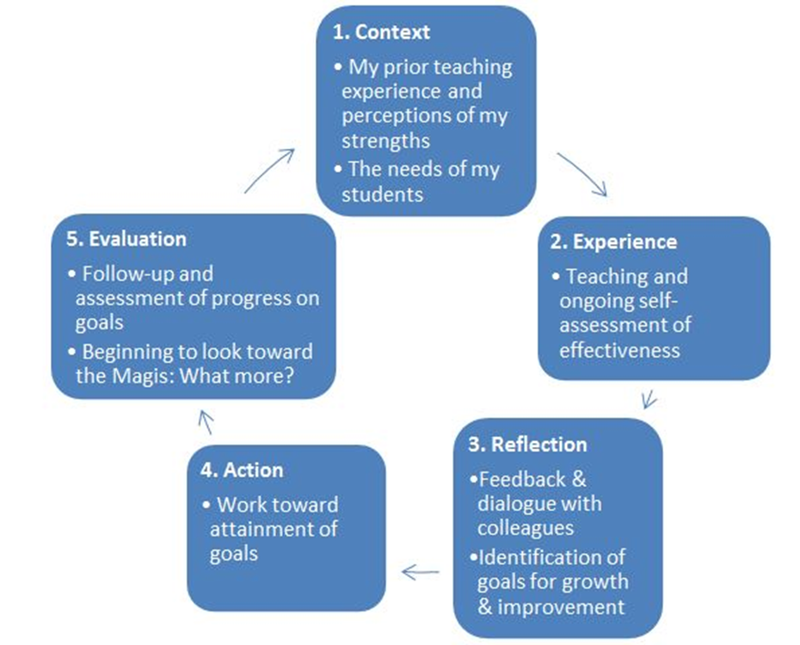
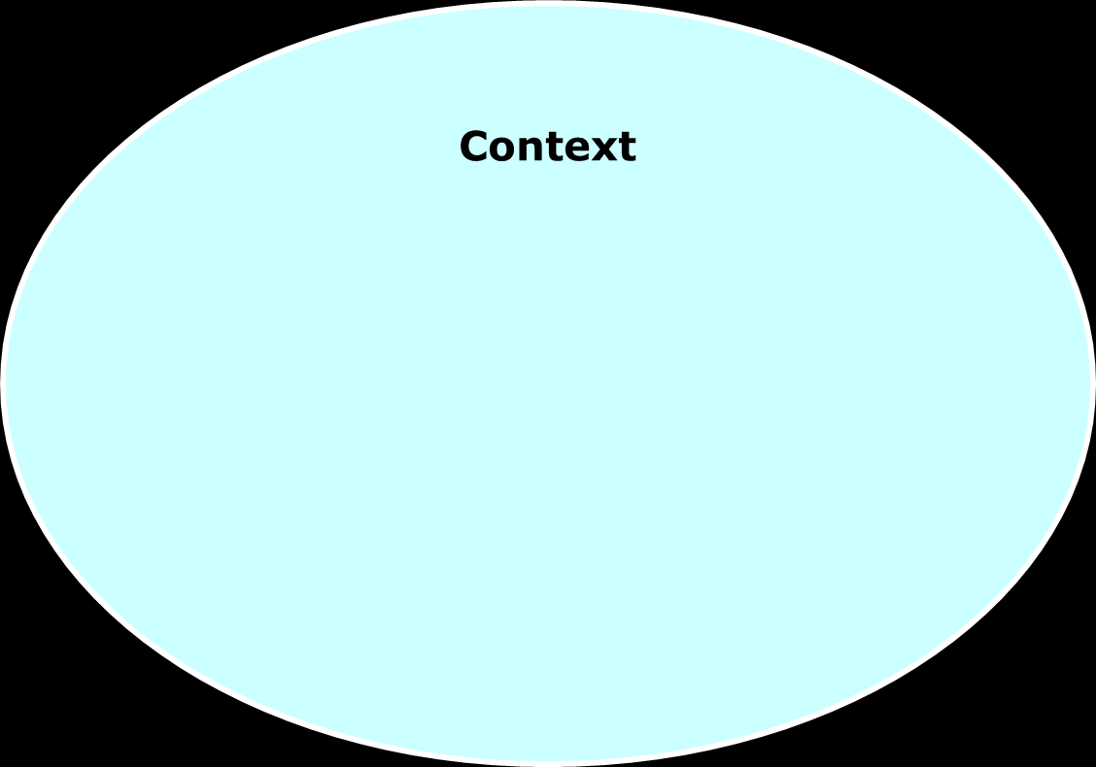
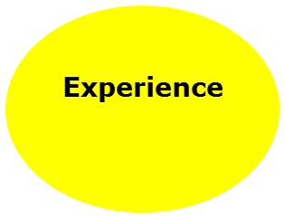
Evaluation
Reflection

Slide 5
The advantages of the Ignatian Pedagogical Paradigm
The Ignatian Pedagogical Paradigm applies to all Curricula.
The Ignatian Pedagogical Paradigm is fundamental to the teaching-learning process.
The Ignatian Pedagogical Paradigm promises to help teachers be better teachers.
The Ignatian Pedagogical Paradigm personalizes learning.

Slide 6
Cura personalis Ignatian-Jesuit characteristic
Care for the whole person – translated from Latin;
Respect, real care and concern for all that makes up each individual;
Purpose - to go beyond the intellect of the head;
A call for every individual to love himself/herself and others: the entire person, the entire gift of life from God given to us;
Encouragement to promote human dignity and care for the mind, body and spirit of the person.

Slide 7
References
Korth, S. J. (2008). Precis of Ignatian pedagogy: A practical approach. In G. W. Traub (Ed.), A Jesuit education reader. Chicago, IL: Loyola Press.
http://www.slu.edu/mission-matters-1028
http://www.loyolajesuit.org/IPP.htm

