Slide 1

WELCOME TO
VOCATIONAL ARENA

Slide 2
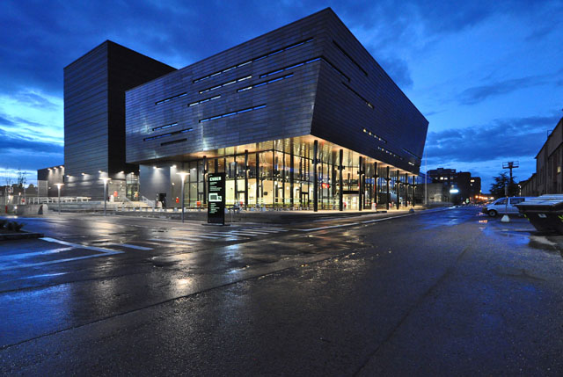

      Opened august 2013
      42000 m2 + BiKuben
      Aprox. 2000 students, 350 employes, 1500 apprentices annually + courses
      Flexible, modern building
      COST: 2 billion NOK (400 mill NZD)

Slide 3
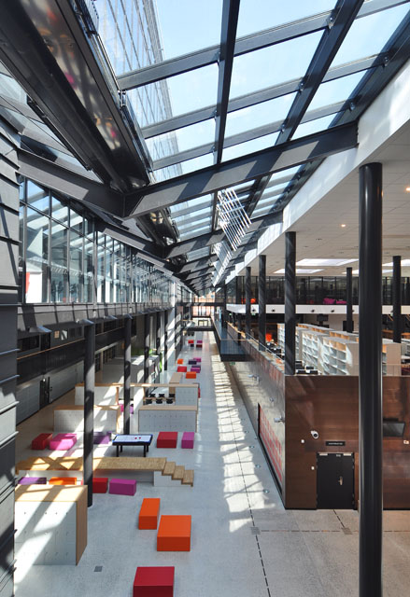
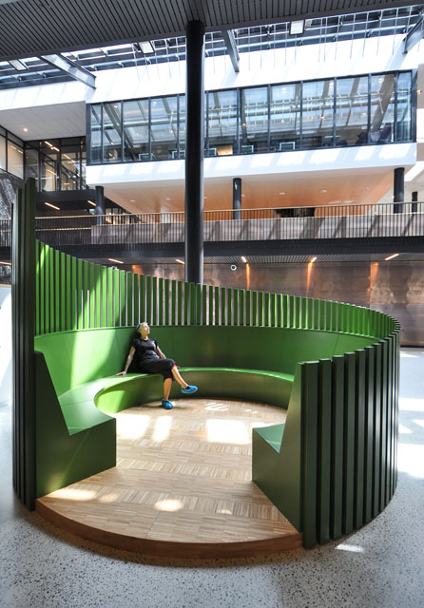
The glass corridor has secluded areas placed in the open, transparent foyer.
Everyone can find a shielded place to spend with friends during recess.

Slide 4
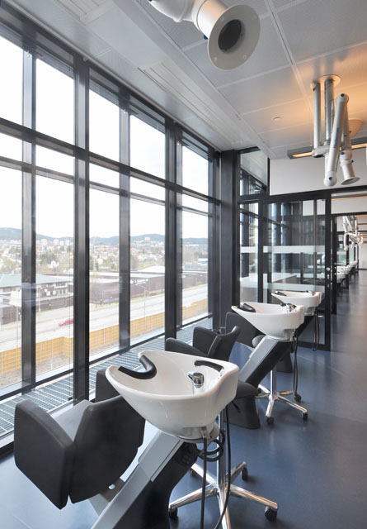
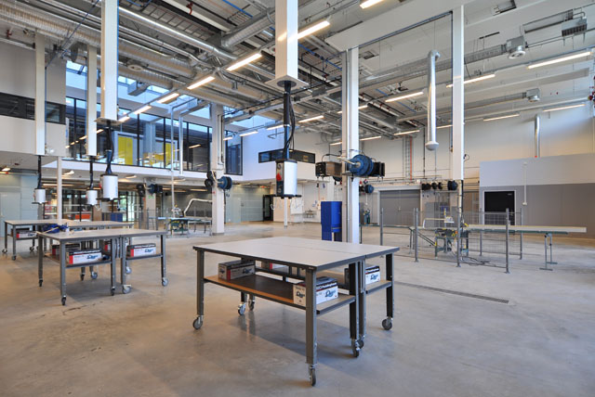
Workshops are located next to each other.
Some have flexible walls that can be opened to create larger rooms. Teachers' workstations are adjacent to the workshops.
Transparency in the workshops
shows student activities.

Slide 5
More than a school
A professional arena for trainees, students and employees
  Kuben upper secondary school
  Oslo Technical school
  Apprenticeship Center for the Building Trades
  Kuben Technology center

Slide 6
EDUCATIONAL PROGRAMS

Slide 7
EDUCATIONAL PROGRAMS (1)
  Building and construction
    Carpenter
    Plumber
    Tinsmith
  Design, arts and crafts
    Hairdresser
    Design and textiles
  Electricity and electronics
    Electrical power
    Refrigeration and heating pumps
    Computers and electronics
    Automation
Notes:
Hair dressing saloon at the ground floor

Slide 8
EDUCATIONAL PROGRAMS (2)
  Healthcare, childhood and youth development
    Child care and youth work
    Health work
  ICT service
  Technical and industrial production
    Car damage, paintwork and bodywork
    Motor vehicles
  General studies
    Norwegian language for minorities
    Preparatory courses for upper secondary
    Pre-university courses

Slide 9
OT- tiltaket
For drop-out students in Oslo
32 students
  Technical and industrial production
  Healthcare, childhood and youth development
  Building and construction
  A few subjects in school and work

Slide 10
How do we work?
Good relation with student and parents
Calling every morning if they dont show up at school
Good colaboration with teacher collegues and advisers.
Teachers work as adwisers
Small groups

Slide 11
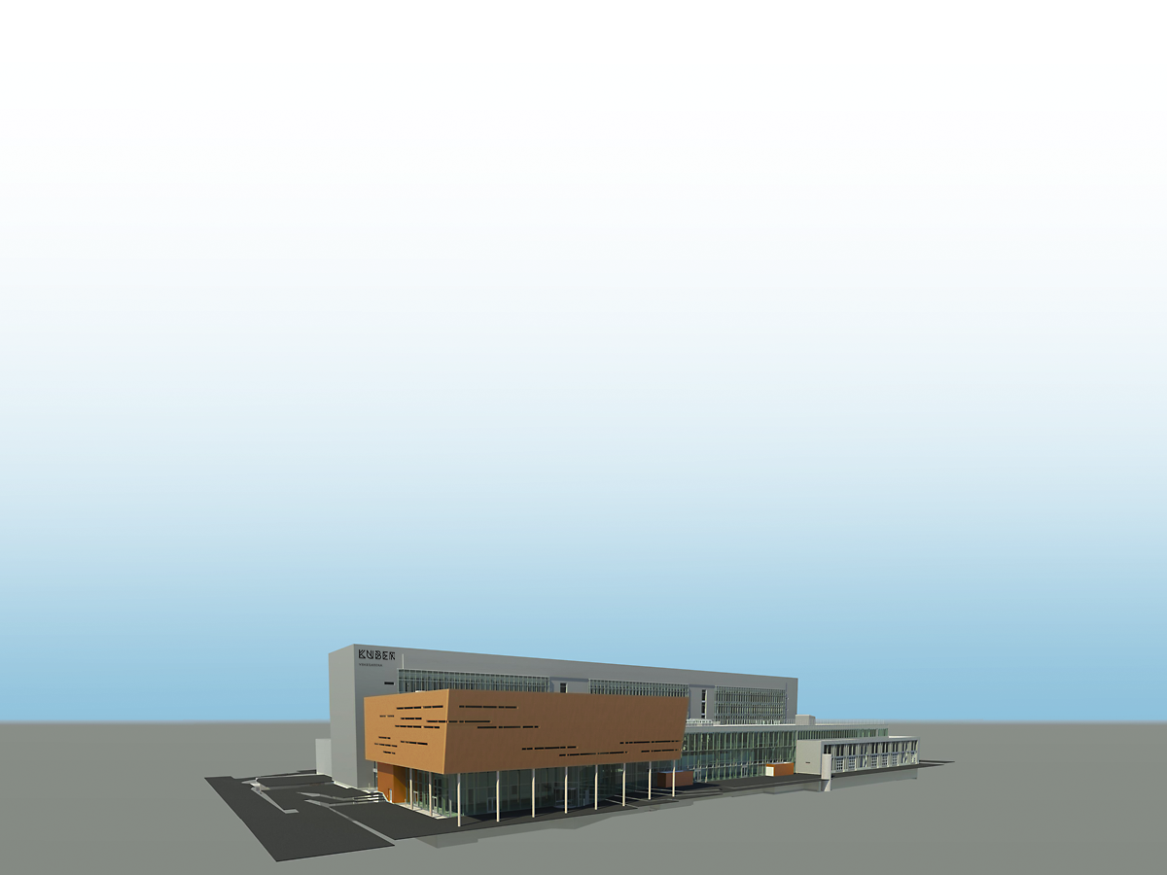

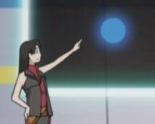
  ACHIEVEMENT MONITORING
Notes:
Blue: under achievers

Slide 12
1HOAA per 1. termin 2013/14
-
-
-
-
-
-
-
-
-
-
-
-
-
-
-
-
-

Slide 13
Drop – out situation i norway
71 % finnish high school in five years.

