Slide 3
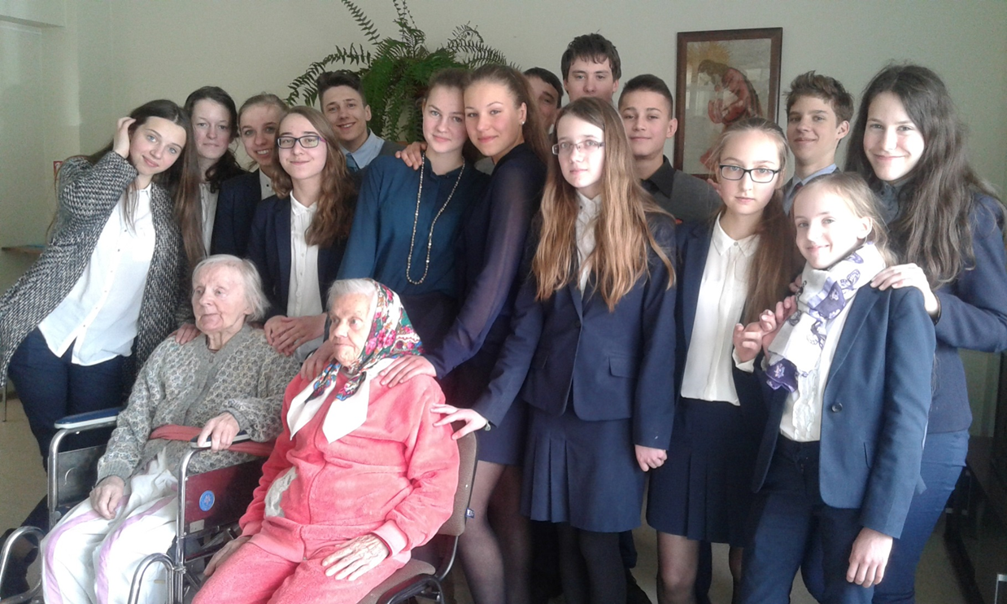
Day of Social Practice

Slide 6
The Fair of Extracurricular Activities

Slide 9
Olweus – Bullying Prevention Program

Slide 11
Retreats

