Slide 1
Kaunas Jesuit High School
Activities Applied
2014-2015

Slide 2
CAREER ORIENTATION DAY
Meetings with representatives of various professions;
University fair;
Meeting with alumni;
Career consultations;
Workshops and seminars.

Slide 3
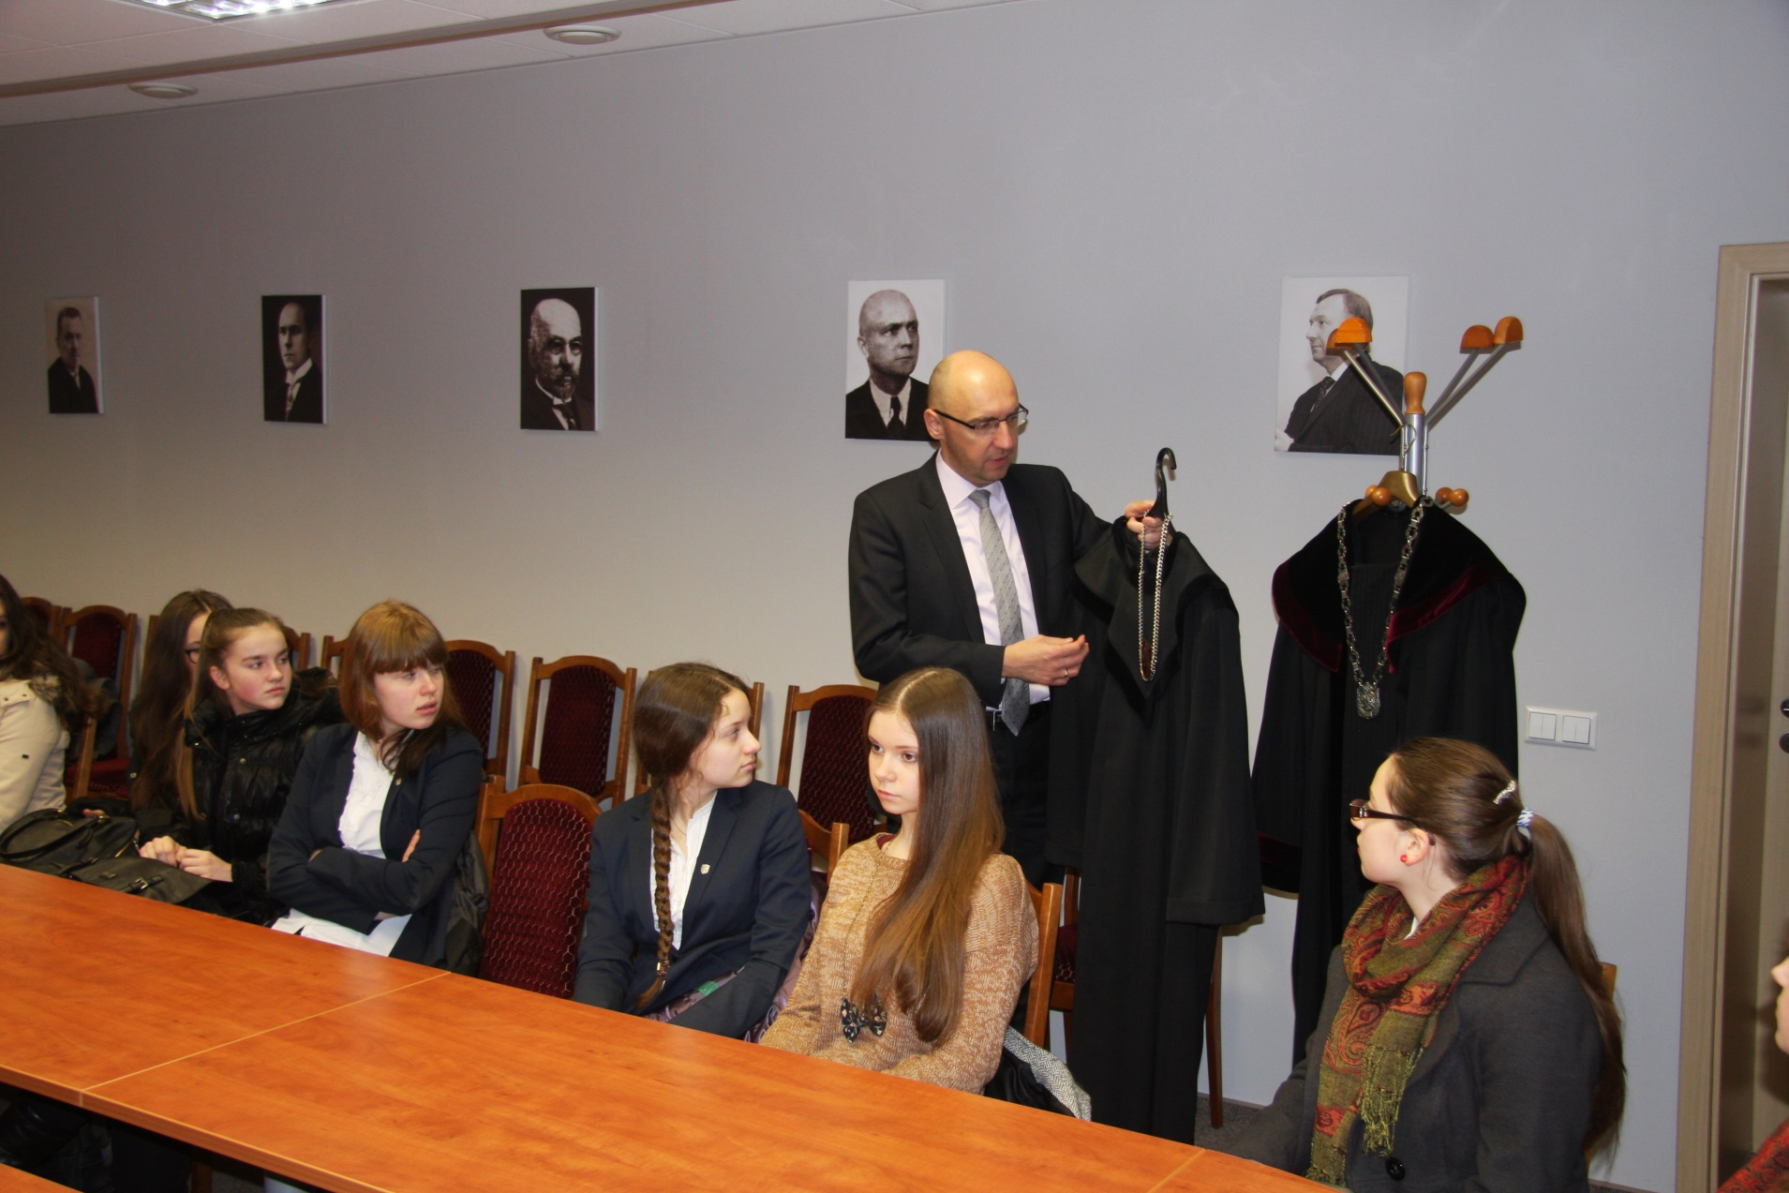

Slide 4
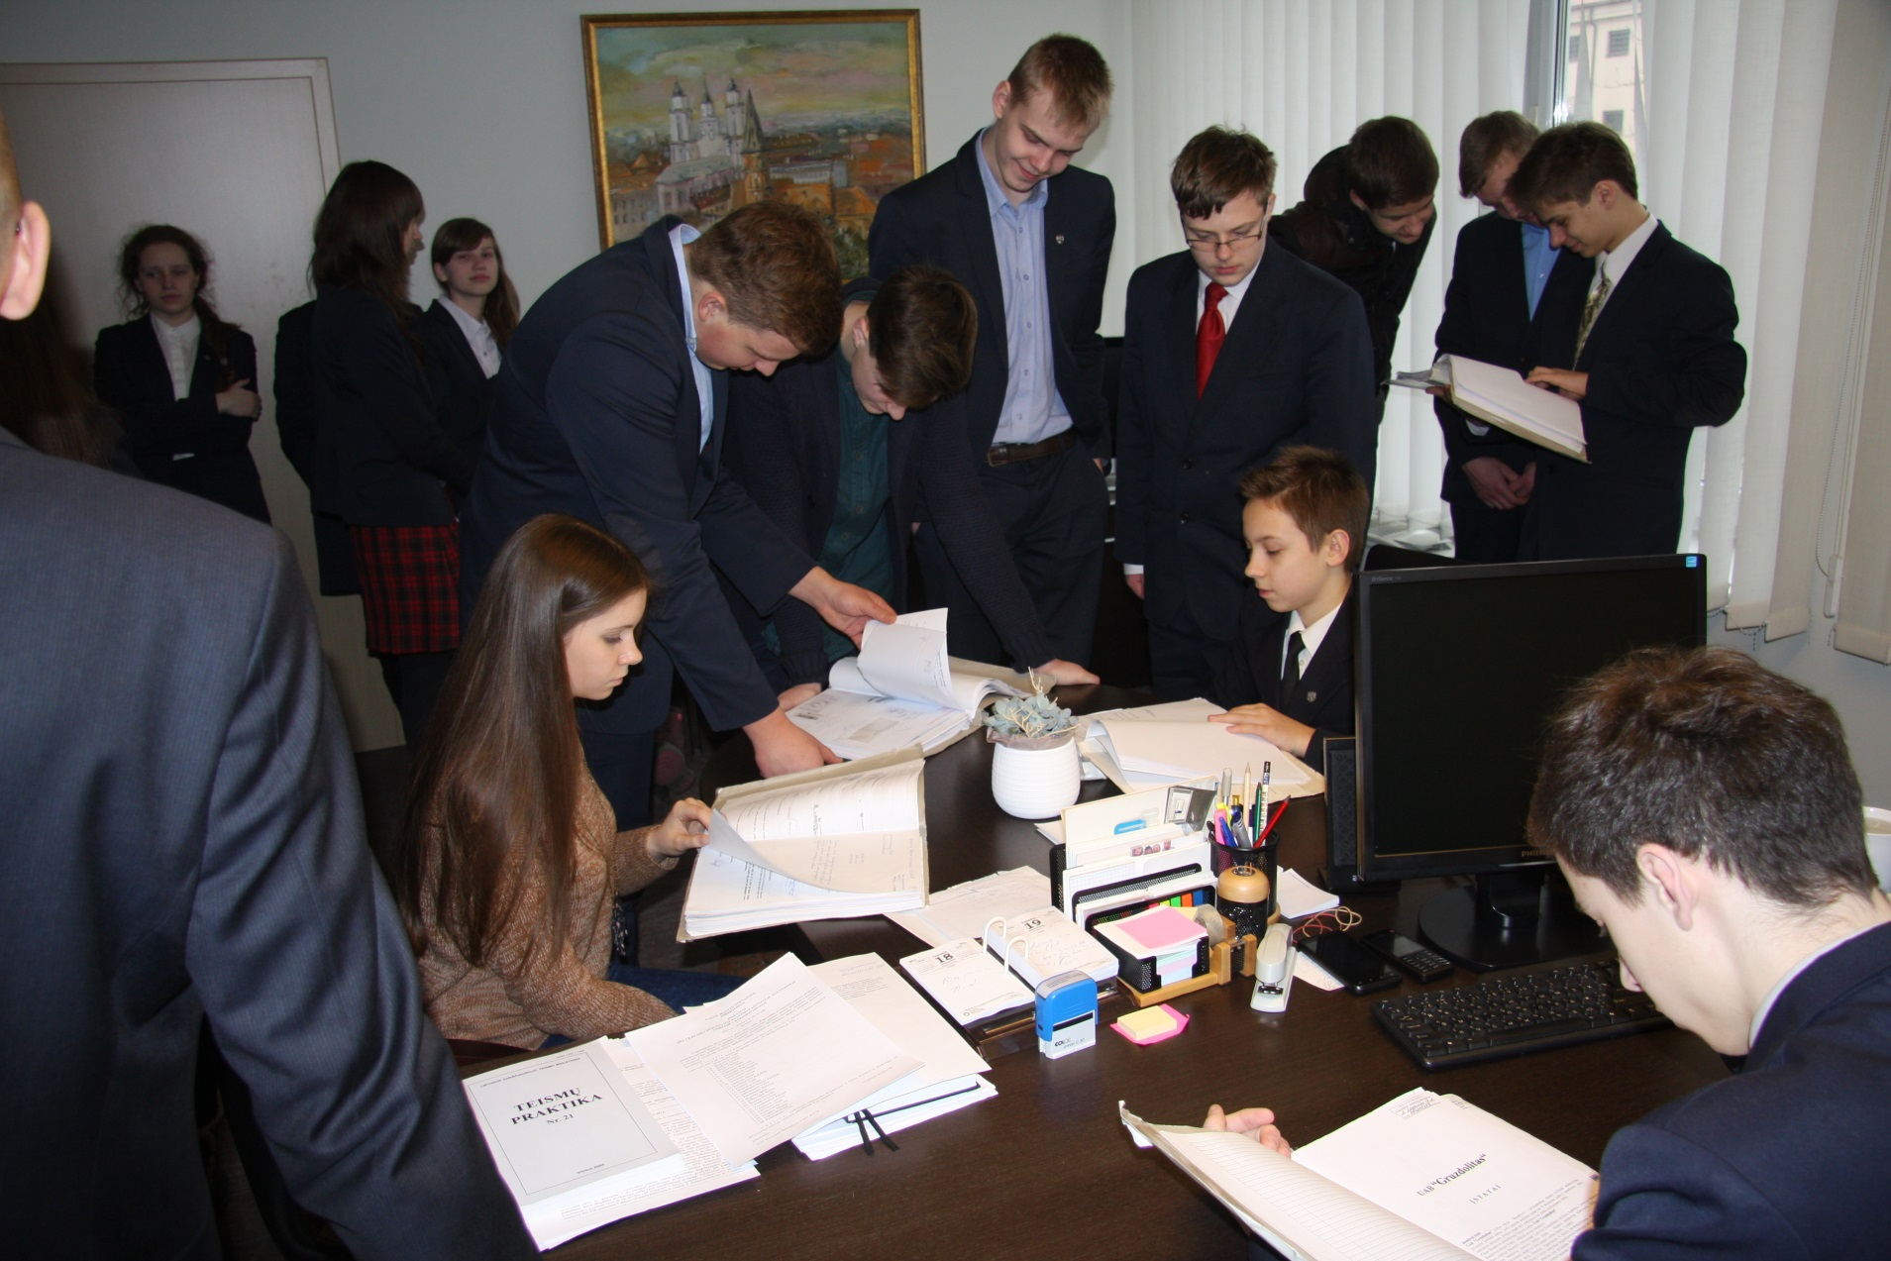

Slide 5
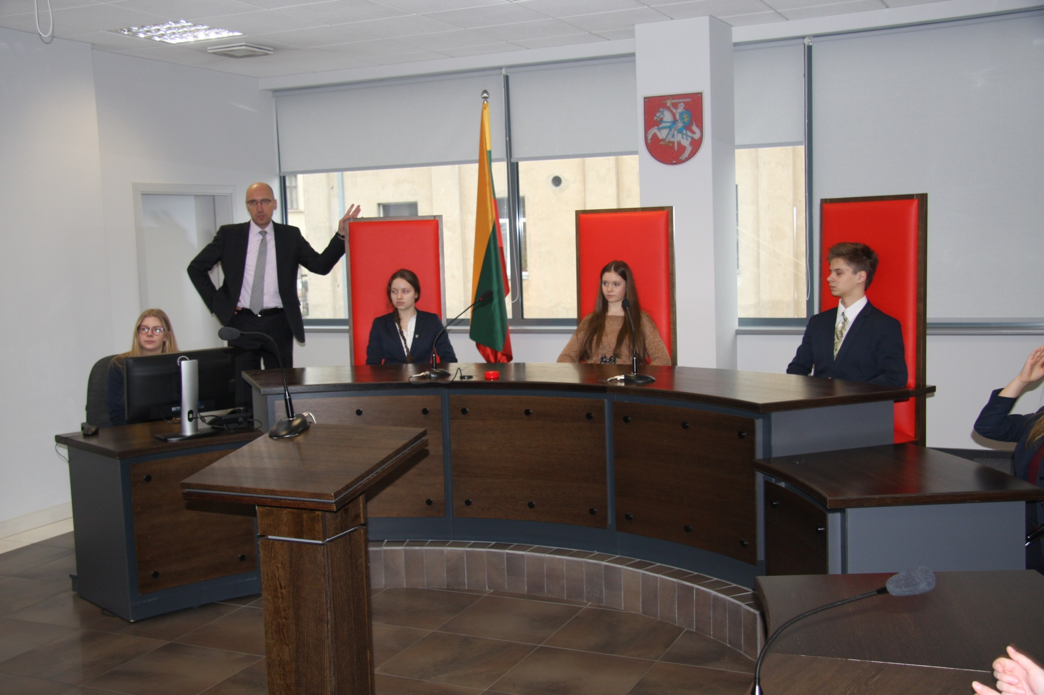

Slide 6
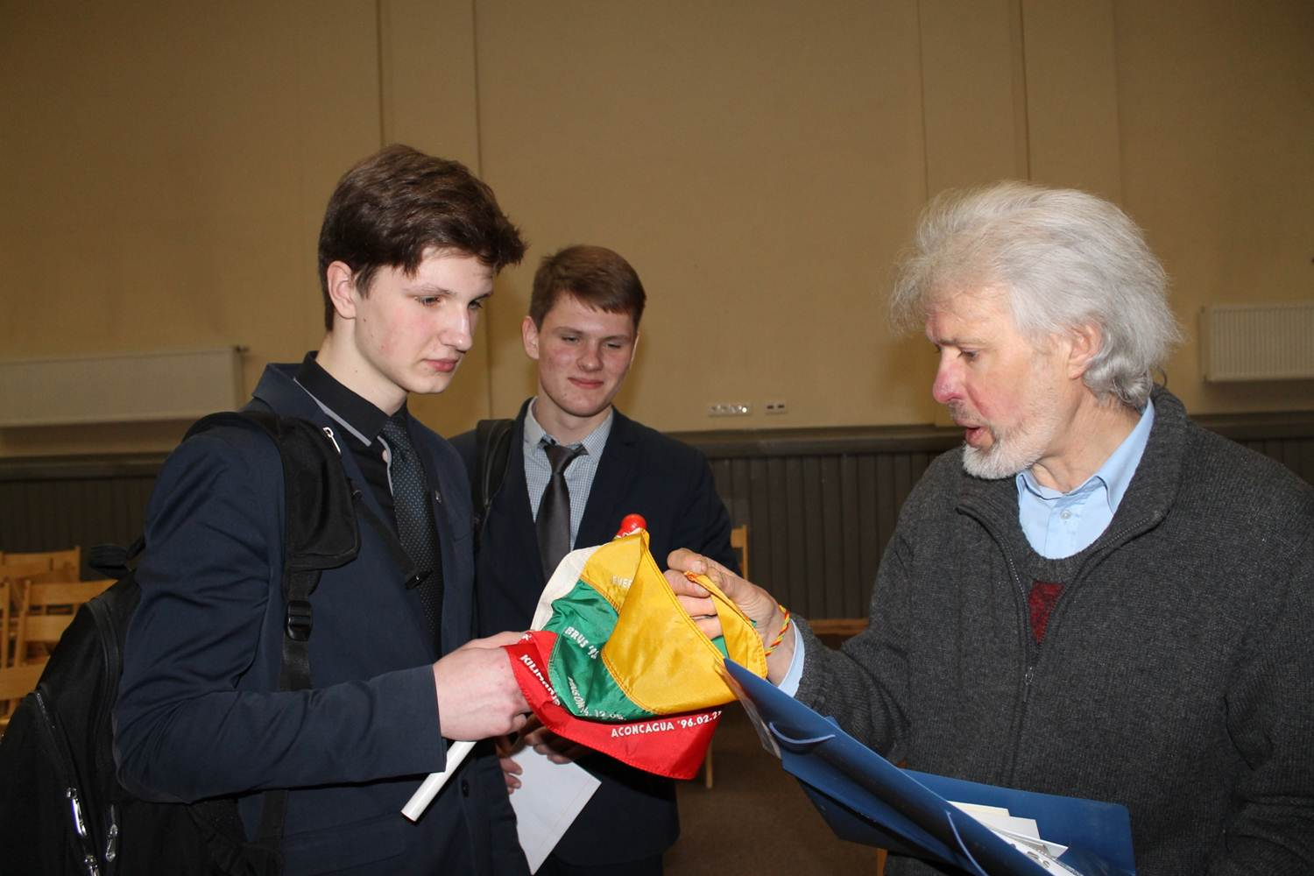

Slide 7
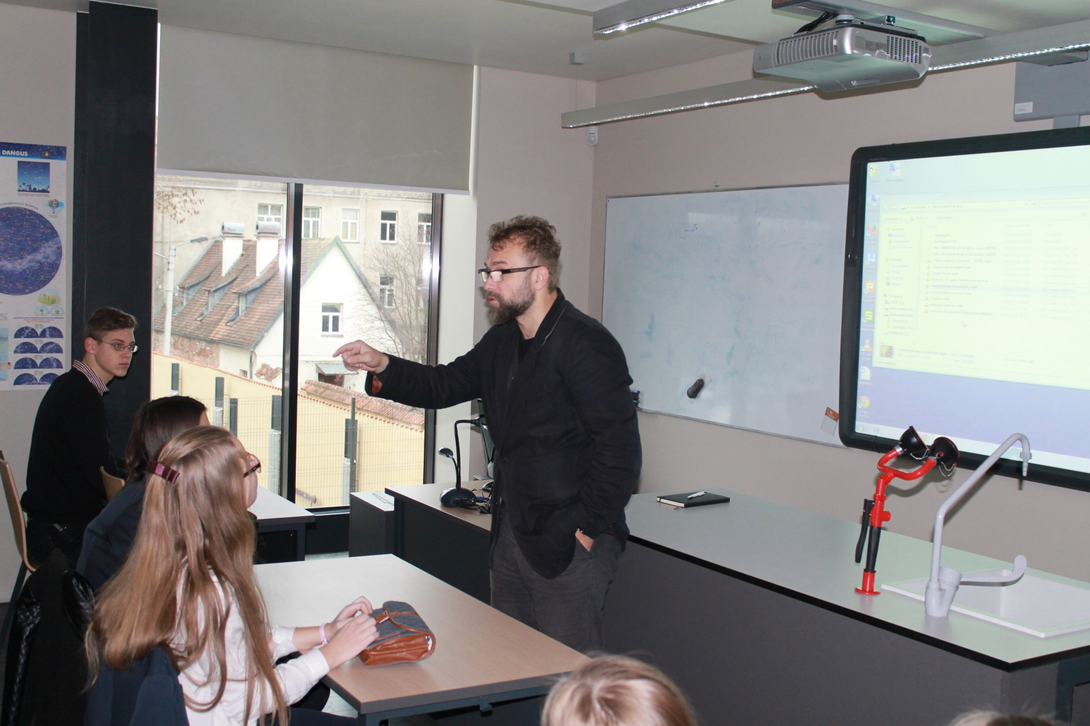

Slide 8
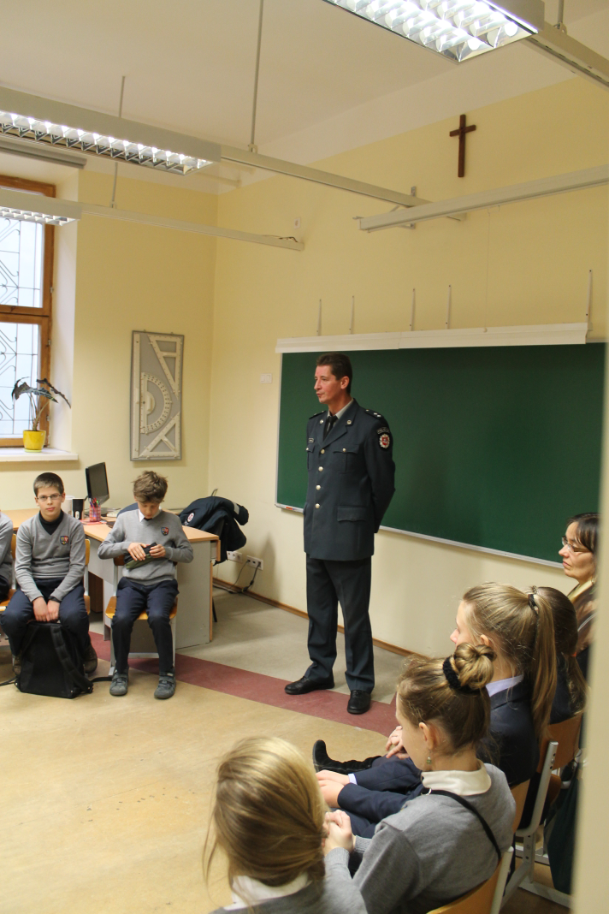

Slide 9
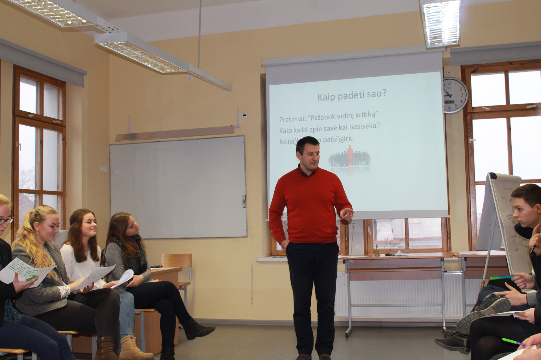

Slide 10
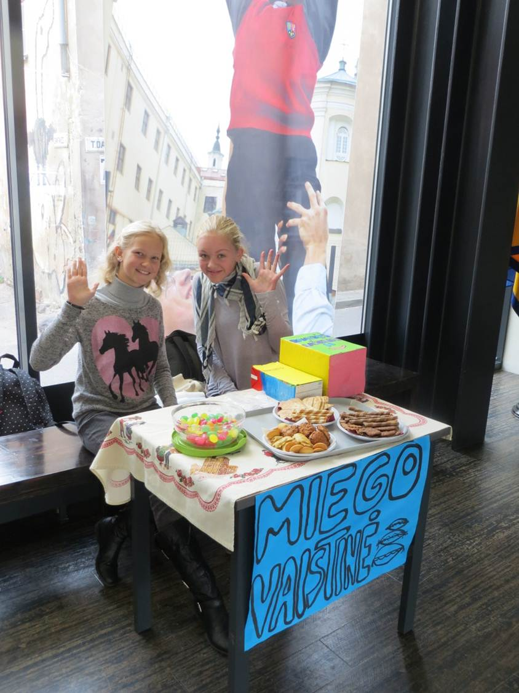
Day of Mental Health

Slide 11
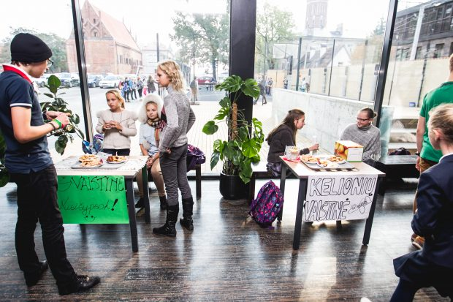

Slide 12
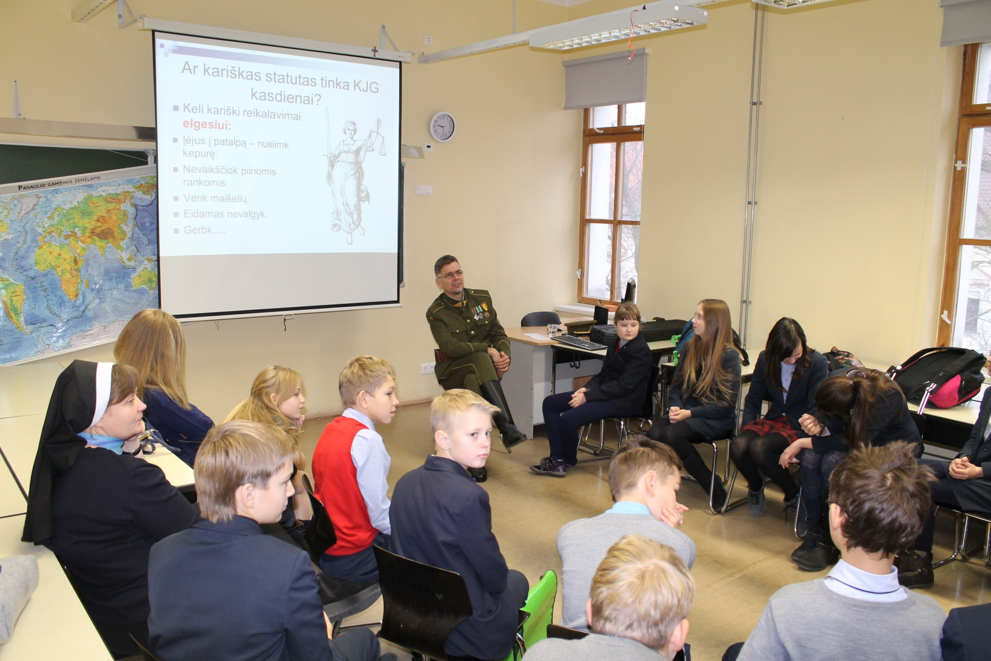
Preventative Day

