Slide 1
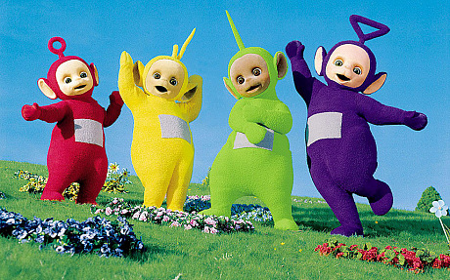
Educational problematic issues within international schools
By Group B A.K.A Teletubbies

Slide 2
Introduction:
Within our group we have put together our unique ideas on educational issues that have a drastic effect on students witin todays society.
These issues vary from lack practical lessons to drop outs. Within this task we will discuss the problems that each international country faces.
We have come up with solutions that maybe useful to help overcome these particular issues.
We decided to group each problem by country.

Slide 3
Problems and Solutions:
Problems that students in Greece faces:
The examination process for teachers are too easy.
Some of the teachers actually dont have the skills to teach properly within a particular subject.
There are lots of studying hours and the school doesn`t provide the education that the students require.
Potential solutions to Greece`s problems:
As a group we think that…
People who are wanting to get the role of becoming a teacher should go through teachers training.
They should be taught how to use new technology so that they are able to teach the students how particular technology should be used. They should be observed by the educational goveners.
Problems that students in Portugal and Cyprus faces:
They have to pay 300 euros anually for books.
There is a lack of resources within these two contries as they have to either pay for their books or they will have to borrow from the higher acdademic years.
Potential solutions to Portugal´s problems.
Libraries that have security. This can help the books to remain intact and refrain from thefts. If they are not returned on time they will be charged.
If a book is borrowed, the students are not permitted to write in these books.

Slide 4
Problems and Solutions:
Problems that students in Turkey faces:
They do not have the freedom to wear their own clothes.
The test system/cirriculum have become very strict and difficult to pass.
The teachers are nt treating their students fairly within the school.
Potential solutions to Turkey´s problems:
The teachers should make their students feel safe, secure and comfortable.
They should be able to have the choice of wearing the schools uniform or not. Whatever makes them feel comfortable.
Problems that students in the UK and Lithuania faces:
Most of the lessons in the schools are not practical, meaning they are based more on theory. This can make students feel de-motivated to study.
The parents need to know how to behave with their children and show them how important education is.
The students do not know how to live on their own.
Potential solutions to the UK´s and Lithuania´s problems:
More practical lessons so that students are engaged within the lesson.
At LEAST one lesson a week for life skills for example, paying taxes.

Slide 5
Problems and Solutions:
Problems that students in Bulgaria face:
They do not have the opportunity to choose a particular subject that they are interested in.
Potential solution to Bulgaria´s problem:
The students should have a choice of whether they want to study a subject or not.
Problems that students in Italy face:
The students do not have enough teaching time from the teacher.
They have the resources to dp participate during the practical lessons in science, however they do not get to use them.
They don´t have the time to practise speaking their chosen language within the lesson. For example, English.
Potential solutions to Italy´s problems:
Teachers should allow the students to use the resources provided so that they can learn how to operate the specific equipment.
More flexiblity within subjects.
Problems for the international students:
All of the students combined have over 25% of the students drop out due to loss of motivation, no equipment, bad teaching skills from the teachers and not engaging lessons.
Over-all work experience has been proven to be the biggest problem amongst the international students.

Slide 6
More Problems and Solutions:
Potential solutions for the international students:
Students learn in very different ways meaning that there should be a variety of methods in which each student can feel like their leaning needs are being met.
Work experinece should be put in every learning cirriculum throughout the globe so that each student can have an experience of what it is like to work in their chosen field.
For those who choose to drop out or not attend school, the parents of that particular child should pay a fine, because they are allowing their child to miss out on an opportunity to learn new things and meet new people.

Slide 7
Conclusion:
In conclusion we have learnt that each country has at LEAST one issue which can cause an effect later on in their lives and may not allow them to have a good job or earn good money.
This can also lead to a cycle where their children, if they choose to have any, may allso have this attitude towards education and may end up as drop outs, for drop outs have a big impoat within todays society.

