Slide 1
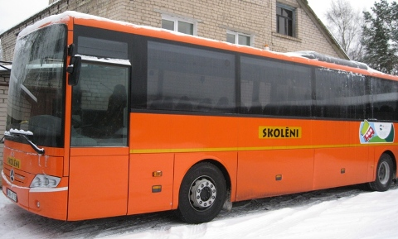
Meetings with representatives from different professions
Experience tour - youth centres in Valka (Latvia) and Valga (Estonia)
Meetings with representatives from different professions
in their working places

Slide 2
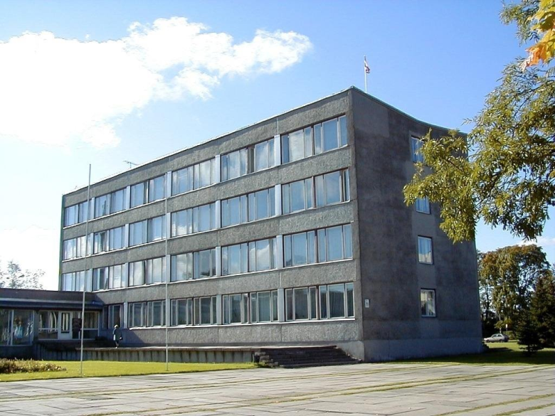
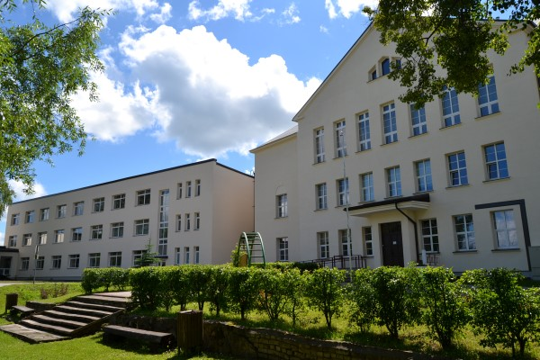
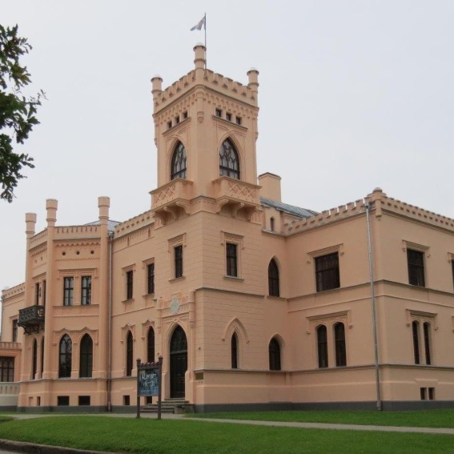
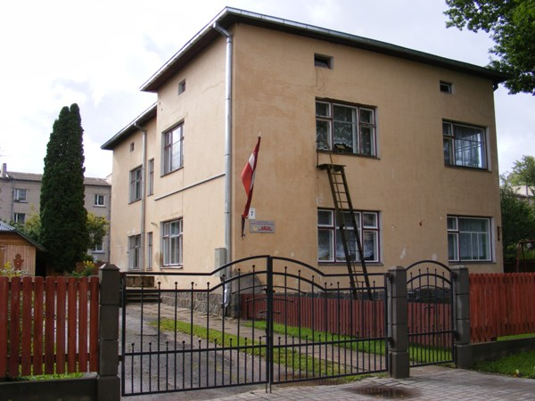
Aluksne municipality
Aluksne municipality`s secondary school
Aluksne museum
Kindergarten «Cālis»

Slide 3
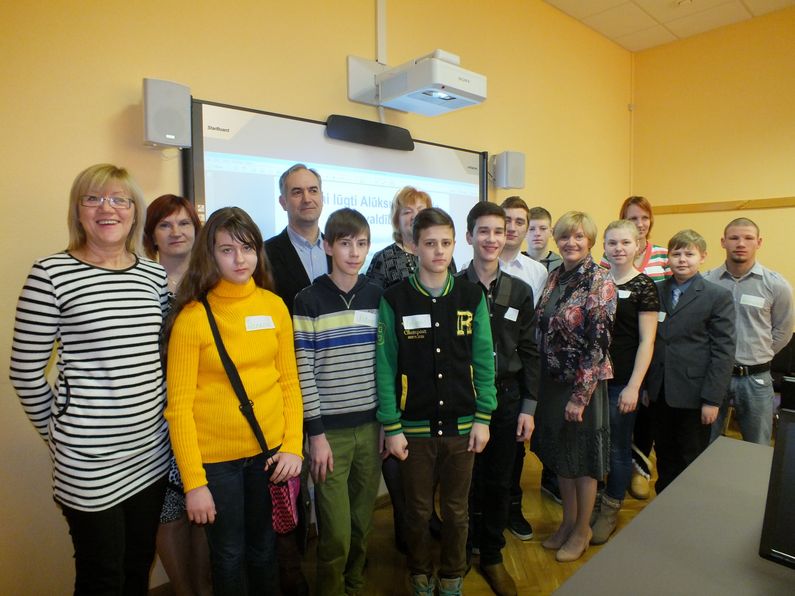
Guntis
Aleksandrs
Dana

Slide 4
What is Shadow day?
Shadow day is very popular and well – known Junior Achievement career educational programme for 1st-12th classes students. According to the programme students visit working places and for 4-6 hours they observe the representative of profession what they have chosen and hospitate its routine.

Slide 5
Why do we need shadow day?
Future profession
Occupation`s+/-, the size of salary, responsibilities, rights, etc.
Propose ideas for representatives
Find out things which normally is difficult to understand.

Slide 6
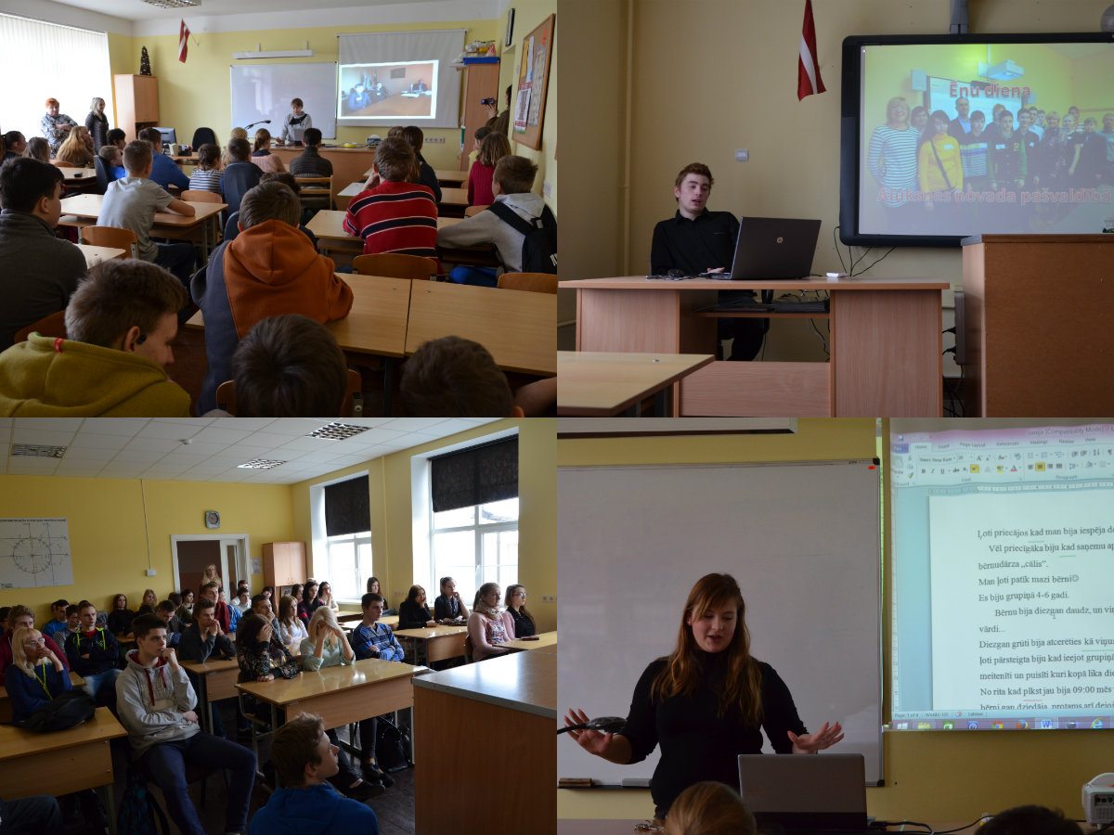
Students are telling about Shadow day

Slide 7
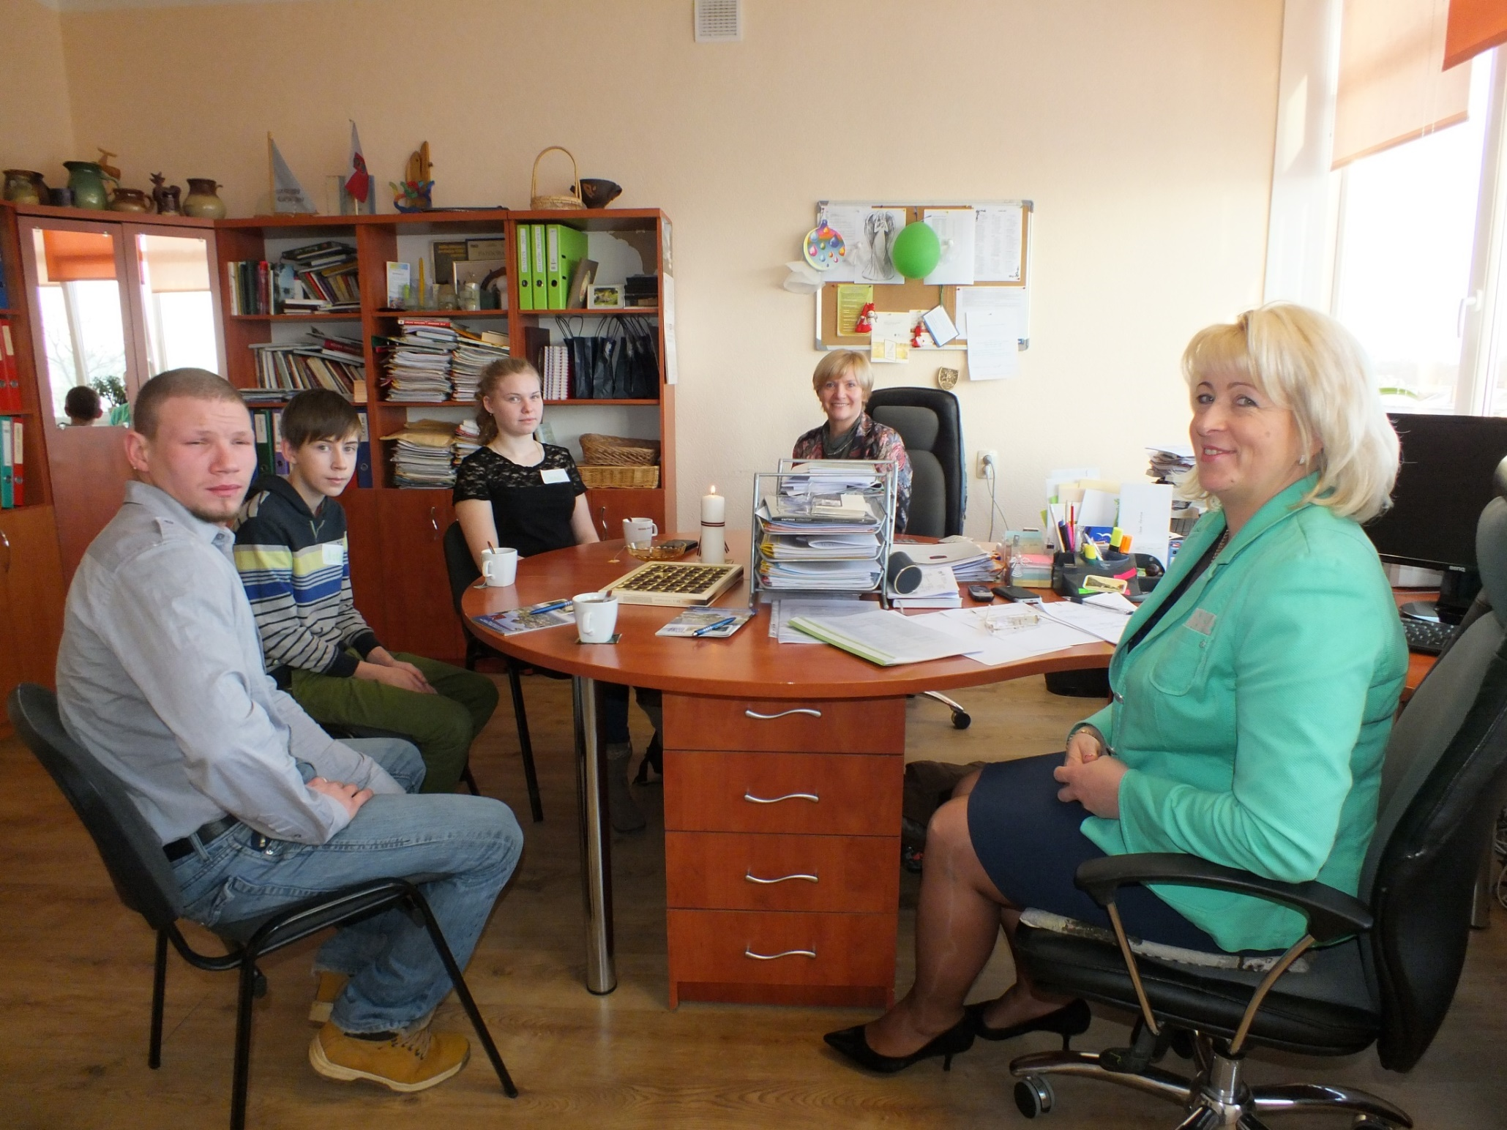
Dana

Slide 8
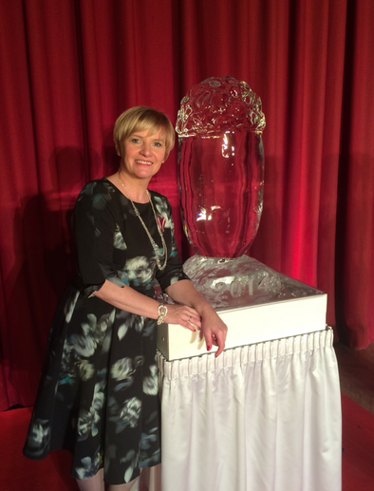
The director of the Culture and sport department of Aluksne municipality
Sanita Eglīte

Slide 9
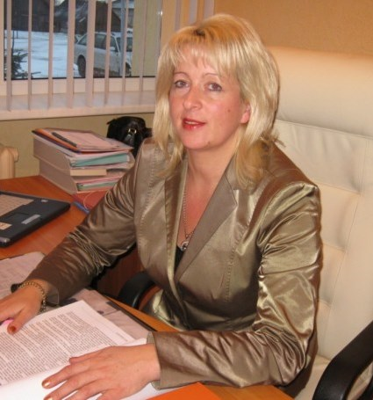
Representative of Culture department Valda Zeltiņa

Slide 10
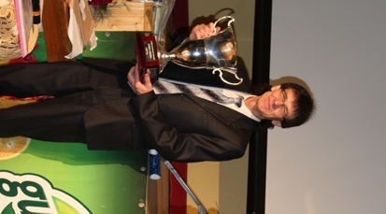
Sports events organizer Vilnis Veļķeris

Slide 11
What did I learn?

Slide 12
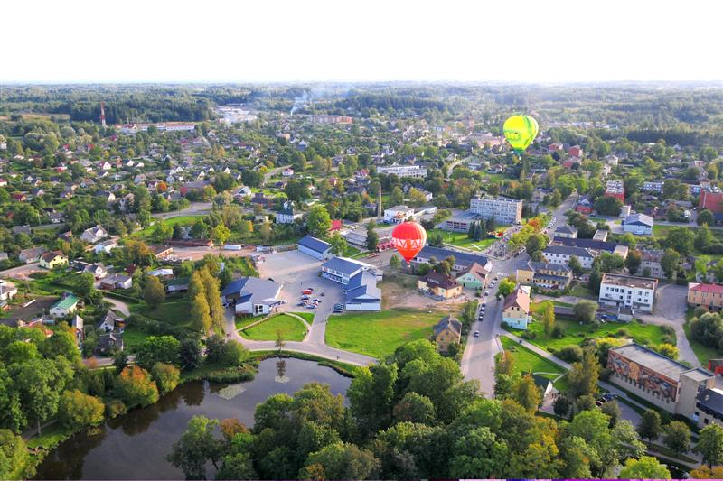
2015 sports and culture events

Slide 14
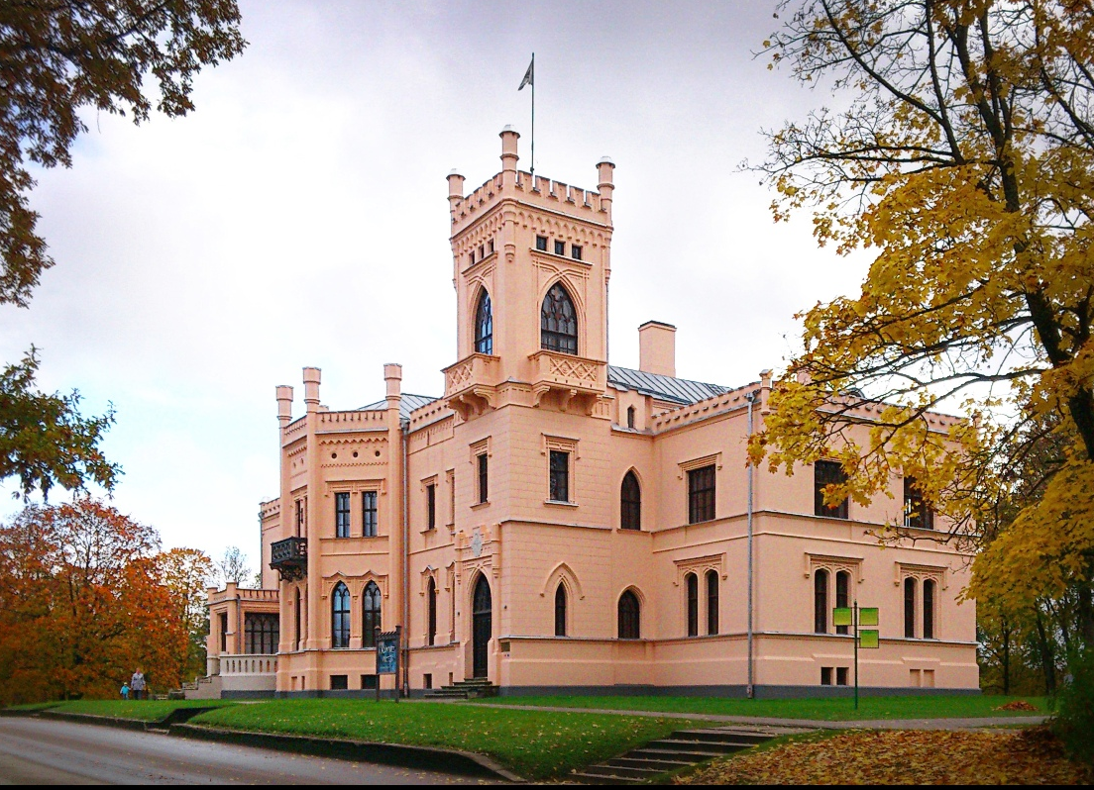
16th May Museums night

Slide 15
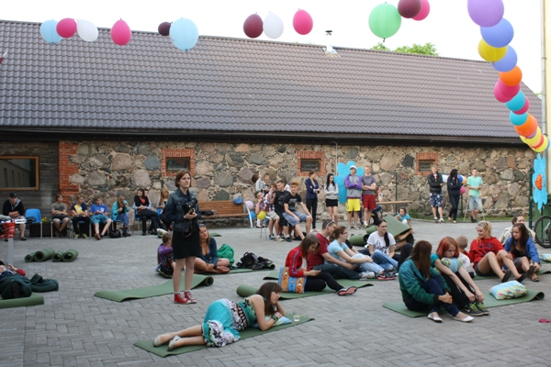
23th May Youth day

Slide 16
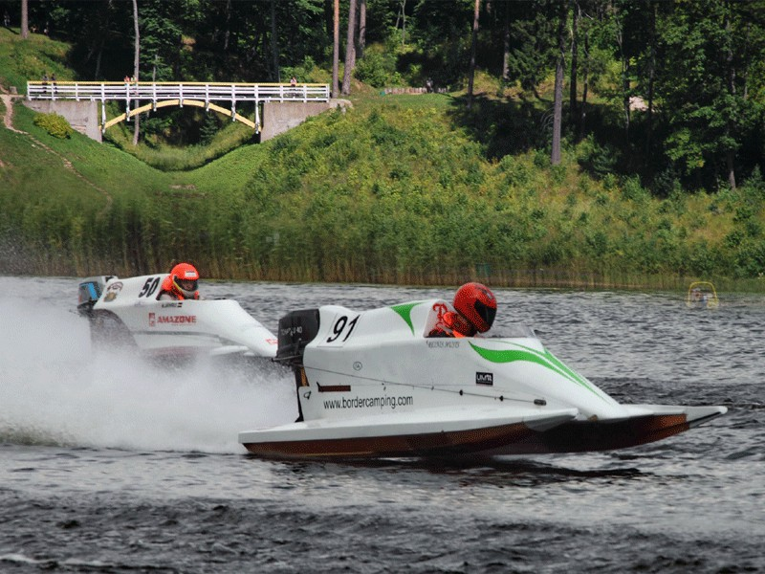
12.06. – 14. 06. Powerboat World championship

Slide 17
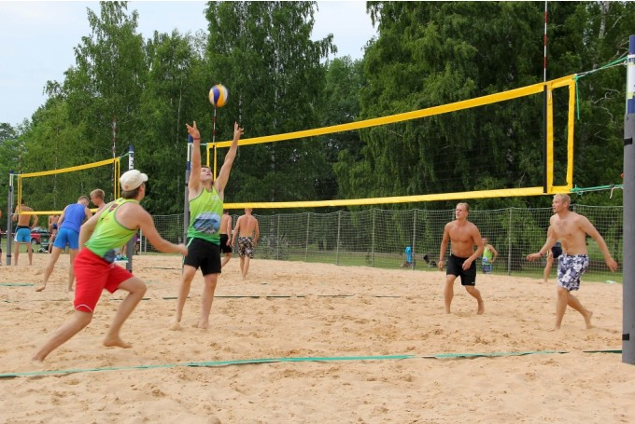
20.06. Transnational competition in beach volleyball «Katrīnas kauss»

Slide 18
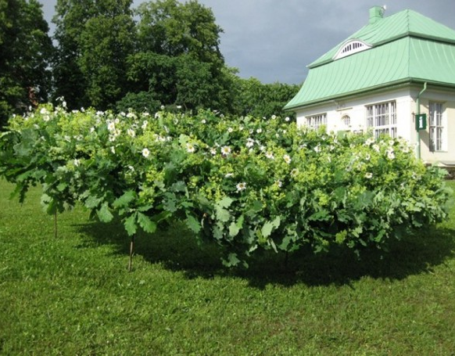
21.06. Summer Soltice celebration «Lielās līgo lustes Alūksnē»

Slide 19
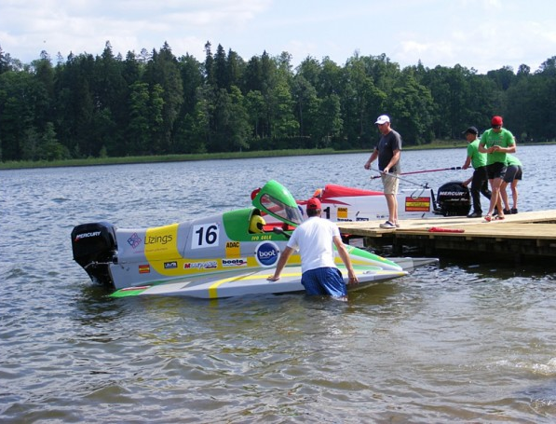
18.- 19.07. Powerboat Baltic Open Championship

Slide 20
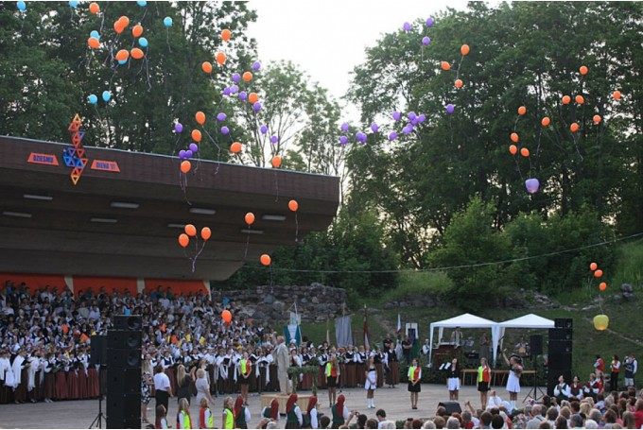
31.07. – 02.08. Aluksne town celebration

Slide 21
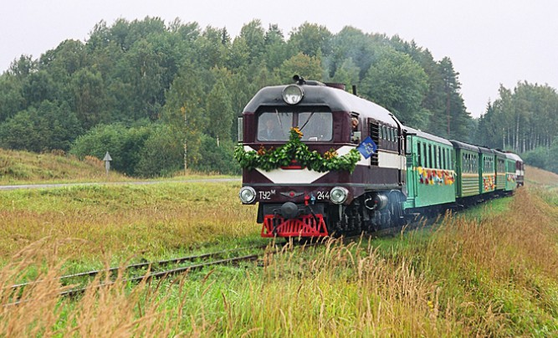
05.09. Celebration of anniversary of narrow gauge railway

Slide 22
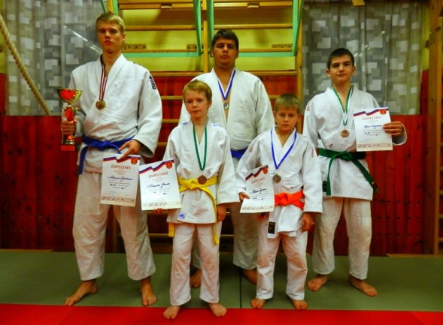
12.12. – 13.12. Transnational Christmas tournament in judo

Slide 23
Aluksne municipality`s entrepreneurs`
representative Indra Levane
Guntis

Slide 24
Alūksnes novada pašvaldības
juridiskās nodaļas vadītāja Aiva Egle

Slide 25
Necessary knowledge
Higher education
A master's degree in business
Communications skills
Languages (Latvian,English, Russian)
Experience in business

Slide 26
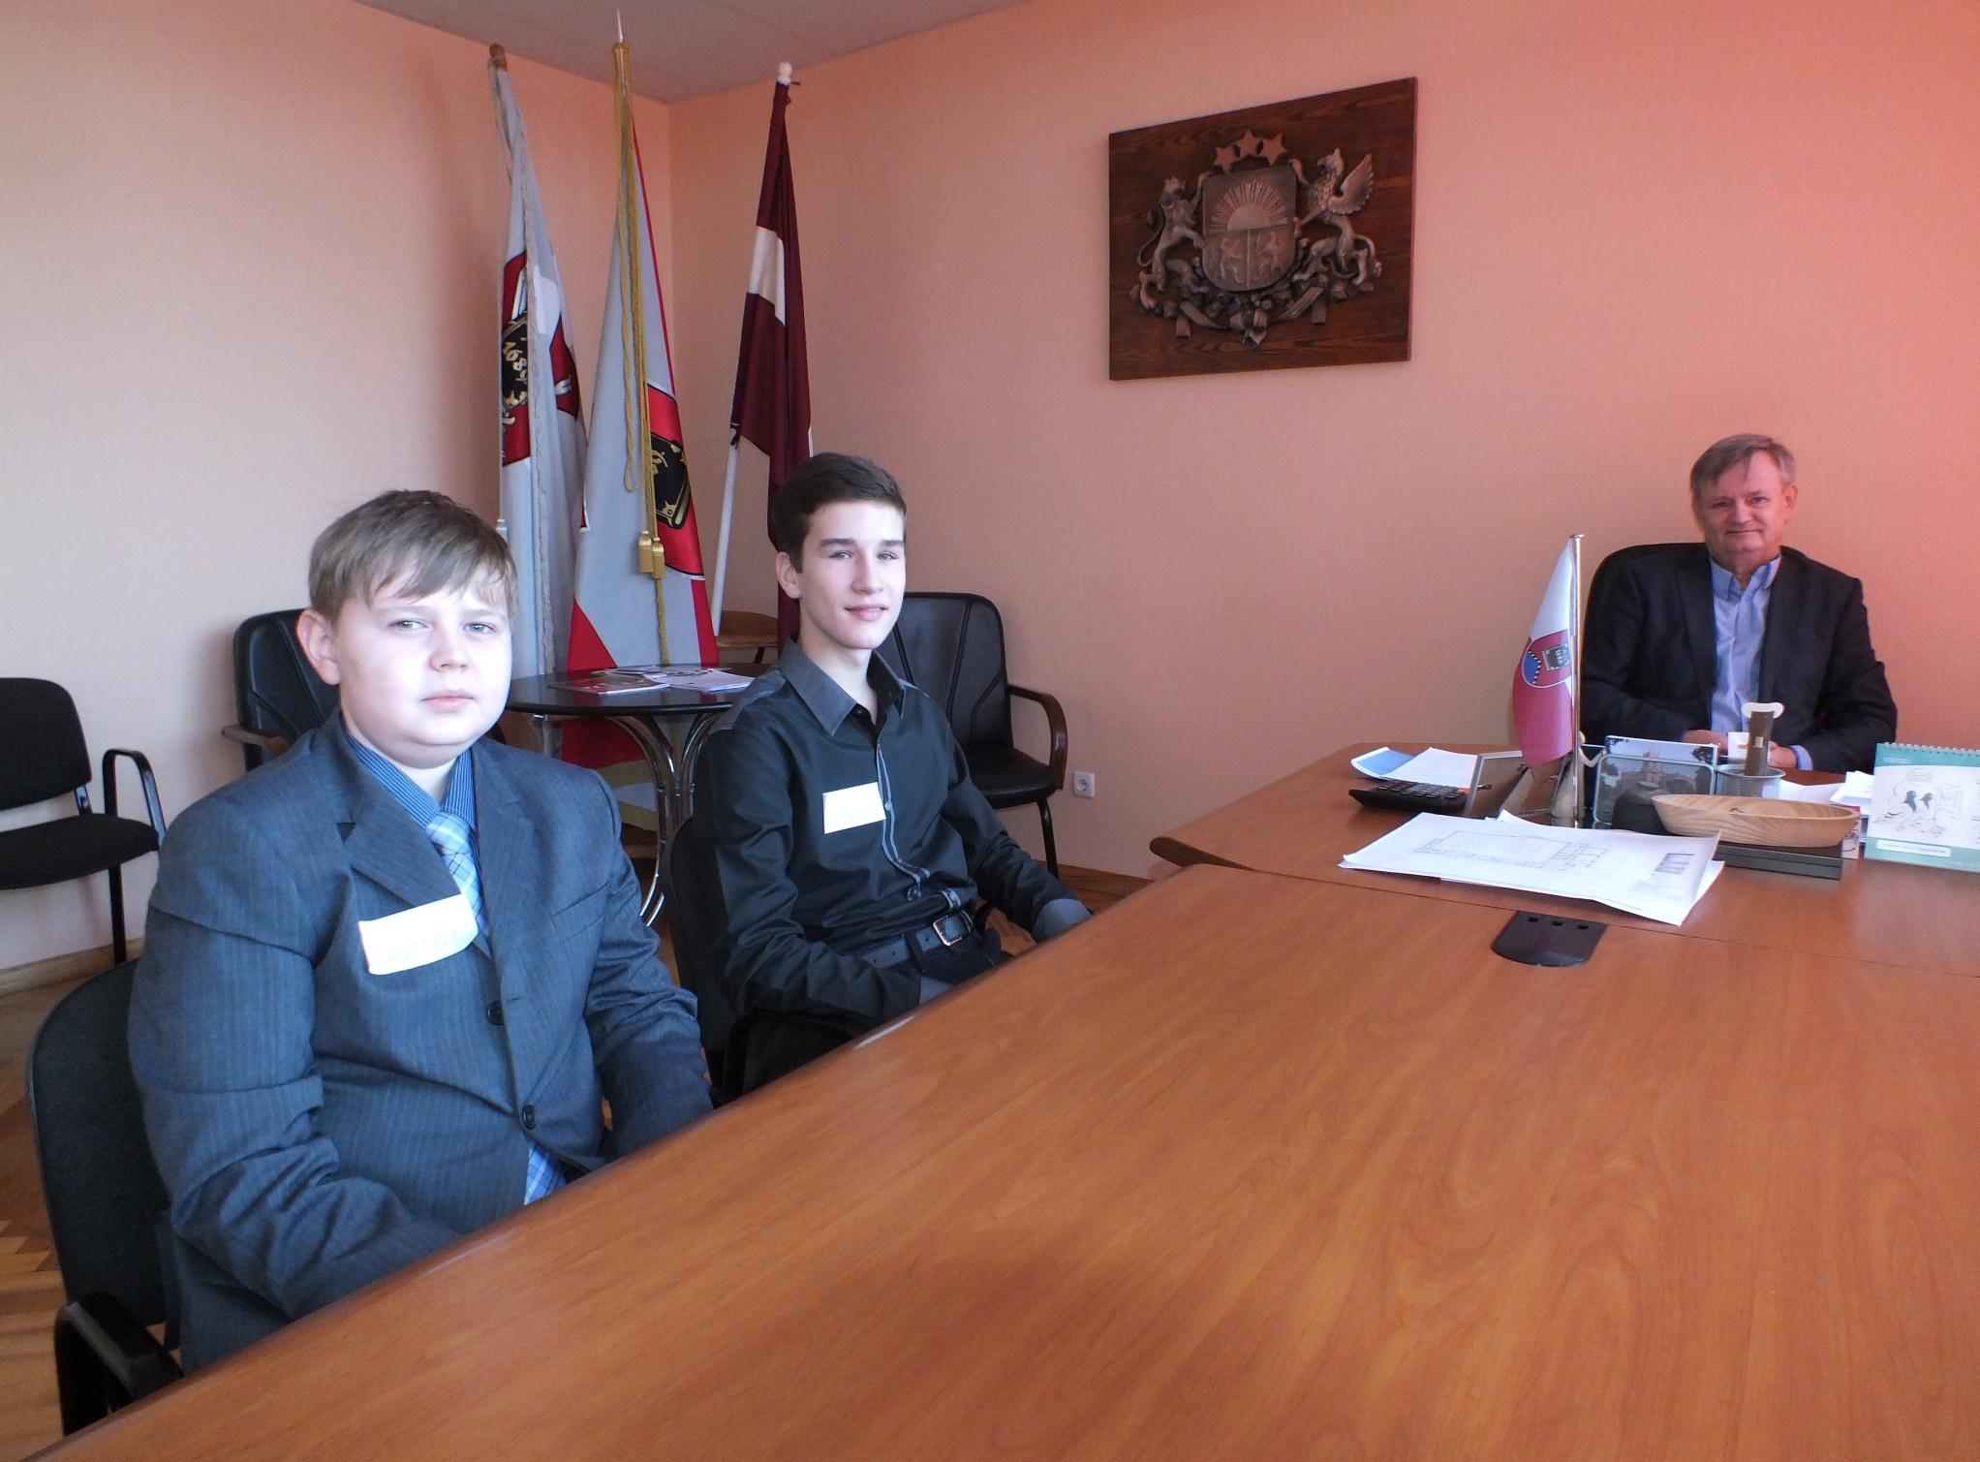
Aleksandrs
Alūksne municipality`s chairman Arturs Dukulis

Slide 27
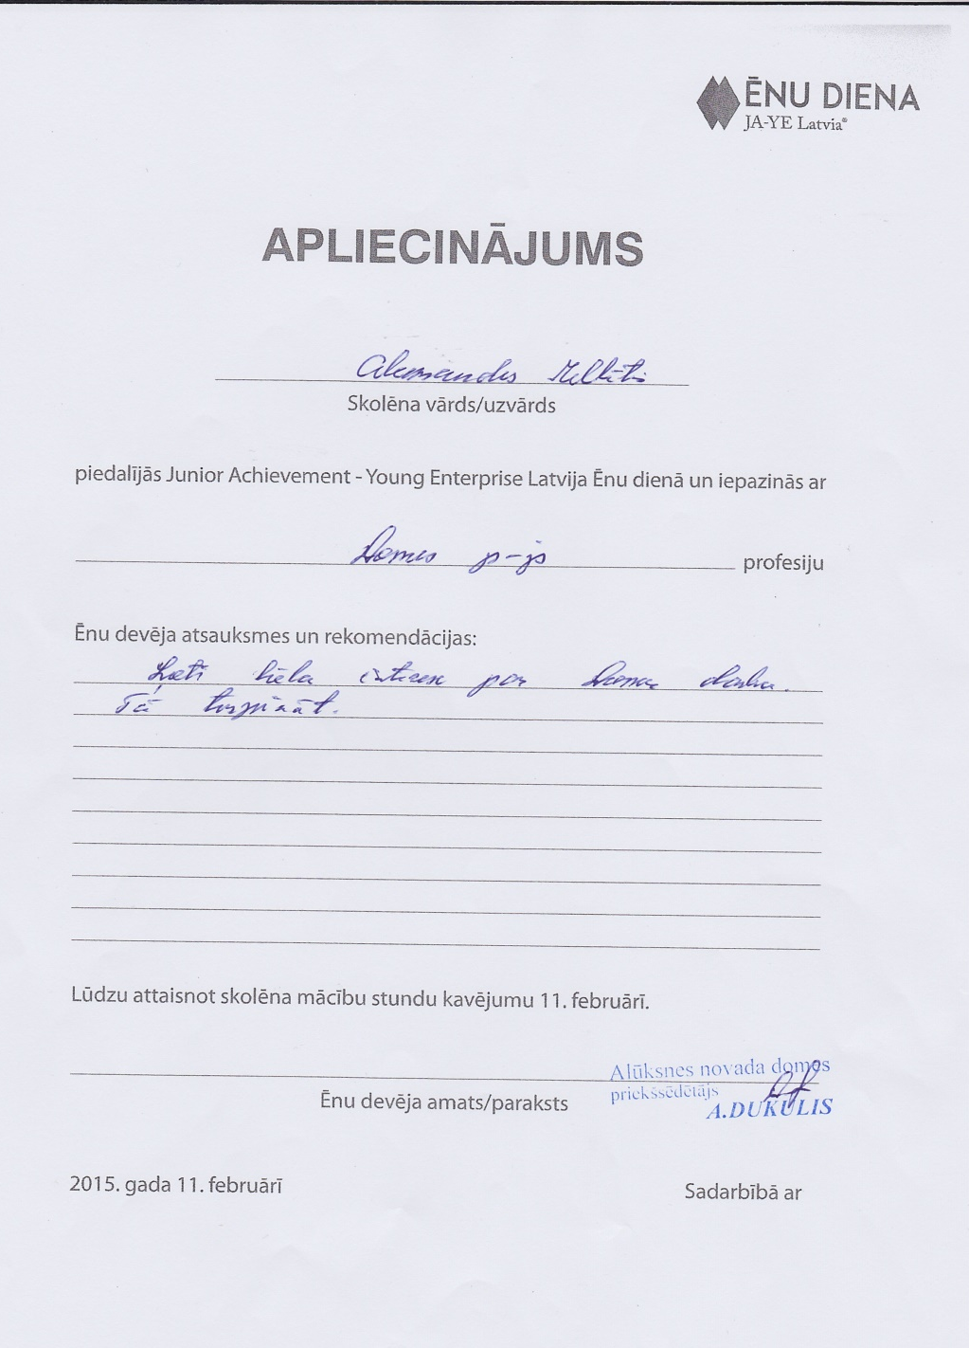
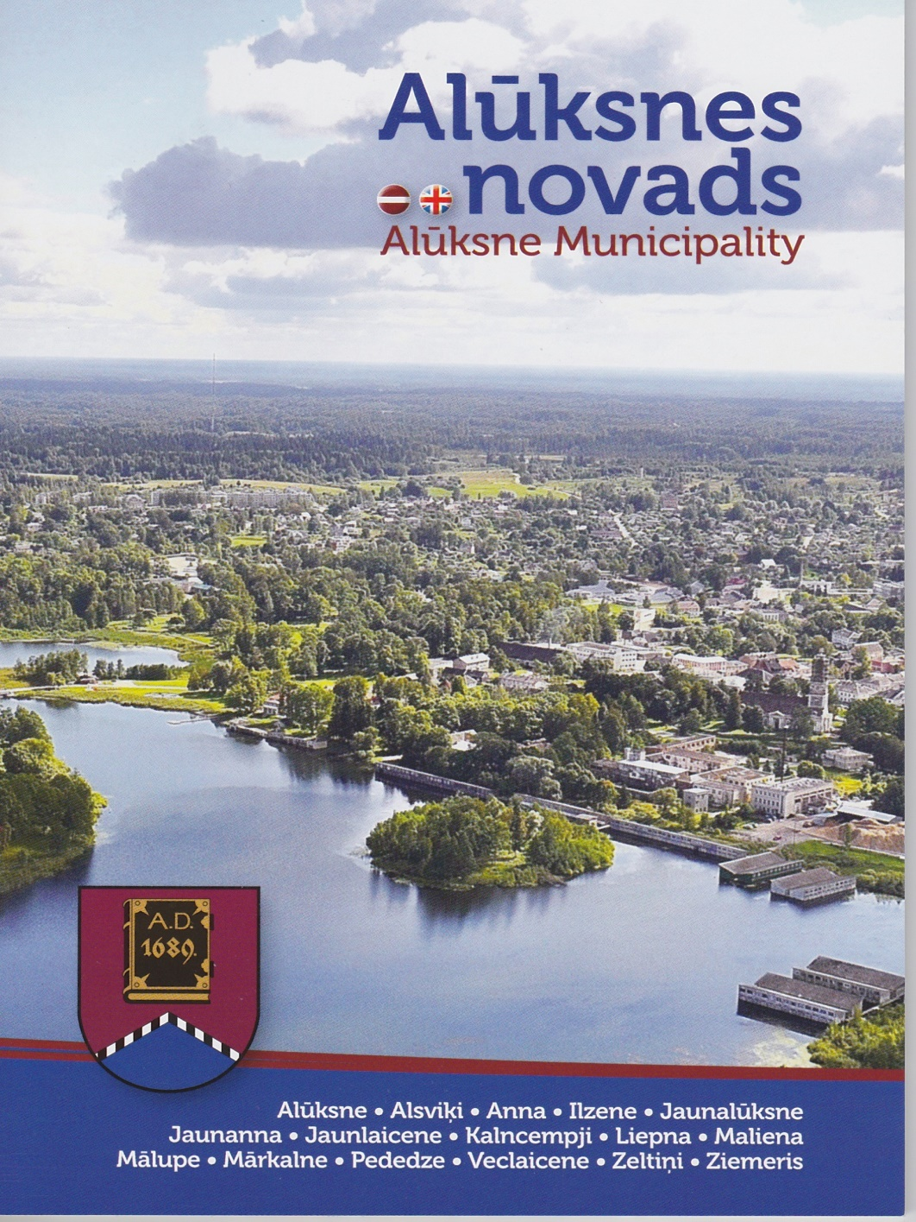
Acknowledgment

Slide 28
Headmistress
Ilze Līviņa

Slide 29
What did I learn?
Evelīna
Day begins with checking e-mails
A lot of paper work
Meetings with different representatives
I learned that school has a passport
Headmasters work is hard

Slide 30
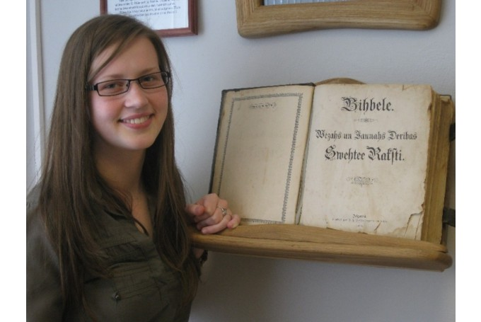
Alūksne museum historian
Linda Safronoviča

Slide 31
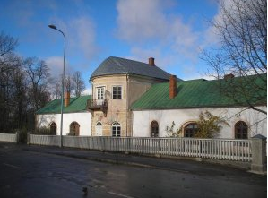
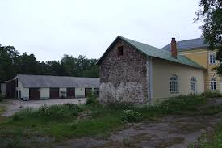
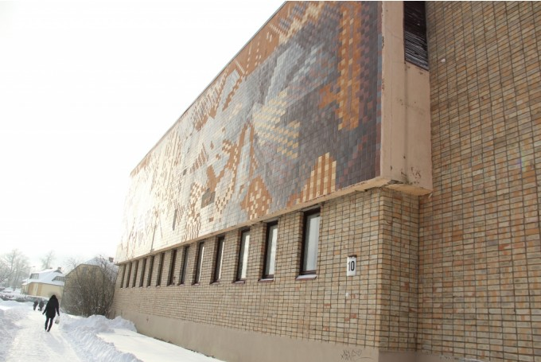
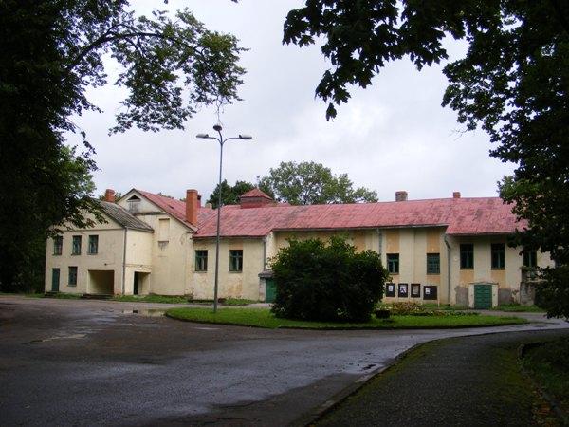
I learned more about some of the Alūksne objects
1.Palms house
2.Ice cellar
3.Lattelecom
4.Culture club

Slide 32
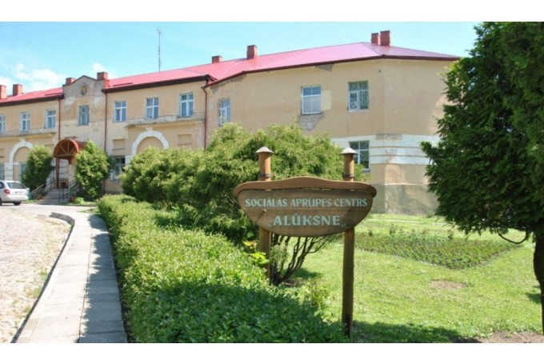
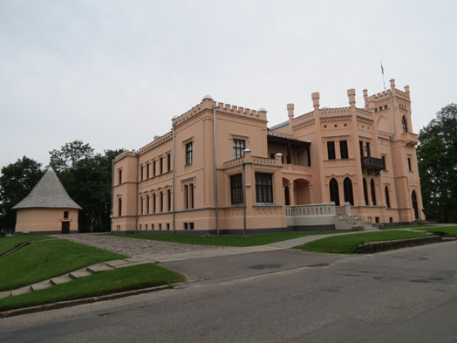
5. Social care center«Alūksne»
6.Alūksne museum

Slide 33
What did I learn?
Alūksne museum has more than 10 000 exhibits
There is regularly held educational activities for students of different ages
I think this profession is interesting
Armands

Slide 34
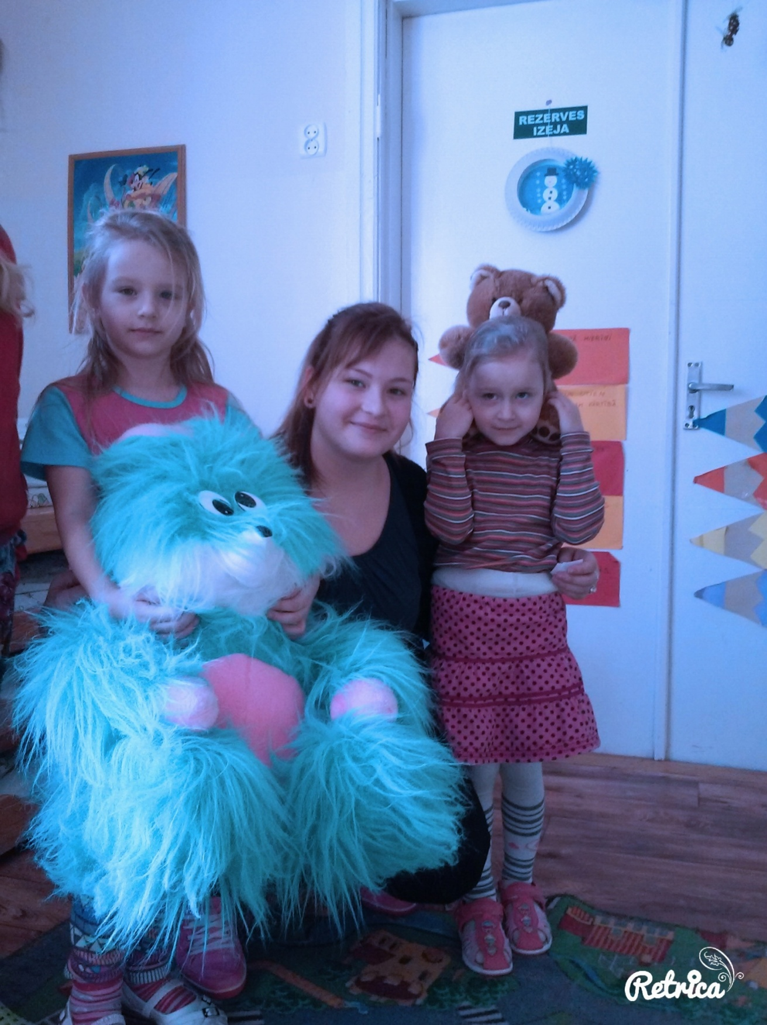
Sanija
Why did I shade?
I like children
How did I spend this day?
Exercising, playing different games, singing.
What surprised me?
Children have very interesting names which are difficult remember

Slide 35
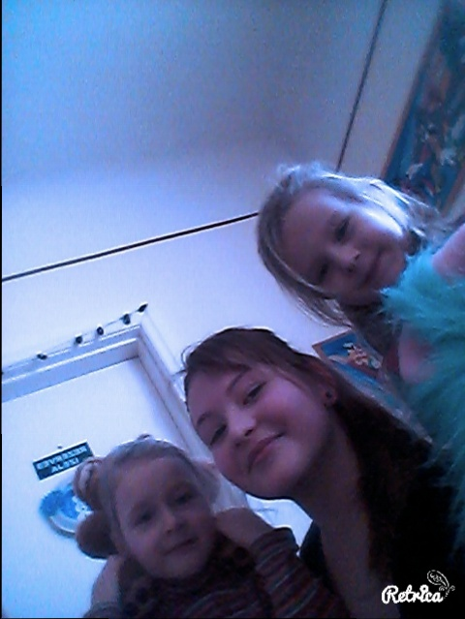
Children liked taking photos
Some of them solve complicated puzzles
It is very interesting to look after 4-5 years old children

Slide 36
Insights in Aluksne schools` students` council representatives experience trip to Valga and Valka

Slide 37
agenda:
Valka Youth office inspection;
Introducing with activities (youth forums, youth council, voluntary work)
Introducing with Valka basic school students council work
Visiting valka art school

Slide 38
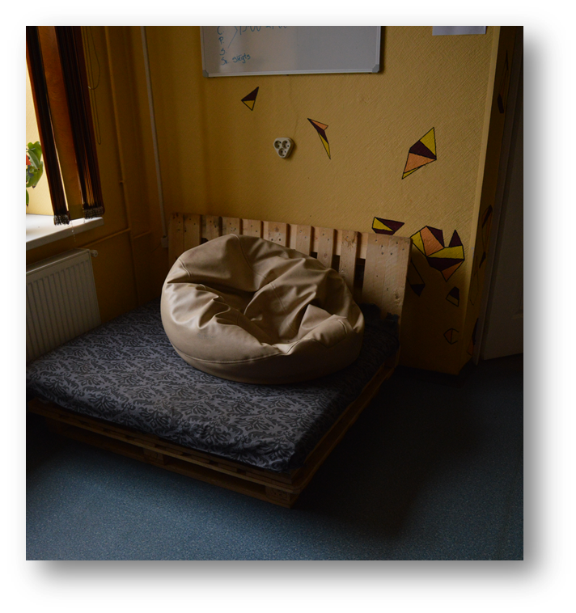
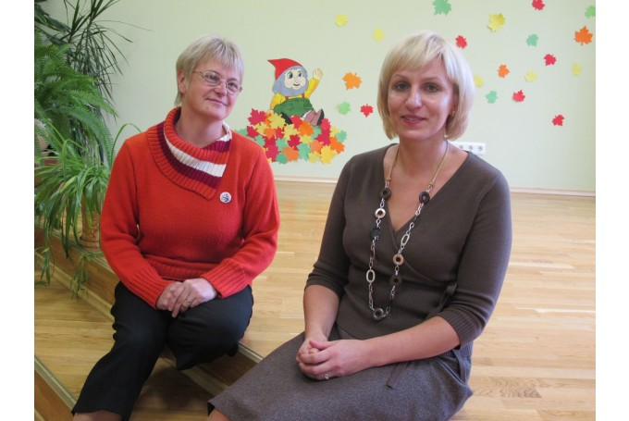
Valka children and youth centre «mice»

Slide 39
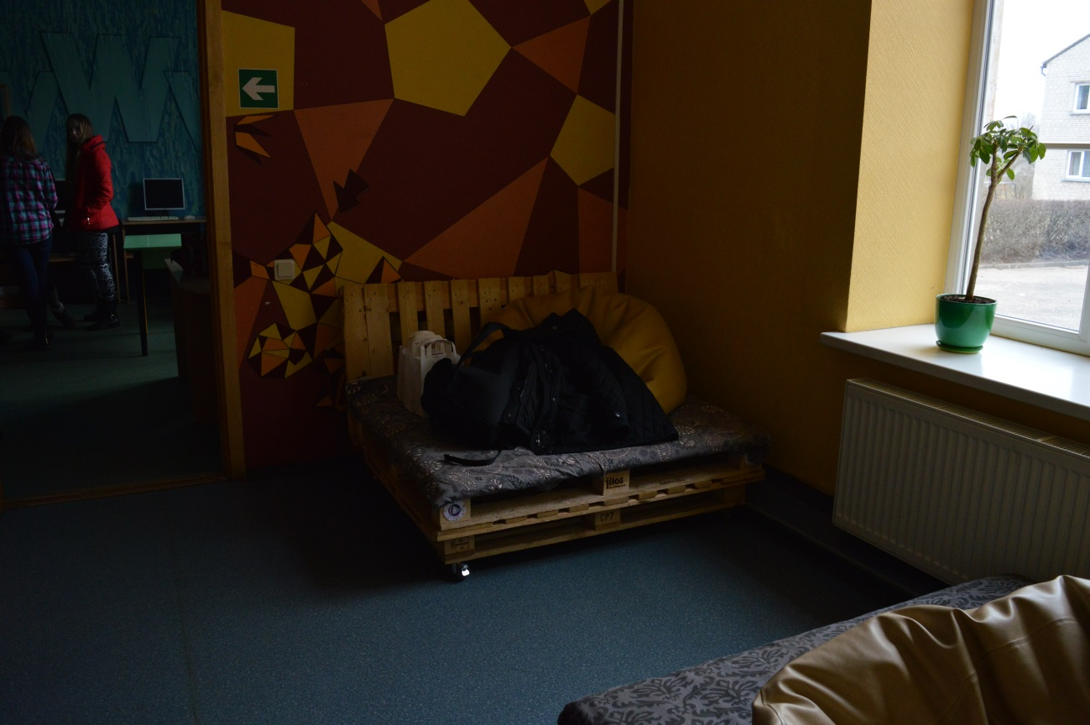
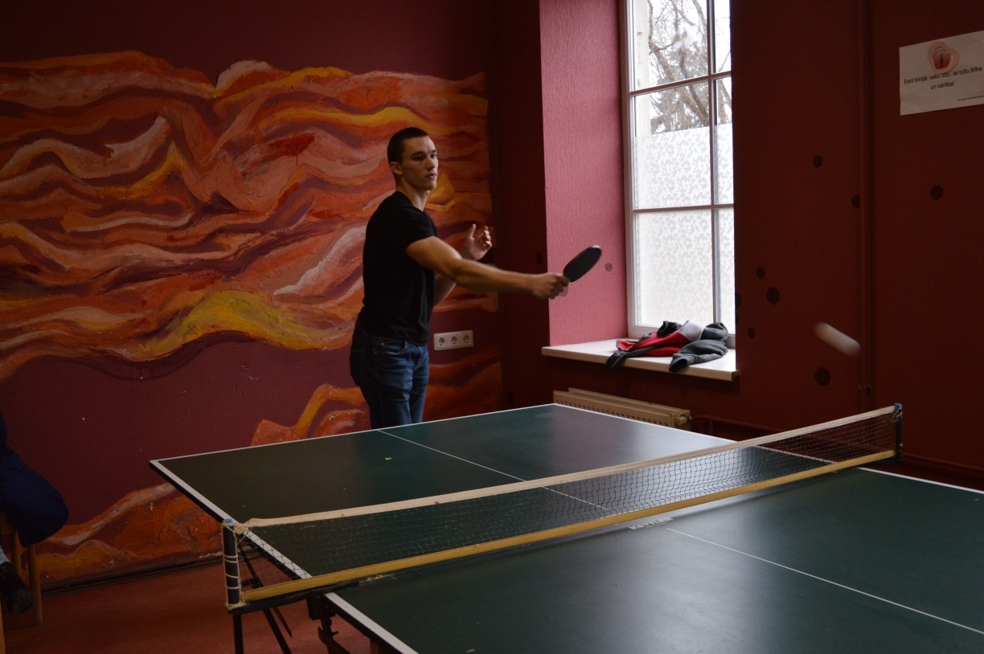

Slide 40
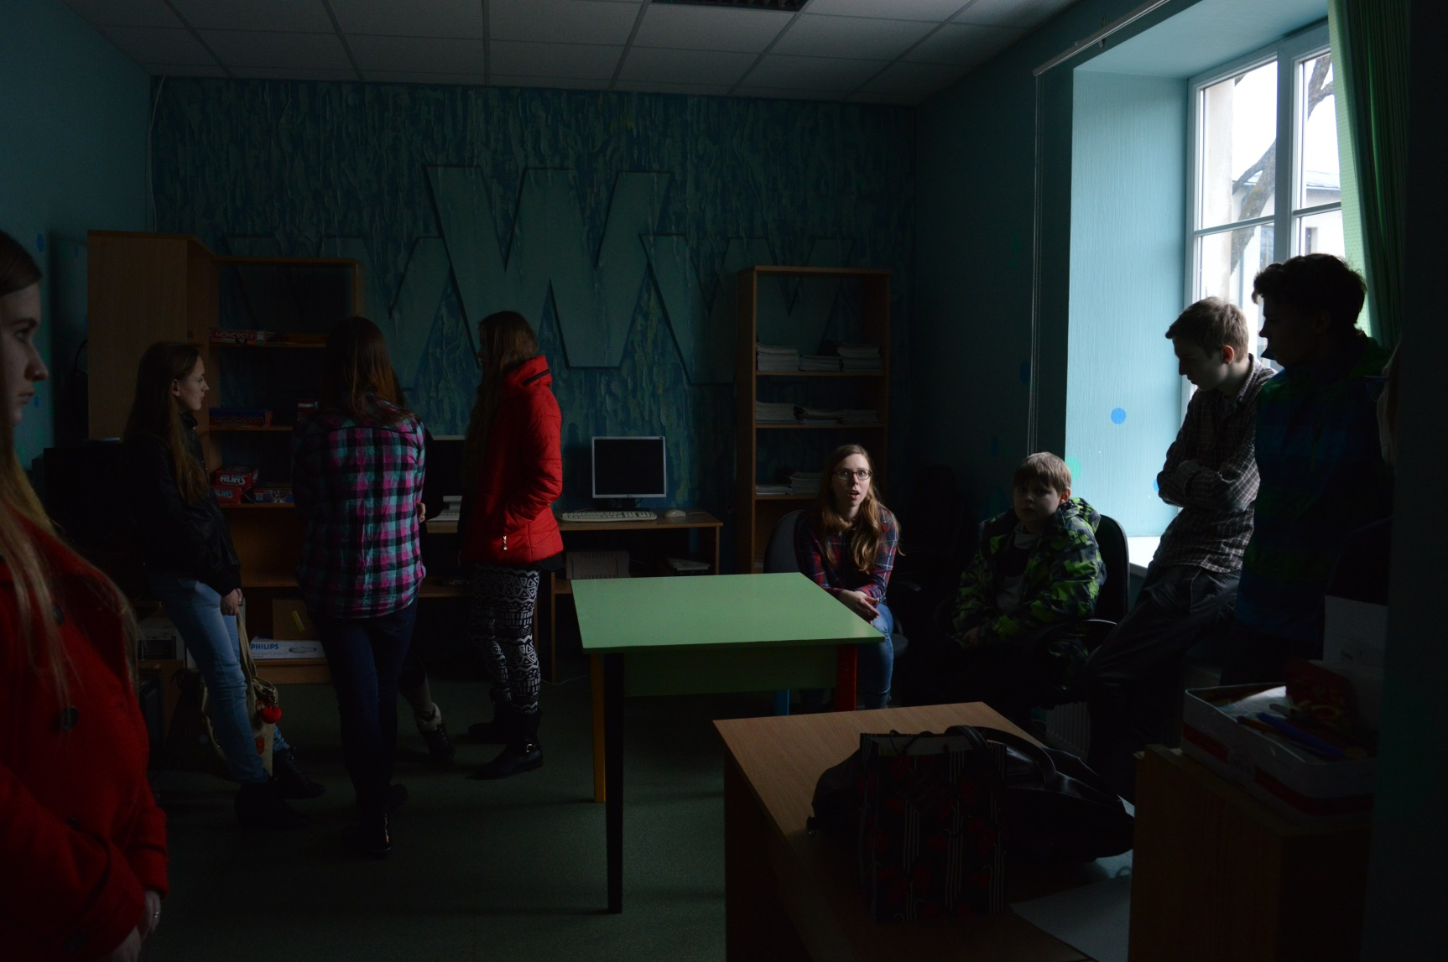
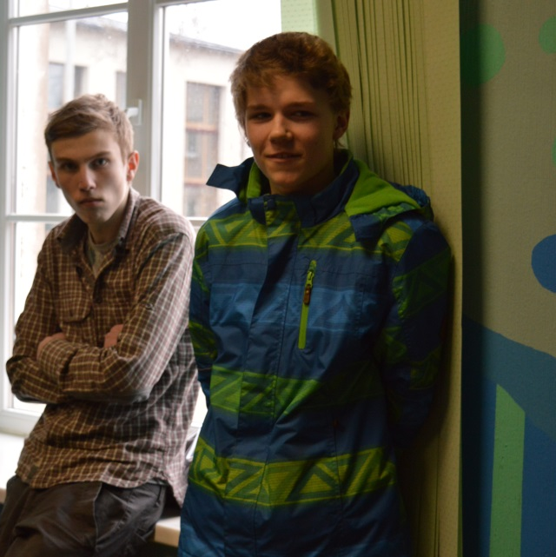
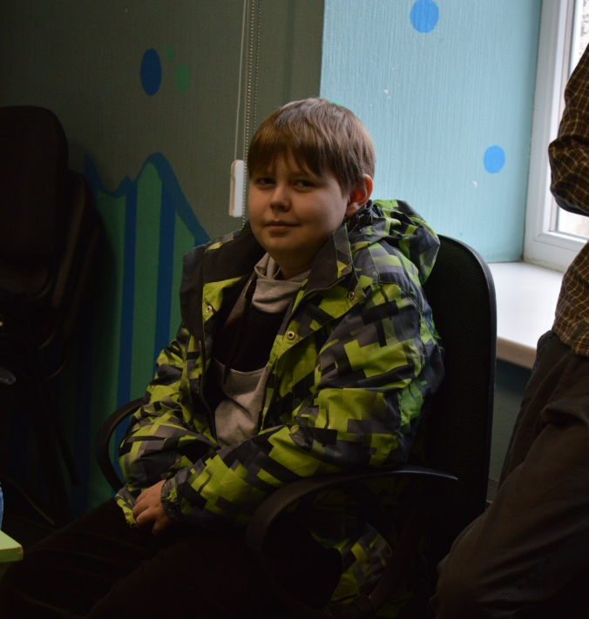

Slide 41
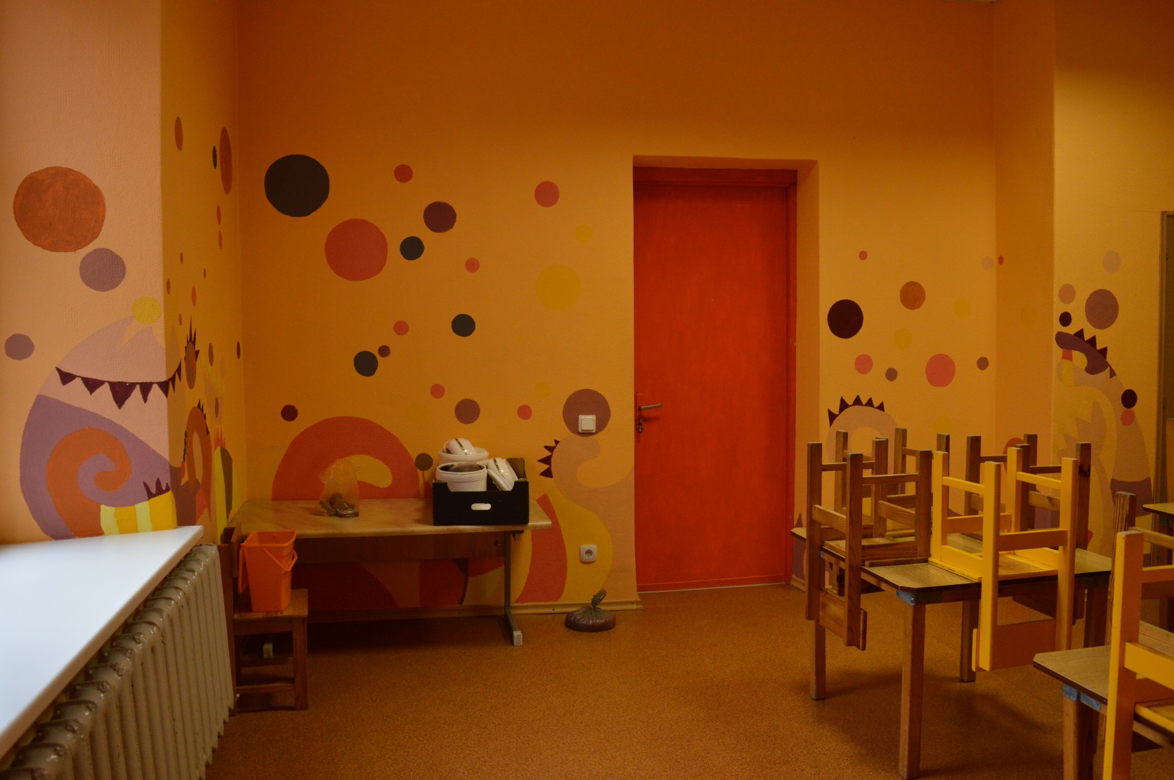
Valka art school

Slide 42
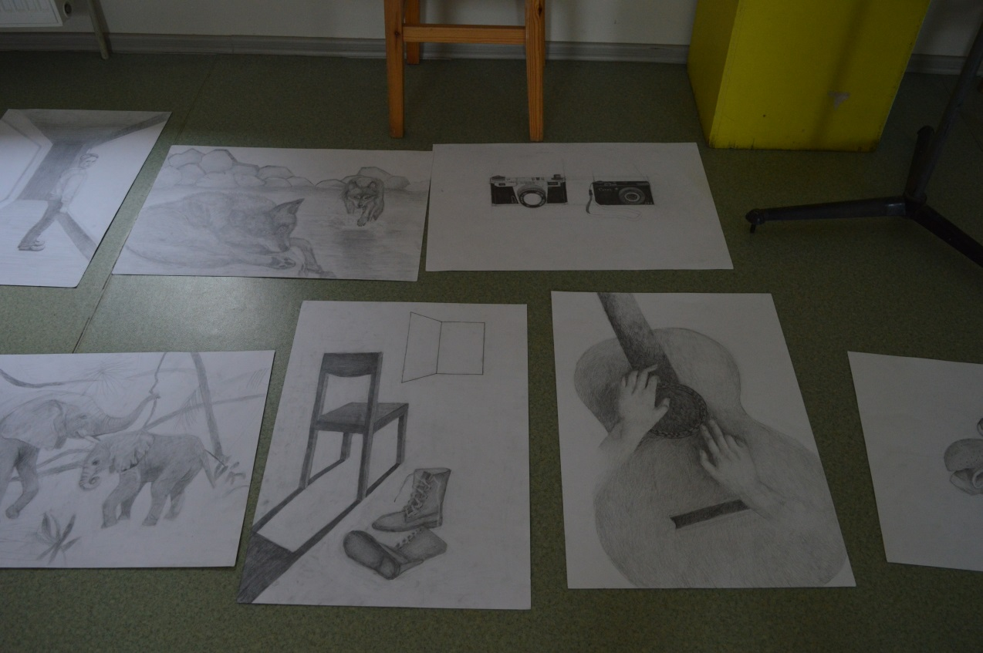
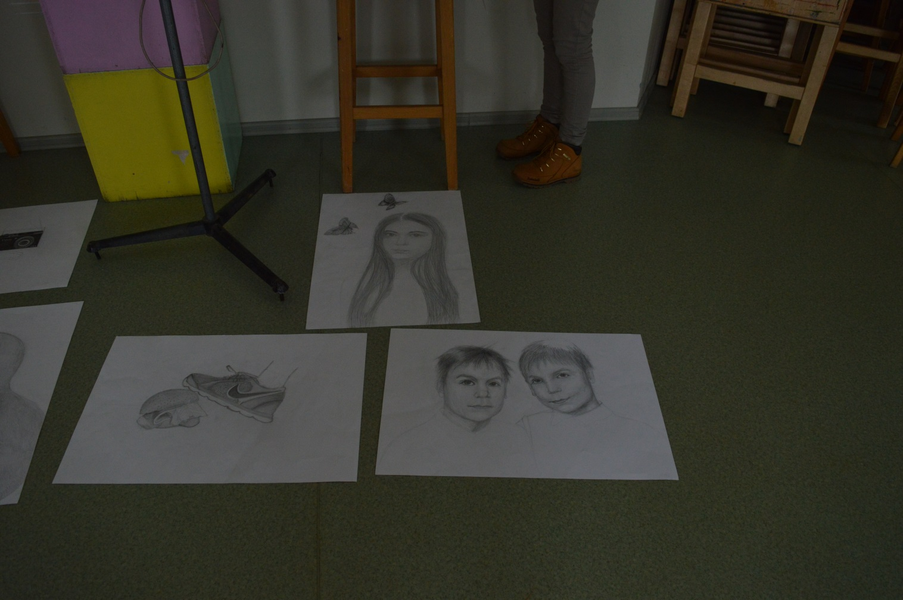

Slide 43
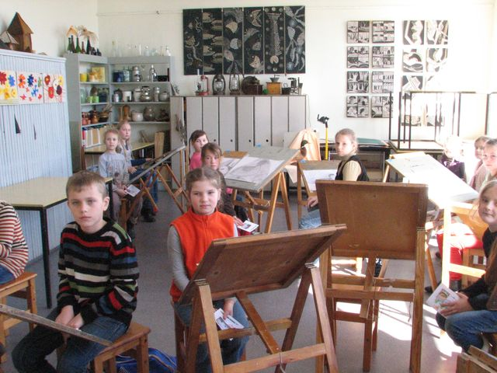

Slide 44
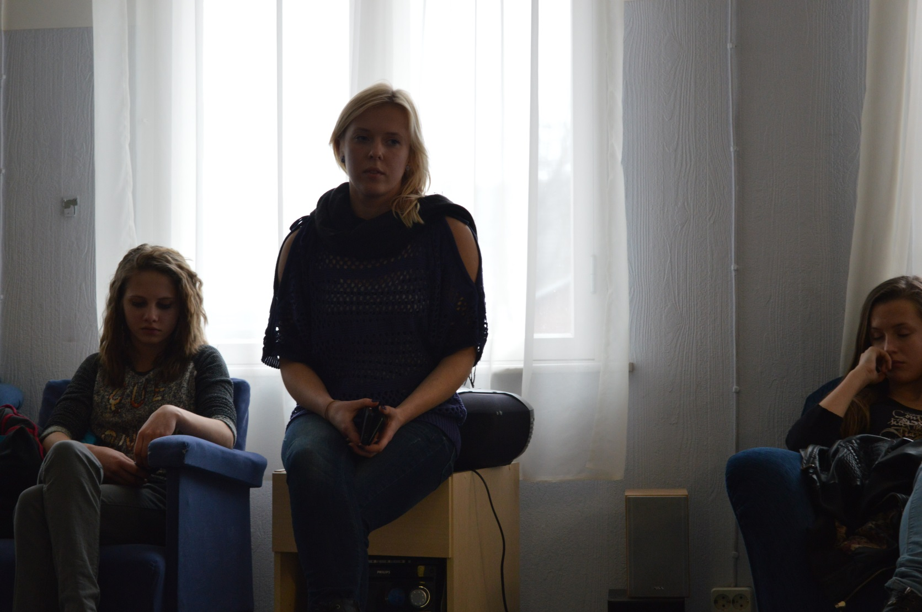
Valga, Tea is introducing with youth centre

Slide 45
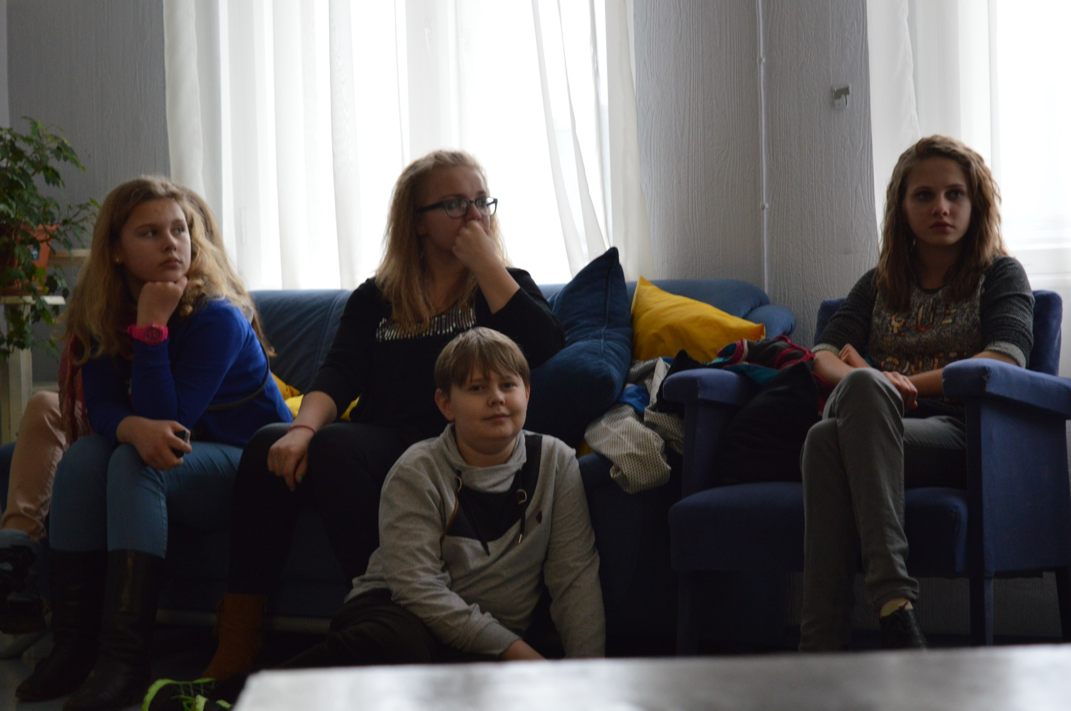
Attentive listeners ...

Slide 46
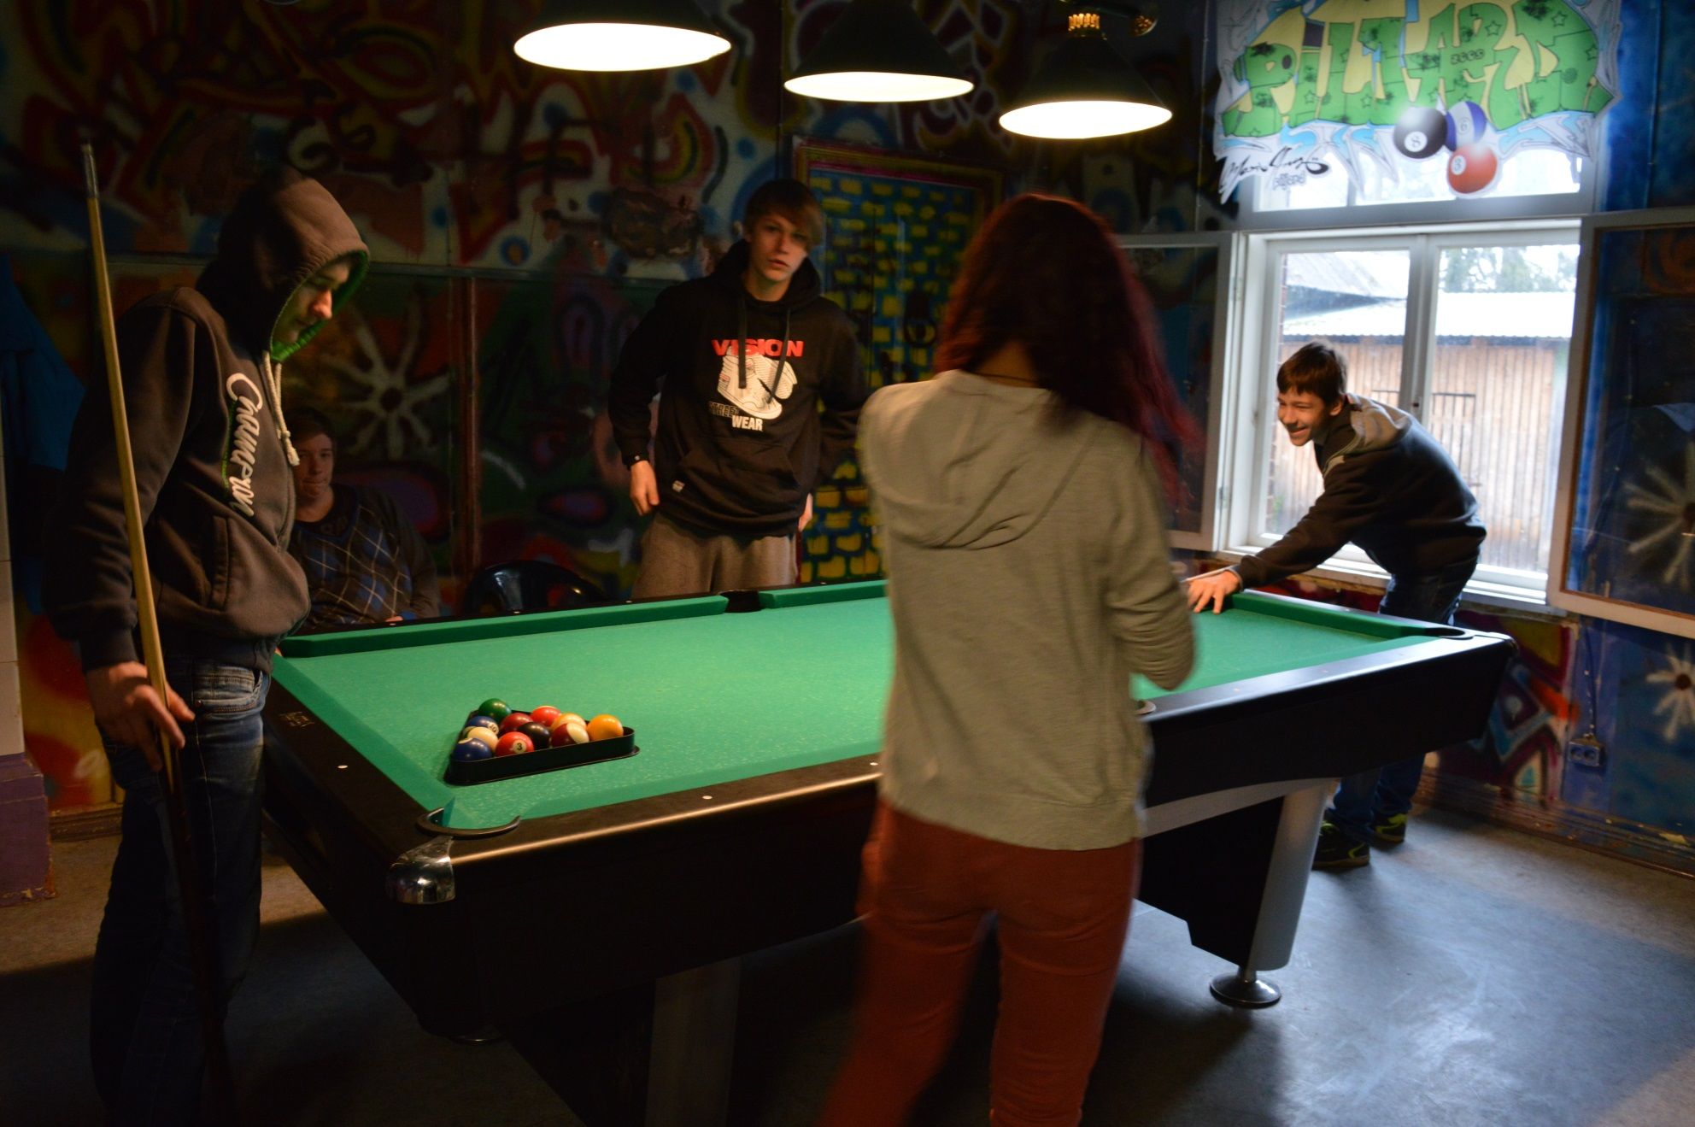
enjoyed!!!

Slide 47
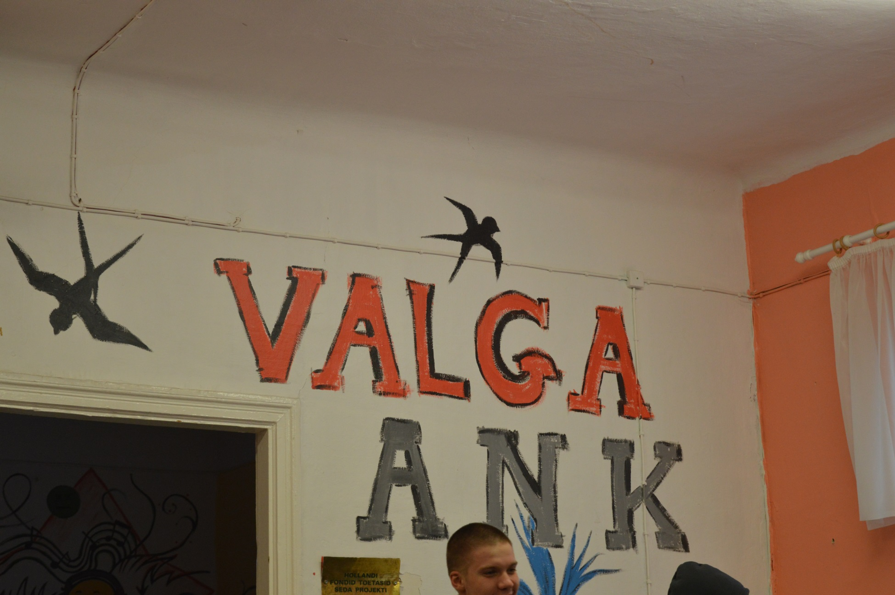

Slide 48
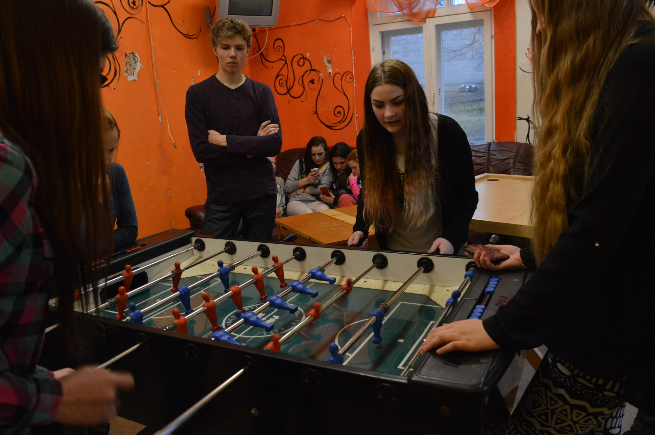

Slide 49
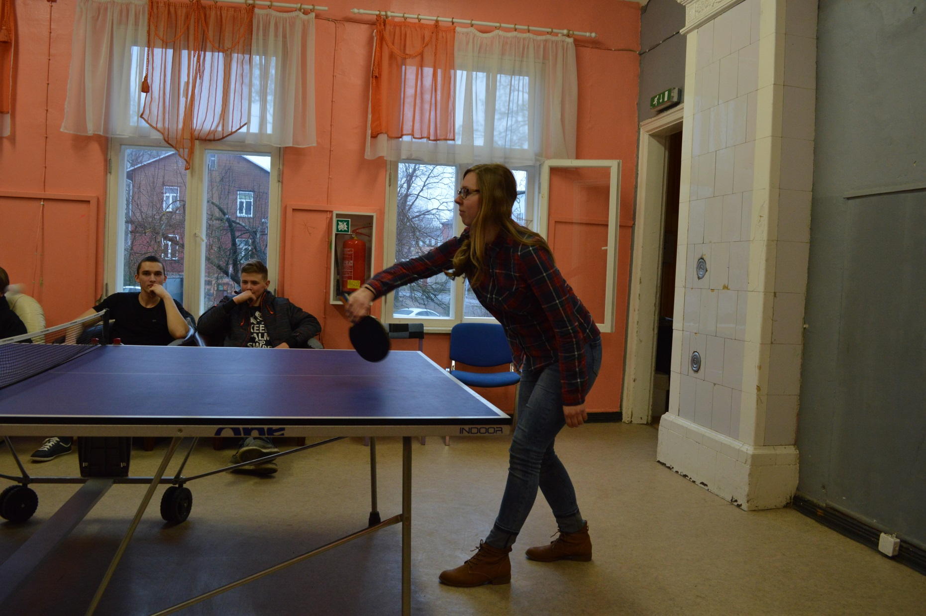

Slide 50
Students from aluksne municipality`s school: Artis 12.a, dana 11.a, marta 8.a un aleksandrs 6. klase

Slide 51
Occupational health and safety specialist

Slide 52
Fire fighters

Slide 53
Chemistry

Slide 54
Physics

Slide 55
Meeting with National Defence studies teacher

Slide 56
Meeting with chaplain

Slide 57
Meeting with volunteers from
Greece and Czech Republic

