Slide 1
Current Problems in Education
Erasmus +

Slide 2
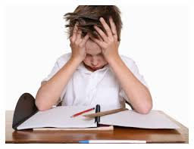
Introduction
In this presentation we are going to talk about the educational problems in most countries in Europe such as Portugal, Greece, Italy, Norway, Turkey and Bulgaria.
We are going to discuss about the possible solutions of the problems.

Slide 3
Principal Problem
The most common problems of all these countries:
Lack of motivation in students and teachers and the enviroment of the school - Norway and Lithuania.
Limited choices in subject - Greece and Portugal.
“School doesn't prepare students for real life. Lack of interdisciplinary connection in Bulgaria”- Daniel.
“In high school you don’t have many options. You can choose between science and languages/humanities. Just in a vocational course you have a variation of options.” – Rúben

Slide 4
Possible solution
Lack of motivation in teachers - Norway and Lithuania
We must have lessons with the necessary topic as well as teachers should explain the topic with simplicity and enjoyment.
Teacher must teach student something new or in new ways. E.g. different technique
Teacher must be more positive about student as well to other.
More teacher training
Lack of motivation in student - The lessons need to be short. To absorb information more effectively. Give rewards to student for participation and good grade. However teachers must discuss to student about what they want if It is was like to be rewards. For example, reward them with food and make them feel important.

Slide 5
Possible solution
Limited choices in subject - Greece and Portugal
In Greece the subject are focused on sciecne more and Art
Teacher must act now and allow more choices for student by investing new courses or specific course such as animation or drama

Slide 6
Thank You for Listening

