Slide 1
St.Ignatius College
Secondary School

Slide 2
Our college
It is one of the ten clusters in which the Ministry of Education, divided the State schooling system.
Our college principal is Ms. M. A. Pace.
The college consist of 2 secondary schools one caters for both boys and girls, whereas the other is an only boys schools(Year 7 – Year 11). Also five primary schools (Year 1 – Year 6) form part of this college.
Students from Qormi, Zebbug, Luqa and Siggiewi constitute the population of our college. For logistic reasons, the girls secondary school this year aspected students from St. Benedicts College.

Slide 3
College Motto
Learning & Growing
Together

Slide 4
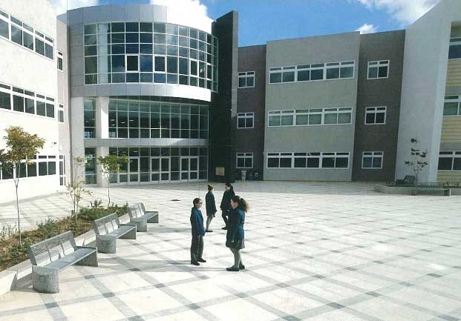
Our school

Slide 5
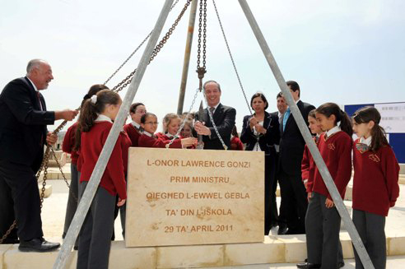
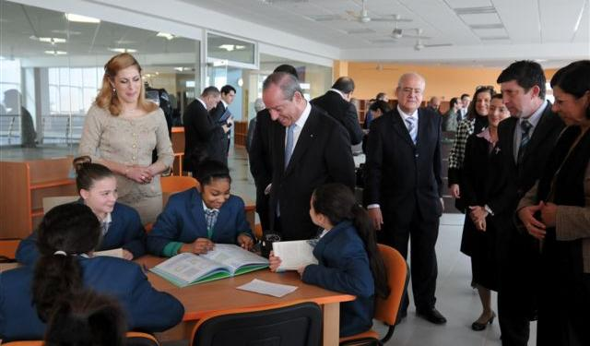
A brief History
The first stone of secondary school girls put in at Ditch on Friday 29th April 2011 by Prime Minister Lawrence Gonzi
Opened its doors to students on Monday 24th September 2012.
the school is spread over a land area of ​​20,000 square meters and includes 49 class, four technology workshops, nine science labs, five computer labs, three art classrooms and three labs home economics, a modern library, sports facilities and a great auditorium.
The school also makes efficient use of alternative energy sources: solar panels, solar water heaters, intelligent lightning and large reservoirs for the storage of rainwater.
The school’s official opening was on Thursday 28th February 2013

Slide 6
Further information
http://sic.handaqgirls.skola.edu.mt/
http://progettkreattiv.blogspot.com/p/blogging_21.html

