Slide 1
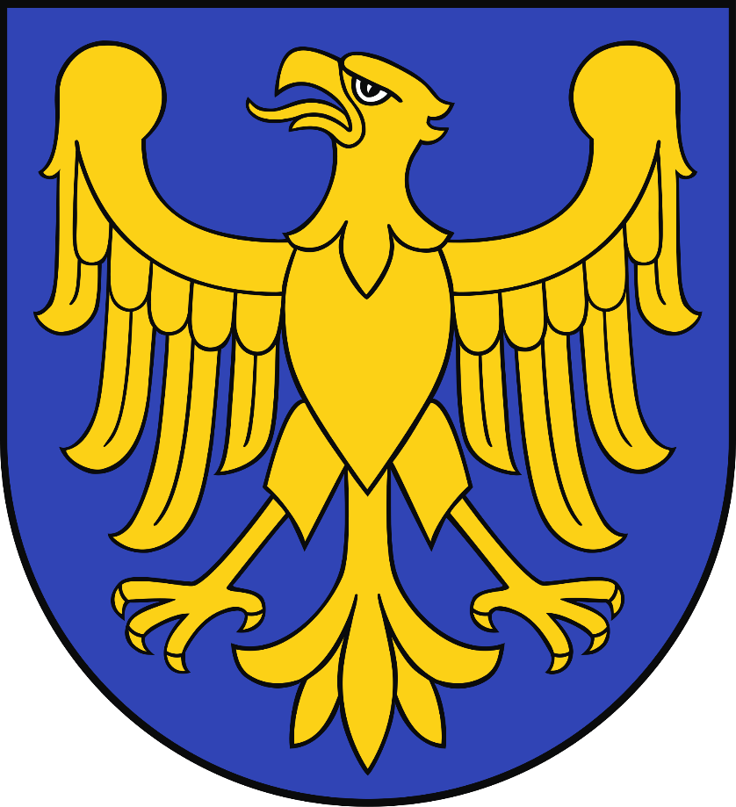
Upper Silesia

Slide 2
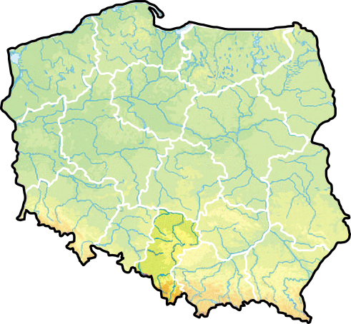
Upper Silesia is a region in the south of Poland.

Slide 3
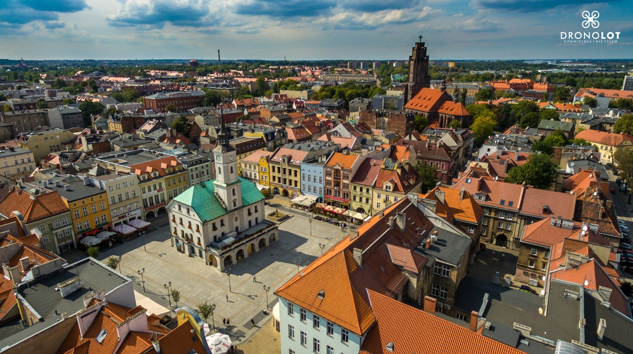
Upper Silesia
This is the region where we live.

Slide 4
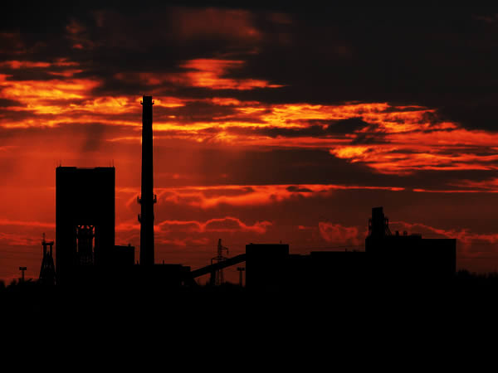
Upper Silesia is the most industrialized area of ​​Poland.

Slide 5
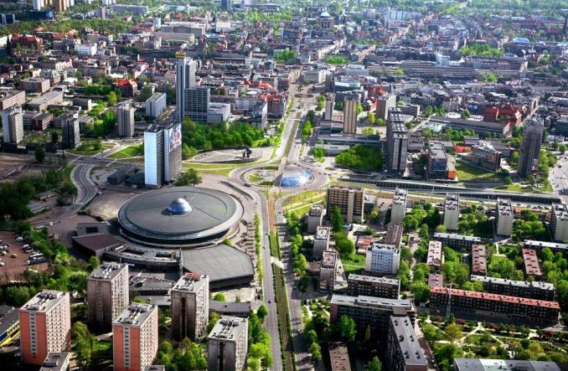
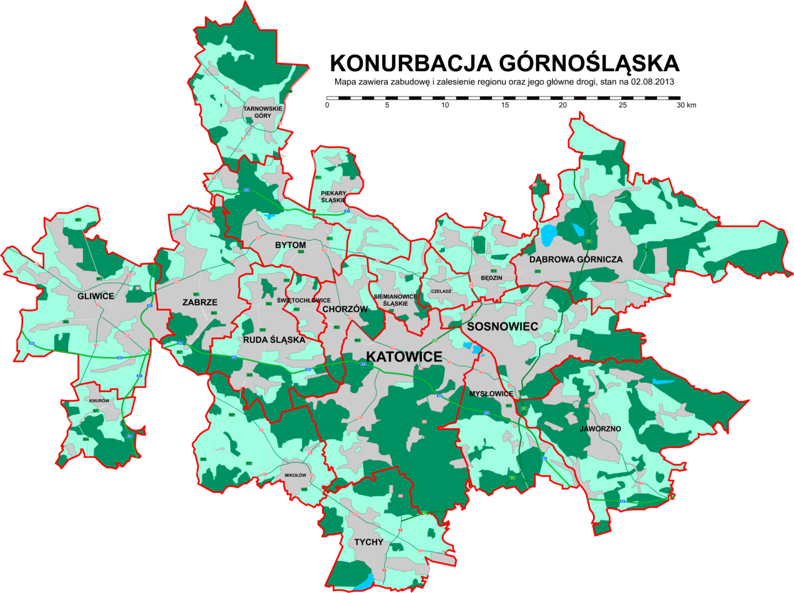
Upper Silesia
Here in one big conurbation of 19 cities
live about 3 million people.

Slide 6
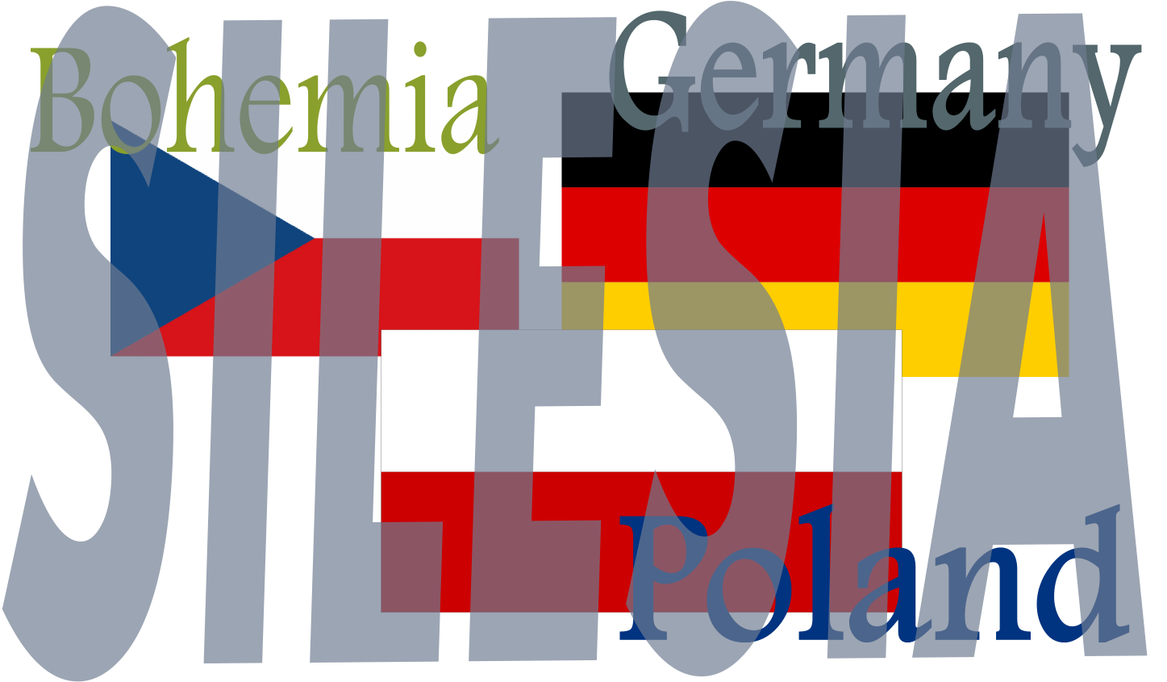
In the past, in different periods of time, Silesia was an independent duchy or a part of Poland, Bohemia (Czechia) or Germany.

Slide 7
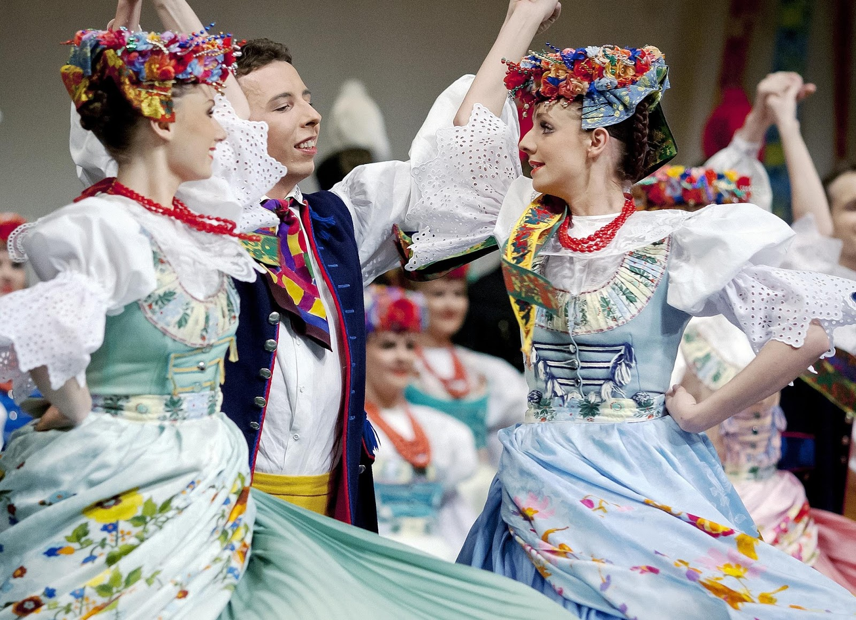
Traditional culture of Upper Silesia

Slide 8
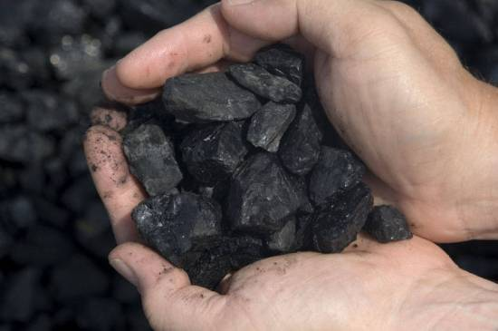
Coal in Upper Silesia
In Upper Silesia there are large underground deposits of coal .
In the past, coal mining was the main industry in the region.

Slide 9
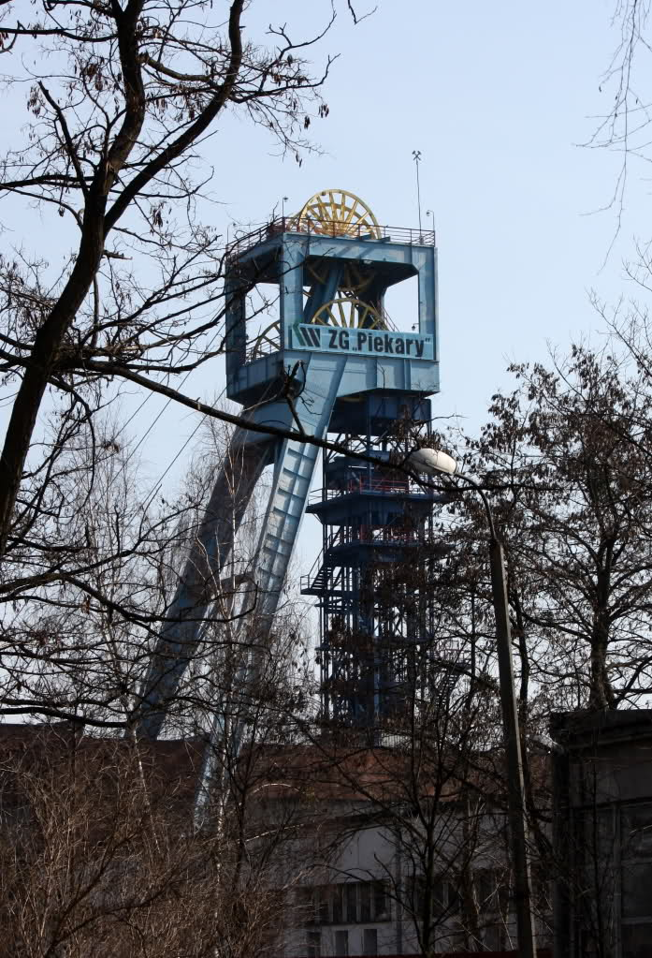
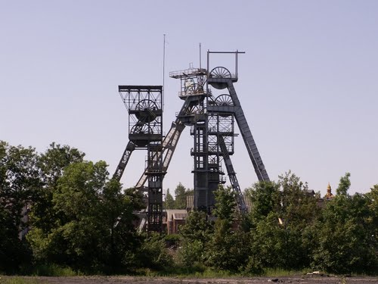
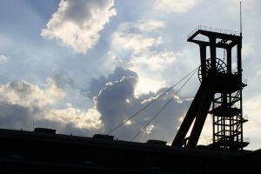
In Silesia you can see the mining shafts everywhere.

Slide 10
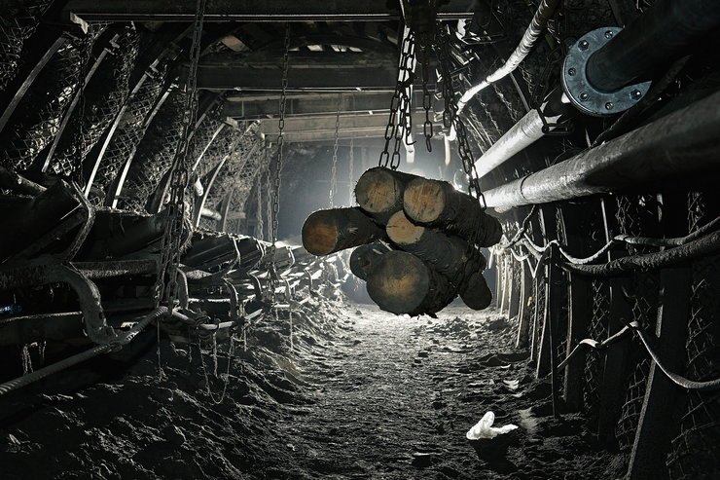
Coal mines
To dig up the coal, people have to work a few hundreds metres underground.

Slide 11
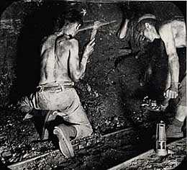
Work of the miners has always been extremely hard and dangerous .

Slide 12
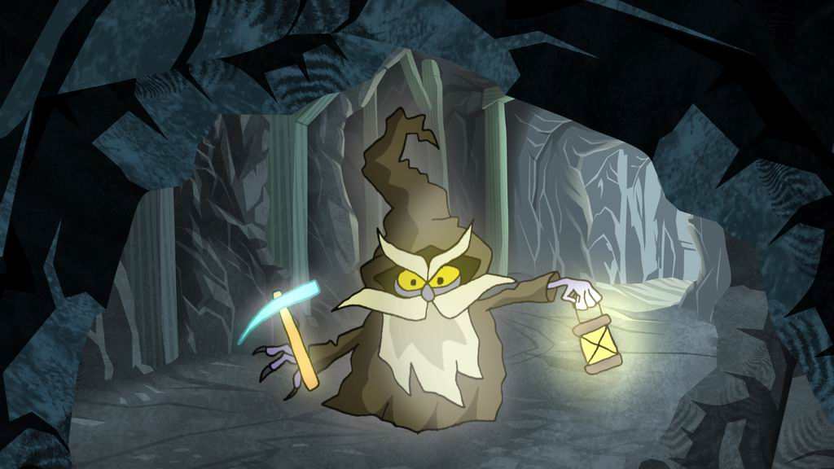
The miners told many stories about the Treasurer, a spirit of coal mines.
Treasurer required hard work honesty and respect from the miners.

Slide 13
Now let’s make some pictures to this story!

